Slide 1
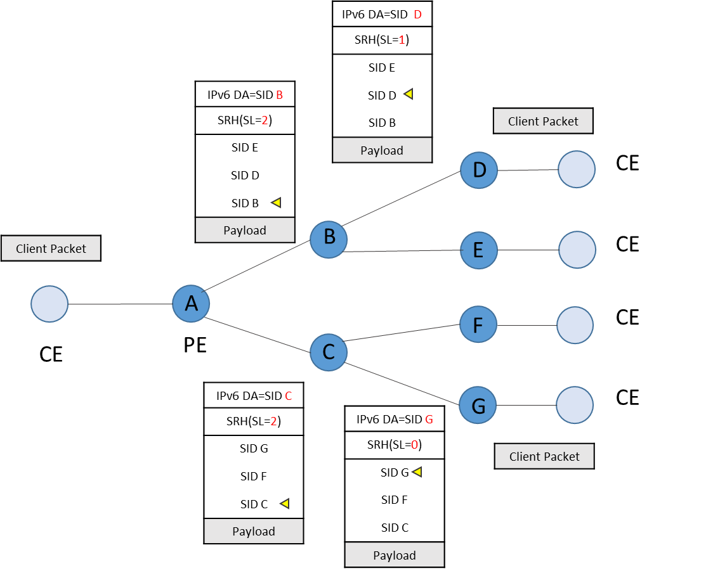
Solution 1: Structural Segment List for Multicast Tree
draft-geng-msr6-traffic-engineering
Basic Idea ：
Define a new Function type, End.RL(Replication through segment list), for explicitly specifying the nodes which the multicast tree passes through; and define two parameters in the SID: Replication Number and Pointer, which are used to indicate the replication-forwarding relationship between upstream and downstream nodes.
Solution：
MSR6 Segment List.
Contains the SIDs corresponding to the indicated nodes in the multicast tree
MSR6 End.RL Segment format.
Locator: used to route to the replication node, e.g., IPv6 address prefix
Function: Indicates that the segment performs the End.RL function.
Replication Number: Indicates how many packets to replicate in this nodes
Pointer: Indicates the Segment left value of the first child node;
End.RL Behavior:
Replicate packets based on “replication number”
update Segment Left and IPv6 DA based on “pointer”
forward the replicated packets to the downstream nodes
Ingress node: Encapsulate the packet with IPv6 header and MRH. The segment list in MRH shows the indicated multicast tree
Endpoint: Replicate the packet based on the “replication number” and update the IPv6 DA with the SID which is indicated by “pointer”
Egress Node: Pointer==0 and de capsulate the packet

Slide 2
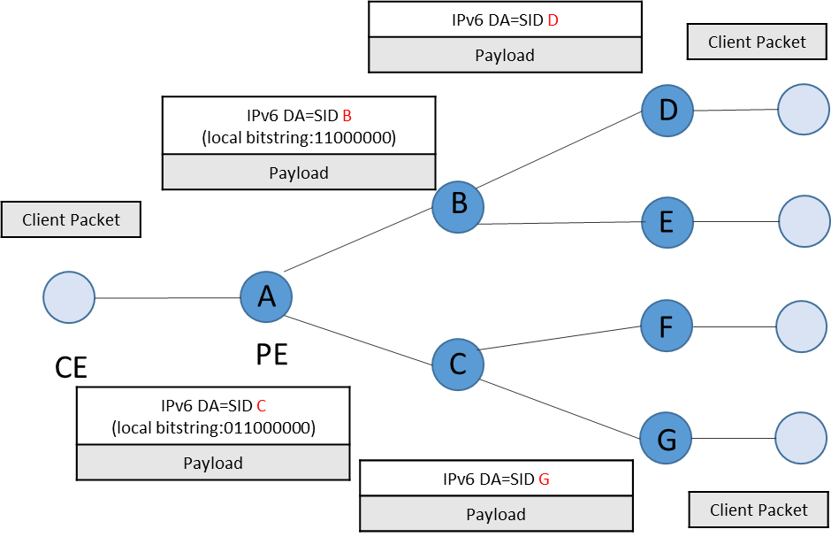
Solution 2: Structural Segment List with Local Bitstring
draft-geng-msr6-rlb-segment
Basic Idea：
Define a new Function type, End.RLB.X(Replication through Local Bitstring), for adding a Local Bitstring to the SID to specify the output port sending; The meaning of the bitstring is local to the the node which advertises the SID
Solution：
MSR6 Segment List
Contains the SIDs corresponding to the indicated nodes in the multicast tree except for the leaf nodes
MSR6 End.RLB.X Segment format
Locator: used to route to the replication node, e.g., IPv6 address prefix
Function: Indicates that the segment performs the End.RL function.
Pointer: Indicates the Segment left value of the first child node;
Local Bitstring: Each bit represents a local outgoing port, and a bit position represents the outgoing port from which the packet is to be forwarded
End.RLB.X Behavior:
Replicate packets based on “bitstring”
update Segment Left and IPv6 DA based on “pointer”
forward the replicated packets to the downstream nodes
Ingress node: Encapsulate the packet with IPv6 header and MRH. The segment list in MRH shows the indicated multicast tree
Endpoint: Replicate the packet based on the “local bitstring” and update the IPv6 DA with the SID which is indicated by “pointer”
Egress Node: Pointer==0 and de capsulate the packet

