Slide 1
LEDGER LENS
Intelligent Document Intelligence Platform
Extract, validate, evidence, and retrieve financial documents through one focused workflow.
Solution Presentation | AI Engineer Internship
Ledger Lens | Solution Presentation | 1

Slide 2
The problem
Financial documents arrive in inconsistent, semi-structured formats.
• Manual extraction is slow and difficult to audit.
• Scanned PDFs and image uploads require OCR before parsing.
• Extracted numbers need accounting consistency checks, not just text recognition.
• A reviewer needs both structured results and the evidence behind each field.
Ledger Lens | Solution Presentation | 2

Slide 3
Solution overview
A compact pipeline turns an upload into a traceable processing result.
• Validate file type, size, readability, and page count.
• Render PDF pages and run EasyOCR over PDF, JPG, and PNG inputs.
• Parse four mandatory financial document types into structured JSON.
• Run formula checks and persist the latest result for retrieval and dashboard history.
Ledger Lens | Solution Presentation | 3

Slide 4
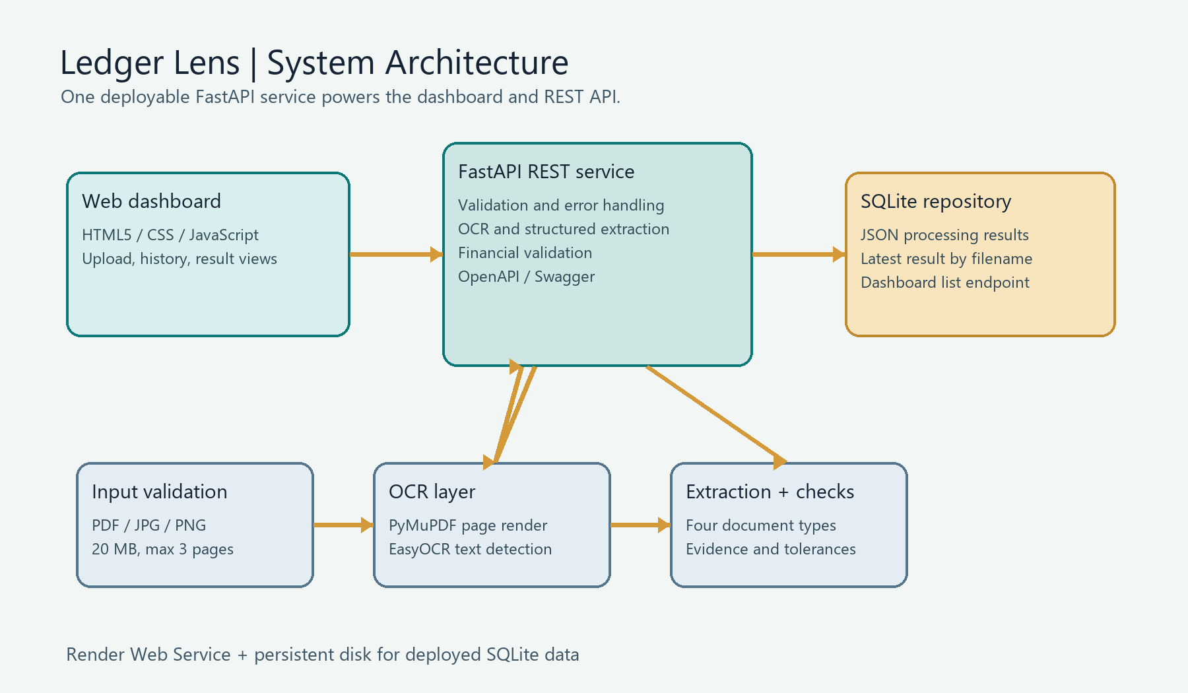
System architecture
Frontend and API share one deployable FastAPI service.
Ledger Lens | Solution Presentation | 4

Slide 5
Processing pipeline
Each stage has a clear responsibility and a testable output.
• Input: multipart upload plus document_type.
• Validation: PDF/JPG/PNG allowlist, empty/corrupt checks, 20 MB limit, three-page limit.
• OCR: PyMuPDF renders PDF pages; EasyOCR extracts spatial text.
• Extraction: document-specific fields, tables, evidence, page numbers, and confidence.
• Validation and storage: financial checks are returned in JSON before SQLite persistence.
Ledger Lens | Solution Presentation | 5

Slide 6
Supported documents
The parser exposes consistent structured data across four financial workflows.
Invoice
Balance sheet
Totals, tax, currency, line items
Assets, liabilities, equity
Profit & loss
Cash flow
Revenue, costs, profit
Operating, investing, financing
Ledger Lens | Solution Presentation | 6

Slide 7
API contract
Simple REST endpoints cover upload, health, retrieval, and dashboard history.
• GET /api/v1/health -> service status.
• POST /api/v1/documents/process -> multipart file plus document_type.
• GET /api/v1/documents/{document_name} -> latest stored processing result.
• GET /api/v1/documents -> processed-document list for the dashboard.
• GET /docs -> generated Swagger/OpenAPI interface.
Ledger Lens | Solution Presentation | 7

Slide 8
Financial validation
Numbers are checked as formulas and returned inside the JSON validation section.
• Invoice: subtotal + tax + shipping - discount = total.
• Balance sheet: assets approximately equal liabilities + equity.
• Profit and loss: revenue - cost of sales - operating expenses = net profit.
• Cash flow: operating + investing + financing = net change; opening + change = closing.
• Tolerance: $0.05 minimum absolute tolerance plus 1% relative tolerance; cash-flow translation tolerance is $5,000.
Ledger Lens | Solution Presentation | 8

Slide 9
Dashboard and persistence
Processed documents remain discoverable after the upload request finishes.
• SQLite stores serialized processing results through a repository layer.
• The dashboard consumes the list endpoint and links to document results.
• GET-by-name returns the latest record for a document filename.
• Local path: data/documents.db; deployed path: /var/data/documents.db on the Render persistent disk.
Ledger Lens | Solution Presentation | 9

Slide 10
Deployment and responsible operation
Render runs the same service that serves the browser dashboard and API.
• Platform: Render Web Service using render.yaml.
• Uvicorn binds to the platform PORT and serves / plus /api/v1.
• Configuration is supplied through environment variables; no secrets belong in Git.
• Persistent disk is required for durable SQLite history on the deployed service.
• Swagger URL and health endpoint provide quick smoke-test entry points.
Ledger Lens | Solution Presentation | 10

Slide 11
Submission verification
Run these checks against the deployed URL before submitting the form.
• Open the frontend URL and upload a representative PDF, JPG, and PNG.
• Confirm GET /api/v1/health returns status ok.
• Confirm POST returns structured extracted_data and validation.checks.
• Confirm GET /api/v1/documents lists the processed record.
• Confirm GET /api/v1/documents/{name} returns the latest stored result.
• Replace the placeholders in README with the real Render and GitHub URLs.
Ledger Lens | Solution Presentation | 11

Slide 12
Limitations and next steps
The current design is submission-ready and intentionally transparent about tradeoffs.
• OCR and first-load model initialization can be slow on small instances.
• Rule-based parsing is tuned to the supplied layouts and may need new templates for novel formats.
• SQLite is suitable for a single service instance, not high-volume multi-instance writes.
• Next: PostgreSQL/object storage, async OCR queue, authentication, rate limits, metrics, and deployment smoke tests.
Ledger Lens | Solution Presentation | 12

