Slide 1
EFFICIENT DATA ANALYTICS TO PREVENT THE RATE OF ACCIDENTS
Abhinav Shikhar (1MS12CS002)
Aishwarya K (1MS12CS007) Gowri Ramaprasad (1MS12CS035) Naveen JS (1MS13CS416)

Slide 2
AGENDA
Analyze Pre-Recorded data on accidents at various cities in India to help reduce accidents.
Predict future data based on past dataset available.
Make appropriate decisions to come up with number of ways to reduce accidents.

Slide 3
DATASET
•
ACCIDENT DATASET (~138,000 Datapoints)
ATTRIBUTES
ACCIDENT_NO ACCIDENT_DATE ALCOHOL_CONSUMED TYPE_OF_ACCIDENT
DAY_OF_WEEK HIT_AND_RUN POLICE_ATTENDED SEVERITY
LATITUDE_LONGITUDE CITY_NAME
FATALITY PEDESTRIANS
PASSENGER DRIVER
UNLICENSED_DRIVER LIGHT_CONDITION NO_OF_VEHICLES NON-INJURIES INJURIES SPEED_ZONE

Slide 4
ALGORITHM
DECISION TREE
K-MEANS (Clustering)
VISUALIZATIONS
Pie Charts
3-D Pie Charts
Facets ( Using R Analytical Tool)
Bar Graphs
Scatter Diagram

Slide 5
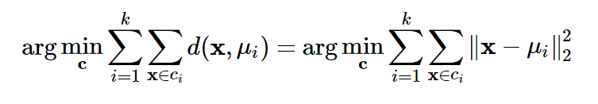
K-Means
K-means algorithm was used for the cluster analysis.
Clustering is the process of partitioning a group of data points into a small number of clusters
1. Initialize the center of the clusters
2. Attribute the closest cluster to each data point
3. Set the position of each cluster to the mean of all data points belonging to that cluster
4. Repeat steps 2-3 until convergence

Slide 6
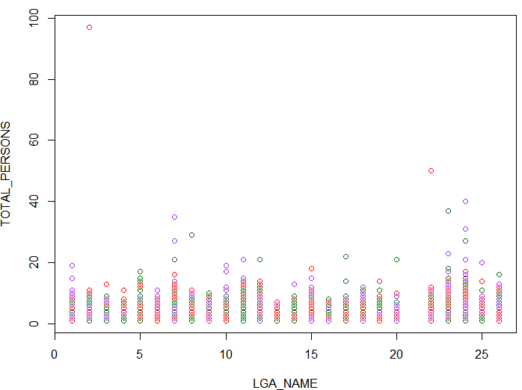
##Kmeans
mydata=read.csv("C:/Users/Naveen/Desktop/final.csv")
##Accrding to rule of thumb k=sqrt(n/2)
results=kmeans(mydata,262)
results$cluster
results$centers
plot(mydata[c("LGA_NAME","TOTAL_PERSONS")],col=c("red","purple","darkgreen"),type="p")

Slide 7
Decision Trees
Decision tree learning is a method commonly used in data mining. The goal is to create a model that predicts the value of a target variable based on several input variables
Decision trees used in data mining are of two main types:
1) Classification tree analysis is when the predicted outcome is the class to which the data belongs.
2) Regression tree analysis is when the predicted outcome can be considered a real number

Slide 8
#libraries to be used to fit decision trees
library(ISLR)
library(tree)
#read dataset
mydata=read.csv("C:/Users/Naveen/Desktop/final.csv")
#checking the condition for the dependent variable
high=ifelse(mydata$DAY_OF_WEEK>=4,"MORE","LESS")
#attaching the variable with the dataset
mydata=data.frame(mydata,high)
names(mydata)
#remove the dependent column from the dataset
mydata=mydata[-3]
set.seed(3)

Slide 9
#setting seed value for the testing and training purpose
set.seed(5)
#training data
train=sample(1:nrow(mydata),nrow(mydata)/265)
test=-train
training_data=mydata[train,]
#testing data
testing_data=mydata[test,]
tree_model=tree(high~.,training_data)
tree_model
#plot the model
plot(tree_model)
text(tree_model,pretty=0)
test_pred=predict(tree_model,testing_data,type="class")
testing_high=high[test]
#find the mean deviation value
mean(test_pred!=testing_high)

Slide 10
#prune the tree
cv_tree=cv.tree(tree_model,FUN=prune.misclass)
names(cv_tree)
#plot the tree
plot(cv_tree$size,cv_tree$dev,type="b")
pruned_model=prune.misclass(tree_model,best=2)
text(pruned_model,pretty=0)
tree_pred=predict(pruned_model,testing_data,type="class")
#determine the mean deviations after pruning
mean(tree_pred!=testing_high)

Slide 11
ADVANTAGES
Simple to understand and interpret. People are able to understand decision tree models after a brief explanation.
Requires little data preparation. Other techniques often require data normalization, dummy variables need to be created and blank values to be removed.
Able to handle both numerical and categorical data.

Slide 12
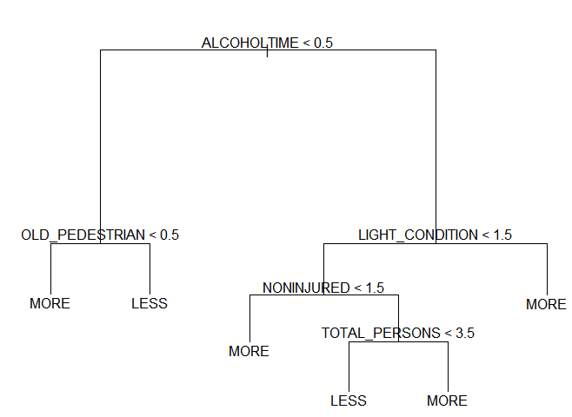
Decision tree for predicting the rate of people’s death

Slide 13
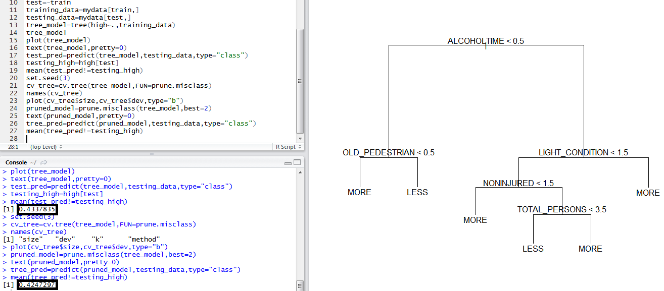
Original fitting
Best Fitting

Slide 14
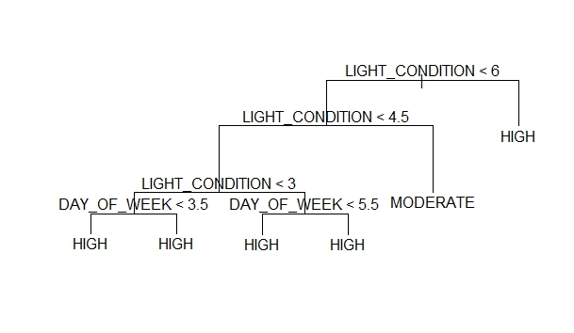
Decision tree to predict the severity of the accident

Slide 15
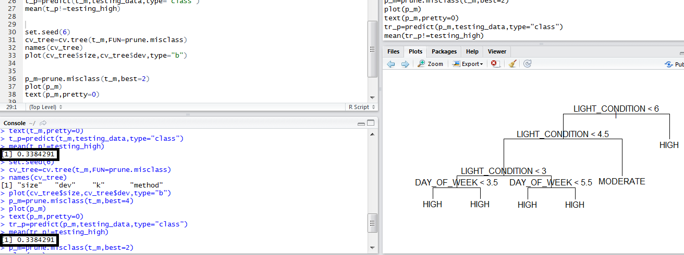
Original fitting
Best Fitting

Slide 16
We not only analyze the data but we also suggest solutions to some of the problems.

Slide 17
PROBLEM #1
The number of people who reach the hospital alive is nearly half the number of people who die on way to the hospital. What could be done ?
We find the areas most prone to accidents based on the city information in the dataset and suggest the government to establish primary aid hospitals around those areas, keep the ambulances available all the time.
This saves time to reach the person.
SOLUTION

Slide 18
PROBLEM #2
Hospitals want to know the best location to build their new
building.
How would you do so ?
We find out the regions with the maximum accidents and suggest the hospitals to build their building close to the prone areas, which would minimize the time taken to reach
the hospital and attract more patients.
SOLUTION

Slide 19
PROBLEM #3
Hundreds of people lose lives due to Drink & Drive accidents.
Is there any solution to it ?
We find out the regions where maximum accidents occur due to the consumption of alcohol. And, we can suggest the bars or alcohol providing facilities to also maintain cab services and
make sure the designated driver isn't drunk.
SOLUTION

Slide 20
PROBLEM #4
Lots of animals are involved in hit and run cases
We find out the areas where the maximum number of accidents occur due to collision of vehicles with the animals. We suggest the government to put up signs for the drivers and instill speed bumps along these areas to avoid such cases.
SOLUTION

Slide 21
PROBLEM #5
During the dawn or dusk, number of accidents seems to be high.
How could this be minimized ?
We suggest that The government install more street lights along the positions where accidents are occurring in higher numbers during dawn and dusk, the
concerned department could increase the intensity of the
traffic lights in all those areas.
SOLUTION

Slide 22
ANALYSIS USING K-MEANS

Slide 23
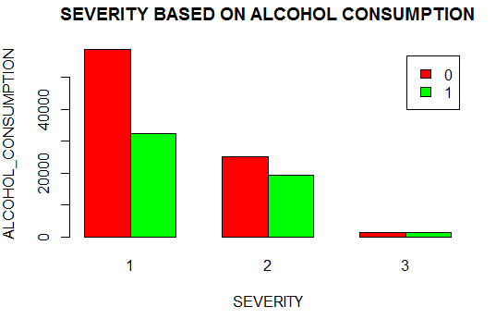

Slide 24
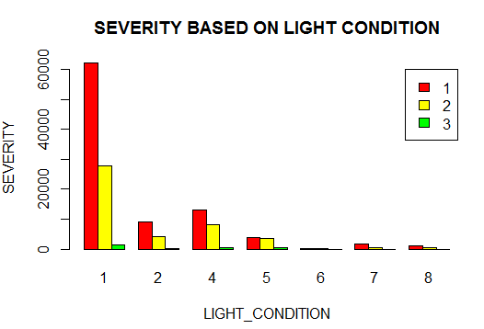

Slide 25
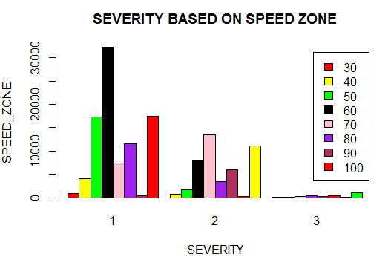

Slide 26
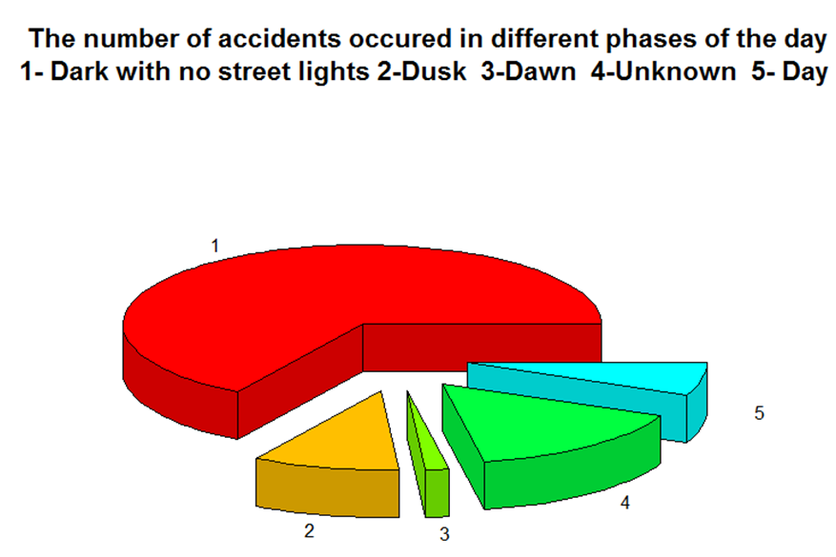

Slide 27
CONCLUSION
Analysis of the accident data quantitatively and qualitatively.
Examine the sequence of conditions which lead to severe accidents using the decision trees
Indicate regions of high density accidents and the severity of the accident and the attributing factors were examined using clustering algorithm.
The project in its early iteration can glean insight into locations which are accident prone and the causes for it.
It is also attempts to research the possible causes of accident and the possible solutions to them.

Slide 28
FUTURE WORK
This system aims to improve the approach to solving the method of collection and analysis of accident related information.
This research attempts to reduce the average of time required by an ambulance to arrive at the spot of the accident and turnaround time with further data analysis.
This predictive model can be implemented in several mobile applications which can minimize risk of accidents.
This data can be used to implement protective measure to ensure road-safety of elderly citizens, wildlife and school children etc.
we believe that this data can also be used, to build hospitals in locations so as to optimize response time and ensure timely arrival of ambulances.

Slide 29
BIBLIOGRAPHY
Lloyd, S. P. (1957). "Least square quantization in PCM". Bell Telephone Laboratories Paper. Published in journal much later: Lloyd., S. P. (1982). "Least squares quantization in PCM" (PDF). IEEE Transactions on Information Theory 28 (2): 129–137. doi:10.1109/TIT.1982.1056489. Retrieved 2009-04-15.
MacQueen, J. B. (1967). Some Methods for classification and Analysis of Multivariate Observations. Proceedings of 5th Berkeley Symposium on Mathematical Statistics and Probability. University of California Press. pp. 281–297. MR 0214227. Zbl 0214.46201. Retrieved 2009-04-07.
MacCameron Monash (University Accident Research Centre ), Accident Data Analysis To Develop Target Groups Countermeasures Volume 1 :Methods and Conclusions. Quinlan, "Learning efficient classification procedures", Machine Learning: an artificial intelligence approach, Michalski, Carbonell & Mitchell (eds.), Morgan Kaufmann, 1983, p. 463-482.
Quinlan, J. R. (1987). "Simplifying decision trees". International Journal of Man Machine Studies 27 (3): 221. doi:10.1016/S0020-7373(87)80053-6.R.
Utgoff, P. E. (1989). Incremental induction of decision trees. Machine learning, 4(2), 161-186
Deng,H.; Runger, G.; Tuv, E. (2011). Bias of importance measures for multi-valued attributes and solutions. Proceedings

