Slide 1
Bluetooth based presence detection system
Prithvi Sharan S Raja Andukondan
1MS12CS078 1MS12CS083

Slide 2
Project Goals
To collect data from Bluetooth sensor and process the same.
Store this data in a database in a suitable form.
Make the data available on-demand using a cloud platform.
Make available this cloud and data on a mobile platform and display the relevant information to the user.
Authentication and access control.
Ensuring robustness and real time data availability.

Slide 3

Description of sensor
Bluetooth Dongle
Bluetooth is a wireless technology standard for exchanging data over short distances (using short-wavelength UHF radio waves in the ISM band from 2.4 to 2.485 GHz) from fixed and mobile devices, and building personal area networks (PANs).
A Bluetooth enabled smart phone and an
independent Bluetooth module compatible
with the Raspberry Pi 2 board comprise the
main sensory components of the system.

Slide 4
Description of SRS
External Interface Requirements
User Interfaces - The main user interface of the current implementation is a mobile friendly website using which the presence can be detected, using the college's LAN.
Hardware Interfaces - The main hardware interface used in the current implementation is bridge interface between the external Bluetooth module and the System on Chip (Raspberry Pi). The interfacing is made via a USB port found on the Raspberry Pi module.

Slide 5
Software Interfaces - The main software interfaces used in the current implementation are –
A) To ensure that the SoC is able to correctly identify and process the unique Bluetooth addresses of the mobile devices, a Python script is used named "bluez" is used.
B) To install the necessary scripts a terminal emulator or an ssh terminal is needed on the SoC.
C) For processing and parsing the received information on the local cloud platform, suitable PHP scripts are used. These are also used to store the results in a database for future analysis and convenient access purposes.

Slide 6
Communication Interfaces - The main communication interface used in the current implementation is the one occurring between the Bluetooth enabled device and the SoC, which are handled by suitable Python Scripts. Another minor communication interface occurs between the SoC and the hosting platform, which is taken care of by suitable PHP scripts.
Functional Requirements
2.1 To provide on-the-go real time lookup for presence of the required entity.
2.2 To make the findings available on a mobile friendly web based platform.
2.3 To provide secure access to the results by ensuring that only concerned end users are given access to the findings.
2.4 To ensure that the findings are periodically relayed to a database where it is stored for future analysis.

Slide 7
Software System Attributes
Reliability - Since the calculations are performed directly on the raw data, with minimal processing and filtering, the accuracy and reliability of the information is of a high degree.
Availability - The findings are hosted on the campus's LAN thereby guaranteeing on-the-fly availability, provided the campus's LAN architecture is fully functional.
Security - Since the website to display the findings is hosted on the campus LAN, it is virtually inaccessible to the external world, via the Internet, assuming it doesn't have a public IP address assigned to it. Also, further restrictions to intra campus usage can be made by registering MAC addresses allowed to view the webpage within the campus, but this as of now is a future enhancement.

Slide 8
Portability - Portability is not a key feature in the current implementation due to more or less static working conditions. However, the overall implementation is easily portable to multiple locations and scenarios, thereby also giving a scalable solution.
Maintainability - Low maintenance is needed for the setup. The main areas where maintenance costs may be incurred are to maintain the SoC and the external Bluetooth module. Maintenance of the website is not of great concern due to its simplistic design.
Performance - One of the key parameters of this implementation is a good performance. Using the best in class SoC and other modules and good programming techniques virtually guarantees good performance at reasonable workloads.

Slide 9
Performance Requirements -
The performance requirements for the implementation are defined using the following key parameters -
Response Time - The Bluetooth enabled mobile devices are monitored continuously and the findings are reported at periodic intervals or as soon as any change in state occurs. The response time is a good 25% extra from the time of occurrence of the event. For example, if an event occurs at time T=1, then the event will be updated on the website at T=1.25.
Workload - The performance is at its peak optimal level, assuming the number of entities monitored is 10. Anything lower, makes it economically unfeasible and anything higher may potentially dampen performance. Therefore, the key workload is 10 devices/SoC.

Slide 10
Scalability - The current implementational model is suitable for a small area of ideally 10 people. However, using better hardware ensures high scalability.
Platform - The main delivery platform is a mobile friendly website hosted on the campus LAN. Even if multiple instances of the sensing devices are used, they can share a common platform to deliver their findings making it a feasible solution.
Database Requirement -
Database is mainly used for an analysis purpose by storing the periodic updates. From a functionality point of view, usage of the database is not a core necessity but only a luxurious add on. Minimal permissions such as creating snapshots, making external backups and recovery options are only needed for the implementation. The database design is also simplistic as it has only a single table, therefore reducing normalization needs.

Slide 11
Design Constraints –
The hardware selected for the implementations is a Raspberry Pi 2 SoC and compatible a compatible Bluetooth module. The scripts running in the implementation are mainly written in Python whereas the scripts to display the information in the website are written in PHP.
Other Requirements –
The 2 main other requirements are a unique private IP address and/or domain name to host the website of the application, and the permission to monitor the Bluetooth enables mobile device.

Slide 12

Description of design architecture
Private Cloud or LAN
Teacher’s Bluetooth enabled mobile
Proposed System
End users

Slide 13
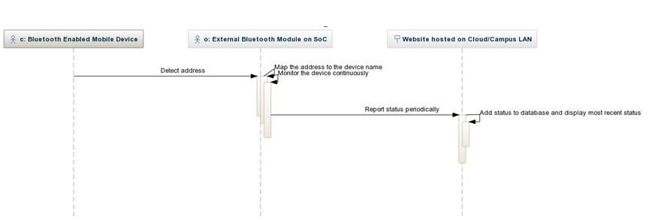
Sequence diagram

Slide 14
Implementation Details
The Bluetooth dongle was interfaced with the Raspberry Pi SoC.
The python code to perform the scanning and computation of scan results is run on the Raspberry Pi.
With additional python, php and json structures the addresses detected are mapped to the people and are written onto a webpage running on a server.

Slide 15
Conclusion and future work
As a part of this project we were able to implement an run successfully a basic working of the presence detection system.
Future improvisations include providing access credentials to end users.
Applications of this system are very vast. Here we try to list a few in the college environment:
Usage of this system in a staff room can help detecting the presence of a teacher. This can help people who are in search of the teacher know whether he/she is available in their cubicle.

Slide 16
Usage of this system in every classroom will help the management keep tabs on the teacher in class., for parameters like time of entry, duration in class, etc which can be used for statistical as well as monitoring purposes.
The detection can also be used to perform or trigger actions based on the arrival or departure of devices in a space like ringing a doorbell, switching on a light, make coffee, etc.
It can be used as an added security feature for objects by merely attaching a Bluetooth module to it.

Slide 17
Bibliography
[1] Jayavardhana Gubbi , Rajkumar Buyya, , Slaven Marusic ,
Marimuthu Palaniswami, Internet of Things(IoT) : A Vision,
Architectural Elements and Future Directions
[2] Friedemann Mattern and Christian Floerkemeier M. Wegmuller, :
From Internet of Computers to Internet of Things
[3] Wireless Communication Standards for the IoT : Greengeek White
Paper
[4] Wireless Connectivity for the Internet of Things - TI White Paper

Slide 18
To conclude,
We believe that this can be the
“Smart Key” for future “Smart Homes”
Thank you

