Slide 1
Data analytics on diabetic data set to predict and to take up preventive measures By- Nikhila-1MS12CS066 Deeksha-1MS12CS025 Rameshwari-1MS12CS036 Chandrakala-1MS12CS020

Slide 2
Project Goals
Analysis based on attributes age, gender, HbA1c result, medication, race.
Analysis using techniques such as regression and clustering.
Finding the relationship and dependency between the attributes
Providing preventive measures based on the analysis

Slide 3
Diabetes Mellitus
Diabetes Mellitus is disease caused due to shortage or excess of insulin in the body.
TYPE 1: The body stops producing insulin which is the hormone that is used break glucose in the blood.
TYPE 2: The body produces excess insulin which lowers the glucose level beyond the limit

Slide 4
Tests
HbA1c or A1c test: This test is used to test the glucose levels over a period of time for accurate analysis.
A1C Level
Normal- below 5.7 percent
Diabetes- 6.5 percent or above
Pre diabetes- 5.7 to 6.4 percent

Slide 5
Data Set Description
Dataset represents 10 years (1999-2008) of clinical care at 130 US hospitals.
It includes over 50 features representing patient and hospital outcomes.
Information was extracted from the database for encounters that satisfied the following criteria.

Slide 6
It is an inpatient encounter (a hospital admission).
It is a diabetic encounter, that is, one during which any kind of diabetes was entered to the system as a diagnosis.
The length of stay was at least 1 day and at most 14 days.
Laboratory tests were performed during the encounter.
Medications were administered during the encounter.

Slide 7
Attributes
patient number
Race
Gender
Age
admission type
time in hospital
medical specialty of admitting physician
number of lab test performed

Slide 8
HbA1c test result
Diagnosis
number of medication
diabetic medications
number of outpatient
Inpatient
emergency visits in the year before the hospitalization, etc.

Slide 9
Implementation
Data Collection
The Health Facts data we used was an extract representing 10 years (1999–2008) of clinical care at 130 hospitals.
Information was extracted from the database for encounters that satisfied the following criteria:
(1)It is an inpatient encounter (a hospital admission).
(2)It is a “diabetic” encounter, that is, one during which any kind of diabetes was entered to the system as a diagnosis.

Slide 10
3)The length of stay was at least 1 day and at most 14 days.
(4)Laboratory tests were performed during the encounter.
(5)Medications were administered during the encounter.

Slide 11
2.Data Cleaning
The original database contains incomplete, redundant, and noisy information as expected in any real-world data.
There were several features that could not be treated directly since they had a high percentage of missing values.
These features were weight (97% values missing), payer code (40%), and medical specialty (47%).

Slide 12
Weight attribute was considered to be too sparse and it was not included in further analysis.
Payer code was removed since it had a high percentage of missing values and it was not considered relevant to the outcome.
Medical specialty attribute was maintained, adding the value “missing” in order to account for missing values.

Slide 13
3.Selecting a Programming Language for Statistical Analysis
For statistical analysis we selected very commonly programming language R.
R is a programming language and software environment for statistical computing and graphics supported by the R Foundation for Statistical Computing.
The R language is widely used among statisticians and data miners for developing and data analysis.

Slide 14
SOFTWARE REQUIREMENT SPECIFICATIONS
External Interface Requirements
a. User Interface
The system’s UI is designed to be spontaneous and user-friendly as possible. An error messages will prompt the user in case of an inaccuracy in input. Notifications through warning messages will serve to keep the user posted.
b. Hardware Interface
Ubuntu 14.04
Enough memory
Enough processing capabilities.
c. Software Interface
PHP / R programming
R studio
d. Communication Interface
No additional specific communication interfaces are needed during the operation.

Slide 15
2. Functional Requirements
a. Generate charts based on age group of patients.
b. Generate charts based on gender.
c. Generate charts based on medical tests.
3.Software System Attributes
Reliability: Software shall never crash or freeze. The unit shall inform the user to re-set the system if major software mal-function has been encounter by the system.
Availability: Data shall be always available when queried.
Security: Data shall be only retrieved but not modified.
Portability: No portability identified at this movement.
Maintainability: The system shall be flexible enough to add new modules and upgrade the existing modules.
Performance: queries should be executed in time.

Slide 16
4. Performance Requirements
The response time should be less than 1 second
Capability to handle 1 lakh+ data points.
5. Database Requirement
H Base is a data model that is similar to Google’s big table designed to provide quick random access to huge amounts of structured data
6. Design Constraints
Additional hardware (memory) and software is required in future to accommodate increasing amount of data.

Slide 17
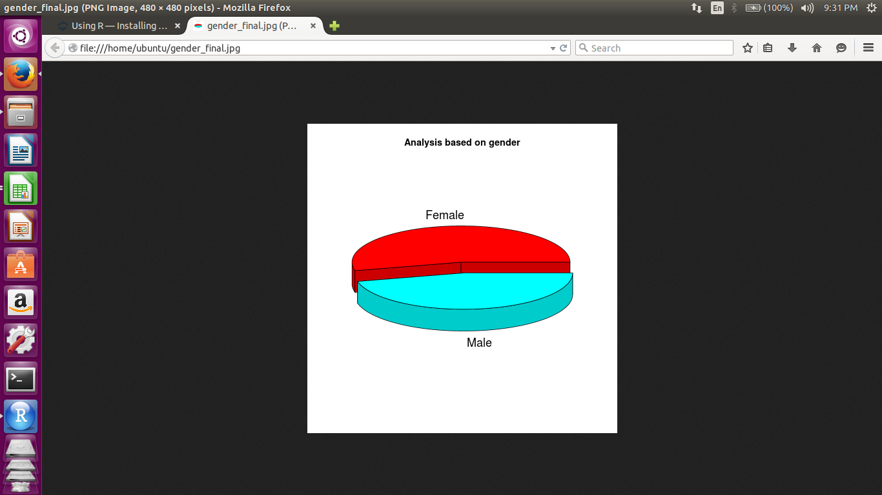
Results
1.Figure-1

Slide 18
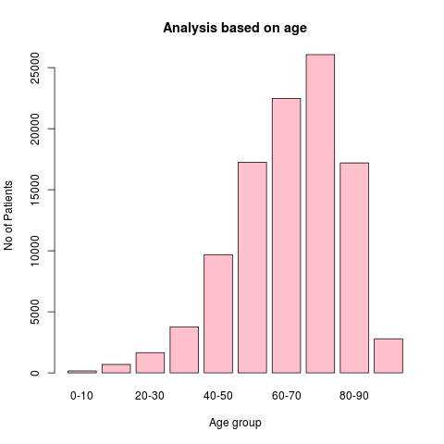
2. Figure-2

Slide 19
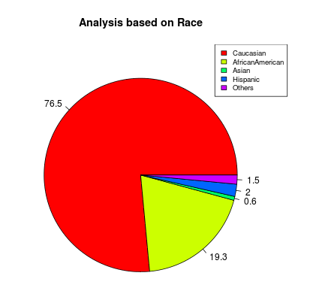
3. Figure-3

Slide 20
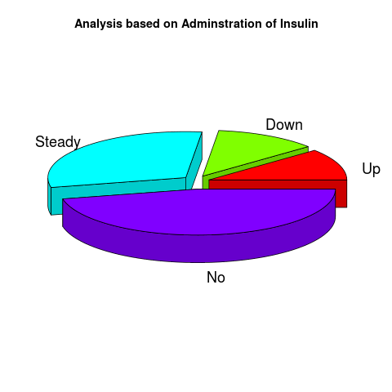
4. Figure-4

Slide 21
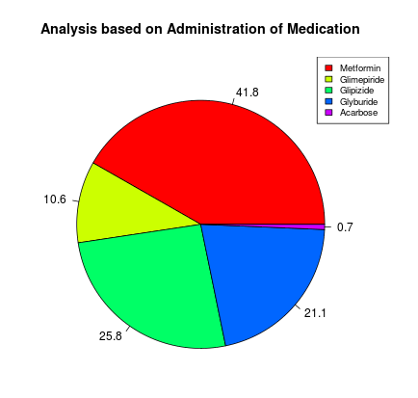
5. Figure-5

Slide 22
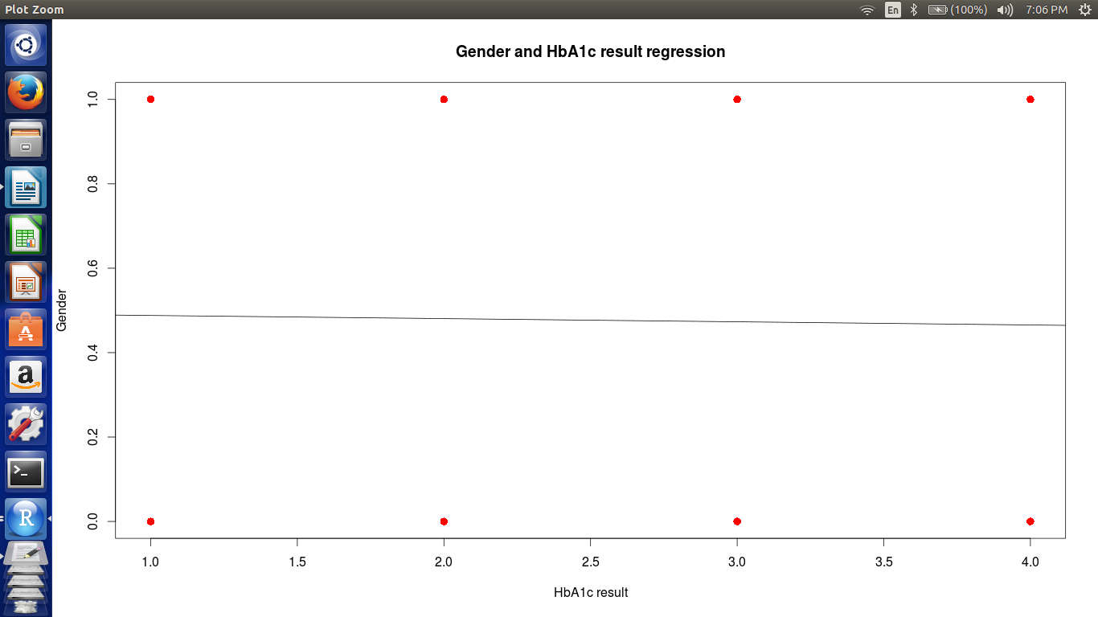
6.Figure-6 : Linear Regression

Slide 23
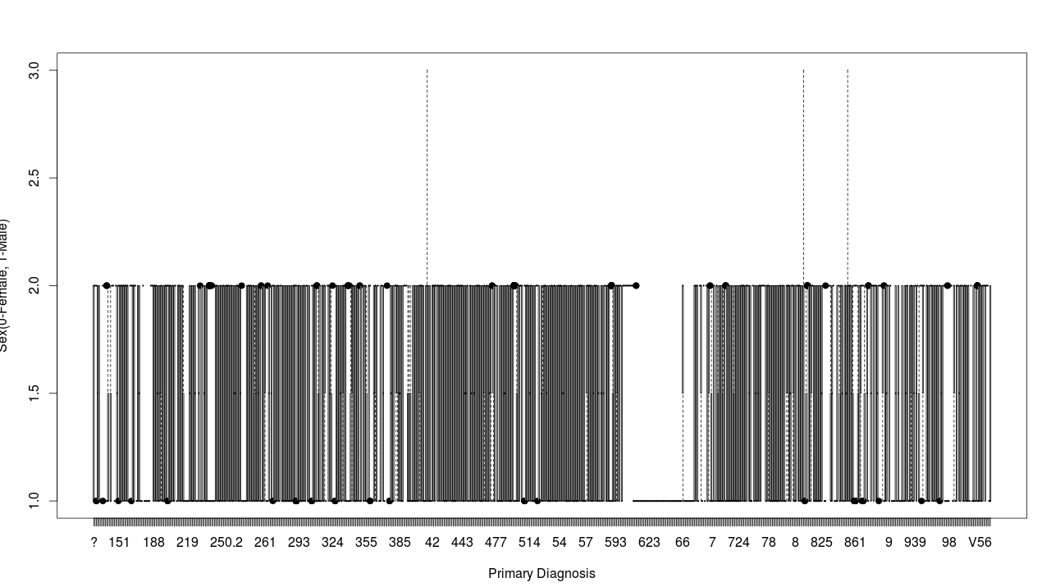
7. Figure-7a : Logistical Regression

Slide 24
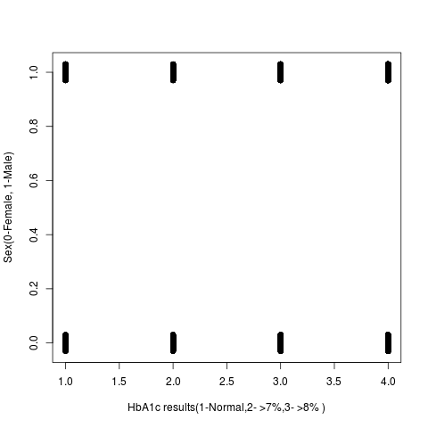
8. Figure-7b

Slide 25
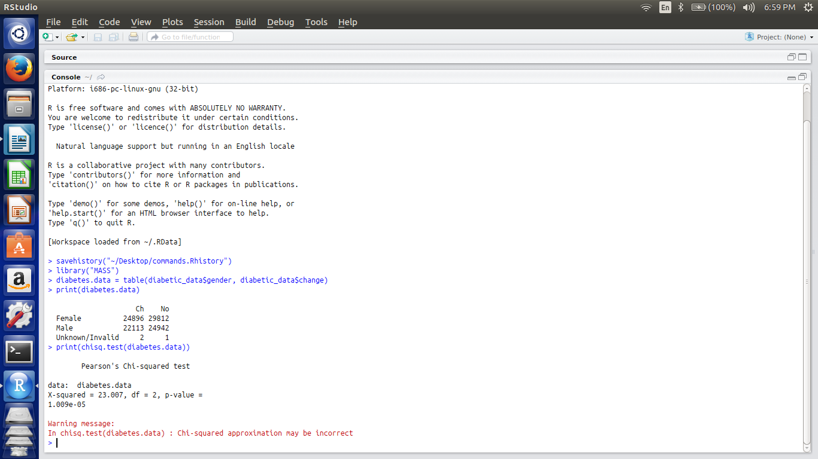
9.Figure-8: Chi Square test

Slide 26
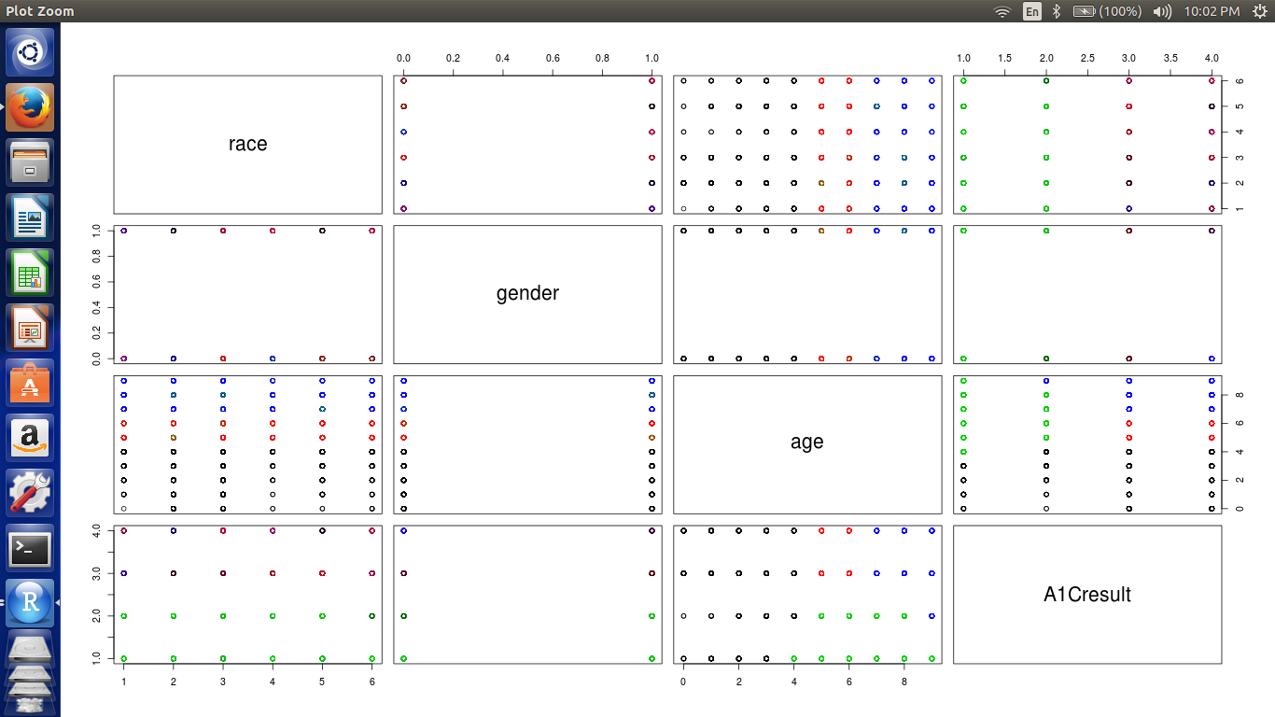
10.Figure-9: K-means Clustering

Slide 27
Conclusion
The groups found to be most affected: Females, 70-80 age group, Caucasian.
Type 2 diabetes was found to be more prevalent.
Metmorfin is the most used medication.
Correlation between gender and HbA1C results was not found.
Infectious and parasitic diseases were found to affect males more.

Slide 28
Endocrine, nutritional metabolic diseases and mental disorder were found to affect females.
Injury and poisoning and neoplasm were found to affect more.
Two major and two minor clusters were found.
Based on the analysis the following preventive measures can be taken:
More precaution to be taken by groups found affected.
Stocking up of most used medication by hospitals.
Provisions of medical facility based on diseases affecting both male and female.

Slide 29
Bibliography
1. http://clinical.diabetesjournals.org/content/29/3/102.full
2. http://randyzwitch.com/hive-five-hard-won-lessons/ 3.http://randyzwitch.com/big-data-hadoop-amazon-ec2-cloudera-part-1
4.http://jdmdonline.biomedcentral.com/articles/10.1186/2251-6581-12-14

Slide 30
THANK YOU

