Slide 1

Amazon Fine Food Reviews

Slide 2
Problem Statement
Recommending products to consumers means not only understanding their tastes, but also understanding their level of experience.
High reviews = Good food.

Slide 3

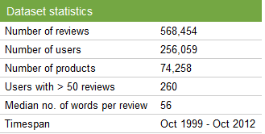
Dataset identification
The Fine Foods datasets consists of 568,454 reviews between October 1999 and October 2012;
256,059 users and 74,258 product

Slide 4
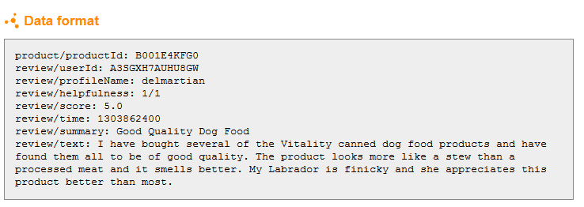
Attributes of data

Slide 5
Identifying the subset of the attributes
Based on the review we divided users
into 5 categories:
1.Light: less the 10 reviews
2.Medium: Greater than 10, but less than or
equal to 50 reviews
3.High: Greater than 50, but less than or equal
to 75 reviews
4.Very heavy: Greater than 75, but less or
equal to 100 reviews
5.Expert: More than 100 reviews

Slide 6
Identifying the subset of the attributes
The actual distribution of review
frequencies is as follows:
count 568462.000000
mean 18.124276
std 41.320272
min 1.000000
25% 1.000000
50% 5.000000
75% 14.000000
max 451.000000

Slide 7
Algorithm for the identification task
Our analysis based on the algorithm MARKOV CHAIN MONTE CARLO.
Our analysis based on the Latent Dirichlet
Analysis (LDA).
Gibbs Sampling is used to extract the
Data from dataset using LDA.
Gibbs Sampling takes some initial values of
parameters and iteratively replaces those values
Conditioned on its neighbors.

