Slide 1

HEALTH CARE SYSTEM

Slide 2

INTRODUCTION
A health system, also sometimes referred to as health care system or healthcare system, is the organization of people, institutions, and resources that deliver health care services to meet the health needs of target populations.
They are constantly monitored and can be alerted 24 hours a day, 7 days a week, offering peace of mind and reassurance to their family and friends

Slide 3
Project Goal
“This project basically aims at providing a smooth and simple monitoring for healthcare of old and differently abled people. It will enable the job of monitoring and analysing the health of the patient in an easy and efficient way. An attempt is being made to ensure that patients under serious medical conditions are facilitated with constant monitoring and on-time assistance during emergencies. ”

Slide 4
Project objectives(SMART)
By developing this healthcare system, the problem of continuous monitoring is addressed.
The temperature and heartbeat pulse of the patient is kept in check and any irregularities in body temperature or heartbeat rate will be immediately intimated to the concerned person whose name will be present in the emergency contacts as well to the doctor concerned.

Slide 5
As stated that the body temperature and heartbeat pulse is monitored continuously, the data is pushed onto cloud and specific actions are taken based on the data pushed. Analysis of the same can also be presented to the doctor for viewing the patient’s health over a certain period of time.
The system attempted to be build is reasonable as it involves basic data sensing from body using appropriate sensors and analysing results based on the data aggregated. This system will efficiently work with proper results being produced

Slide 6
This system attempted to be built is absolutely in the time frame and will be completed by the end of second week of December and we will be successfully completing the project with all its deliverables and without any compromise on quality.

Slide 7
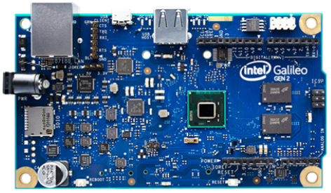
Intel Galileo gen 2

Slide 8
Description
The Intel® Galileo Gen 2 development board is a microcontroller board based on the Intel® Quark™SoC X1000 application processor, a 32-bit Intel® Pentium® brand system on a chip (SoC). It is the first board based on Intel® architecture designed to be hardware and software pin-compatible with shields designed for the Arduino Uno* R3.
This platform provides the ease of Intel architecture development through support for the Microsoft Windows*, Mac OS*, and Linux* host operating systems. It also brings the simplicity of the Arduino integrated development environment (IDE) software.
The Intel Galileo Gen 2 board is also software-compatible with the Arduino software development environment, which makes usability and introduction a snap. In addition to Arduino hardware and software compatibility, the Intel Galileo Gen 2 board has several PC industry standard I/O ports and features to expand native usage and capabilities beyond the Arduino shield ecosystem. A full-sized mini-PCI Express* slot, 100 Mb Ethernet port, Micro-SD slot, 6-pin 3.3V USB TTL UART header, USB host port, USB client port, and 8 Mbyte NOR Flash* come standard on the board.
Intel Galileo Gen 2 improves on Gen 1 by replacing the RS-232 console port with a 6-pin 3.3V USB TTL UART header. New additions to the Intel Galileo Gen 2 board include 12-bit pulse-width modulation (PWM), console UART1 redirection to Arduino* headers, 12V Power-over-Ethernet (PoE) capability, and a power regulation system that accepts power supplies from 7V to 15V

Slide 9


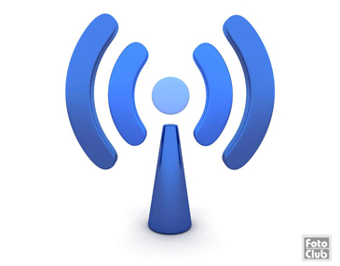
SENSORS

Slide 10
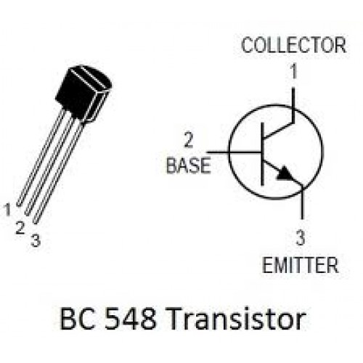
BC 548B TRANSISTOR

Slide 11
Description
The BC548 is a general purpose NPN bipolar junction transistor found commonly in European electronic equipment and present-day designs in Australian and British electronics magazines where a commonly-available low-cost NPN transistor is required. It is a part of a family of NPN and PNP epitaxial silicon transistors that include higher-quality variants, originating in 1966 when Philips introduced the metal-cased BC108 family of transistors which became the most used transistors in Australia and taken up by many European manufacturers. The BC548 is the modern plastic packaged BC108, and can be used in any circuit designed for the BC108 or BC148, which includes many Mullard and Philips published designs.
The BC548 is low cost and is available in most European Union and many other countries. It is often the first type of bipolar transistor hobbyists encounter, and is often featured in designs in hobby electronics magazines where a general-purpose transistor is required.

Slide 12

TCRT1000-Heart beat sensor

Slide 13
Working Principle
The heartbeat sensor is based on the principle of photo phlethysmography.
It measures the change in volume of blood through any organ of the body which causes a change in the light intensity through that organ (a vascular region).
In case of applications where heart pulse rate is to be monitored, the timing of the pulses is more important.
The flow of blood volume is decided by the rate of heart pulses and since light is absorbed by blood, the signal pulses are equivalent to the heart beat pulses.

Slide 14
Working
The basic heartbeat sensor consists of a light emitting diode and a detector like a light detecting resistor or a photodiode.
The heart beat pulses causes a variation in the flow of blood to different regions of the body.
When a tissue is illuminated with the light source, i.e. light emitted by the led, it either reflects (a finger tissue) or transmits the light (earlobe).
Some of the light is absorbed by the blood and the transmitted or the reflected light is received by the light detector.
The amount of light absorbed depends on the blood volume in that tissue.
The detector output is in form of electrical signal and is proportional to the heart beat rate.
The digital pulses are given to a microcontroller for calculating the heat beat rate, given by the formula-
BPM(Beats per minute) = 60*f

Slide 15
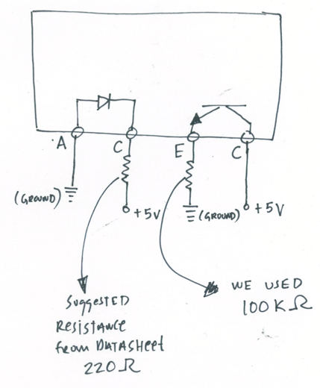
Pin description
Pin C: To give supply voltage to the LED
Pin A and E are grounded. Pin C is the output. Pin E is also the enable pin and pulling it high turns the LED on and the sensor starts working. It is embedded on a wearable device which can be worn on the wrist and the output can be sent wirelessly (through Bluetooth) to the computer for processing.

Slide 16
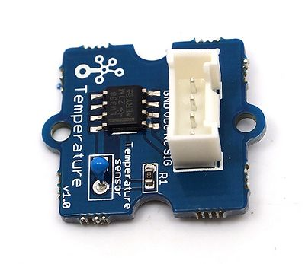
Grove Temperature sensor

Slide 17
Description
Grove is a modulated, ready-to-use tool set. Much like Lego, it takes a building block approach to assembling electronics. Compared with the traditional, complicated learning method of using a breadboard and various electronic components to assemble a project, Grove simplifies and condenses the learning process significantly. The Grove system consists of a base shield and various modules with standardized connectors. The base shield allows for easy connection of any microprocessor input or output from the Grove modules, and every Grove module addresses a single function, such as a simple button or a more complex heart rate sensor. Each one comes with clear documentation and demo code to help you get started quickly. The Grove system also offers stand-alone mixer packs (Grove - Mixer Pack and Grove - Mixer Pack V2) that include a set of Grove modules that can be connected with each other to circuits without having to use a base shield of any sort. This way, various projects and circuits that do not need micro-controllers or microprocessors can be built.

Slide 18
Technical specifications
Voltage: 3.3 ~ 5V
Max power rating at 25℃: 300mW
Zero power resistance: 10 KΩ
Operating temperature range: -40 ~ +125 ℃

Slide 19
PROJECT PROGRESS
Activity Definition
Activity Sequencing
Design
Implementation
Timeline

Slide 20
Activity Definition
Feasibility test of the idea
Technology and Trend Survey
Conceptualizing the idea
Decision on the board and SoCs to be used
Decision on the sensors to be used
Decision on the programming language to be used and other hardware components

Slide 21
Activity Sequencing
Feasibility
Survey
Conceptualizing the idea
Coding platform and hardware components
Sensor Selection
Board Selection
Design Phase
Implementation

Slide 22
Design
Circuit Design
Algorithm Design
Algorithm Optimization
Selection of the programming platform for implementation
Design of the web application for retrieving and processing data
Interface for rendering the deliverables

Slide 23
Implementation
Board used: Intel Galileo gen 2
Sensors: DS12B20, TCrT1000,LM324 Amp
Coding Platform: Arduino
Programming Language: C
Database: Cloud/Local Server
Values read by the sensors are passed on to a specific IP Address from where the data is retrieved for processing

Slide 24
Timeline
Activity | Time frame
Activity Definition Activity Sequencing Design Implementation 1)Circuit 2)Programming 3)Reading Sensor values 4)Consolidation of data 5)Pushing data to internet 6)Database 7)Web interface 8) System Testing 9)Finalization | 01-09-2015 to 04-09-2015 05-09-2015 to 07-09-2015 08-09-2015 to 14-09-2015 15-09-2015 to Present. 15-09-2015 to 17-09-2015 18-09-2015 to 21-09-2015 21-09-2015 to 23-09-2015 24-09-2015 to 27-09-2015 28-09-2015 to 10-10-2015 012-10-2015 to 28/11/2-15 30-10-2015 to 8/12/2015 9/12/2015 11/12/2015

Slide 25
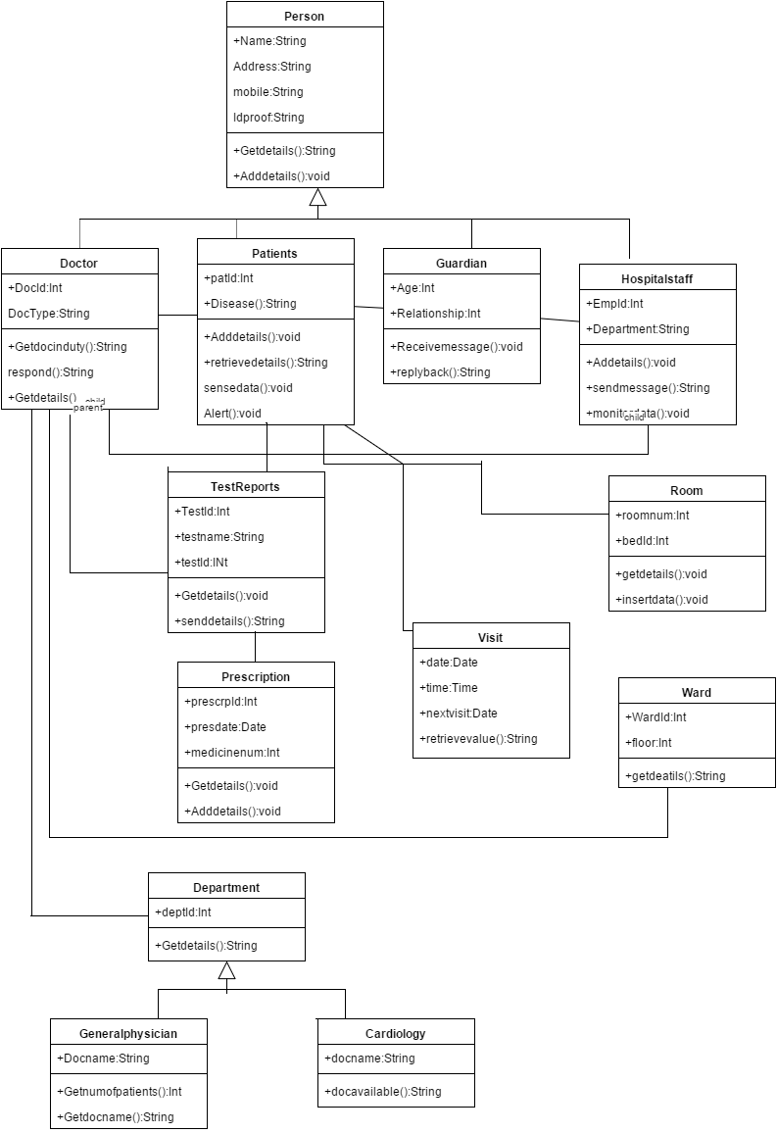
Class Diagram
Since we've a healthcare system, it mainly focuses on patients. We create a main class Person wherein we have person details such as Name, Address, contact info etc. Which in turn is generalized to four sub classes namely: Doctor, Patient, Guardian and Hospital Staff. Patient is related to the guardian as well as hospital staff. A relation also exists between hospital staff and the guardian. Doctor and hospital staff are also associated with each other. Every doctor is associated with some or the other department. Dept class is generalized to other sub classes as Cardio, Pediatrics, Ortho and general physician. Test report class includes Tid, Name, Date etc which in turn is associated with both doctor and patient. Prescription class is similarly associated with doctor and patient and has attributes Medicine Name, Date, Pid etc. To keep track of the general visit of the doctor Visit class is maintained. General details of patient like Room, Ward etc are also maintained in classes for efficient hospital management and to tackle emergency situations.

Slide 26
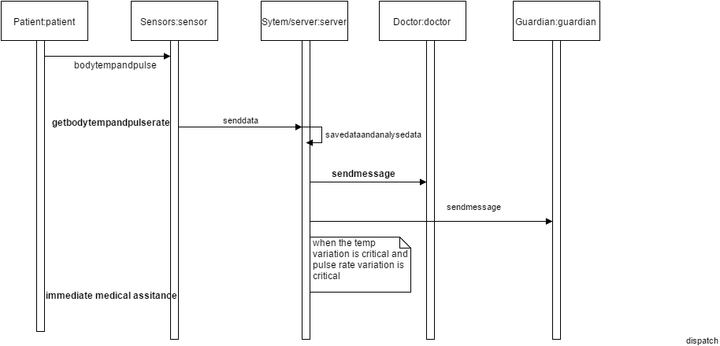
Sequence Diagram
In our sequence diagram we've 5 main classes which refers to the main aspects of the healthcare system namely: Patient, Sensor, Server, Doctor and Guardian. We've 2 scenarios in the sequence diagram firstly normal case and secondly exception scenario. Healthcare system proceeds as the sensor continuously senses data from patients. On receipt of the data, the data is pushed onto the server where it is saved and analyzed. After analyzing the received data, there can be 2 cases: 1)If the patient's body temperature and pulse are normal and hence the sensor continue to get data from patient's body without any further action. 2)When the patient's body temperature or pulse rate shows an abnormality the doctor and the guardian are notified with an emergency message and made aware of the patient's condition for the treatment.

Slide 27
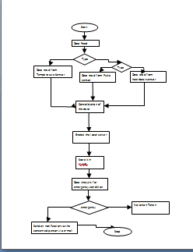
Implementation
The sensors are connected to galileo gen2 board along with a LAN wire connected to its port to make the data available across the internet.The patient is made to touch both the sensors to take the readings.When the connection is established it will start reading the parameters of sensors like p1, p2, p3 etc. The threshold levels for the required sensors are set as t1, t2, t3 etc. The sensor data are read using the arduino IDE using appropriate codes. The data can be analyzed anywhere any time. The data is continuously read thus making it highly reliable .Lan cable is connected to the board to make the data available on the local server.
The data that is read is pushed on to the local server created using xampp for every reading using python codes.The data sent to xampp is stored in mysql database.The data is read from the sensor every 10 seconds and sent to the server which is made available in the web interface created using PHP.When the temperature variations or pulse rate variations exceeds the predefined threshold values it sends an email to the guardian using python code and the clinical staff thus making them aware that the patient needs immediate care.The patients body temperature and the pulse values can be accessed by the guardian by the web interface provided even under normal health conditions .This web interface provides a graphical representation of the data that is read and collected thus keeping them updated about the patients health.Thus providing an easy and efficient way to monitor and access the patient’s health condition.

Slide 28
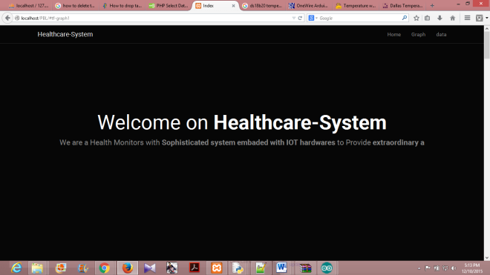
Results

Slide 29
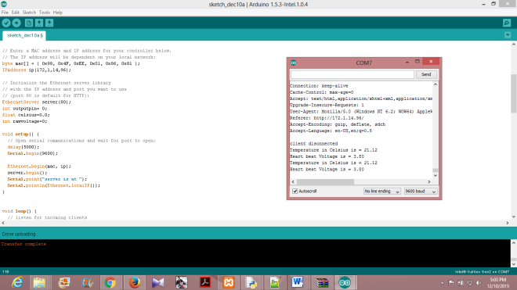
Results

Slide 30
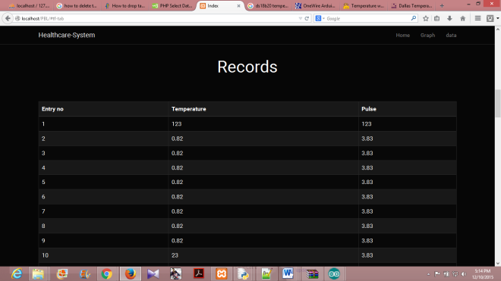
Results

Slide 31
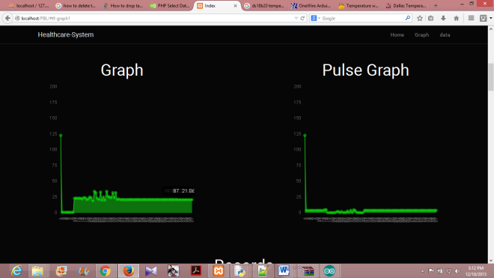
Results

Slide 32
Conclusion
The healthcare monitoring system is successful in its objective of providing an efficient and compelling way of health care of patients. The basic aim to reduce the manual effort put in such task and to maintain a separate catalogue for patients. This will help the doctors for recognizing any trends and making further decisions on medication and treatment for that patient. Such systems can help in reduction in also maintaining the reports for the patients.

Slide 33
Future Work
Using this system as framework, the system can be expanded to include various other sensors which could include body movement sensors, pressure sensors etc..and storing it onto the cloud. By storing onto clous data can be accessed from anywhere and large volumes of data can be easily stored.This will further help in even more effective monitoring of patients. This kind of a system with respective changes can be implemented in the hospitals for disabled people ,in nursing homes or at old age homes will serve the people better and in an easy way.

Slide 34
Bibliography
[1] Python Software [US],[online] Available: https://pypi.python.org/pypi
[2]Galileo Gen2 ,[online]Available:https://www.arduino.cc/en/Guide/IntelGalileoGen2
[3] Claire Rowland, Elizabeth Goodman, Martin Charlier, Ann Light & Alfred Lui “Designing Connected Products”,
[4][online]Available: http://enterpriseiotbook.com
[5][online]Available:https://software.intel.com/en-us/iot/library/galileo-getting-started
[6] Madni, A.M., "Smart Configurable Wireless Sensors and Actuators for System of Systems (SoS) Applications". Keynote Address, Proceedings, IEEE SMC Intl. Conf. on System of Sytems Engineering, Los Angeles, April 2006.
[7].VonLubitz, D. and N. Wickramasinghe, 2006 "Healthcare and Technology: The Doctrine of NetworkcentricHelahtcare," Intl. J Electronic Healthcare(IJEH), vol. 4, pp.322-344.
[8]Introducing Intel Galileo as a development platform of smart sensor: Evolution, opportunities and challenges,School of Engineering and Advanced Technology, Massey University, Palmerston North, New Zealand Ghayvat, Hemant ; Mukhopadhyay, S.C.
[9] D. Guinard, "A Web of Things Application Architecture - Integrating the Real-World into the Web," Ph.D., ETH Zurich, 2011.
[10]Introducing the intelgalileo development board. [Online]. Available: http://www.intel.com/content/www/us/en/do-it-yourself/galileomaker- quark-board.html
[11] N. Tsuruta, Y. Shigeta, S. Maeda, S. Takahashi and T. Morimoto "A Dialogue System for Home Health care(In Japanese)", Correspondences on Human Interface, vol. 4, no. 4, 2002
[12] Python Software [US],[online] Available:https://docs.python.org/3/library/email-examples.html
[13]Albert Sweigart”Automate the boring stuff with python”,February 25, 2015

Slide 35
THANK YOU
BY:
ADARSH RAJ
ANVITHA D RAO
VISHAL MAHULI
VISHWANATH KULKARNI
1MS12CS005
1MS12CS010
1MS12CS134
1MS12CS135

