Slide 1
PROJECT BASED LEARNING(Iot) Home Security Email Alert system
- By
Savitha K N 1MS13CS419
Varsha C G 1MS13CS422
Yashaswi G 1MS12CS146
Vidyavati Hallikhed 1MS12CS422

Slide 2
Project Goals
The components should be inexpensive(i.e.,low cost platform for interconnecting electrical/electronic devices and various sensors in a home via internet )
The components should all be low powered..
Provide a simple , fast and reliable way to automate the environment.
Enabling Real-time monitoring of the house

Slide 3
Sensors
PIR Sensor
A passive infrared sensor(PIR) is an electronic sensor that measures infrared light radiating from objects in its field of view. The sensor is often manufactured as part of an integrated circuit.
Fire Detection sensor:
Sense one or more of the products or phenomena resulting from fire such as smoke,heat,infrared and/ultraviolet light radiation or gas

Slide 4
SRS
External Interface Requirements.
* User Interfaces: The first interface is the login-in screen.
Hardware Interfaces:
→Raspbian OS: The Raspberry Pi operates on a LINUX based open source operating system called Raspbian OS.
Raspberry Pi camera:This device captures the images of the intruders and sends the particular images to the registered mail address.
SSMTP and Mpack:The SSMTP is used to configure the email address in the system and Mpack is used to send email with attachment to the configured email address.

Slide 5
SRS
c)Software Interfaces:
→LINUX OS: LINUX is a Unix-like and mostly POSIX compliant computer operating system(OS) assembled under the model of free and open source software development and distribution
Communication Interfaces: The system uses a Wi-fi or GPRS connection to send the information to the registered mail address.
Software Quality Attributes:
Interface is accessible from at least one or more convinient places:
This includes all of the home’s common entry ways. If the system interface is not readily accessible, then it will not be as easy to control and will offer little convenience.
Interface and system must be properly connected to the sensors:
It is essential to have a secure wiring, preferably inside the walls, for reliable sensor information to guard against false images.

Slide 6
Class Diagram
Home
Input
Server
Output
Sensor
Python
Camera
Alert

Slide 7
Sequence Diagram
:Input
:Server
:Output
Sensor senses object
Capture photo
Notify User
Reply to the server
Inform to the Input

Slide 8
Implementation
Tool Introduction :
Installation of PuTTY Configuration:
Putty configuration is to install Raspbian OS . Putty configuration is SSH and Telnet client .It is a open source software that is available with source code.
Installation of RASPBIAN OS:
Need to install Raspbian operating system in Pc, An operating system is the set of basic programs and utilities that make your Raspberry Pi run.

Slide 9
Technology
Raspberry Pi
The Raspberry Pi hardware has evolved through several versions that feature variations in memory capacity, and peripheral device support.
Python
Python interpreters are available for installation on many operating systems, allowing Python code execution on a wide variety of systems.

Slide 10
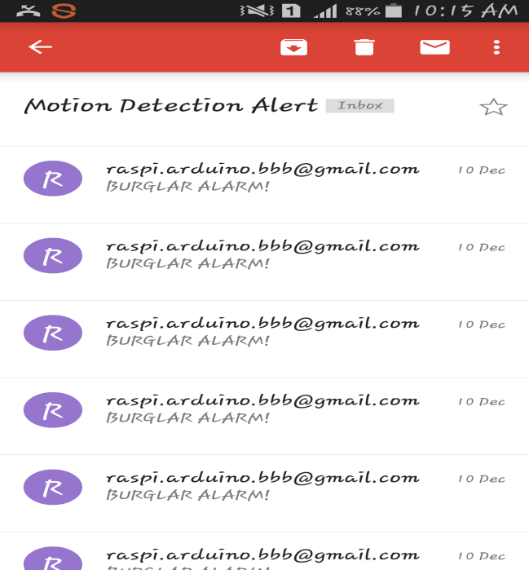
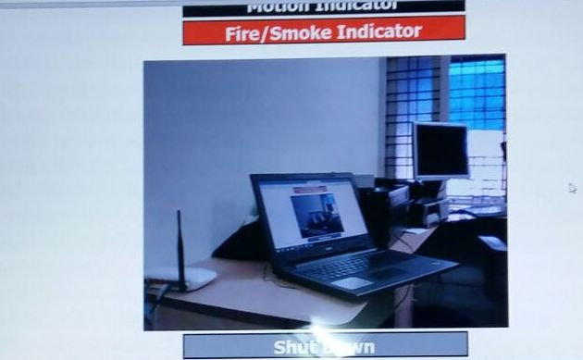
Result

Slide 11
Conclusion and Future work:
Thus we have designed a smart surveillance system capable of recording/capturing video/image and transmitting to a smart phone. It is advantageous as it offers reliability and privacy on both sides. It is authenticated and encrypted on the receiver side, Hence it offers only the person concerned to view the details.

Slide 12
REFERENCES [1]. http://www.instructables.com/id/Home-Security-Email-Alert-System-using- Raspberry-Pi/ [2]. "U.S. Patent 613809: Method of and apparatus for controlling mechanism of moving vessels and vehicles". United States Patent and Trademark Office. 1898-11-08. Retrieved 2010-06-16. [3].http://www.smartcomputing.com/editorial/article.asp?article=articles%2F1995 %2Fmar95%2Fpcn0323%2Fpcn0323.asp retrieved 2010 09 02 [4]. William C. Mann (ed.) Smart technology for aging, disability and independence : the state of the science, John Wiley and Sons, 2005 0 -471-69694-3, pp. 34-66 [5]. "Home automation costs". Totalavcontrol.co.uk. Retrieved 2010-02-18.

