Slide 1
PROJECT BASED LEARNING
Income based Data Analysis on US Census
Krishna Chaitanya
Meghana B S
Nirupam K N
Sharath R

Slide 2
Project Goals
To provide a clear insight into the income ranges, standard of living and the economic status of the population using Statistical analysis. The carpooling scenario is also pondered and aims to suggest carpooling taking into account the present people exercising carpooling.
To bring out the following:
The percentage distribution of men and women in the workforce
Average salary a person can expect based on his education level
Classes of income for the entire population
Proficiency in English of the population
Economic classes hierarchy in the society
Extent to which carpooling can be done in each state

Slide 3
Datasets
US Census Data with 3.5 million Data points.
Size - 4.5GB
Information of approximately 3.5 million households.
Information about who they are and how they live including ancestry, education, work, transportation, internet use, and residency.

Slide 4
Description about SRS
SRS is a document describing the entire project with respect to the requirements. It helps in better understanding of the project by specifying the functional requirements, software system attributes etc.
It minimizes the time and effort required to analyse the data as the requirement are specified.
Functional Requirements
Gender distribution in occupation
Education - Salary Relationship
English proficiency
Classification into economic classes
Composition of Carpool

Slide 5
Description about SRS
Hardware Requirements
64 Bit Processor
4 GB RAM
40 GB ROM
I3 processor
Software Requirements
Java1.7
Hadoop 2.6.x
Python 2.7
R

Slide 6
Description about SRS
Software System Attributes
Reliability
Availability
Security
Portability
Maintainability
Performance
Performance Requirements
Computer should not be shut down in between and hadoop should not be stopped.
The given data should be normalized and should contain all the data correctly.
Minimization of time complexity for
1. Given datasets
2. Required attributes with null tuples
3. Required attributed without null tuples
4. After code optimization

Slide 7
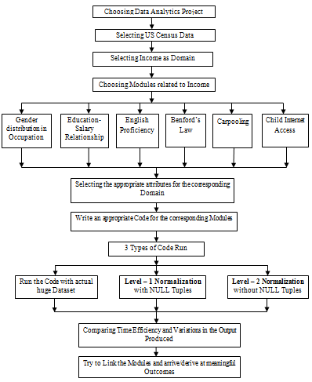
Design
FLOW DIAGRAM

Slide 8
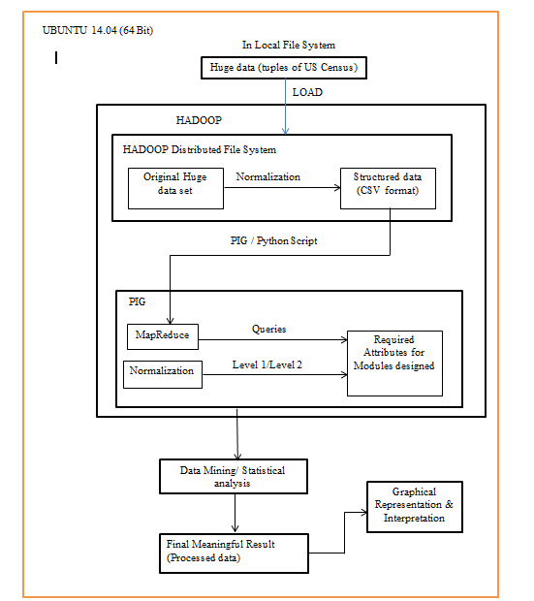
SYSTEM ARCHITECTURE

Slide 9
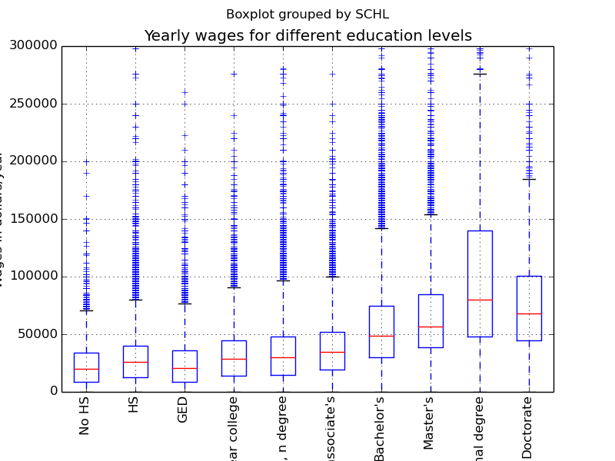
Implementation
Education Salary

Slide 10
Education Salary
1)WITH NULL TUPLES
chiru@chiru-Inspiron-N5110:~$ vi lat.py
chiru@chiru-Inspiron-N5110:~$ python lat.py
1.599688 seconds process time
2)WITHOUT NULL TUPLES
chiru@chiru-Inspiron-N5110:~$ vi lat.py
chiru@chiru-Inspiron-N5110:~$ python lat.py
1.366611 seconds process time

Slide 11
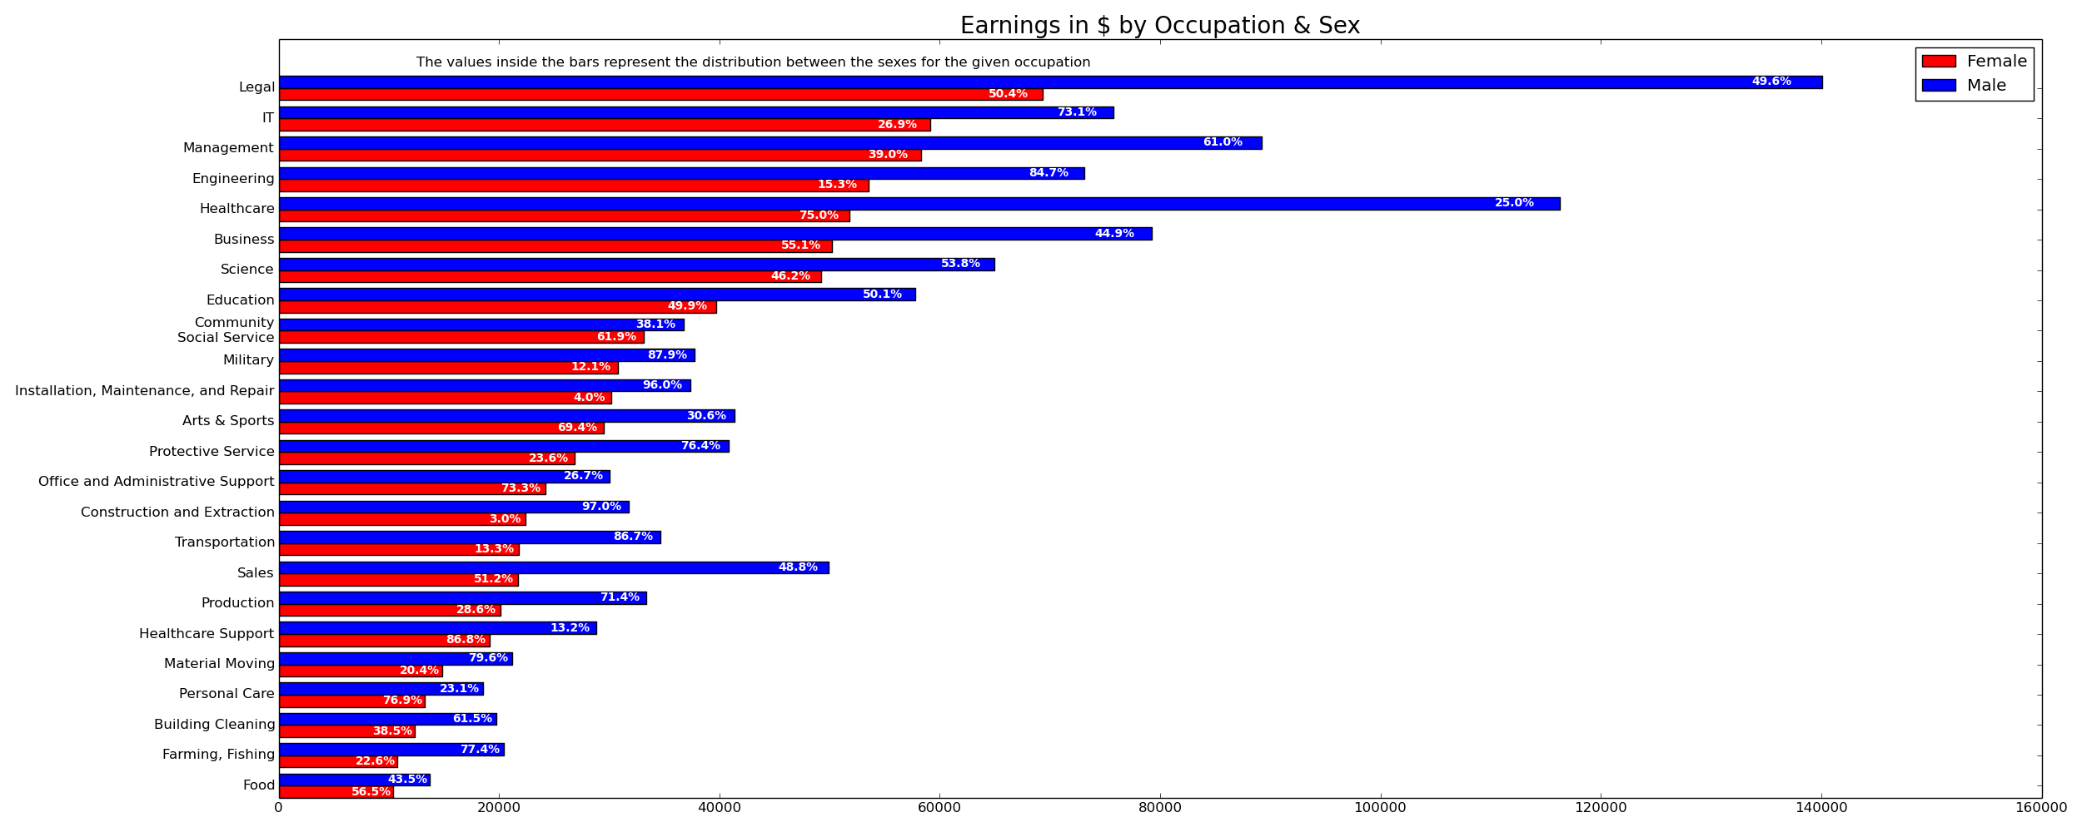
Gender Distribution in workforce

Slide 12
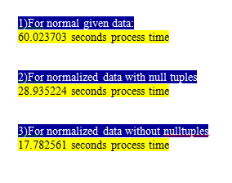
Gender Distribution in workforce

Slide 13
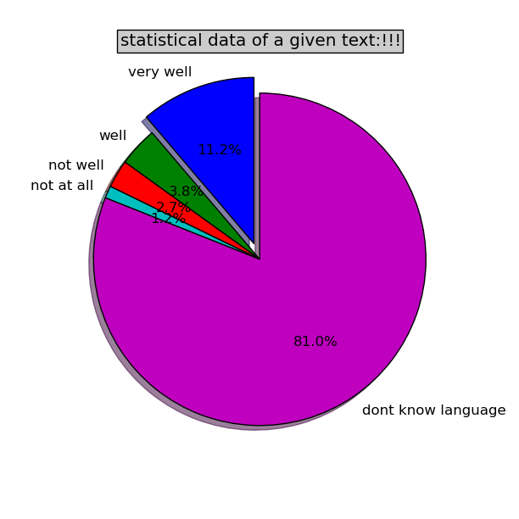
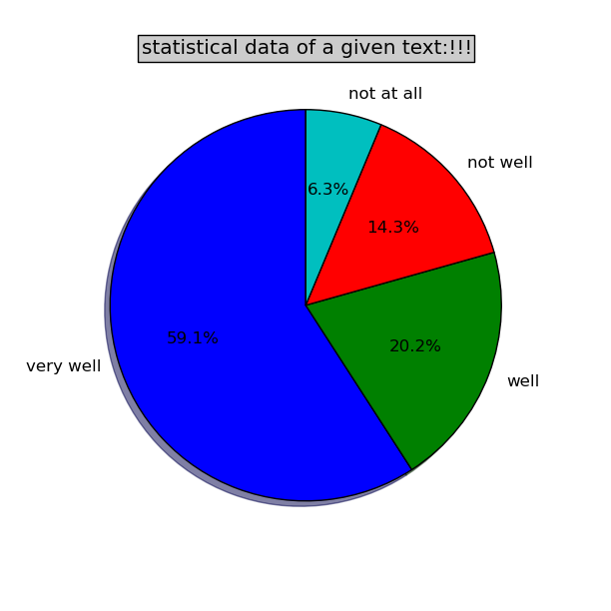
English Proficiency

Slide 14
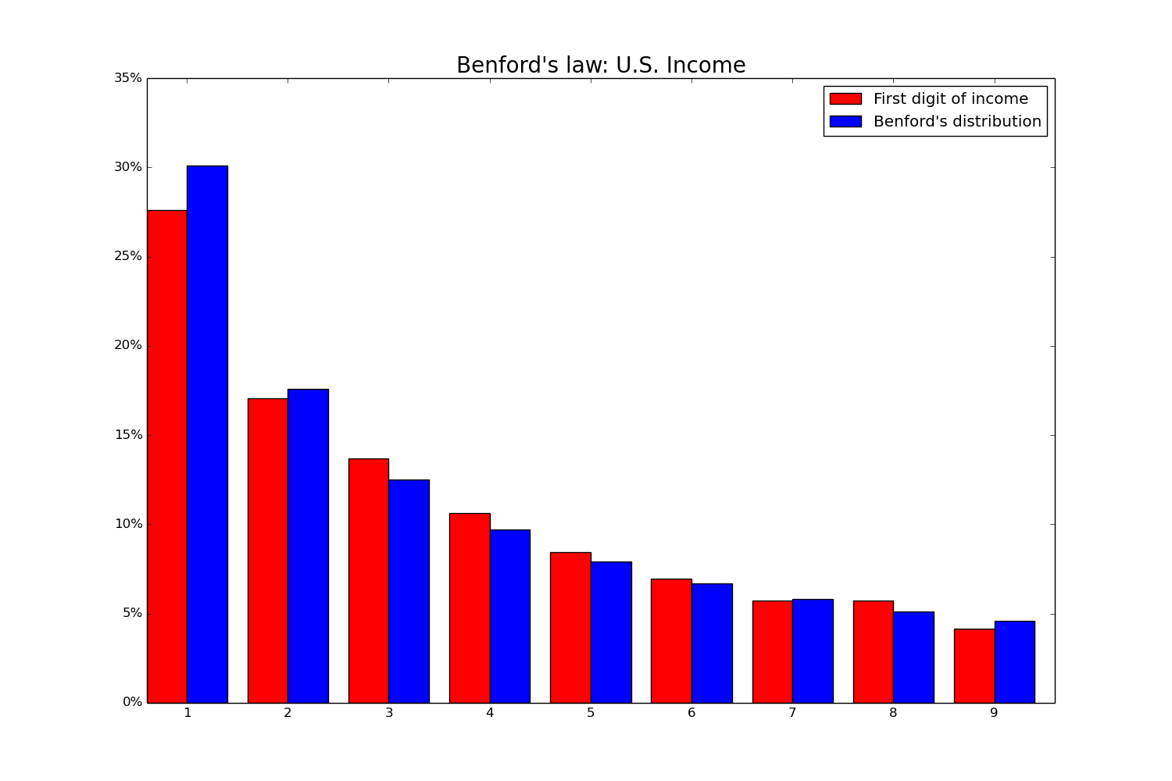


Benford’s law

Slide 15
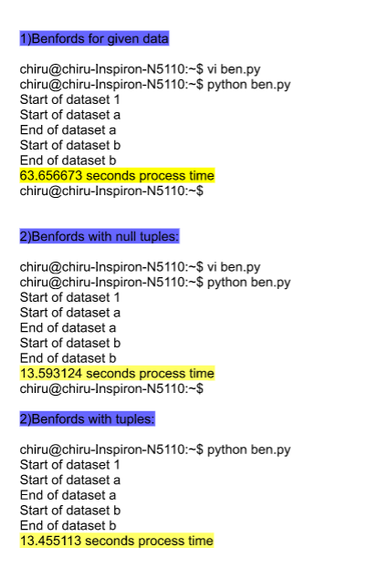
Benford’s Law

Slide 16

Heat map of Children without Internet Access

Slide 17
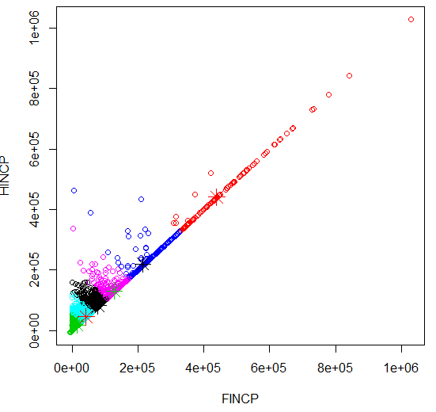
K-means
Result of k means clustering using two income parameters (FINCP HINCP ) with 6 clusters

Slide 18
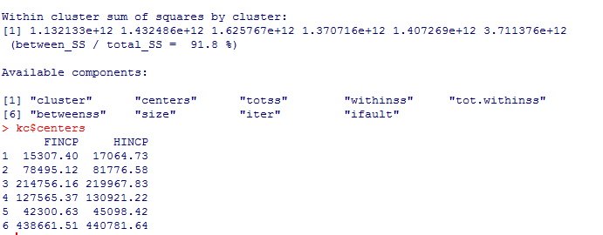
K-means
Result of k means clustering using two income parameters (FINCP HINCP ) with 6 clusters along with cluster points

Slide 19
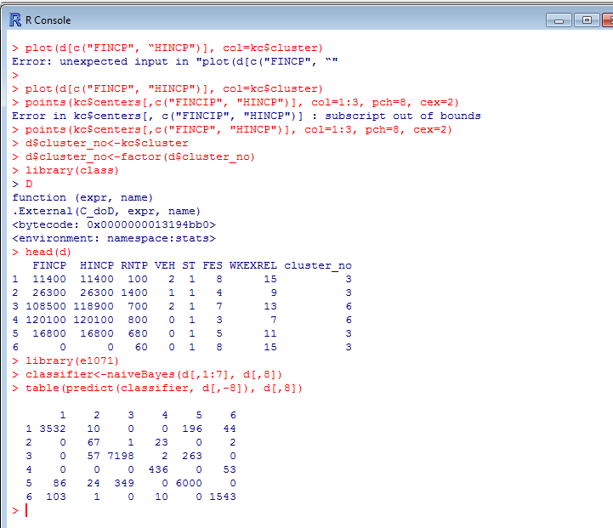
Naïve Bayes Classifier
The prediction is performed as to which category a person might belong taking into account number of vehicles, state, and so on

Slide 20
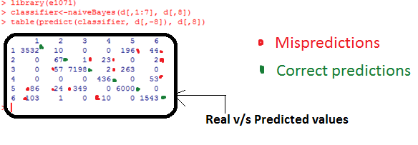
Naïve Bayes Classifier
Comparison between the real cluster categories and the ones predicted by Naïve Bayes Classifier

Slide 21
Bibliography
Estimates of income for small places: An application of James-Stein Procedures to Census data
https://www.kaggle.com/ : US Census Data
https://en.wikipedia.org/wiki/Apache_Hadoop: Hadoop
Inequality in income and mortality in the United States – Paper published on Analysis of mortality and potential pathways
https://en.wikipedia.org/wiki/Python_(programming_language) : Python Wikipedia
https://cwiki.apache.org/confluence/display/PIG/PigTutorial: Pig tutorials
http://www.r-statistics.com/2013/08/k-means-clustering-from-r-in-action : webpage on k-means clustering using R
http://www.rdatamining.com/examples/association-rules : webpage on Naïve Bayes Classifier using R
https://en.wikipedia.org/wiki/Benford%27s_law : Benford’s law Wikipedia page

Slide 22

“A large income is the best
recipe I ever heard of ”
-Jane Austen , English novelist

