Slide 1
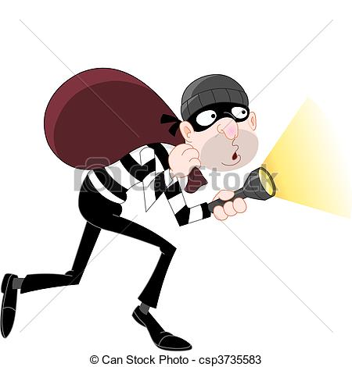
Intrusion Detector
ABHILASH MUKESH :1MS12CS001
MEETI BALIGA :1MS12CS054
RAUNAK SHAH :1MS12CS090

Slide 2
Project goals
The goal of the project is to increase sense of security in household environments.
The project aims at creating a portable and efficient intrusion detector that notifies the user of any human interference around the sensor’s field of view.

Slide 3
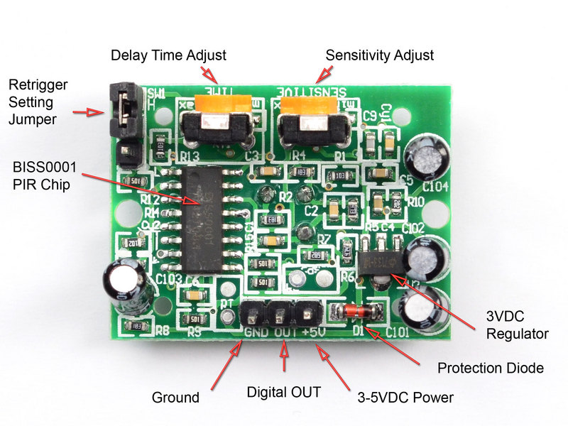
Description of sensors
1.Passive Infrared Motion Sensor (PIR sensor)
An electronic sensor that measures infrared (IR) light radiating from objects in its field of view.
A PIR-based motion detector is used to sense movement of people, animals, or other objects moving around within approximately 10m from the sensor.

Slide 4
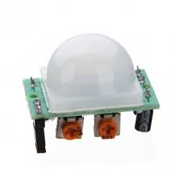
Operating principle:
All objects with a temperature above absolute zero emit heat energy in the form of radiation.
This radiation is invisible to the human eye because it radiates at infrared wavelengths, but it can be detected by electronic devices designed for such a purpose.
The term passive in this instance refers to the fact that PIR devices do not generate or radiate any energy for detection purposes. They work entirely by detecting the energy given off by other objects.

Slide 5
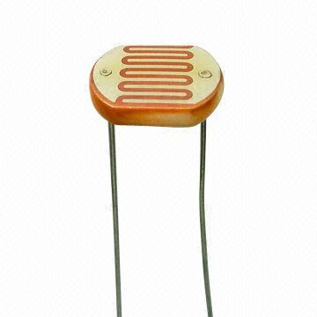
2.Photo Resistor
A photoresistor or light-dependent resistor (LDR) or photocell is a light-controlled variable resistor.
The resistance of a photoresistor decreases with increasing incident light intensity; in other words, it exhibits photoconductivity.

Slide 6
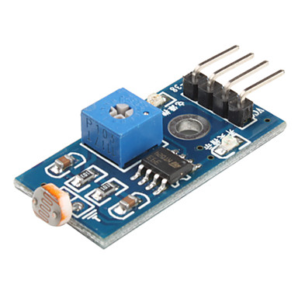
Operating principle:
A photoresistor is made of a high resistance semiconductor. If light falling on the device is of high enough frequency, photons absorbed by the semiconductor give bound electrons enough energy to jump into the conduction band.
The resulting free electron (and its hole partner) conduct electricity, thereby lowering resistance. 20mm-Photocell-Ldr
A single photoresistor might be useless since you will need the digital signal according to the brightness. The light sensor module is designed for that purpose.

Slide 7
Progress of the project
The project is now able to detect intrusion from the surroundings and transmit raw data to the raspberry pi.
The raspberry pi is able to process the raw data received. It is able to save the crucial details about time of detection into google forms using python.

Slide 8
Software Requirement Specification
External Interface Requirements
User Interfaces: A web application is created to communicate details of the intrusion and light intensity of the environment to the user. The web application is updated every few minutes for a better user experience.
Hardware Interfaces: Raspberry pi Model-2 with Raspbian OS installed, acts as the hardware interface along with the passive infrared sensor and the photo resistor module.
Software Interfaces: The software is executed by running the python program on the terminal of the Raspberry pi. Raspbian Operating System runs on the raspberry pi.
Communication Interfaces: The PIR communicates with the raspberry pi on intrusion detection. The raspberry pi via the internet saves the details of intrusion into a google form.

Slide 9
Functional Requirements
The project must be capable of performing the following tasks:
Detect intrusion from its surroundings
Detect change in light intensity
Process received raw data
Save data into google forms
Retrieve data from google forms and save to database
Receive data from database and display it on the web application.

Slide 10
Software System Attributes
Reliability – The application’s reliability depends on the internet connections and the well-being of the server. It also depends on the performance of the sensors. Due to its simple design the project can be considered fairly reliable.
Availability – The service is available all time.
Security – Server crashes are the biggest security threat. Since google forms are used unwanted intrusion can be of concern.
Portability – The software is fairly portable. The hardware can be installed anywhere and data can be accessed from any part of the world.
Maintainability – The hardware has minimum maintenance requirements as it does not have a complex design. However a database has to be maintained and checked for sufficient space regularly.
Performance – The performance directly depends on the sensors used for the project. Their performance can be highly increased by increasing their sensitivity.

Slide 11
Performance Requirements
The Raspberry pi should have continuous power supply.
The database should be regularly updated without lag.
The sensor should not be sensitive to minor intrusions which can lead to incorrect output.
Database Requirements
The project uses MongoDB database along with google forms to store data. JDBC is used to retrieve data from MongoDB and display on the web application.
Design Constraints
The intrusion detector works only when the raspberry pi is supplied with continuous power
Intrusion on the rarer side of the sensor cannot be detected.

Slide 12
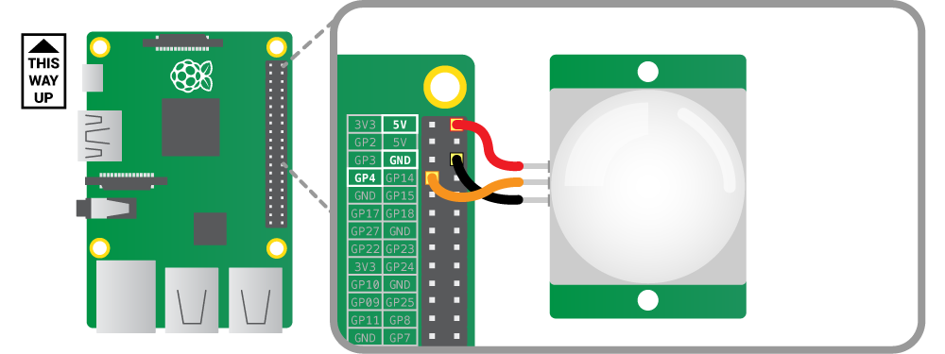
Design

Slide 13
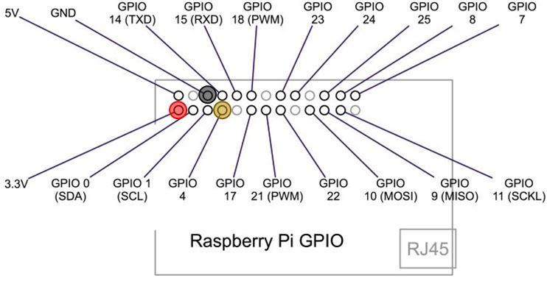

Slide 14
Code:
import RPi.GPIO as GPIO
import time
from urllib.request import urlopen
import sys
sensor = 4
GPIO.setmode(GPIO.BCM)
GPIO.setup(sensor, GPIO.IN, GPIO.PUD_DOWN)
previous_state = False
current_state = False
while True:
time.sleep(0.001)
previous_state = current_state
current_state = GPIO.input(sensor)
if current_state != previous_state:
new_state = "HIGH" if current_state else "LOW"
if new_state== "HIGH":
localtime=time.asctime(time.localtime(time.time()))
print ("intrusion detected at local time",localtime)
urlopen("https://docs.google.com/forms/d/1OvMU9v4GYL6BMX_9V2JxwwiXgupvT2pR-HueGl-j2ZU/formResponse?ifq&entry.1963731240=yes&submit=Submit")

Slide 15
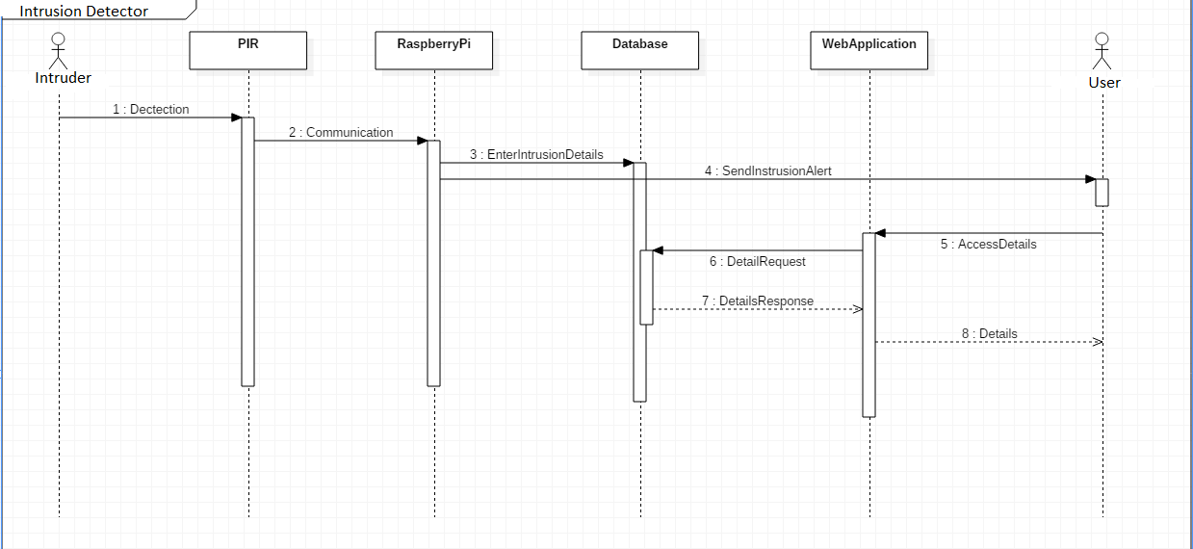
Sequence Diagram:

Slide 16
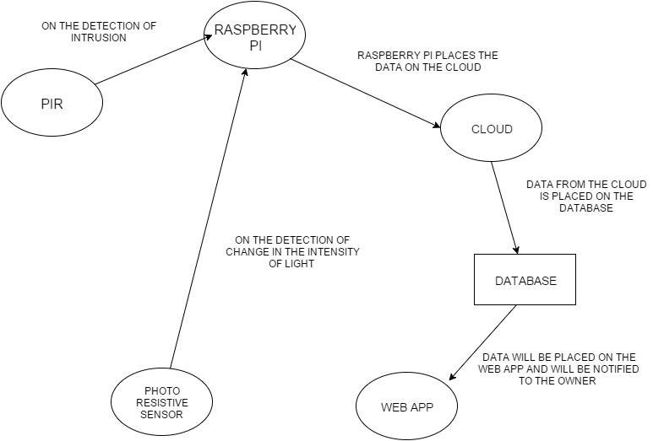
Data Flow Diagram

Slide 17
References
raspberrypi.org
learnpython.org
shakeuplearning.com
tutorialspoint.com/python/
github.com/InitialState/piot-101

Slide 18
THANK YOU

