Slide 1
LANDSLIDE DETECTION SYSTEM
A PROJECT ON IOT
BY
VISHAL KUMAR SAH 1MS12CS133
SUPRATIK SHARMA 1MS12CS118
RAKESH ROSHAN 1MS12CS088
SUMEET SEN 1MS12CS116

Slide 2
INDEX
Abstract
Description about Sensors (IOT)
Description about the SRS
Description about the Design Architecture with Class Diagram and Sequence Diagram
Project Goals
Implementation details
Results
Conclusion and Future work
Bibliography

Slide 3
ABSTRACT
This is an IOT project to detect landslides by monitoring various sensor’s data real time and uploading the data on cloud in order to alert people in case of any ongoing landslide situation or a probable landslide situation in landslide prone areas. This is a microcontroller based (using Raspberry pi soc) project which is interfaced with various sensors like vibration sensor, moisture sensor, pressure sensor and the soc is configured to connect to an existing cloud framework provided by a free and open source cloud infrastructure NIMBUS .

Slide 4
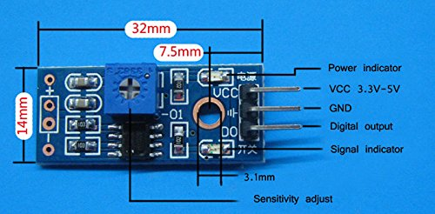
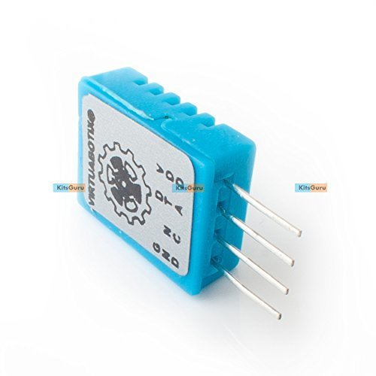
DESCRIPTION ABOUT SENSORS
There are two sensors which are used in the project.
Vibration Sensor – SW-420
Temperature /Humidity Sensor – DHT11

Slide 5
DESCRIPTION ABOUT SENSORS
VIBRATION SENSOR (SW-420)
The use of the company's production of SW-420 normally closed type vibration sensors. comparator output signal clean wave well, driving ability, 15mA
rated voltage and 3.3V-5V output: digital switching output (0 and 1) a bolt-hole for easy installation
Small Board PCB dimensions: 3.2cm x 1.4cm. using wide LM393 voltage comparator
Module description: the product when it is not shock, vibrate switch is closed on-State, output output low level, the green indicator light is on; When vibration, vibration switches disconnected moments, output output line, the Green led is not lit; the output can be directly connected to the microcontroller, by single-chip computer to detect high or low level, to detect whether there is vibration, alarm function

Slide 6
DESCRIPTION ABOUT SENSORS
VIBRATION SENSOR (SW-420)
USES:
For a variety of shocks triggering, theft alarm, smart car, an earthquake alarm, motorcycle alarm. This module when compared with normally open shock sensor module, shock triggered much longer can drive relay module

Slide 7
DESCRIPTION ABOUT SENSORS
Temperature /Humidity Sensor – DHT11
This DHT11 Temperature & Humidity Sensor features a temperature & humidity sensor complex with a calibrated digital signal output. By using the exclusive digital-signal-acquisition technique and temperature & humidity sensing technology, it ensures high reliability and excellent long-term stability.
This sensor includes a resistive-type humidity measurement component and an NTC temperature measurement component, and connects to a high-performance 8-bit microcontroller, offering excellent quality, fast response, anti-interference ability and cost-effectiveness.
Digital Output Single Wire Output Stable & long term accuracy Full range temperature compensated Relative humidity and temperature measurement Calibrated digital signal outstanding long-term stability pins packaged and fully interchangeable DHT11 output calibrated digital signal

Slide 8
DESCRIPTION ABOUT SENSORS
Temperature /Humidity Sensor – DHT11
It utilizes exclusive digital-signal-collecting-technique and humidity sensing technology, assuring its reliability and stability.
Its sensing elements are connected with 8-bit single-chip computer. Each DHT11 element is strictly calibrated in the laboratory that is extremely accurate on humidity calibration

Slide 9
DESCRIPTION ABOUT SRS
1.External Interface Requirements
User Interfaces
First page would be login page. This page will allow the user to login as manager or volunteer.
The volunteer side mobile application will consist of three buttons start, end and delivered. On pressing the start button, the information about the location of the volunteer is continuously uploaded to the cloud and this uploading will stop on pressing the stop button.
Deliver button is used to increment count of vaccinated children.
The manager side mobile application will have track and buttons. Track button is used to monitor the location of volunteer.

Slide 10
DESCRIPTION ABOUT SRS
Hardware Interfaces
Raspberry pi makes use of Raspian OS. A python code is written to collect various data from the sensors and upload it to the cloud.
The digital output generated by these sensors are uploaded into the cloud using a python code. The cloud platform used here is ‘CARRIOTS’ Deliver button is used to increment count of vaccinated children.
The physical GPS is managed by the GPS application in the mobile phone and the hardware connection to the database server is managed by the underlying operating system on the mobile phone and the web server

Slide 11
DESCRIPTION ABOUT SRS
Software Interfaces
Yousup API is installed in the Raspian OS which is used to send whatsapp message to the volunteers when abnormal conditions are found in vaccination box.
The physical location of volunteers is tracked continuously by using maps to ensure that they cover all the assigned areas.
The communication between the database and the web portal consists of operation concerning both reading and modifying the data, while the communication between the database and the mobile application consists of only reading operations.

Slide 12
DESCRIPTION ABOUT SRS
Communication Interfaces
The communication between the different parts of the system is important since they depend on each other.
Internet connection and a web browser are required in order to access the data from the cloud and analyze it.

Slide 13
DESCRIPTION ABOUT SRS
2. Functional Requirements
Functional Requirement 1.1:
ID: FR1
TITLE: Download mobile application
DESC: A user should be able to download the mobile application through either an application store or similar service on the mobile phone. The application should be free to download.
DEP: None

Slide 14
DESCRIPTION ABOUT SRS
Functional Requirement 1.2:
ID: FR2
TITLE: User log-in - Mobile application
DESC: The user should be able to log in to the mobile application. The log-in information will be stored on the phone and in the future the user should be logged in automatically. If the user logs in as administrator, he gets full access to volunteer’s location and activities
DEP: FR1

Slide 15
DESCRIPTION ABOUT SRS
Functional Requirement 1.3:
ID: FR3
TITLE: Get the sensor reading
DESC: The various data readings such as temperature (in Kelvin), light intensity (in luminous) and equilibrium (angle of rotation) inside the vaccine box are obtained using python code.
DEP: NONE

Slide 16
DESCRIPTION ABOUT SRS
Functional Requirement 1.4:
ID: FR4
TITLE: Upload the sensor reading to cloud
DESC: Sensor data reading are uploaded to cloud using python code. The cloud platform used is ‘CARRIOTS’.
DEP: FR3

Slide 17
DESCRIPTION ABOUT SRS
Functional Requirement 1.5:
ID: FR5
TITLE: Check for abnormal conditions
DESC: If temperature is not within range specified by WHO or if there is light exposure or if there is too much of shaking, the manager as well as volunteer are notified so that they can take appropriate actions to preserve the vaccines.
DEP: FR4

Slide 18
DESCRIPTION ABOUT SRS
Functional Requirement 1.6:
ID: FR6
TITLE: Send GPS coordinates to cloud
DESC: The volunteer’s mobile continuously sends GPS coordinates like longitude and latitude to cloud.
DEP: FR2

Slide 19
DESCRIPTION ABOUT SRS
Functional Requirement 1.7:
ID: FR7
TITLE: Track the volunteer
DESC: The manager side application receives the GPS coordinates from cloud and traces it to ensure that volunteers covers all the assigned areas.
DEP: FR1, FR6

Slide 20
DESCRIPTION ABOUT SRS
3. Software System Attributes
Reliability
The reliability that the system gives precise sensor reading. The cloud platform used should be reliable, secure and fast. There should be proper internet connectivity to cloud.
Availability
The system should be available all the time during vaccination program.
Security
The system should be secure enough to prevent the external attacker from entering malicious data which may affect the
Portability
The system is portable across different operating system.
Maintainability
The code written is modular, simple and easy to read. Hence the maintenance required is less. The application need not be updated frequently.

Slide 21
DESCRIPTION ABOUT SRS
4. Performance Requirements
The performance of the system depends upon the reliability and efficiency of sensors ie how fast the sensors produce readings.
It also depends upon cloud platform we choose ie higher the capacity of the cloud, higher the performance. Also we require high speed internet for instant uploading of data values.

Slide 22
DESCRIPTION ABOUT SRS
5. Database Requirement
The database should be able to store large number of readings. The database should not crash when the number of hits is high. The database should be flexible and querying should be fast.

Slide 23
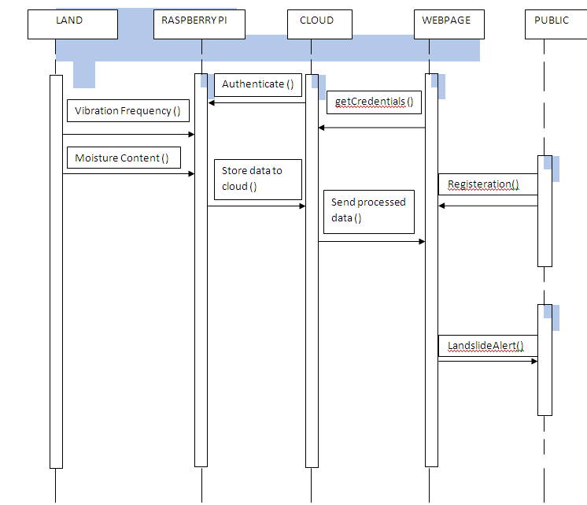
SEQUENCE DIAGRAM

Slide 24
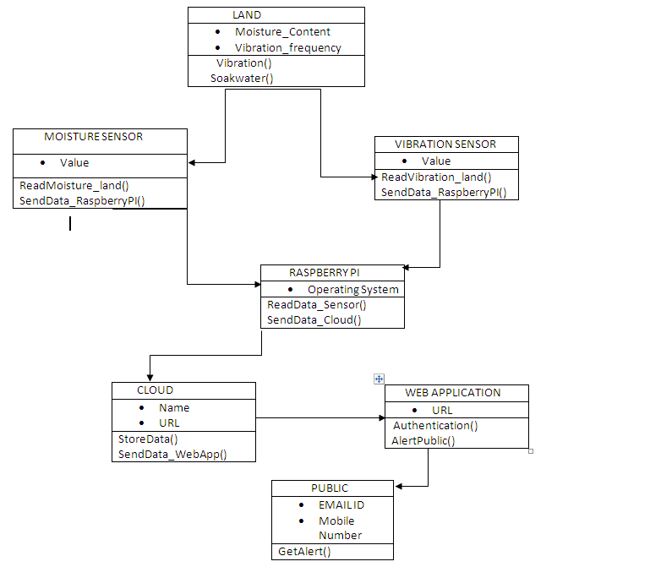
CLASS DIAGRAM

Slide 25
Goals
This project can be implemented at a larger scale by analyzing the data sets during the rainy or monsoon months of the year actively to detect landslides.
If the sets represent a probable set where a possibility of landslide is imminent, a warning can be sent immediately to the nearby location, thus preventing the public from using the danger zone areas.
A lot of lives can be saved by early warnings of landslides.

Slide 26
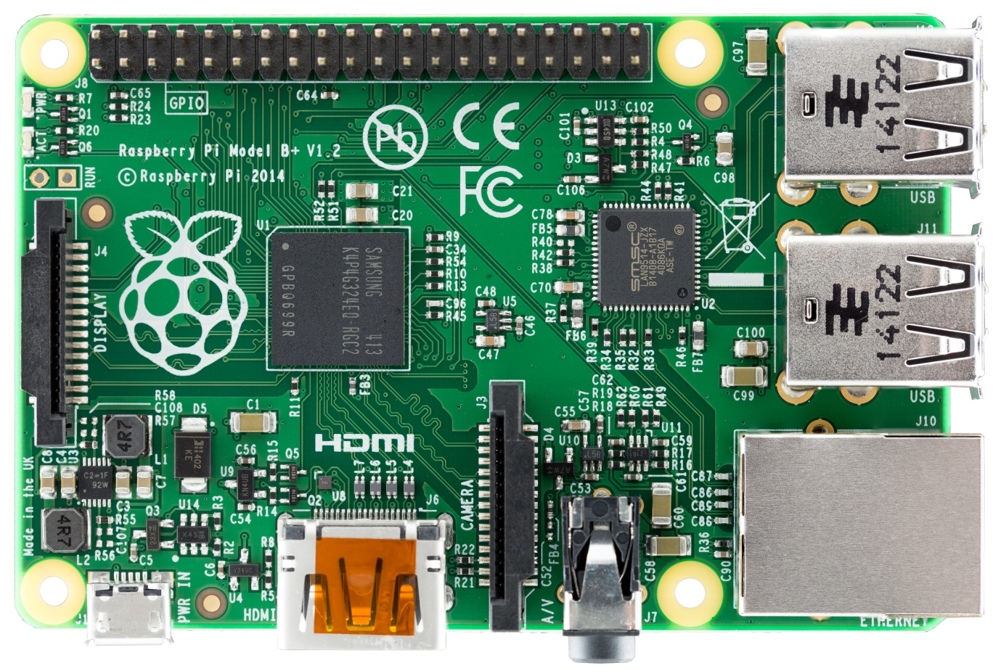
Implementation Details
Client Module - Raspberry Pi
The Raspberry Pi is a low cost, credit-card sized computer that plugs into a computer monitor or TV, and uses a standard keyboard and mouse. It is a capable little device that enables people of all ages to explore computing, and to learn how to program in languages like Scratch and Python.

Slide 27
Implementation Details
using three sensors ie. Vibration sensor , temperature sensor and moisture sensor and the data from each of the three sensors is uploaded to the cloud in real time via raspberry pi soc.
The sensors are interfaced with the soc where the analog signal collected by the sensors is converted into digitally interpretable data. This digital data is the output from the sensors which act as an input for the raspberry pi board.

Slide 28
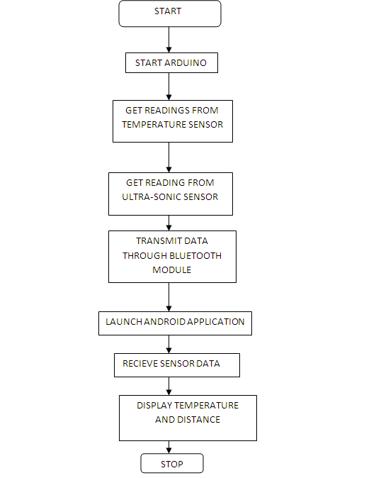
Implementation Details FLOWCHART:

Slide 29
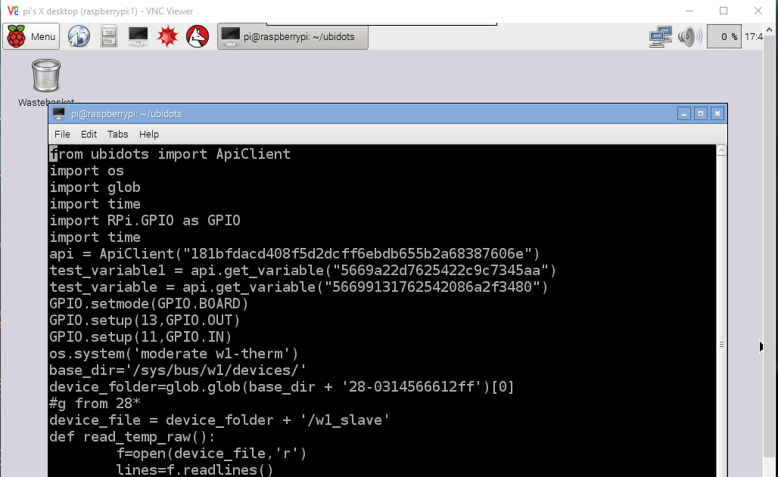
RESULTS
Python Code

Slide 30
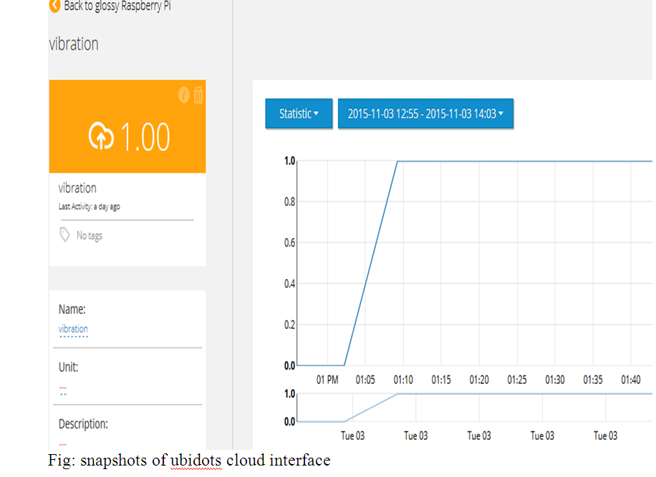
RESULTS

Slide 31
Conclusion
The report concludes in outlining four central areas where the best efforts must be put into in order to reach a reality of “Land Slide Detection”:
Increased use of sensors to increase awareness to the happenings in the field and the Landslide Detection disaster.
Gathering more data and analyzing it in advance to manage more efficiently at the time of the event.
Sharing mutual knowledge between different information systems.
Developing smart systems that help to lessen the causalities in the Landslide .

Slide 32
Bibliograpgy
[1]https://www.nedcc.org/free-resources/preservation-leaflets/3.-emergency- management/3.2-an-introduction-to-fire-detection,-alarm,-and-automatic-fire-sprinklers
[2] http://ubidots.com/
[3]http://www.govtech.com/fs/New-Era-in-Firefighting-Leverages-the-Internet-of-Things.html
[4]http://www.forbes.com/sites/federicoguerrini/2015/06/29/firefighters-and-the-internet-of-things/
[5]http://www.jbrehm.com/blog/2015/6/11/smart-fire-fighting-merging-iot-and-big-data-for-fire-safety
[6] http://www.criticallink.com/2015/07/firefighting-and-the-iot/
[7] http://www.nist.gov/el/fire_research/201506_smart_fire_roadmap.cfm
[8] IEEE Journals and papers - http://ieeexplore.ieee.org/
[9] http://blog.ubidots.com/topic/raspberry-pi

