Slide 1
Data Analytics
on
Medicare Payments
in the U.S

Slide 2
TEAM MEMEBERS
Sriram Anupindi 1MS12CS111
Suhail T N 1MS12CS115
Mayank Sharma 1MS11CS062
Ashresh 1MS11CS034

Slide 3
Project Goals
The output of this project is an interactive web application which provides users with information with regard to inpatient procedures in the U.S. The web site will display the compressed data by using tables, graphs, histograms and popular visual representations. Through this project we wish to make law makers more aware of the rising health issues in a particular state , as well as educating the public with regard to the cost of the various popular procedures.

Slide 4
PROBLEM DEFINITION
To identify relationships between the features of the data set pertaining to the provision of medical services (Hospitals) with regard to the100 most frequent discharges spread across a vast number of geographical locations in the United States of America.
The list of relationships which have been identified by us are:
State wise count of the no of cases for a particular procedure.
Average cost for a particular procedure across all hospitals in a particular state.
Classification of hospitals as high, medium and low for a particular state based on the number of discharges.

Slide 5
Data Sets

Slide 6
LIST OF ATTRIBUTES(Source.csv)
• DRG Definition - A statistical system for classifying any inpatient staY into groups for the purposes of payment.
• Provider Id - 5 digit number used to uniquely identify a particular hospital.
• Provider Name- Name of the Hospital.
• Provider Street Address - The local address of the Hospital.
• Provider City - The city where the Hospital is located.
• Provider State - The state to which the Hospital is located in.
• Provider Zip Code - 5 digit region Code
• Hospital Referral Region Description - A Hospital Referral Region (HRR) is a regional health care market for specialized consultative care, where caring for the patient requires the services of a major referral center.

Slide 7
• Total Discharges - The number of discharges billed by the provider for inpatient hospital services.
• Average Covered Charges - The provider's average charge for services covered by Medicare for all discharges in the DRG
• Average Total Payments: The average total payments to all providers for the MS-DRG including the MSDRG amount, teaching, disproportionate share, capital, and outlier payments for all cases.
• Average Medicare Payments: The average amount that Medicare pays to the provider for Medicare's share of the MS-DRG.
Total Number of Records = 163066
Total Number of Features per Record = 12

Slide 8
LIST OF ATTRIBUTES(Avg.csv)
• DRG Definition - A statistical system for classifying any inpatient staY into groups for the purposes of payment.
• Provider State - The state to which the Hospital is located in.
• Average Cost Paid by Patient- This is calculated as the numerical difference between Average Total Payments and the Average Medicare Payments.
Total Number of Records = 138924
Total Number of Features=3

Slide 9
LIST OF ATTRIBUTES
(countwise.csv)
• DRG Definition - A statistical system for classifying any inpatient staY into groups for the purposes of payment.
• Provider State - The state to which the Hospital is located in.
•Total Discharges - The number of discharges billed by the provider for inpatient hospital services.
Total Number of Records = 134816
Total Number of Features=3

Slide 10
LIST OF ATTRIBUTES
(countwise.csv)
• DRG Definition - A statistical system for classifying any inpatient staY into groups for the purposes of payment.
• Provider State - The state to which the Hospital is located in.
•Total Discharges - The number of discharges billed by the provider for inpatient hospital services.
Total Number of Records = 134816
Total Number of Features=3

Slide 11
Description of SRS
The project requirements are classified into the following subcategories-
External Interface Requirements – Specifies the hardware and software requirements to run the project such as Linux OS, Java environment etc.
Functional Requirements – Used to define the specific behavior or function of the various modules and components in the project. Here we explain how Map Reduce ,Octave and the other components constitute the given system.
Software System Attributes- These define the potential attributes and qualities the software should posses such as reliability, availability, security etc.
Performance Requirements – The ideal performance parameters which a system needs to satisfy such as robustness and efficiency.

Slide 12
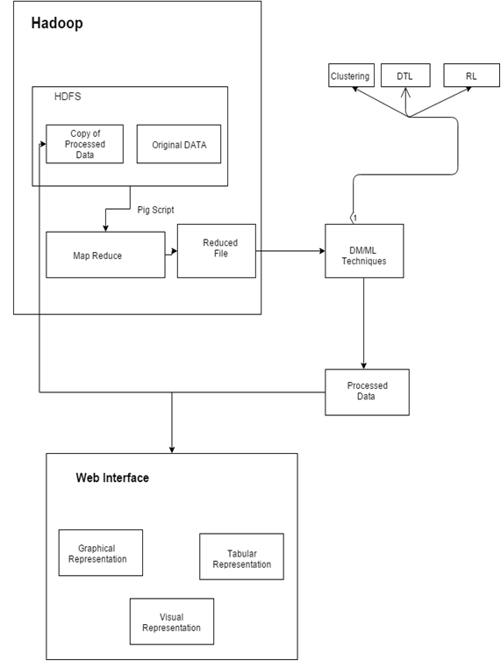
Architecture Diagram

Slide 13
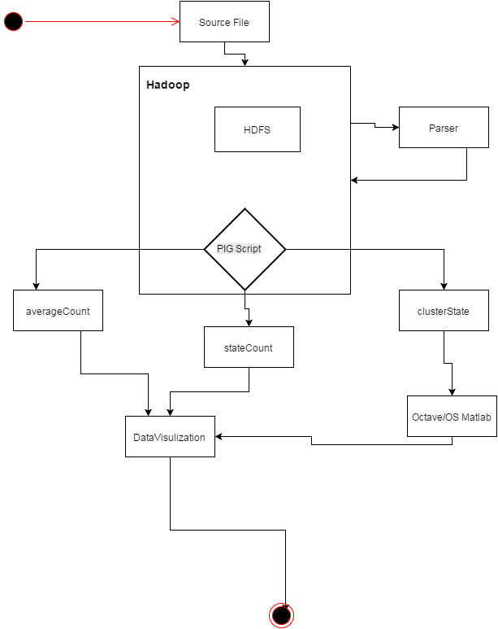
Flow Diagram

Slide 14
IMPLEMENTATION

Slide 15
RESULTS

Slide 16
Future Scope
The Future Scope of the project is:
The future scope of this project is to include more data sets covering fiscal years post 2011; this will expand the analytical reach of the data as predictive algorithms can be applied.
Another major area for growth is to implement the analytical model in the Indian demographic to investigate central and state government health schemes such as CGHS, Rajiv Arogya Bhagya respectively.

Slide 17
Conclusion
After successfully implementing the above project we arrive at a conclusion, data analytics on Medicare payments is a fruitful analytical endeavor. During the analysis we observed noticeable variations in the number of cases as well as average payment made by patients for a particular procedure across different states. These variations benefit policy makers and citizens and improve the quality of their decisions. The clustering of Hospitals in a particular state based on the number of discharges helps officials into classifying them as high, medium and low priority hospitals.

Slide 18
THANK YOU

