Slide 1
SENTIMENT ANALYSIS FOR MOVIE REVIEWS
By:
Kush Bavishi 1ms12cs049
Udhav Chandel 1ms12cs123
Devayani Urs 1ms12cs064
Pallavi Hemmige 1ms12cs071

Slide 2
Introduction
Sentiment analysis is becoming a popular area of research and social media analysis, especially around user reviews and tweets. It is a special case of text mining and while it’s often not very accurate, it can still be useful. Here we focus on 5 possible sentiment classifications which we will deal with later.

Slide 3
Project Goals
The aims are:
To construct a database of reviews(words/phrases) on the keywords
Machine learning techniques which are based on a training set and will determine the sentimental value of the sentence/word/phrases.
To provide a sentimental value after thorough analysis of the movie review data set which can help an individual choose a movie.

Slide 4
Example:
If a movie review has words such as “witty” and “funny” then it implies that the sentiment is POSITIVE
However if it has words like “neither funny nor witty” or “horrible” then it implies that the sentiment it NEGATIVE

Slide 5
Supervised learning
Input data is called training data and has a known label or result such as spam/not-spam or a stock price at a time.
A model is prepared through a training process where it is required to make predictions and is corrected when those predictions are wrong. The training process continues until the model achieves a desired level of accuracy on the training data.

Slide 6
Details of the Requirements in brief
Hadoop framework : Apache Hadoop is an open-source software framework written in Java for distributed storage and distributed processing of very large data sets on computer clusters built from commodity hardware. All the modules in Hadoop are designed with a fundamental assumption that hardware failures (of individual machines, or racks of machines) are commonplace and thus should be automatically handled in software by the framework

Slide 7
Java: (Sun Java 7): Java is a set of computer software and specifications developed by Sun Microsystems, later acquired by Oracle Corporation, that provides a system for developing application software and deploying it in a cross-platform computing environment.
Data sets ( test & train data sets): Test data is data which has been specifically identified for use in tests, typically of a computer program. Some data may be used in a confirmatory way, typically to verify that a given set of input to a given function produces some expected result. Training data is the data on which the machine learning programs learn to perform correlational tasks (classify, cluster, learn the attributes, et al).

Slide 8
MySQL: is an open-source relational database management system.
Xampp server: is a free and open source cross-platform web server solution stack package developed by Apache Friends, consisting mainly of the Apache HTTP Server, MySQL database, and interpreters for scripts written in the PHP and Perl programming languages.
Ubuntu Operating System: Ubuntu Linux operating system and distribution, with Unity as its default desktop environment for personal computers including smart phones in later versions.
SAP Lumira: SAP Lumira (formerly called SAP Visual Intelligence) is a self-service, data visualization application for business users.

Slide 9
Description of data set
ATTRIBUTES:
Phrase ID
Sentence Number
Phrase
Sentiment value: It has 5 values. They are:
-negative=0
-somewhat negative=1
-neutral=2
-somewhat positive=3
-positive=4

Slide 10
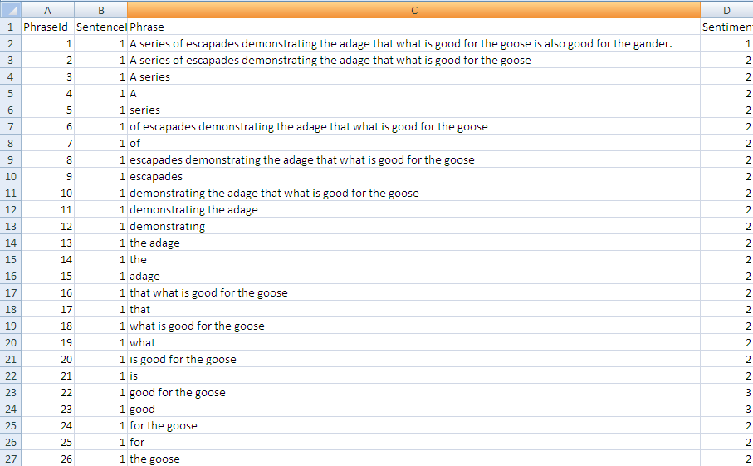
Train Data set

Slide 11
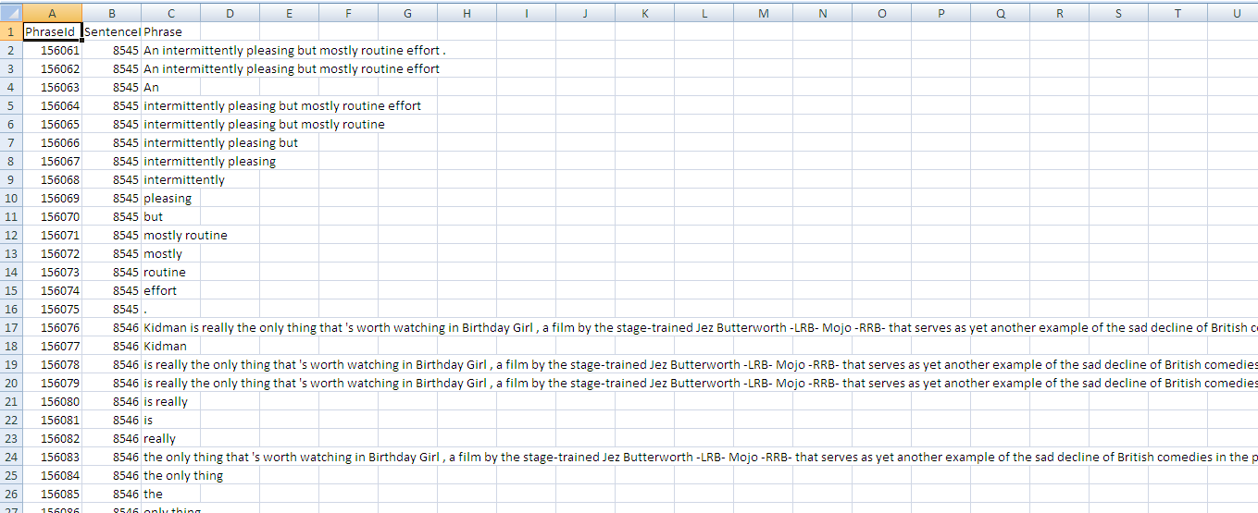
Test Data set

Slide 12
Algorithms used…
Naïve bayes: Popular method for text categorization, the problem of judging documents as belonging to one category or the other (such as spam or legitimate, sports or politics, etc.) with word frequencies as the features. Naive Bayes is a simple technique for constructing classifiers: models that assign class labels to problem instances, represented as vectors of feature values, where the class labels are drawn from some finite set. All naive Bayes classifiers assume that the value of a particular feature is independent of the value of any other feature, given the class variable
Bag of words: The bag-of-words model is commonly used in methods of document classification, where the (frequency of) occurrence of each word is used as a feature for training a classifier.
Ngram: n-gram is a contiguous sequence of n items from a given sequence of text or speech. The n-grams typically are collected from a text or speech.

Slide 13
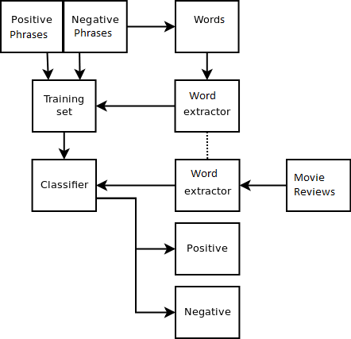
Flow Diagram

Slide 14
SRS
A software requirements specification (SRS) is a description of a software system to be developed, laying out functional and non-functional requirements, and may include a set of use cases that describe interactions the users will have with the software.

Slide 15
The contents of our SRS are:
External Interface Requirements
User Interfaces
Hardware Interfaces
Software Interfaces
Communication Interfaces
Functional Requirements
Functional Requirement
Functional Requirement
Software System Attributes
Reliability
Availability
Security
Portability
Maintainability
Performance
Performance Requirements
Database Requirement
Design Constraints
Other Requirements

Slide 16
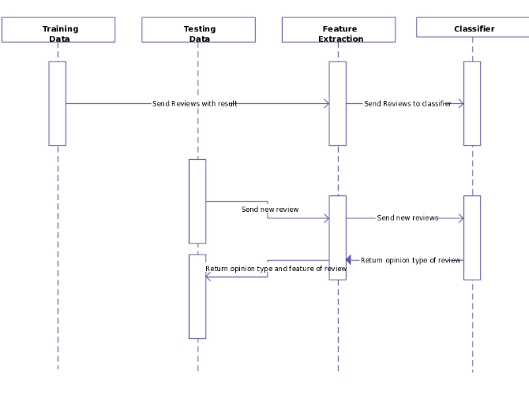
Description of the Design
Sequence Diagram

Slide 17
For training data, we initially extract the fields we require.
Our next step is to store the values into the MySQL database.
We then extract the the fields of the test dataset.
Our next job is to run the machine learning concepts.
We finally provide an analysis of the different sentiment values and a final sentiment value for the dataset.

Slide 18
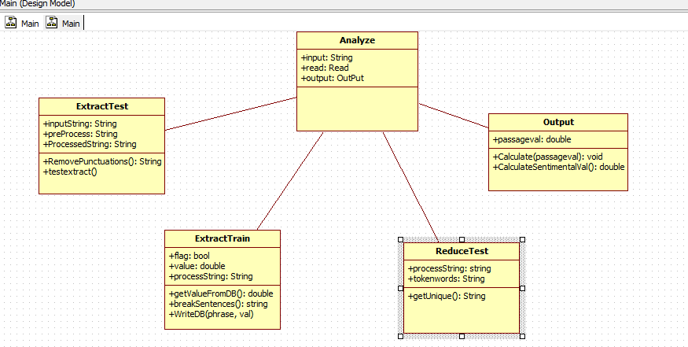
Class Diagram

Slide 19
Extract Test: From the test dataset that we have obtained from rotten tomatoes, we extract the required the fields from the test data test.
Extract Train: From the train dataset that we have obtained from rotten tomatoes, we extract the required the fields from the train data test and we store it in the MySQL database.
Analyze: After the extraction of data we analyze the test data using the train data and obtain the sentiment values.
Reduce Test: This step is performed to eliminate redundancy in the data obtained, by using MapReduce algorithm on Hadoop.
Output: The result is the sentiment values obtained and it’s classification five categories.

Slide 20
Implementation details
The steps under the process of implentation:
Extract the phrases from the test data: Our test data has several extra columns from which we are extracting the required data and writing it onto a file. N-Grams algorithm is used for this process.
Map-reduce operations performed on the test data: Our test data will be reduced by implementing the map-reduce operation on phrases using Hadoop to give us the count of non-unique phrases.(phrase count)
Putting Train data into the database: The data that is in the data set is transferred or put in to the mySQL database with the help of a java code or java program.
Calculating the sentimental value: Finally, the sentiment value is calculated for the particular movie review and hence the sentiment analysis is available to the user. This is done by using string matching algorithm.

Slide 21
Result
The result is the sentiment values obtained and it’s
classification into five categories, where the five categories are:
-negative
-somewhat negative
-neutral
-somewhat positive
-positive

Slide 22
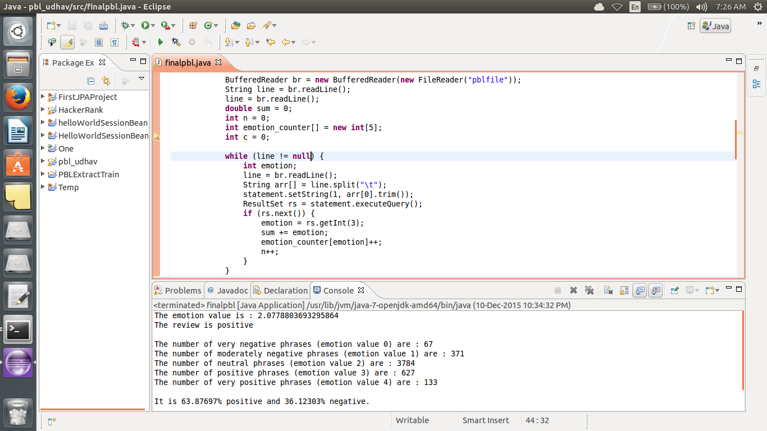
Output

Slide 23
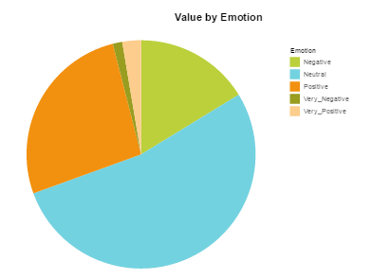
Visualization using SAP Lumira

Slide 24
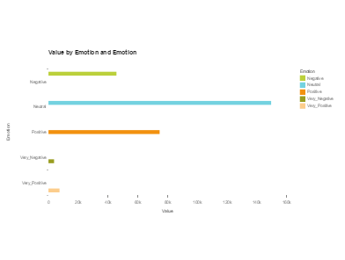
Visualization using sap lumira

Slide 25
Future work
Of course, by improving it, our approach would perform even better. The first improvement would be expanding the current training dataset. The next would be auto correcting the misspelt words. The same applies to using synonyms if words the model knows and understands as part of a class are not found inside the tweet content. An interesting area of the future work would also be profiling the users based on their opinions.

Slide 26
conclusion
Having applied all the above steps, we manually cross-checked the results for many reviews. We found that our Sentiment Analysis system was accurate in most of the cases. So the precision of the system stands pretty accurate.

Slide 27
Bibliography
http://www.cisco.com/web/offer/email/43468/5/Cloud_Computing_in_Higher_Education.pdf : Cloud Computing in Higher Education: A Guide to Evaluation and Adoption
http://edcetera.rafter.com/5-ways-students-can-use-cloud-computing-to-amp-up-their-learning/
Mell, P., & Grance, T. (2009, 7 10). The NIST Definition of Cloud Computing http://www.nist.gov/itl/cloud/upload/cloud-def-v15.pdf
http://hortonworks.com/hadoop-tutorial/how-to-refine-and-visualize-sentiment-data/

Slide 28
THANK YOU

