Slide 1
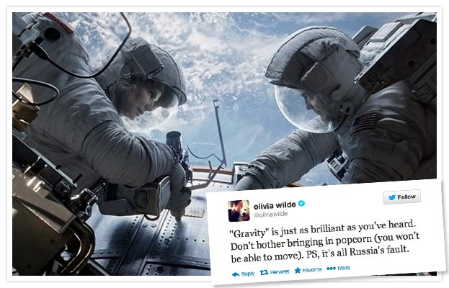
PREDICTION OF MOVIE SUCCESS USING SENTIMENT ANALYSIS OF TWEETS

Slide 2

INTRODUCTION
twitter.com is a popular microblogging website.
Each tweet is 140 characters in length , known as “tweets”.
Tweets contain rich information about people’s preferences.
People share their thoughts about movies using Twitter.
The challenge is to gather all the relevant data , detect and summarize the overall sentiment to predict the success of a movie.

Slide 3

PROBLEM STATEMENT
To provide a Sentiment analysis system for movies, review classification, that may be helpful to analyze the information in the form of the number of tweets where opinions are highly unstructured and are either positive or negative.

Slide 4

PROJECT GOALS
Data Collection: existing twitter data set
To implement an algorithm for automatic classification of text into positive, negative or neutral.
Sentiment Analysis: train a classifier to classify the tweets as: positive, negative and neutral.
Graphical representation of the sentiment .

Slide 5
DATA SET
Sentiment data is unstructured data that represents opinions, emotions, and attitudes contained in sources such as social media posts, blogs, online product reviews, and customer support interactions.
For this project we are streaming twitter data using twitter API.
We have created 2 data dictionaries one for positive data and another for negetive data.

Slide 6

REQUIREMENTS
Windows Operating System
Knowledge of R programming
language
Twitter API
Mdern Web Browser
HTML, CSS, JavaScript

Slide 7
DESIGN
“Natural Language Processing” for text mining.
Text mining is one of the application of NLP.
“tm” package of R is used for text mining.
To Assign a numeric score to each tweet we’ll simply subtract the number of occurances of negetive words from number of positive.
Large negetive score will correspond to more negetive expression.

Slide 8
CONTD..
Neutral(or balanced) tweets should net to zero.
Very positive tweets should score larger

Slide 9
Code snippet
score.sentiment = function(sentences, pos.words, neg.words, .progress='none')
{
require(plyr)
require(stringr)
# we got a vector of sentences. plyr will handle a list
# or a vector as an "l" for us
# we want a simple array ("a") of scores back, so we use
# "l" + "a" + "ply" = "laply":

Slide 10
CONTD..
scores = laply(sentences, function(sentence, pos.words, neg.words) {
# clean up sentences with R's regex-driven global substitute, gsub():
sentence = gsub('[[:punct:]]', '', sentence)
sentence = gsub('[[:cntrl:]]', '', sentence)
sentence = gsub('\\d+', '', sentence)
# and convert to lower case:
sentence = tolower(sentence)
# split into words. str_split is in the stringr package

Slide 11
CONTD…
word.list = str_split(sentence, '\\s+')
# sometimes a list() is one level of hierarchy too much
words = unlist(word.list)
# compare our words to the dictionaries of positive & negative terms
pos.matches = match(words, pos.words)
neg.matches = match(words, neg.words)
# match() returns the position of the matched term or NA
# we just want a TRUE/FALSE:

Slide 12
CONTD…
pos.matches = !is.na(pos.matches)
neg.matches = !is.na(neg.matches)
# and conveniently enough, TRUE/FALSE will be treated as 1/0 by sum():
score = sum(pos.matches) - sum(neg.matches)
return(score)
}, pos.words, neg.words, .progress=.progress )
scores.df = data.frame(score=scores, text=sentences)
return(scores.df)
}

Slide 13
SRS
Hardware
The application is intended to be a stand-alone, single-user system. The application will run on Ubuntu operating system.
Software Interfaces
Inputs
User interface and twitter API
Output: graph
OS :Ubuntu
User interfaces include :user input and output (topic mood graph)

Slide 14
SRS cont..
Functional requirements include:
Retrieving input ,real time processing , sentiment analysis and output.
Performance Requirements:
Real-Time
The software will provide up-to-date information, limited only by the rate of Twitter input. The gauge output should display the latest results at all times
Software System Attributes
Reliability:
The software will meet all of the functional requirements without any unexpected behavior.

Slide 15
SRS cont..
Availability:
The software will be available at all times on the OS, as long as the device is in proper working order. If those services are unavailable, the user should be alerted.
Security:
The software should never disclose any personal information of Twitter users, and should collect no personal information from its own users
Maintainability:
The software should be written clearly and concisely. The code will be well documented. Particular care will be taken to design the software modularly to ensure that maintenance is easy.
Portable : works on Ubuntu

Slide 16
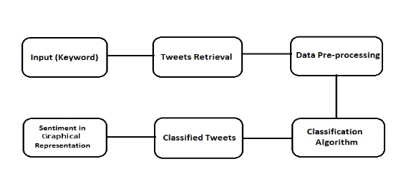
CLASS DIAGRAM

Slide 17
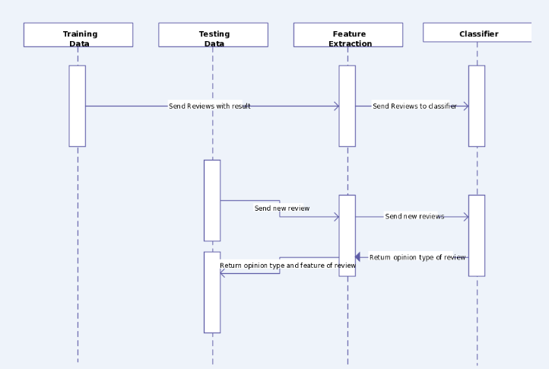
SEQUENCE DIAGRAM

Slide 18
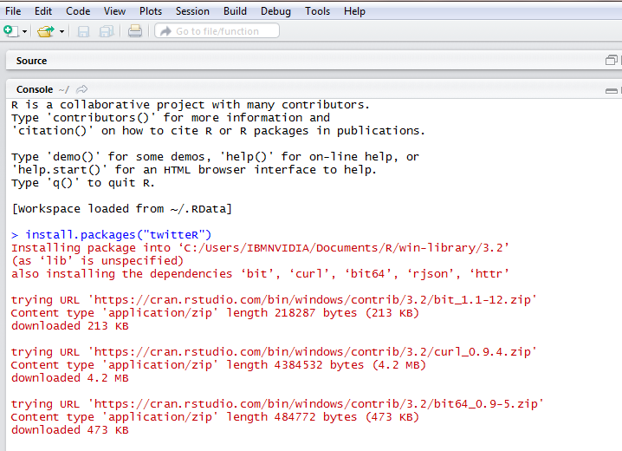
IMPLEMENTATION
Installing all necessary packages

Slide 19
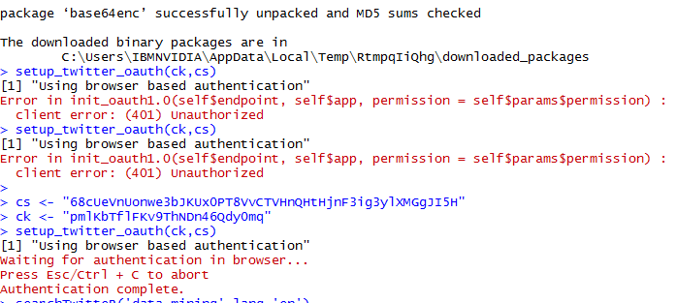
Authenticating Twitter API

Slide 20
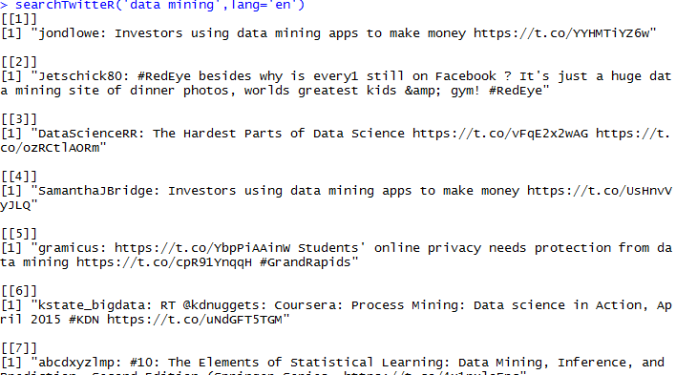
Tweets Extraction

Slide 21
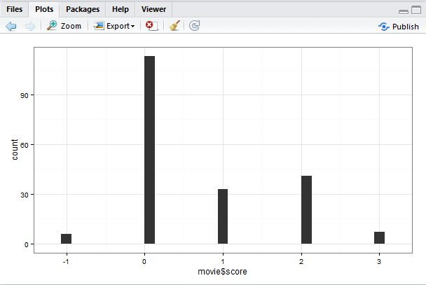
RESULT

Slide 22
CONCLUSION
We did some preliminary study in using sentiment analysis to predict a movie’s box office success. The results show that the box office success can be predicted by analyzing sentiment of the movies with simple metrics and pretty good accuracy.
THANKYOU!!

