Slide 1
Large Scale Classification of Multilabel Documents
Animesh R
Arvind Hudli
Darshan Dorai
Dhiresh Jain

Slide 2
Project Goals
Given a document and its term frequencies, we need to predict the labels to which the document belongs.
To minimize the computation load on the client machine.
To improve the prediction accuracies of the prediction model.
To reduce the time taken for prediction.

Slide 3
Dataset Description
24 lakh documents and 3.5 lakh categories.
Documents can have multiple categories.
Description of term frequencies for each document is provided.
Documents have been scraped from Wikipedia.
Given a document and its term frequencies, we need to predict to which categories the document belongs.

Slide 4
Dataset Description (cont.)
The format of each data file follows the libSVM format.
Each line corresponds to a sparse document vector and has the following format:
label, label, label …. feat:value, feat:value.
Label is an integer and corresponds to the category to which the document vector belongs
The pair feat:value coresponds to a non-zero feature with index feat and value value
Feat refers to the ID of the term
Value refers to the term frequency of the term in the document
Example : 74 126 34 905:2 11143:7 87645:8

Slide 5
SRS Description
User Interfaces: - User provides the input CSV file for the python based application. The result is then flushed locally to the disk as a text file. The user runs the python program from the terminal.
Hardware Interfaces
Minimum Requirements: 4GB RAM/20GB Hard disk/i3 processor.
Recommended Requirements: 8GB RAM/40GB Hard Disk/ i7 processor.
Software Interfaces: The software is executed by running the python program on the terminal. Several python modules like Pandas, Scipy, numpy, pyCuda are needed on the client’s local machine.
Communication Interfaces:
Input to program – CSV file containing details of the documents, terms and their corresponding categories.
Output of program – The categories of the respective documents is flushed to the local disk in the form of a text file in the recommended format.

Slide 6
SRS Description – Software System Attributes
Reliability – The application’s reliability depends on the accuracy of its predictions. The predictions can be drastically improved by providing a larger training set in the CSV file.
Availability – The program is available 24x7.
Security – Since our program does not interact with any entity over the internet, it is highly secure. All the computations are performed locally on the machine.
Portability – The software is fairly portable The client must install a few python dependencies on his/her local machine before running our application.
Maintainability – The software has minimum maintenance requirements since it is a prediction based software.
Performance – The performance directly depends on the RAM available on the local machine. This is because large computations are performed in memory in our software.

Slide 7
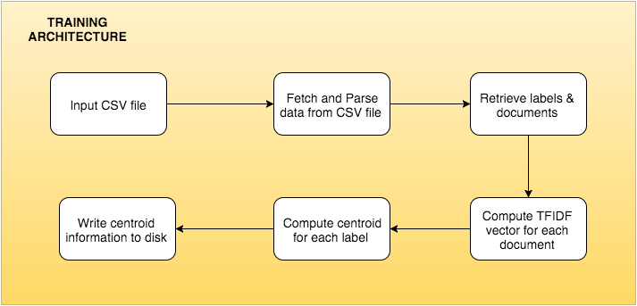
Architecture

Slide 8
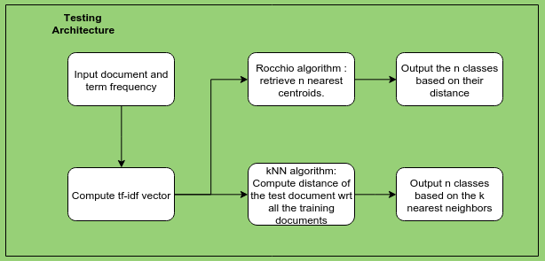
Architecture

Slide 9
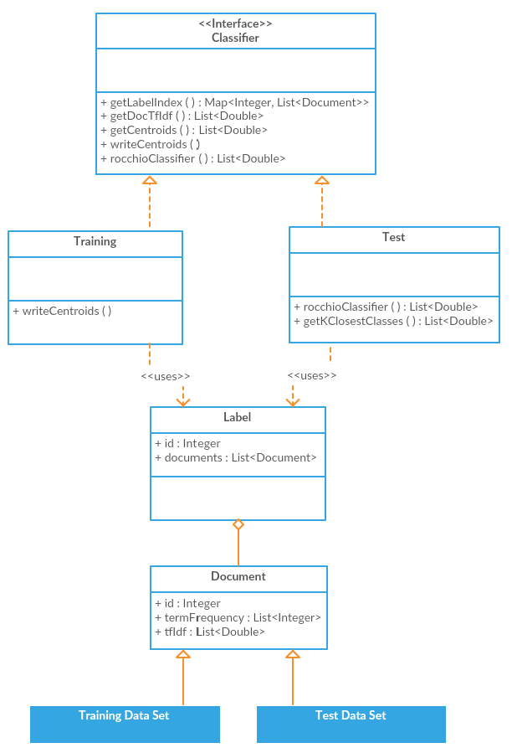
Class Diagram

Slide 10
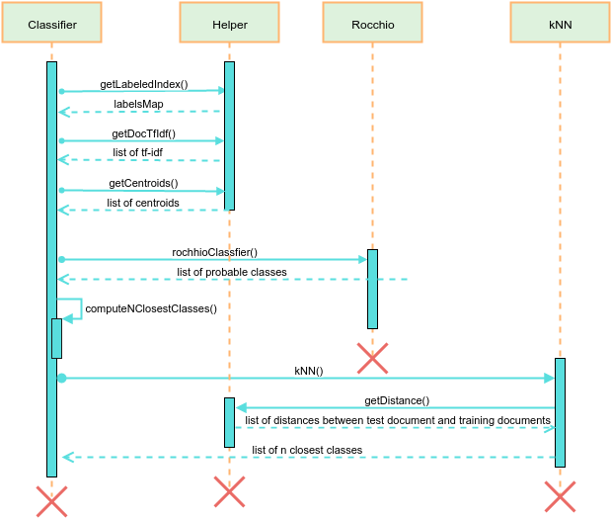
Sequence Diagram

Slide 11
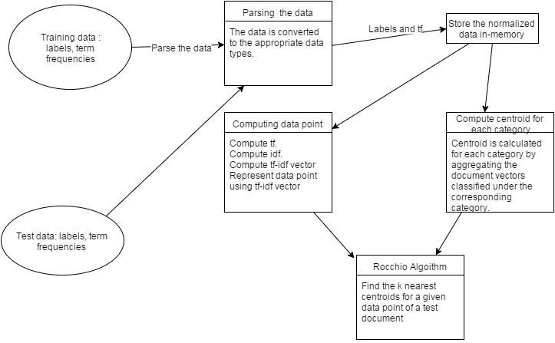
Data Flow Diagram

Slide 12
Implementation
Fetching of data
Parsing of data
Compute term frequency
Compute inverse document frequency
Compute tf and idf
Compute tf-idf vector for each document
Compute centroid for each category.
Compute k nearest centroids for a given tf-idf vector
Validate the predicted classification

Slide 13
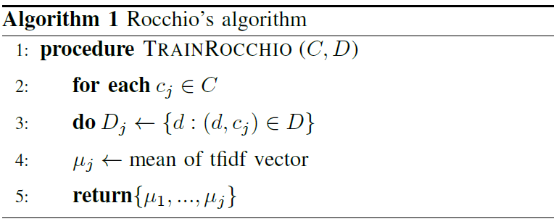
Algorithms Used
Rocchio Algorithm

Slide 14
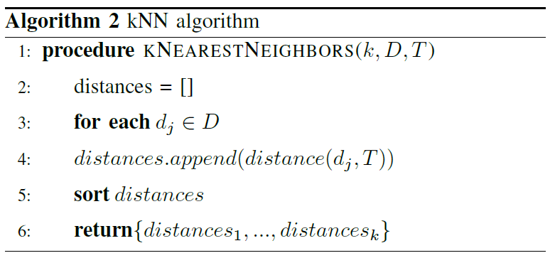
kNN Algorithm

Slide 15
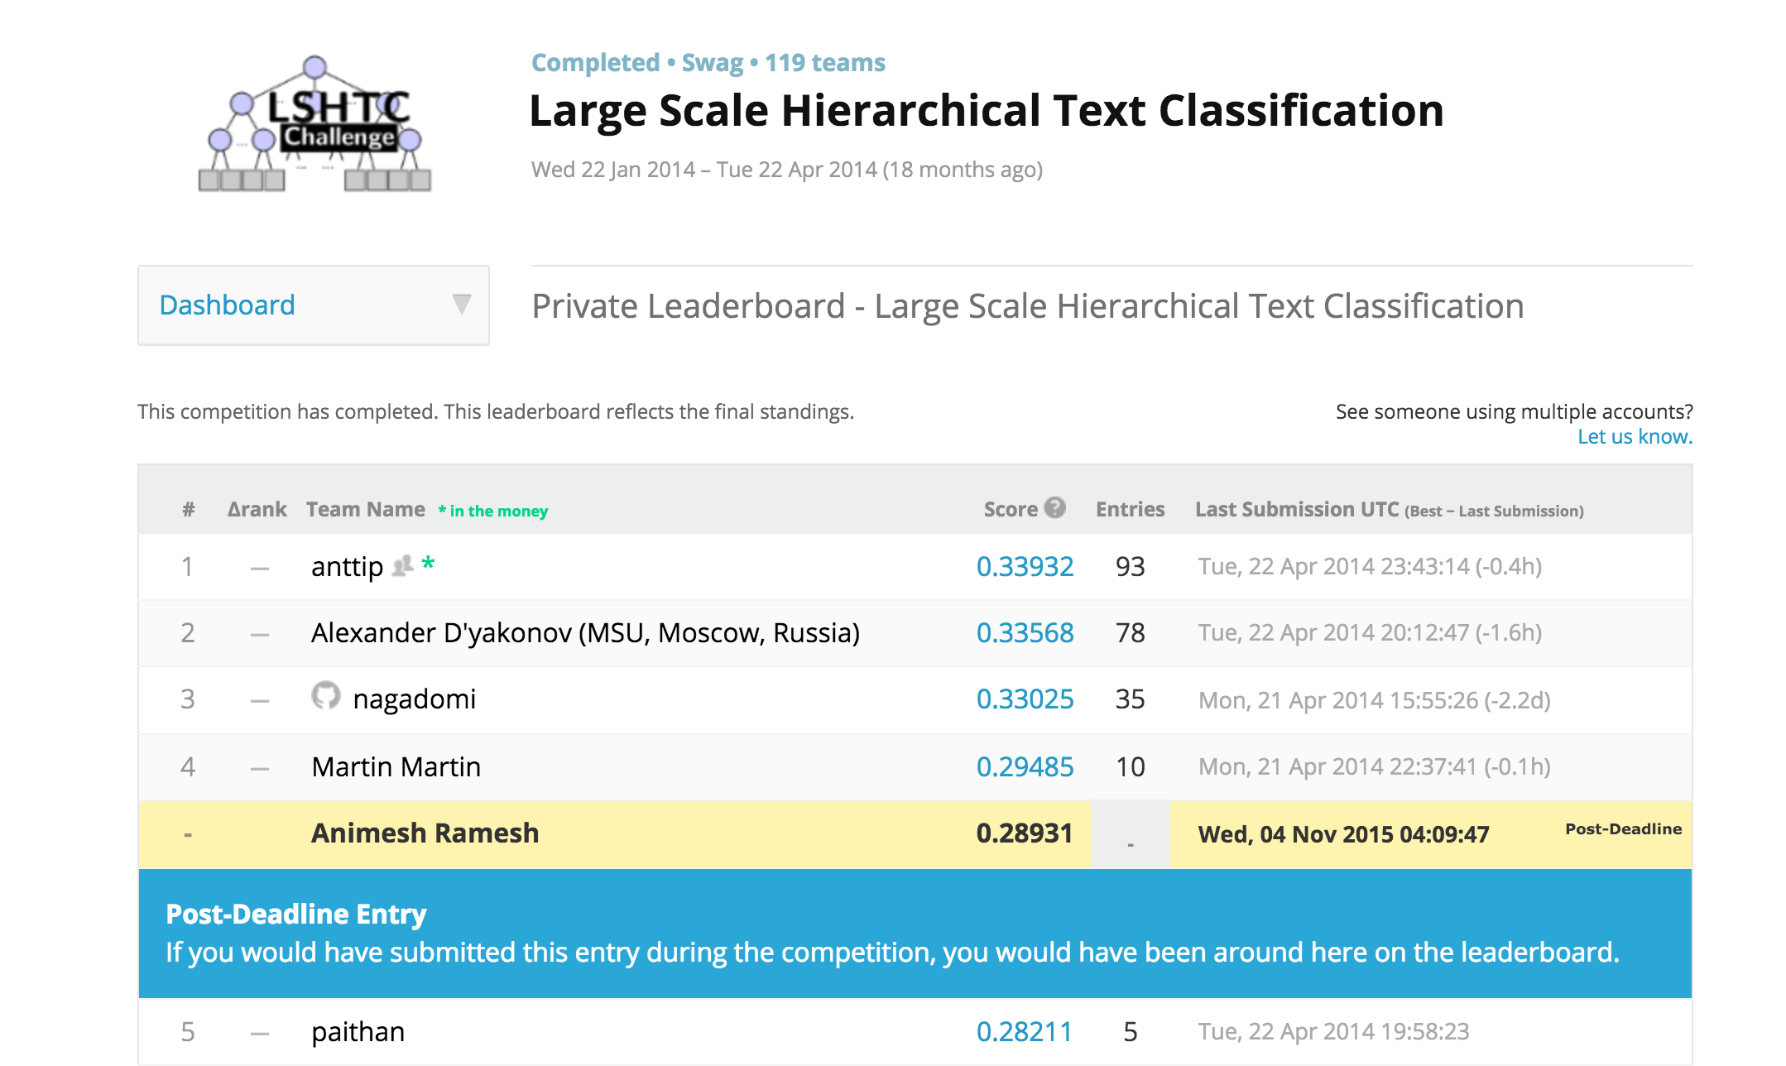
Results
The score received by this framework was 0.28931 for the Rocchio based approach and 0.23088 for the kNN approach. As it was elaborated earlier, kNN is computationally more intensive as compared to Rocchio's algorithm. The Rocchio based approach was ranked 5 of 150 on the Kaggle leaderboard.

Slide 16
Conclusion
Vspace based architecture to predict the labels of a given document.
Compared Rocchio's and kNN algorithm and elaborated why Rocchio's algorithm is more efficient and accurate than kNN.
Regardless of the primitive nature of these methods, its drawbacks are negligible considering the massive scale of the dataset.
The computational potential in the CUDA based Nvidia GPUs have also been exploited in order to compute the distances between the high dimensional vectors.

Slide 17
Future Work
More research on unsupervised learning in multilabel text classification.
Methods which involve complex syntax and semantics have proven to be less accurate as compared to the naive approaches.
Research could be on improving the existing algorithms which utilize the syntax and semantics of text.

Slide 18
Bibliography
Kaggle LSHTC Challenge, http://kaggle.com/c/lshtc
Krzysztof Sopyła, Paweł Drozda, Przemysław Górecki. SVM with CUDA Accelerated Kernels for Big Sparse Problems. 2012
V. Vaitheeshwaran, Kapil Kumar Nagwanshi, T. V. Rao. Multicore Processing for Classification and Clustering Algorithms, 2012.
Basu, T. Effective Text Classification by a Supervised Feature Selection Approach 2012
A Sun et. al. Short text classification using very few words. 2012
CH Wan, LH Lee, R Rajkumar, D Isa - Expert Systems with Applications. A hybrid text classification approach with low dependency on parameter by integrating K-nearest neighbor and support vector machine. 2012

Slide 19
Thank You

