Slide 1
Sentiment Analysis: Amazon Product (Movie) Review
Bharath Kumar S - 1MS12CS018
Ganapati R Hegde - 1MS12CS032
Jivitesh Mopuri - 1MS12CS042
Keshava R - 1MS12CS045

Slide 2
CONTENTS
Project Goals
Description about the Data Sets
Description about the SRS
Description about the Design Architecture with Class Diagram and Sequence Diagram
Implementation details
Results
Conclusion and Future work
Bibliography

Slide 3
PROJECT GOALS
Movies have become the major part of the entertainment industry
The movies are always criticised or praised in the social media.
The goal of this project is to find out which movie is criticised or praised through the reviews in the major site like Amazon.
Also we evaluate and propose the best or the worst movie to watch based on the review.

Slide 4
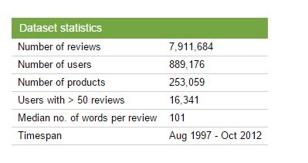
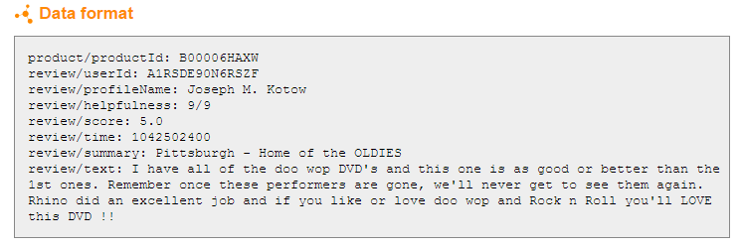
DESCRIPTION ABOUT THE DATA SETS
The data statistics:
Over 8 million nodes

Slide 5
DESCRIPTION ABOUT THE SRS
The SRS document enlists enough and necessary requirements that are required for the project development or analysis.
SRS helps in better understanding of the project by specifying the functional requirements, software system attributes etc.
It minimizes the time and effort required to analyse the data as the requirement are specified.
It also specifies system and hardware requirements.

Slide 6
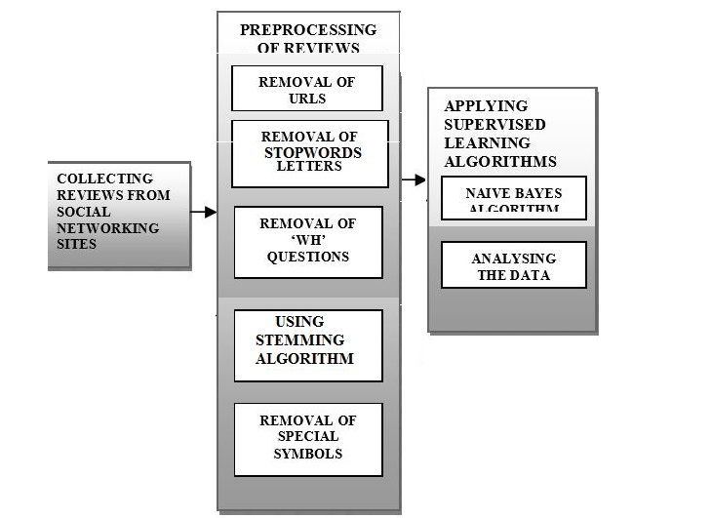
DESIGN ARCHITECTURE

Slide 7
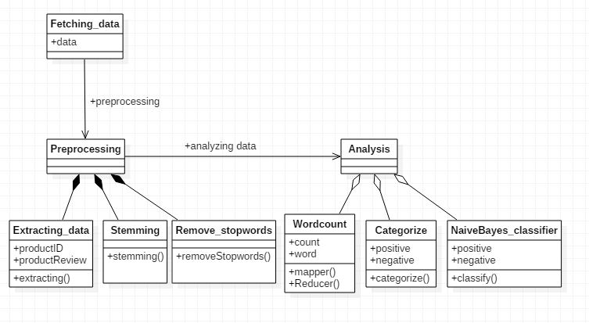
CLASS DIAGRAM

Slide 8
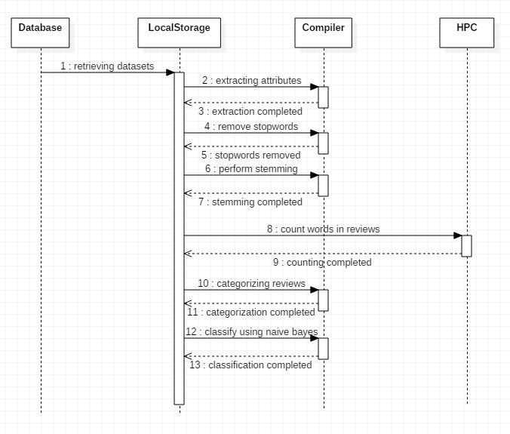
SEQUENCE DIAGRAM

Slide 9
IMPLEMENTATION DETAILS
Tools used:Hadoop,hive,eclipse
There are 4 modules used in this project for the analysis
Module for retrieving the datasets
Module for preprocessing the data
Sentiment analysis module
Filtering or classification module
Algorithm used:stemmers,naïve bayes

Slide 10
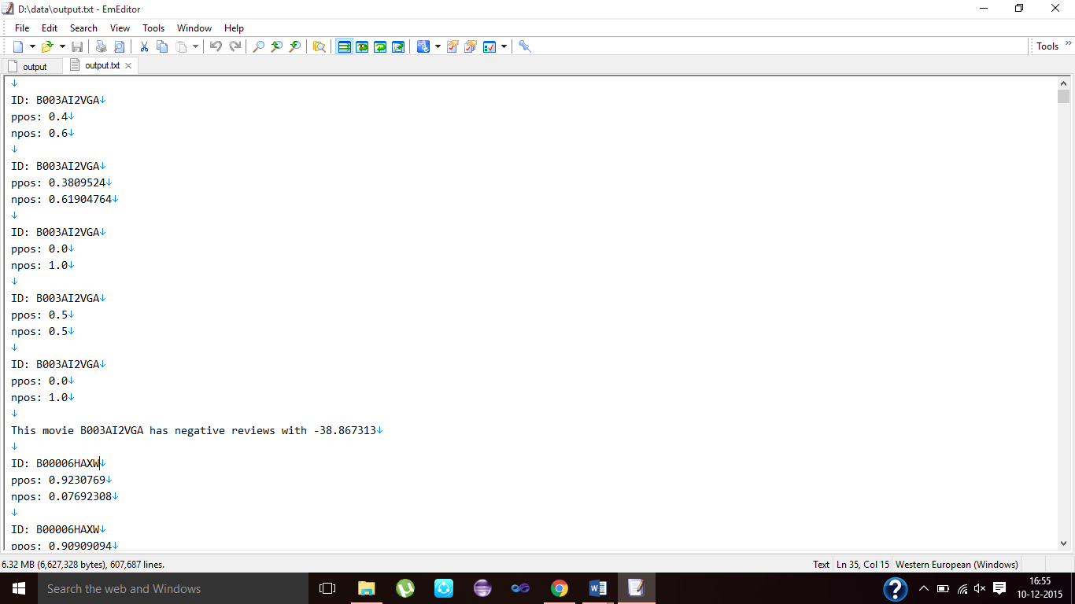
RESULTS

Slide 11
CONCLUSION AND FUTURE WORK
Our basis of the project is roughly based on the above techniques discussed to build a custom database of these movie reviews with the score on the positive and negative scale. So, that the user community can have these somewhat processed raw data for this dataset to be expanded to produce different products in this topic.
The scope of this project aims to satisfy the user community to make their own analysis of this classified data and also can be used for further research topic.
Creating more and new path of exploration in the field of entertainment in this case movies. This expands the horizons of these current fields which were not possible before this.

Slide 12
BIBLIOGRAPHY
https://snap.stanford.edu/data/
https://en.wikipedia.org/wiki/Sentiment_analysis
http://www.bogotobogo.com/Hadoop/BigData_hadoop_Install_on_ubuntu_single_node_cluster.php
https://Hadoop.apache.org/
https://hive.apache.org

Slide 13


