Slide 1
M.S. Ramaiah Institute of Technology, Bangalore Department of Computer Science and Engineering CSPE734: Project based Learning – Internet of Things Energy and Human Resource Management
Project Team Members:
Tejas d. hasarali (1ms12cs120)
Vikas h. (1ms12cs129)

Slide 2
Problem statement
Energy and Human Resources are not efficiently managed in most organizations thusly, our project aims at managing these resources by making energy consuming equipment automated and delineated human resource monitoring.

Slide 3
System on Chip Features:
The Raspberry Pi 2 Model B is the second generation Raspberry Pi having Broadcom BCM2836 Arm7 Quad Core Processor powered Single Board Computer running at 900MHz with 1GB of RAM and it has
40 pin extended GPIO
4 x USB 2 ports
4 pole Stereo output and Composite video port
Hi Definition 1080p HDMI port for video output
Micro SD port for loading the operating system and storing data
10/100 Ethernet Port for connecting the Raspberry Pi to the Internet
Camera Interface (CSI) port for connecting the Raspberry Pi camera
Display Interface (DSI) display port for connecting the Raspberry Pi touch screen display
VideoCore IV 3D graphics core

Slide 4
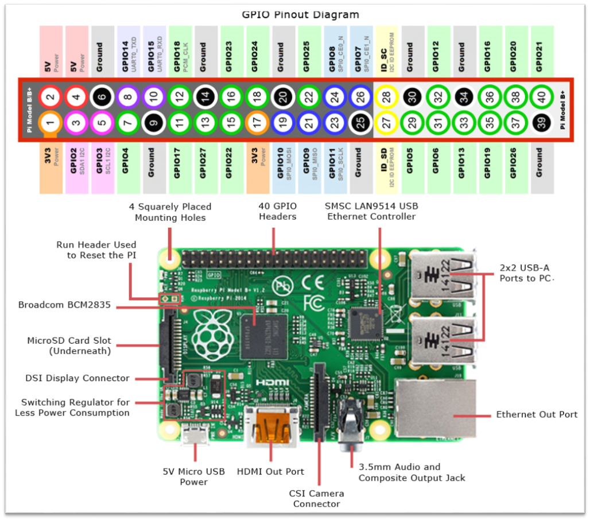

Slide 5
Project Goals
The objective of the project is conservation of energy which is taken for granted in urban areas since the paucity is not yet felt by them.
Another important goal is to easily have a check on the number of hours an employee works in his day of work. The immediate effect would be to identify and manage the workaholics and remiss workers in the institution.
To complete the project in time and considering all the economic criteria for an engineering project.
To meet all the requirements of the problem statement.
For the team members to work in synergy in the team as a single output oriented entity.

Slide 6
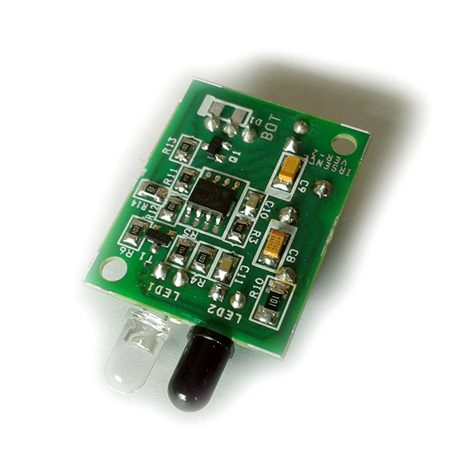
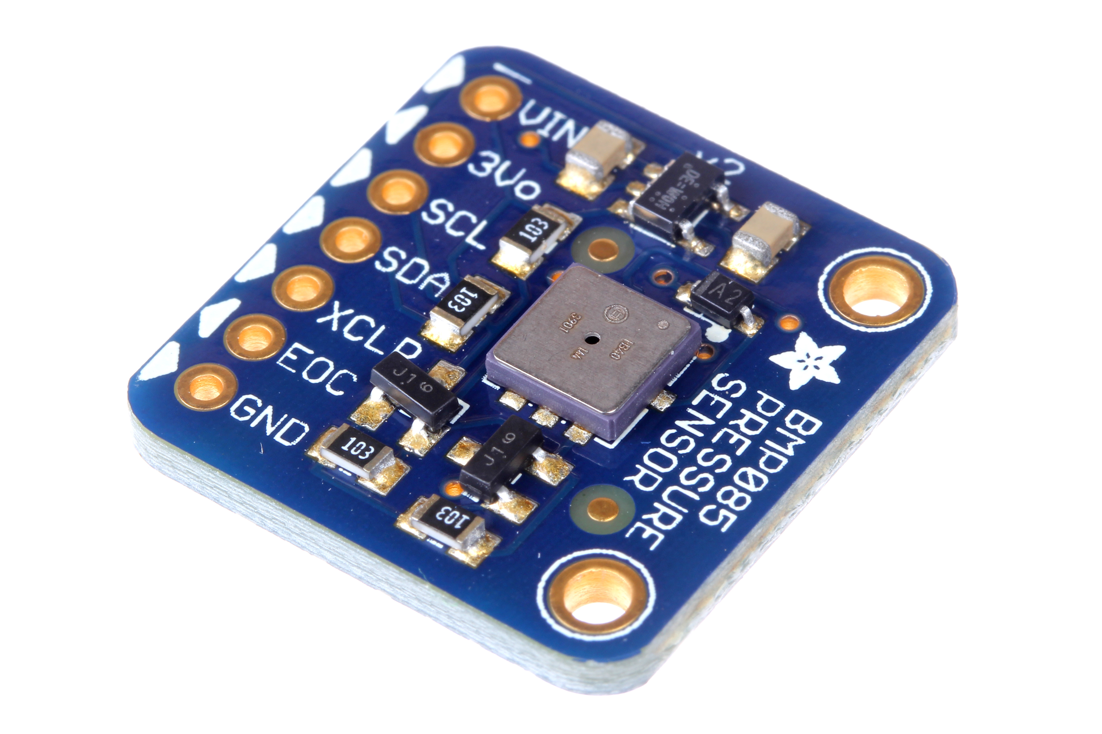
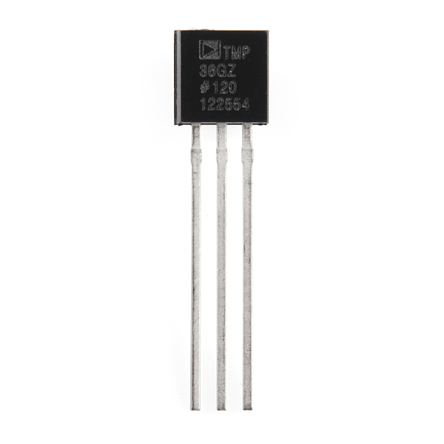
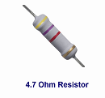

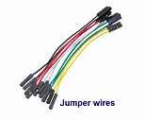
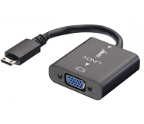

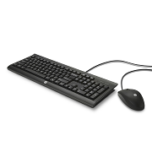
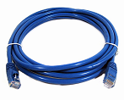
IR Proximity Sensor
Pressure Sensor
Temperature Sensor
Resistor
Micro SD Card
Jumper Wires
HDMI-VGA adapter
Monitor
Keyboard-Mouse
LAN cable
Components Used

Slide 7
Sensors Used
IR Proximity Sensor- An IR proximity sensor works by applying a voltage to a pair of IR light emitting diodes (LED’s) which in turn, emit infrared light. This light propagates through the air and once it hits an object it is reflected back towards the sensor. The sensing unit, in the form of an integrated circuit (IC), detects the reflected infrared light and sends a corresponding signal to the output terminal.
Temperature Sensor- It can be used to detect the changes in the surrounding temperature with the help of temperature dependent variable resistors. The output current inversely depends on the temperature sensed by the sensor.
Pressure Sensor- In this Pressure is measured relative to perfect vacuum condition. Perfect vacuum is a condition where there is no matter present in the atmosphere and hence, nil air pressure exists in that region. Sensors based on absolute pressure measurement require strict specifications for precise outputs. Sensors based on this type of measurement are used in barometric or altitude related pressure measurements.

Slide 8
Software Requirement Specification
1. External Interface Requirements
a. User Interfaces
b. Hardware Interfaces
c. Software Interfaces
d. Communication Interfaces
(More delineation in the attached MS Word file)

Slide 9
Software Requirement Specification
2. Functional Requirements
Functional Requirement 1.1 Functional Requirement 1.6
Functional Requirement 1.2 Functional Requirement 1.7
Functional Requirement 1.3 Functional Requirement 1.8
Functional Requirement 1.4 Functional Requirement 1.9
Functional Requirement 1.5 Functional Requirement 1.10
(More delineation in the attached MS Word file)

Slide 10
Software Requirement Specification
3. Software System Attributes
a. Reliability
b. Availability
c. Security
d. Portability
e. Maintainability
f. Performance
(More delineation in the attached MS Word file)

Slide 11
Software Requirement Specification
4. Performance Requirements
5. Database Requirement
6. Design Constraints
7. Other Requirements
(More delineation in the attached MS Word file)

Slide 12
Working
Two proximity sensors are used to detect direction of motion of the employee.
The energy consuming equipment in the area are managed according to the direction of employee sensed.
Pressure and temperature sensors are used to detect employee presence in the cubicle.
This data can be used to manage cubicle resources and calculate the number of hours worked per week.

Slide 13
Progress
The initial requirements of having the IR detectors work and having a count of the number of people in a cubicle or room in check so as to manage energy consuming resources in the room is completed .
The calculation of time worked using Heat and Pressure sensors is implemented successfully.
Another module of controlling the room resources using a mobile application from a remote place is underway. The rudimentary Android mobile app is built using Android Studio and this will be augmented to the existing SoC implementation.

Slide 14
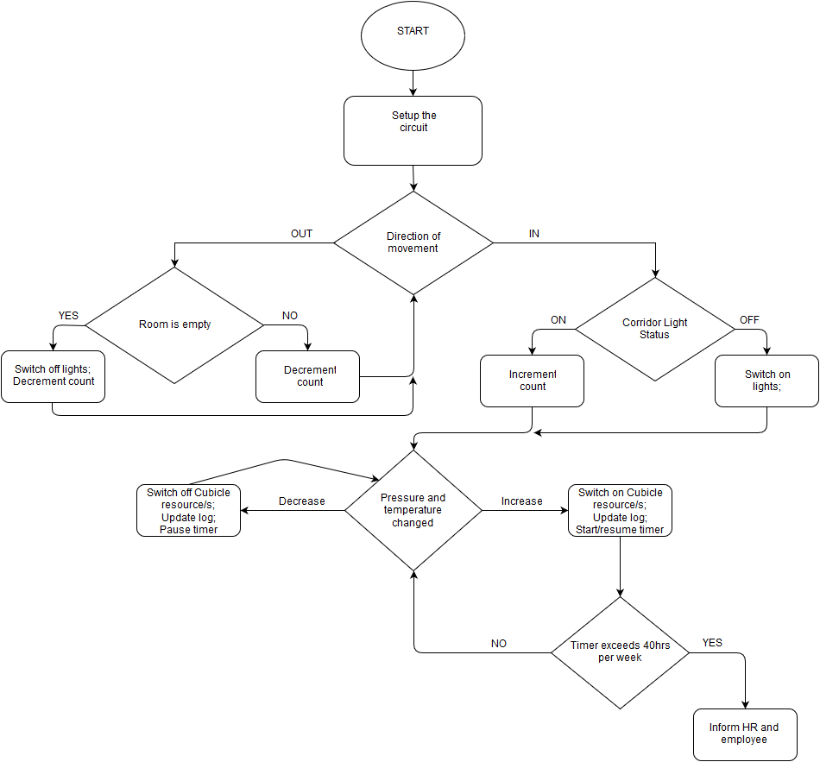
Flow Diagram

Slide 15
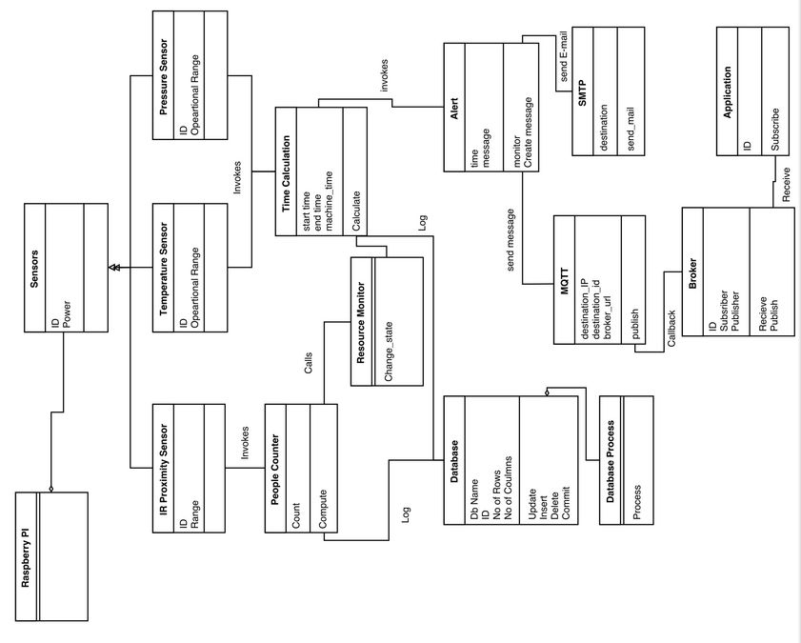
Class
Diagram

Slide 16
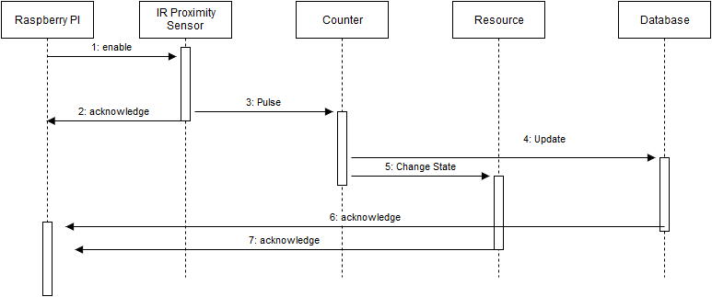
Sequence Diagram (Count Check)

Slide 17
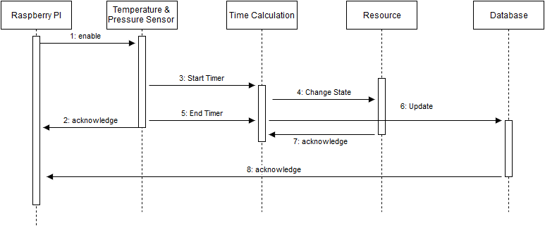
Sequence Diagram (Time check)

Slide 18
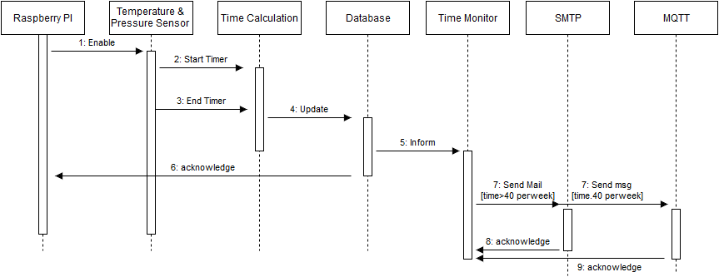
Sequence Diagram (Intimation)

Slide 19
Application of the project
Intended application is in two folds:
Firstly, it is important to conserve energy because the natural resources that are essential for production of these energy are being depleted faster than they can be regenerated. This problem can be minimised by automating resource usage using our proposed model.
Secondly, the man force in a particular company though eminent in their fields are still humans. Workaholics need to be managed by HR department and our project does exactly that by informing authorities when an employee exceeds his maximum working hours per week. Contrary to that, there will be employees who spend time in the campus without working. Our model gives statistics on the number of hours an employee has worked.

Slide 20
Bibliography
https://www.raspberrypi.org/products/raspberry-pi-2-model-b/
http://www.element14.com/community/docs/DOC-73827/l/the-new-raspberry-pi-2-model-b-1gb-technical-specifications
http://dreamgreenhouse.com/projects/2013/presence/index.php
http://www.g9toengineering.com/AllSaints/infraredproximity.html
https://quickleft.com/blog/ocupado-an-internet-connected-restroom-occupancy-detector/

