Slide 1
Smart Agriculture and Storage System
Submitted by
Monu Singh (1MS12CS058)
Rajan Kumar Sah(1MS12CS084)
Vikash Bajoria(1MS12CS131)
Yogesh Manglekar(1MS12CS136)

Slide 2
Project Goals
Crop science: by matching farming practices more closely to crop needs
Environmental risks: by reducing environmental risks of temperature and humidity requirements to the crops
Achieving security to the crop storage area
Better decision making against any climate change
To achieve higher rate of crop production
Maintaining suitable environment in the crop storage area

Slide 3
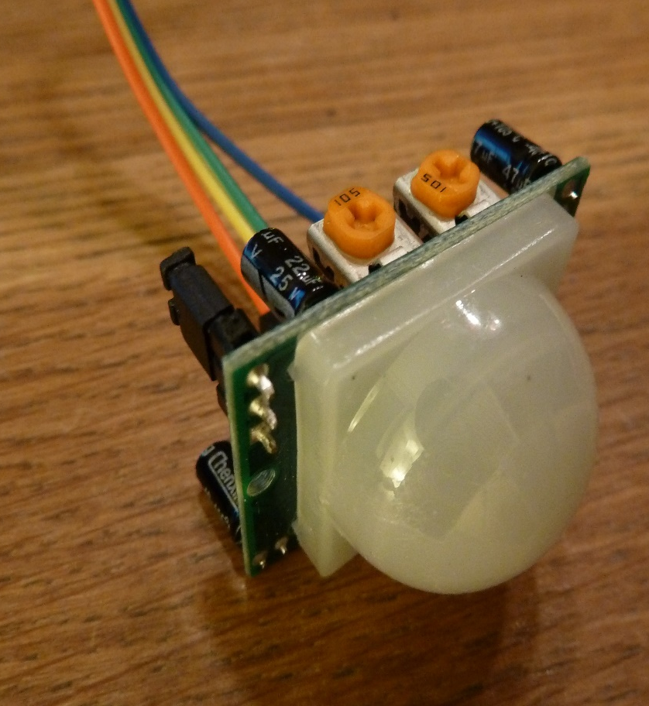
Motion Detection Sensor(HC-SR501)
HC-SR501 is based on infrared technology, automatic control module, using Germany imported LHI778 probe design, high sensitivity, high reliability, ultra-low-voltage operating mode, widely used in various auto-sensing electrical equipment, especially for battery-powered automatic controlled products.
Working Voltage Range: DC 4.5V- 20V
Current Drain: <60uA
Detection Range: <140°
Voltage Output: High/Low level Signal: 3.3V TTL output
Detection Distance: 3 to 7m (can be adjusted)
Work temperature: -20-+80°C

Slide 4
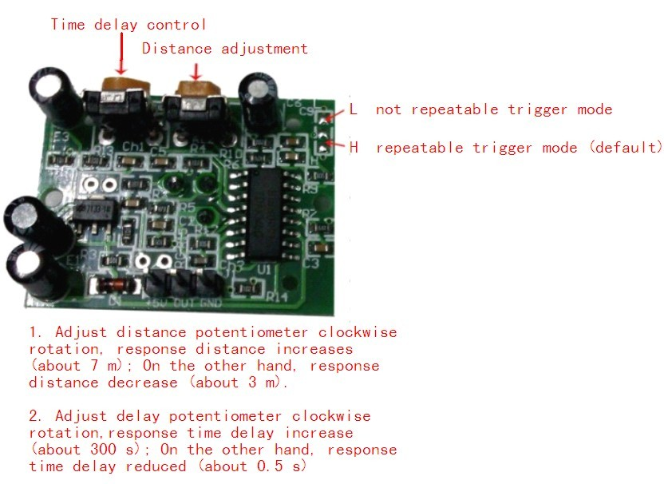

Slide 5
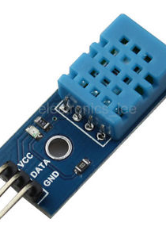
Humidity and Temperature Detection Sensor(DHT11)
This DHT11 Temperature & Humidity Sensor features a temperature & humidity sensor complex with a calibrated digital signal output.
Power supply range:3.0V-5.5V (Included)
Operating temperature range: -55°C - +125°C (-67°F - +257°F)
Storage temperature range: -55°C - +125°C (-67°F +257°F)<50uA
Signal Output Type: Analog
Output lead: red (VCC), yellow(DATA) , black(GND)

Slide 6
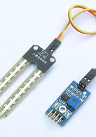
Soil Moisture Sensor(LM393)
This is a simple water sensor can be used to detect soil moisture when the soil moisture deficit module outputs a high level, and vice versa output low. Use this sensor produced an automatic plant water device, so that the plants in your garden without people to manage.
Operating voltage: 3.3V-5V
Module dual output: mode, digital output, analog output
Interface Description:
VCC: 3 V-5V
GND: GND
DO: digital output interface (0 and 1)
AO: Analog Output Interface

Slide 7
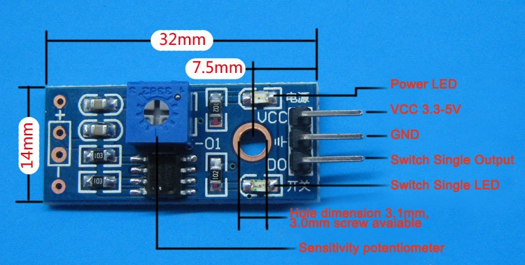

Slide 8
Software Requirements Specification
1.Specific Requirements: This section contains all of the functional and quality requirements of the system. It gives a detailed description of the system and all its features. It give a better understanding of the system and detailed description of the system used in the project.
1.1.Software Interface: We are using raspberry pi and installed an operating system which is raspbian linux. We have used the NOOBS IMAGE. provide user interface .It has wifi interface through which we could connect to internet and could send data obtained through sensor to the cloud for further use. We can use it just as laptop. The user could run program and could see the result.
Ubidots helps you create applications that capture real-world data and turn it into meaningful actions and insights. We think you shouldn't have to be a web/data expert, or hire one, in order to stream your sensor data to the cloud and extract its full value through real-time visualizations.

Slide 9
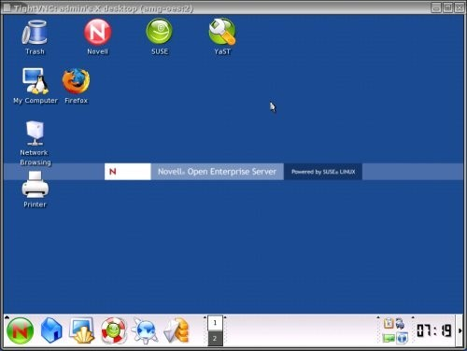

Slide 10
1.2.Hardware interfaces
The Pi has always supported 1-wire, I2C and SPI interfaces via the GPIO header. These allow various devices to be connected to the Pi and controlled via software. SPI Interface, General GPIO,i2c Interface,1-wire Interface. These interface make it easy to use.
Motion detection sensor(HC-SR501)
Humidity and Temperature Detection Sensor(DHT11)
Soil Moisture Sensor(LM393)
Wi-fi router, jumper wires

Slide 11
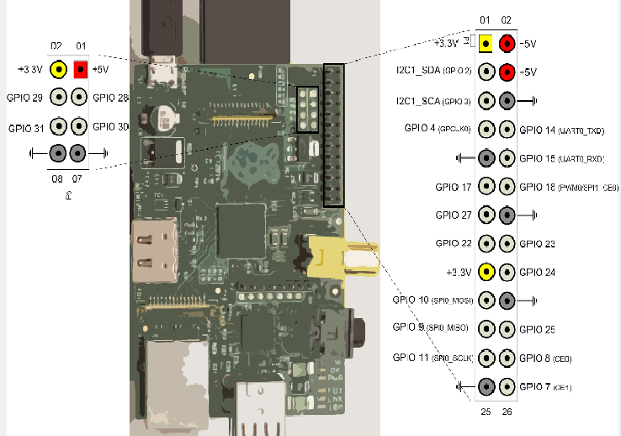

Slide 12
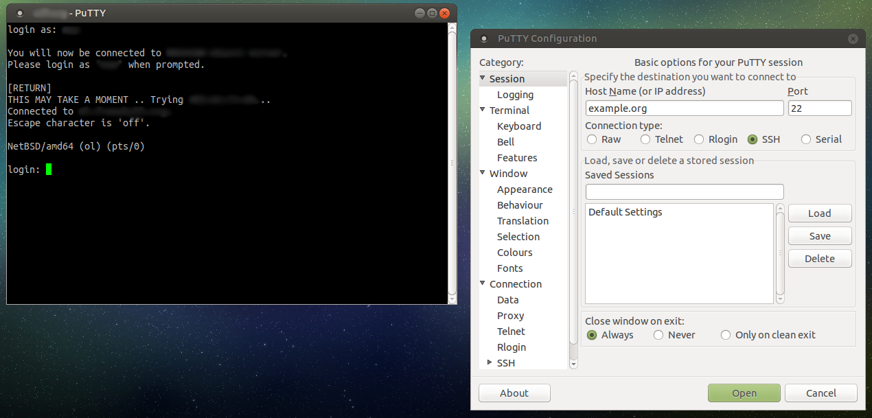
1.3.User interfaces
PuTTY is a free and open-source terminal emulator, serial console and network file transfer application. It supports several network protocols, including SCP, SSH, Telnet, rlogin, and raw socket connection.

Slide 13
2.Functional Requirements:
A user should be able to get the notification if some problem occur. The user should get message regarding the condition of the storage system and unfavourable environmental condition in field.
The storage facility should have the temperature, humidity sensor and motion detector which gives user about the condition. It should read the data and send the data to the cloud.
The field should have the motion detector sensor which send the data to the cloud if there is intruder, it sends tshe data to the cloud.
The soil moisture sensor checks the moisture content in the soil and informs the user about it.
The cloud is the platform which store the data on virtual memory and and get the data from sensor and send the data to mail.

Slide 14
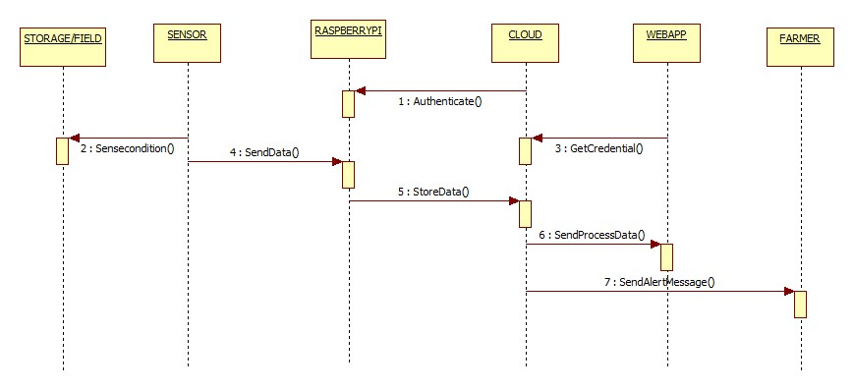
Design Architecture
Data is collected from storage system and field through sensors which are interfaced with raspberry pi, the data acquired is sent to cloud. The data stored in cloud is mailed to the farmer.
Sequence Diagram

Slide 15
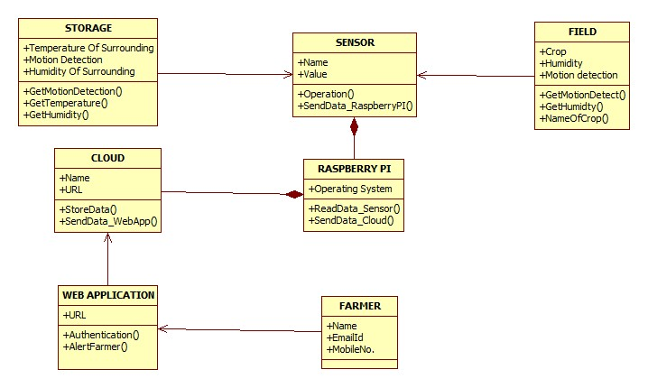
Class Diagram:

Slide 16


Implementation Details:
The raspberry Pi board is used that is interfaced with sensors(Temperature and humidity sensor, Soil moisture sensor and Motion detection sensor). Uraspberry Pi is running on raspbian operating system which is included in Noobs. The Raspberry is connected to the cloud through ubidots API. The data acquired from the sensors is stored on the cloud and sent to the farmers through mail.
.
RASPBERRY
PI
Temperature
SENSOR
CLccccloudOUD
Motion detector

Slide 17
Conclusion and Future Work:
Project will help the farmers to take actions when there is not favourable condition at the field sight.
Security to the storage system.
Project will help to notify the farmer about the moisture content in soil.
Project will help to increase the crop production rate
Project will help to maintain the temperature and humidity at the storage system by using external cooling systems
The motion detector sensor senses the motion of intruders into the storage system.

Slide 18
Bibliography
Raspberry Pi – Wikipedia, the free encyclopedia
PuTTY - Wikipedia, the free encyclopedia
www.smartfarming.com

