Slide 1

Data Analysis On Twitter Data
Submitted By :
Praveen K - 1MS12CS075
Praveen S P - 1MS12CS076
Manoj A - 1MS12CS053
Jayachitra T R - 1MS12CS040

Slide 2
CONTENTS
1. Problem Statement
2. Project goals and Objectives
3. Description about the Data Sets
4. Description about the SRS
5. Description about the Design Architecture
6. Implementation Details
7. Results
8. Conclusion and Future Work
9. Bibliography

Slide 3
PROBLEM STATEMENT
The problem in sentiment analysis of twitter data is classifying the polarity of a given text in the document, sentence or phrase.
The Main goal is to determine whether the expressed opinion in the text is positive, negative or neutral.

Slide 4
GOALS and OBJECTIVES
The objective is to implement an algorithm for automatic classification of text into positive, negative or neutral.
Sentiment Analysis to determine the attitude of the mass is positive, negative or neutral towards the subject of interest.
Graphical representation of the sentiment in form of Pie-Chart.

Slide 5
Social media has become a major platform for information sharing.
Due to its openness in sharing data, twitter is a prime example of social media.
The goal of this project is to find out trends by aggregating the data in social networking site such as twitter. Analysis of twitter Data to evaluate nature of user tweets.
Also we propose and evaluate a probabilistic framework for estimating a twitter user's city-level tweet nature.

Slide 6
Description About the Data sets
The training set contains 115,886 twitter users and 1,19,629 tweets from the users.
All the locations of the users are self- labeled in United States in city-level granularity.
The test set contains 5,136 twitter users and 1,22,891 tweets from the users.
All the locations of users are uploaded from their smart phones with the form of "UT: Latitude , Longitude".

Slide 7
Description about the SRS
The SRS document enlists enough and necessary requirements that are required for the project development.
SRS helps in better understanding of the project by specifying the functional requirements, software system attributes etc.
It minimizes the development effort.
Serve as a basis for enhancement.

Slide 8
Description about the Design Architecture
Number of Modules: 4
Fetching and Extracting Data:
Data Pre-processing:
Classification:
Analysis
Algorithm Design :
Porter’s Algorithm

Slide 9
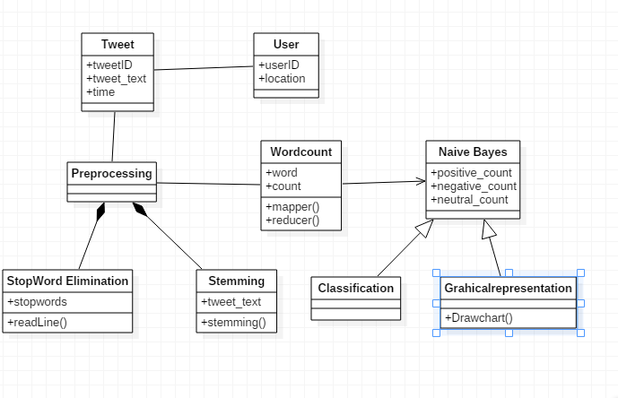
Class Diagram
Tweets are highly unstructured and also non-grammatical
Out of Vocabulary Words
Lexical Variation
Extensive usage of acronyms like asap, lol, afaik etc.

Slide 10
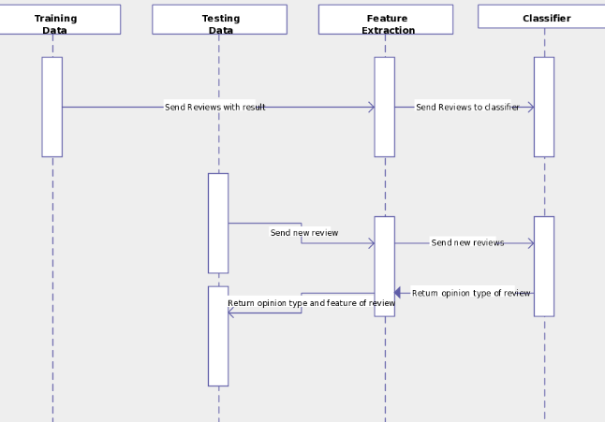
Sequence Diagram
Applications to Review-Related Websites
Movie Reviews, Product Reviews etc.
Applications as a Sub-Component
Technology Detecting antagonistic, heated language in mails, spam detection, context sensitive information detection etc.
Applications in Business and Government Intelligence
Knowing Consumer attitudes and trends
Applications across Different Domains
Knowing public opinions for political leaders or their notions about rules and regulations in place etc.

Slide 11
Implementation Details
Twitter Data Set Identification and Extraction
Pre-processing of data set
Removing unwanted attributes
Eliminating stop words
Stemming ( Porter’s algorithm)
Tweet classification
Positive
Negative
Neutral

Slide 12
Our Approach :
i.Stop words removal:
The stop words like a, an , this which are not useful in performing the analysis are removed in this phase. Stop words are removed using java in eclipse platform. All the words are not considered are not considered for analysis.
ii. Unstructured to structured:
Twitter comments are mostly unstructured i.e. ‘aswm’ is written ‘awesome’, ‘happyyyyyy’ to actually ‘happy’. Conversion to structured is done by dynamic data records of unstructured to structured and vowels adding.
iii. Stemming:
In stemming we use porter’s algorithm to remove suffix and prefixes from the tweeter data set file and normalise it.

Slide 13
Results
After streaming the tweets into HDFS in real time, Naïve bayes is used in analyzing the tweets. Tweets are tagged as documents where categories are the hash tags defined in the configuration file. Later the tweets are grouped as positive, negative and neutral based on subjectivity corpus forming a dictionary of words and its polarity. The sample example shown in pie chart which is obtained by running the map reduce code in hadoop.

Slide 14
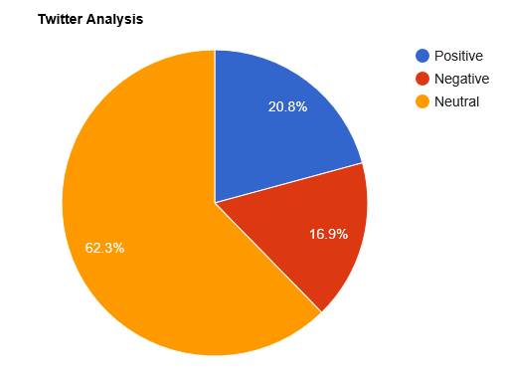
GRAPHICAL REPRESENTATION OF NATURE OF USER TWEETS
The sample count or the the given above chart is shown in the following table:
Opinion | Count
Positive | 25540
Negative | 20765
Neutral | 76586

Slide 15
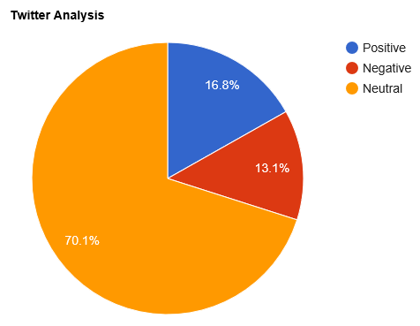
GRAPHICAL REPRESENTATION OF NATURE OF SINGLE USER TWEET
The sample count or the the given above chart is shown in the following table:
Opinion | Count
Positive | 313
Negative | 152
Neutral | 555

Slide 16
Conclusion and Future work
This project gave us hands on experience of handling and parallel processing of huge amount of data. Data collection process introduced us to java twitter streaming API. It was very interesting to gather and then aggregate the social networking data so as to extract interesting patterns and recent trends from it. We got exposure to work with prominent parallel data processing tool: Hadoop. Apache Hadoop framework is gaining significant momentum from both industry and academia as the volume of data to analyze growth rapidly.
This project helped us not only to gain knowledge about installation and configuration of hadoop distributed file system but also map reduce programming model. At the end of analysis phase data visualization was performed with the help of Google Developer. Amongst the many fields of analysis, there is one field where humans have dominated the machines more than any – the ability to analyze sentiment, or sentiment analysis.
The future of this data analysis field is vast. IBM has announced the launch of its new API Watson which can give 86% accuracy of the sentiments. This project not only analyses the sentiments of the user but also computes other results like the user with maximum friends/followers, top tweets etc. hence hadoop can also be effectively used to compute such results in order to determine the current trends with respect to particular topics. This can be very useful in the marketing sector too.

Slide 17
Bibliography
https://archive.org/download/twitter_cikm_2010
http://www.cloudera.com/content/www/enus/documentation/other/tutorial/CDH5/Hadoop-Tutorial/ht_example_4_sentiment_analysis.html
https://github.com/omarshammas/sentiment_analysis
https://github.com/timvandermeij/sentiment-analysis/tree/master/words
https://github.com/madhusudancs/sentiment-analyzer/blob/master/analyzer/train.py
http://academictorrents.com/details/d8b3a315172c8d804528762f37fa67db14577cdb
https://archive.org/details/twitter_cikm_2010
http://www.mrgeek.me/technology/datascience/data-mining-1-5-million-tweets-for-twitter-sentiment-analysis/
http://www.slideshare.net/sumit786raj/sentiment-analysis-of-twitter-data?related=1
http://www.slideshare.net/niteshsinghns/twitter-sentiment-analysis-project-report
http://www.alex-hanna.com/tworkshops/lesson-6-basic-sentiment-analysis/
http://alexdavies.net/twitter-sentiment-analysis/
http://www-nlp.stanford.edu/courses/cs224n/2009/fp/3.pdf

