Slide 1
SENTIMENT ANALYSIS ON TWITTER DATA
By:
Lakshmishree C 1MS12CS050
Neha P 1MS12CS143
Niharika W M 1MS2CS065

Slide 2
Project Goals
Build sentiment analyzer to perform sentiment analysis on Twitter data to predict the most popular smartphone.
To extract a set of 1,00,000 tweets from twitter API for specific keywords or hashtags.
Train the machine learning classifier, Naïve Bayes using a set of manually classified training data.
Generate a feature vector for the tweet set by extracting the labels from the tweets.
Classify the test dataset using the trained classifier and obtain the result in form of graph.
Deduce the attitude of people towards well established smartphone companies using the result of the above analysis.

Slide 3
Description about the Data Sets
Tweet dataset
The initial raw data set obtained by extraction of tweets from twitter api contains 1,00,1002 data points.
For each user id, for the specified keyword(hashtag) indicated by query attribute, the latest tweet is extracted which is stored in the content attribute.
The following are the attributes of the extracted data.
id, query, tweet_id, inserted_date, truncated, language, possibly_sensitive, coordinates, retweeted_status, created_at_text, created_at, content,from_user_screen_name, from_user_id, from_user_followers_count, from_user_friends_count, from_user_listed_count, from_user_statuses_count, from_user_description, from_user_location, from_user_created_at, retweet_count, entities_urls, entities_urls_count, entities_hashtags , entities_hashtags_count, entities_mentions, entities_mentions_count, in_reply_to_screen_name, in_reply_to_status_id, source, entities_expanded_urls , json_output , entities_media_count, media_expanded_url, media_url, media_type, video_link, photo_link, twitpic

Slide 4
Description about the Data Sets(cont.)
Training dataset
The training dataset consists of 20,000 classified tweets. It has two attributes polarity defined as positive,negative or neutral for each tweet and the content of the tweet. This dataset is fed to the classifier for training.
Example: |negative| | @switchfoot http://twitpic.com/2y1zl - Awww, that's a bummer. You shoulda got David Carr of Third Day to do it. ;D|
Test dataset
The sampled dataset from the initial dataset consists of 1 lakh data points with two attributes keyword and the content.
This dataset is in the .csv form which is fed to the classifier for classifying each tweet as positive, negative or neutral.

Slide 5
Progress of the Project
Extraction of 1,00,1002 tweets for the keywords iphone, iphone6s, Samsunggalaxy, ipad, galaxys6, nexus4,nexus5,nexus6, nexus10, iphone5, galaxys6edge.
Identification of the machine learning classifier, Naïve Bayes.
Sampling of the data with attributes keyword and content for test data.
Collection of 20000 training dataset which is manually classified.
Preprocessing of sample tweets from training dataset.

Slide 6
Description about the SRS
The Software Requirements Specification (SRS) documents key specifications, describes a prototype in terms of functional and non functional requirements for Twitter Sentiment Analyser.
The information documented, helps to design and develop the sentiment analyser.
It defines the External Interface Requirements, Functional Requirements, Software System Attributes, Performance Requirements, Database Requirement, Design Constraints and other requirements.

Slide 7
Description about the SRS(cont.)
EXTERNAL INTERFACE REQUIREMENTS
User Interfaces
Hardware Interfaces
Software Interfaces
Communication Interfaces
FUNCTIONAL REQUIREMENTS
Retrieving input
Sentiment Analysis
Output
SOFTWARE SYSTEM ATTRIBUTES
Reliability
Availability
Security
Portability
Maintainability
Performance

Slide 8
Description about the SRS(cont.)
PERFORMANCE REQUIREMENTS
Response time
System Resource Consumption
DATABASE REQUIREMENT
DESIGN REQUIREMENT
Processing Power
Deployment Point
Operating Platform
OTHER REQUIREMENT
Safety Requirements

Slide 9
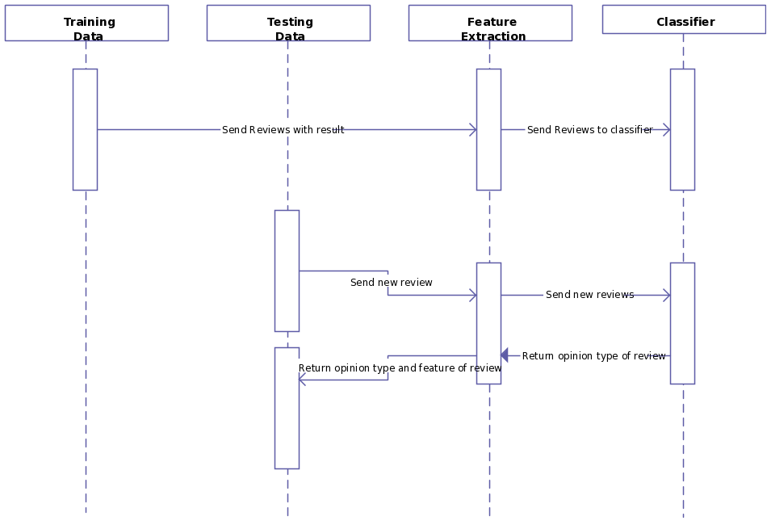
Description about the Design with Class Diagram and Sequence Diagram
Sequence diagram

Slide 10
Description about the Design with Sequence Diagram
The following are the processes used in the sequence diagram to show the interaction between them:
Training data- this involves training set which is manually classified.
Testing data- consists of the sampled data from initial data extracted for particular keyword.
Feature extraction- input is the tweets from either training set or testing set from which labels are extracted after preprocessing and filtering.
Classifier – the feature list is fed to classifier in training stage to train the classifier. The feature list from test set is sent to classifier which gets classified and returned with appended opinion type.(positive,negative,neutral)

Slide 11
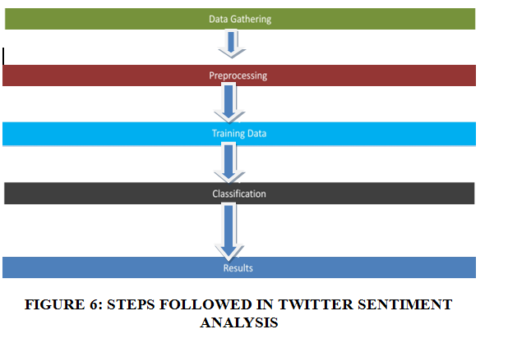
Project Implementation Details
The following steps are followed in our project:
Data collection, Pre-processing, Training the classifier and Classification

Slide 12
Data collection: Twitter API
For classification and training the classifier we need Twitter data. For this purpose we make use of API's twitter provides. Twitter provides two API's; Stream API and REST API.
The difference between Streaming API and REST APIs are: Streaming API supports long-lived connection and provides data in almost real -time. The REST APIs support short-lived connections and are rate-limited (one can download a certain amount of data [*150 tweets per hour] but not more per day).
REST APIs allow access to Twitter data such as status updates and user info regardless of time. However, Twitter does not make data older than a week or so available. Thus REST access is limited to data Twittered not before more than a week. Therefore, while REST API allows access to these accumulated data, Streaming API enables access to data as it is being twittered.

Slide 13
Preprocessing
The tweets gathered from twitter are a mixture of urls, and other non-sentimental data like hashtags \#", annotation \@" and retweets \RT". To obtain n-gram features, we first have to tokenize the text input. Tweets pose a problem for standard tokenizers designed for formal and regular text. The following figure displays the various intermediate processing feature steps.
Tokenize
For a sample input text say "Today the weather is sunny and beautiful", Tokenizers divide strings into lists of substrings also known as Tokens. Tokenizing the text makes it easy to separate out other unnecessary symbols and punctuations and filter out only those words that can add value to the sentimental polarity score of the text.
Stop words
In information retrieval, it is a common tactic to ignore very common words such as \a", \an", \the", etc. since their appearance in a post does not provide any useful information in classifying a document. Since query term itself should not be used to determine the sentiment of the post with respect to it, every query term is replaced with a QUERY keyword. Although this makes it somewhat of a stop word, it can still be useful when not using a bag-of-words model and the location of the query in relation to other words becomes important.

Slide 14
Training Data
To precisely label the text into their respective classes and thus achieve highest possible accuracy, we plan to train the classifier using pre-labelled twitter data itself.
In our project, we have used a training dataset that was already available on the internet.

Slide 15
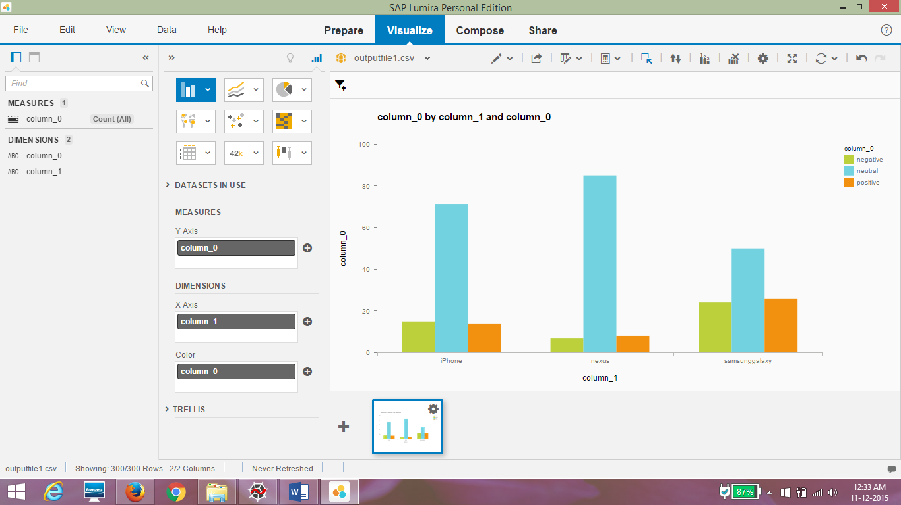
Result and Snapshots

Slide 16
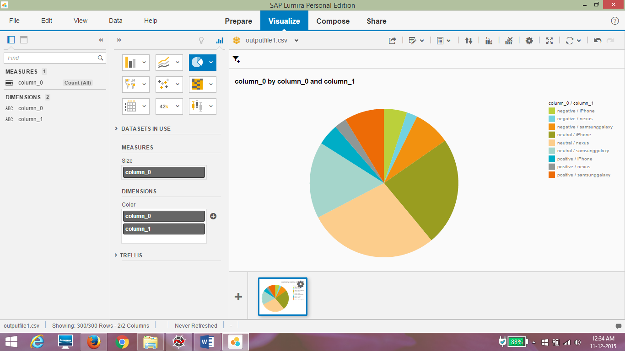

Slide 17
Scope for Future Work
The overall efficiency of the twitter sentiment analyzer can be improved.
The following can be incorporated:
Bigger Dataset: The training dataset in the order of millions will cover a better range of twitter words and hence better unigram feature vector resulting in an overall improved model. This would vastly improve upon the existing classifier results.
Internationalization: Currently, we have focused only on English tweets but Twitter has a huge international audience. It should be possible to use this approach to classify sentiment in other languages with a language specific positive/negative keyword list.
Interpreting Sarcasm: The present approach is currently incapable of interpreting sarcasm. In general sarcasm is the use of irony to mock or convey contempt, in the context of current work sarcasm transforms the polarity of an apparently positive or negative utterance into its opposite.

Slide 18
Conclusion
We presented results for sentiment analysis on Twitter to find the most preferred smartphone, by building a supervised system.
To conclude, this report has illustrated that an effective sentiment analysis can be by collecting a sample audience opinions from Twitter. Throughout the duration of this project many different data analysis tools were employed to collect, clean and mine sentiment from the dataset. Such an analysis could provide valuable feedback to customers who are would want to buy a new smartphone. Discovering negative trends early on can allow them to make informed choices. It is apparent from this study that the machine learning classifier used has a major effect on the overall accuracy of the analysis.

