Slide 1
INTERNET OF THINGS
WEATHER STATION WITH ARDUINO UNO
BY
V.UDITH
1MS12CS124

Slide 2
What is Arduino Uno?
Arduino is an open-source computer hardware and software company, project and user community that designs and manufactures microcontroller-based kits for building digital devices and interactive objects that can sense and control the physical world
The Arduino Uno is a microcontroller board based on the ATmega328 . It has 14 digital
input/output pins (of which 6 can
be used as PWM outputs), 6 analog inputs, a 16 MHz crystal oscillator, a
USB connection, a power jack, an ICSP header, and a reset
button.
It contains everything needed to
support the microcontroller; simply connect it to a computer with a USB cable or power it with a AC-to-DC
adapter or battery to get started. The Uno differs from all preceding boards in that it does not use the FTDI
USB-to-serial driver chip. Instead, it features the Atmega8U2 programmed as a USB-to-serial converter

Slide 3
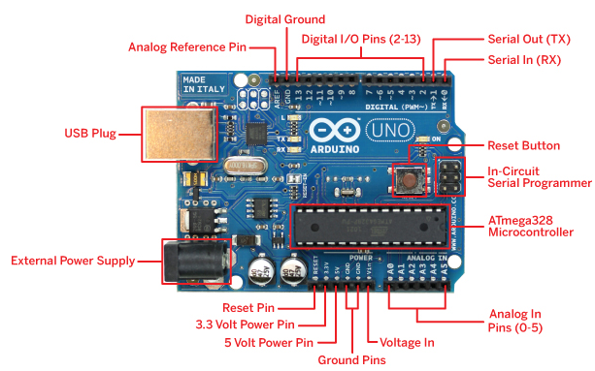
THE ARDUINO UNO

Slide 4
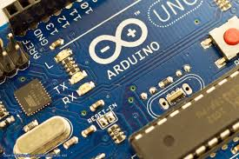
TECHNICAL
SPECIFICATION
Microcontroller : ATmega328P
Operating Voltage : 5V
Input Voltage : 7-12V
Input Voltage (limit) : 6-20V
Digital I/O Pins : 14 (of which 6 provide PWM output)
PWM Digital I/O Pins : 6
Analog Input Pins : 6
DC Current per I/O Pin :20 mA
DC Current for 3.3V Pin : 50 mA
Flash Memory : 32 KB (0.5 KB used by boot loader) SRAM : 2 KB (ATmega328P)
EEPROM : 1 KB (ATmega328P)
Clock Speed :16 MHz
Length : 68.6 mm
Width :53.4 mm
Weight : 25 g

Slide 5
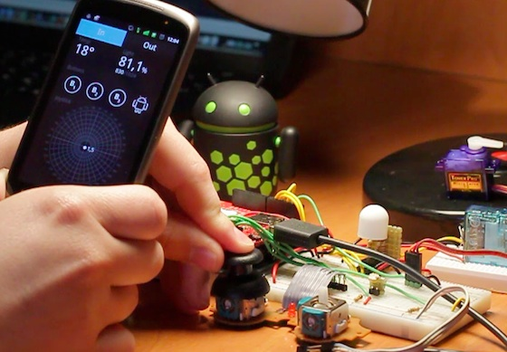
The Idea.... Abstract
1
System on chip + smartphone + sensors = innovation

Slide 6
WEATHER STATION
An innovative way to analyse and monitor weather

Slide 7
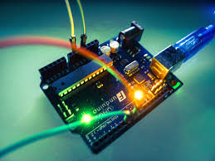
Abstract
The problem of monitoring the work environment and at the same time increasing connectivity is one of the core problems facing today. There is always a need to monitor the work environment like finding out the temperature and the pressure .This can be particularly helpful to maintaining lab conditions .It might also be required to analyze the data over a period of time which is difficult if done manually.
This Iot project serves as a solution.
The project proposes to use a open source microcontroller with the aim of providing a cheap electronic alternative in measuring the temperature by means of an bmp80 pressure sensor and a standard DHT11 temperature and humidity module.
It then uses a Bluetooth Transceiver Module with TTL Outputs-HC05 to transmit the sensor data to the android device.
The application running on the android device pairs with the Bluetooth module and receives the sensor data and displays it accordingly.
This project also uses Thingspeak a cloud based platform and service to create channels and facilitate the monitoring and logging of the temperature over a period of time and also charts them which communicate the changes in the environment to a layman through graphical representation.

Slide 8
THE PLAYERS
ANDROID
ARDUINO
THINGSPEAK

Slide 9
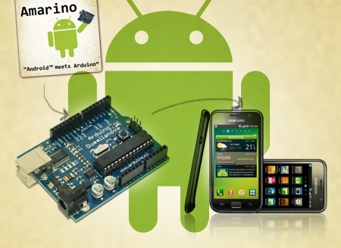
THE ANDROID PRESPECTIVE
v
With the boom in smart phones running on the android platform .it becomes simpler to use a app interface for means of communication using online tools like appinventor and amarino toolkit
.

Slide 10
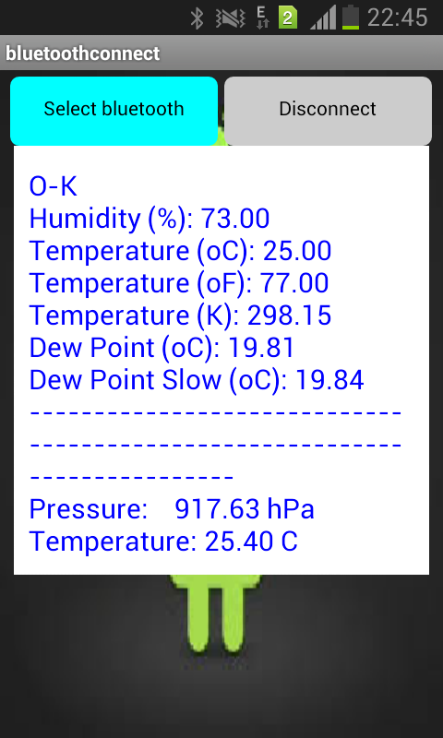
Place your screenshot here
Android project
.

Slide 11
Thingspeak
ThingSpeak is an open source Internet of Things application and API to store and retrieve data from things using the http protocol over the Internet or via a Local Area Network. Thingspeak enables the creation of sensor logging applications, location tracking applications, and a social network of things with status updates

Slide 12
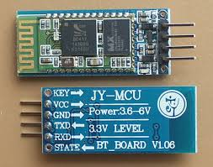
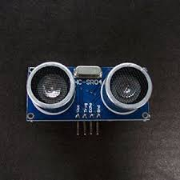
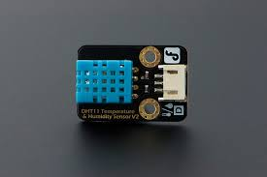
The sensors and modules
DHT11 temperature and humidity sensor
BMP180 Barometric Pressure
Bluetooth Transceiver Module with TTL Outputs-HC05
ESP8266 WIFI MODULE
ARDUINO ETHERNET SHEILD

Slide 13
The overview of the sensors
BMP180 Barometric Sensor- 5V ready
Vin: 3 to 5VDC
Logic: 3 to 5V compliant
Pressure sensing range: 300-1100 hPa (9000m to -500m above sea level)
Up to 0.03hPa / 0.25m resolution
-40 to +85°C operational range, +-2°C temperature accuracy
This board/chip uses I2C 7-bit address 0x77.
DHT11 SENSOR
The DHT11 is a basic, ultra low-cost digital temperature and humidity sensor. It uses a capacitive humidity sensor and a thermistor to measure the surrounding air, and spits out a digital signal on the data pin
BLETOOTH MODULE
Power supply: +3.3VDC 50mA
Frequency: 2.4GHz ISM band
Bluetooth protocol: Bluetooth Specification v2.0+EDR
Bluetooth transceiver pcb

Slide 14
PROCESS FLOW DIAGRAM
DTH11 and BMP180 Barometric Pressure sensor collect data
Bluetooth module transmits
Sensor data
Device pairs with Bluetooth module through app
App displays information

Slide 15
PROCESS
DTH11 and BMP180 Barometric Pressure sensor collect data
WiFi module transmits
Sensor data
Thingspeak displays data in the form of charts

Slide 16
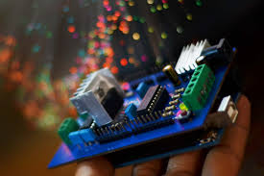
THANK YOU

Slide 17
REFERENCE
WIKIPEDIA
Internet of things by donald norrris
30 android and arduino project for evil genius

