Slide 1
FleetPulse: Your Bike System’s Real-Time Control Centre
Manraj Singh Sidhu

Slide 2
Objective
Build a functional prototype using the London Bike Hire dataset that showcases end-to-end data and product skills.
Key Aims:
Use London-Cycle-Hire Dataset
Perform data exploration
Deliver an interactive front-end
Keep the experience minimal, modular, and useful

Slide 3
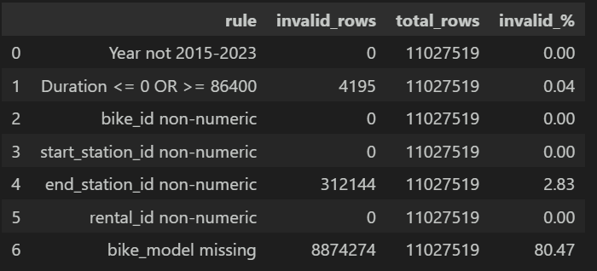
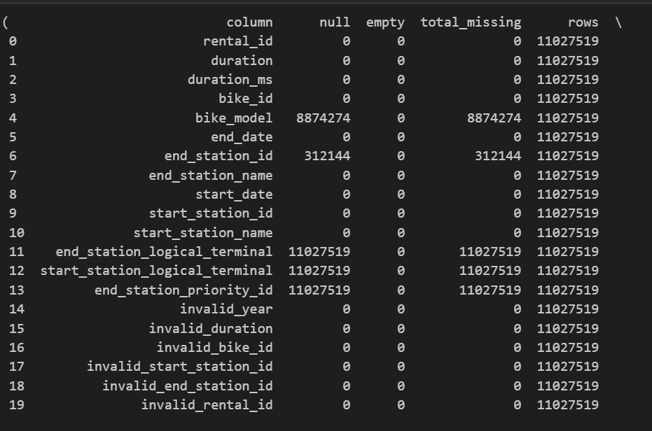
Data Research & Exploration
Data Sources & Scope
Trips: 2022 London cycle-hire history (Bronze Parquet)
Stations: London cycle-hire station metadata
Timeframe: Focused on June 2022 snapshot for “live” simulations
Data Quality Profiling
Completeness: Null / missing IDs per column
Uniqueness: Duplicate rental IDs or trip records
Validity:
Start_date year is 2015-2023 as the data is within that range
Trip Duration greater than 0 seconds and less than 86400 seconds (24hrs)
IDs purely numeric
Consistency: Trip station IDs exist in the station reference table
Findings:
Cycling Stations - 2 invalid rows due to docks count being non_positive, 797 null/missing values for removal date and 88 for install date

Slide 4
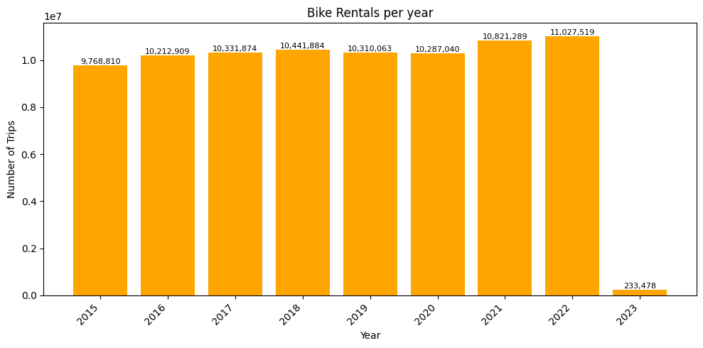
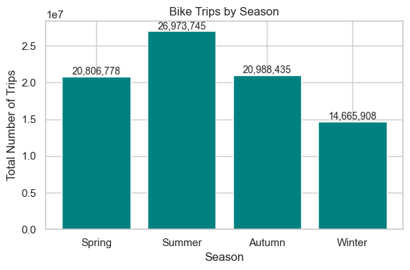
Data Research & Exploration
Trend Over Time:
From 2015 we have seen the number of total trips increase by 12.9%
Summer represented 32% of all bike rides in 2022
For 2022:
Average Trip Duration: 19.77 minutes
Median trip duration: 14.00 minutes
Total Trip Time: 2,670,682 hours
Unique Start Stations: 779
Unique End Stations: 779
Total Unique Stations in Reference: 800
This demonstrates that there are 21 missing station or stations not being logged properly when docked by bikes.

Slide 5
Key Insights
What was discovered?
1. Station Concentration
All “Hyde Park” stations combined (e.g. Hyde Park Corner; Kensington Gardens; Wellington Arch; Albert Gate) launched 288 ,861 rides in 2022 → 3.6 % of all 2022 trips
Hyde Park Corner, Hyde Park alone accounts for 17.4 % of trips from the Top-10 start stations
It is the 4th highest station based on average trip duration being such a touristy area is makes sense and also location being cycling friendly
2. Peak Weekend Usage
Morning peak: 09:00–12:00
Evening peak: 15:00–18:00
Weekday
Morning Peak: 06:00-09:00
Evening Peak: 18:00-21:00
3. Busiest Start Stations
Weekday Evenings:
Hyde Park Corner (1906 trips)
Wormwood Street / Liverpool Street
Weekday Mornings:
Waterloo Station 3 (23433 trips)
Waterloo Station 1 (15171 trips)
Weekend Mornings:
Hyde Park stations predominantly with the exception of Kensington Gardens
Weekend Evenings:
All top spots occupied by “Hyde Park”–area stations
4. Busiest End Stations
Weekday Mornings:
Holborn; Bank; Queen Street; St James’s Park
Weekday Evenings:
Waterloo Station; King’s Cross / Belgrove St; Hyde Park
5. Nearest-Stations for Hyde Park Corner
Knightsbridge, Hyde Park
Grosvenor Crescent, Belgravia
Wellington Arch, Hyde Park
Park Lane, Mayfair
Albert Gate, Hyde Park

Slide 6
Prototype

Slide 7
Next Steps: Turning Data into New Products & Revenue
Initiative | What We’ll Build / Enable | Benefit to London Cycle Hire
Predictive ML for Station Capacity | Classification model flags stations “Likely Full / Empty in next 30 mins.” Traffic-light alerts feed into Ops Pulse & driver routing to help with bike replenishment Bikes to be concerned or for service based on distance travelled across a time period. | Pro-active bike redistribution → fewer stockouts / overcrowded docks. Shorter customer walk-aways and complaints. Ops team can fix bikes on the go and can be proactive rather than reactive.
Consumer Companion App | Mobile view to “Find nearest bike & free dock” in real-time. Crowding forecast overlay. | Friction-free user experience → higher ridership & loyalty. Push-notification channel for offers or service updates.
Data-as-a-Service / Ad-Planning API | Anonymised heat-map API: footfall by hour, day, season. Self-serve dashboards for media-planning agencies. | New revenue stream from mobility analytics. Helps advertisers target undervalued high-visibility zones.

Slide 8
Q&A

Slide 9
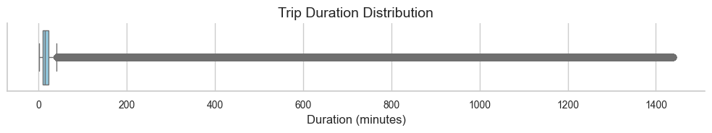
Appendix
Trip Duration Distribution - Figure 2
Figure 1 -Bike Rentals Per Year

Slide 10
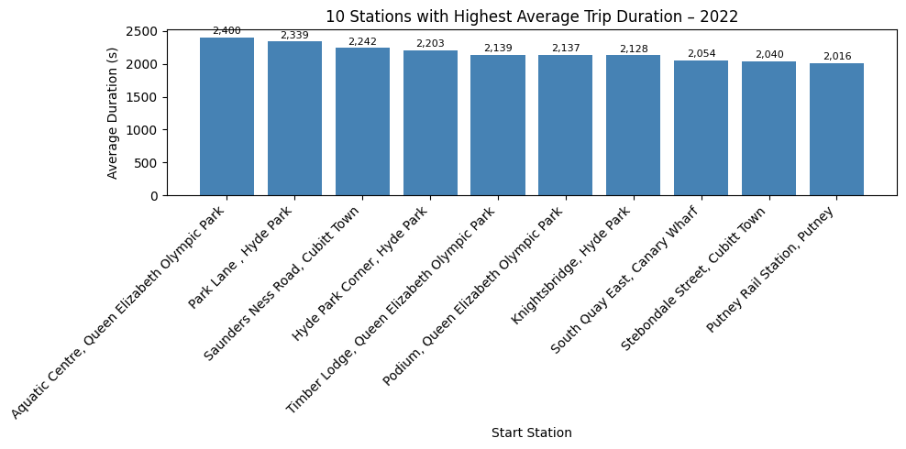
Appendix
Top 10 Stations with Highest Average Trip Duration - Figure 4
Figure 3 -Bike Trips Per Season

Slide 11
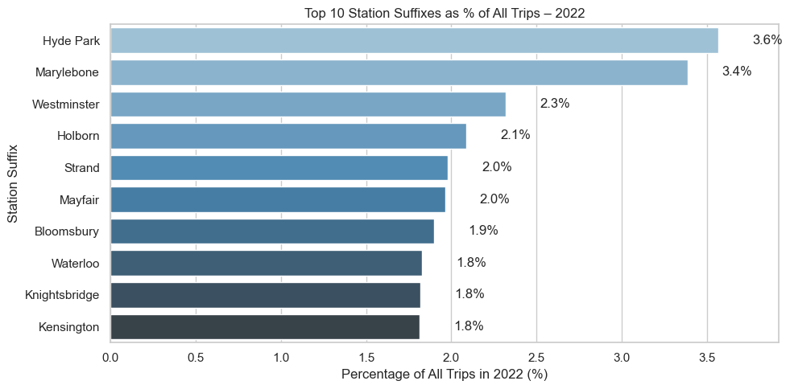
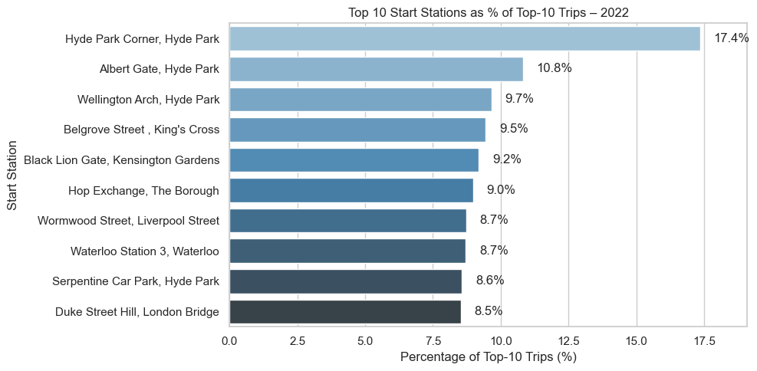
Appendix
Top 10 Station Suffixes by % of All Trips in 2022 - Figure 5
Top 10 Station % of Top-10 Trips in 2022 - Figure 6

Slide 12
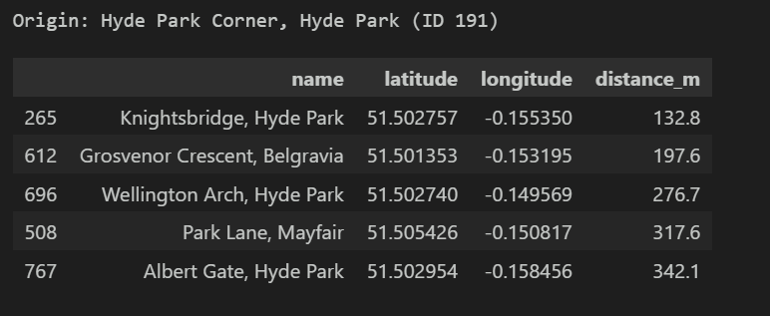
Appendix
Nearest 5 Stations to Hyde Park by distance - Figure 7

