Slide 1
Analysis of New York City Boroughs
For readers intending to move to New York City to follow their dreams

Slide 2
Business Problem
“Start spreading the news, I'm leaving today. I want to be a part of it…” New York City – the city that never sleeps – is still the one destination for many people who want to follow their dreams to succeed.
This document analyses some attributes of New York City areas to help in deciding where to look for the place to live:
rent prices
crime rate
popular social places.

Slide 3
Data used in the analysis
Historical monthly data by borough or neighbourhood on housing price index, asking sale price, asking rent and other data (Link).
Data on felony, misdemeanour, and violation crimes reported to the New York City Police Department (NYPD) for all complete quarters for year 2019 (Link).
GeoJSON file with Boundaries of Boroughs for New York City (Link).
Forsquare API to get the most common venues of given Borough of New York City.

Slide 4
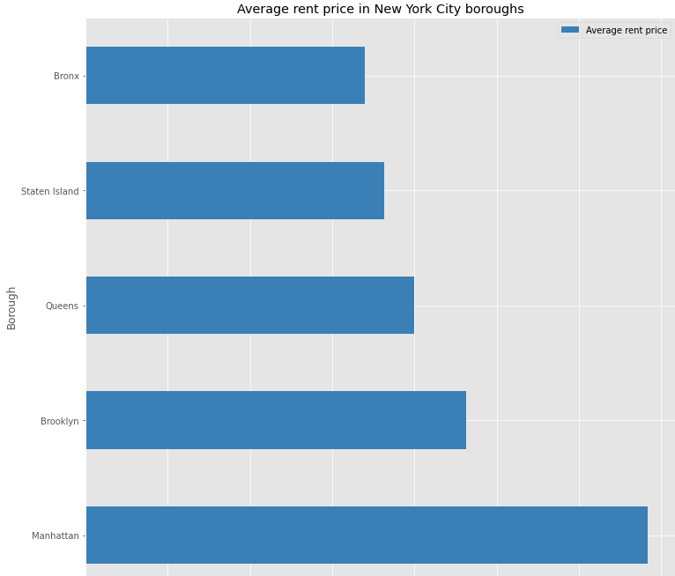
Average rent price

Slide 5
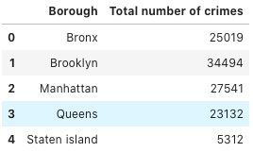
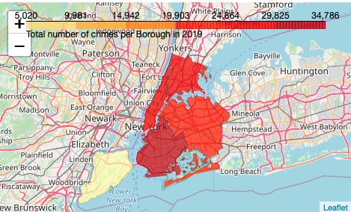
Total number of crimes per borough

Slide 6
Popular social venues

Slide 7
Conclusion
While the rent is high in the more popular boroughs of the New York City, the crime rates are also the highest in these boroughs, as expected.
Bronx has the lowest average rent prices, and lower crime rates than Brooklyn and Manhattan.
Depending on the reader’s personal preference, the analysis of the most popular social venues each borough and neighbourhood may factor in the decision where to move:
A person preferring outdoor life may prefer location close to parks.
A person preferring night life may prefer location close to bars and restaurants.
A person with pets may prefer location close to pet stores.
…

