Slide 1
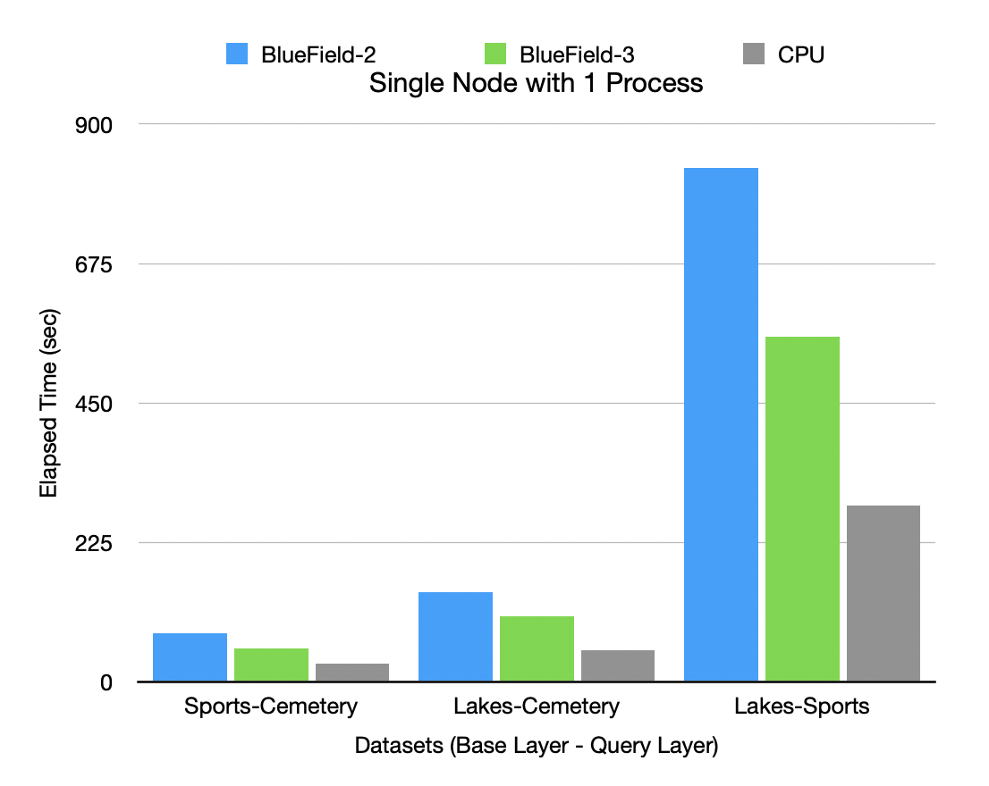
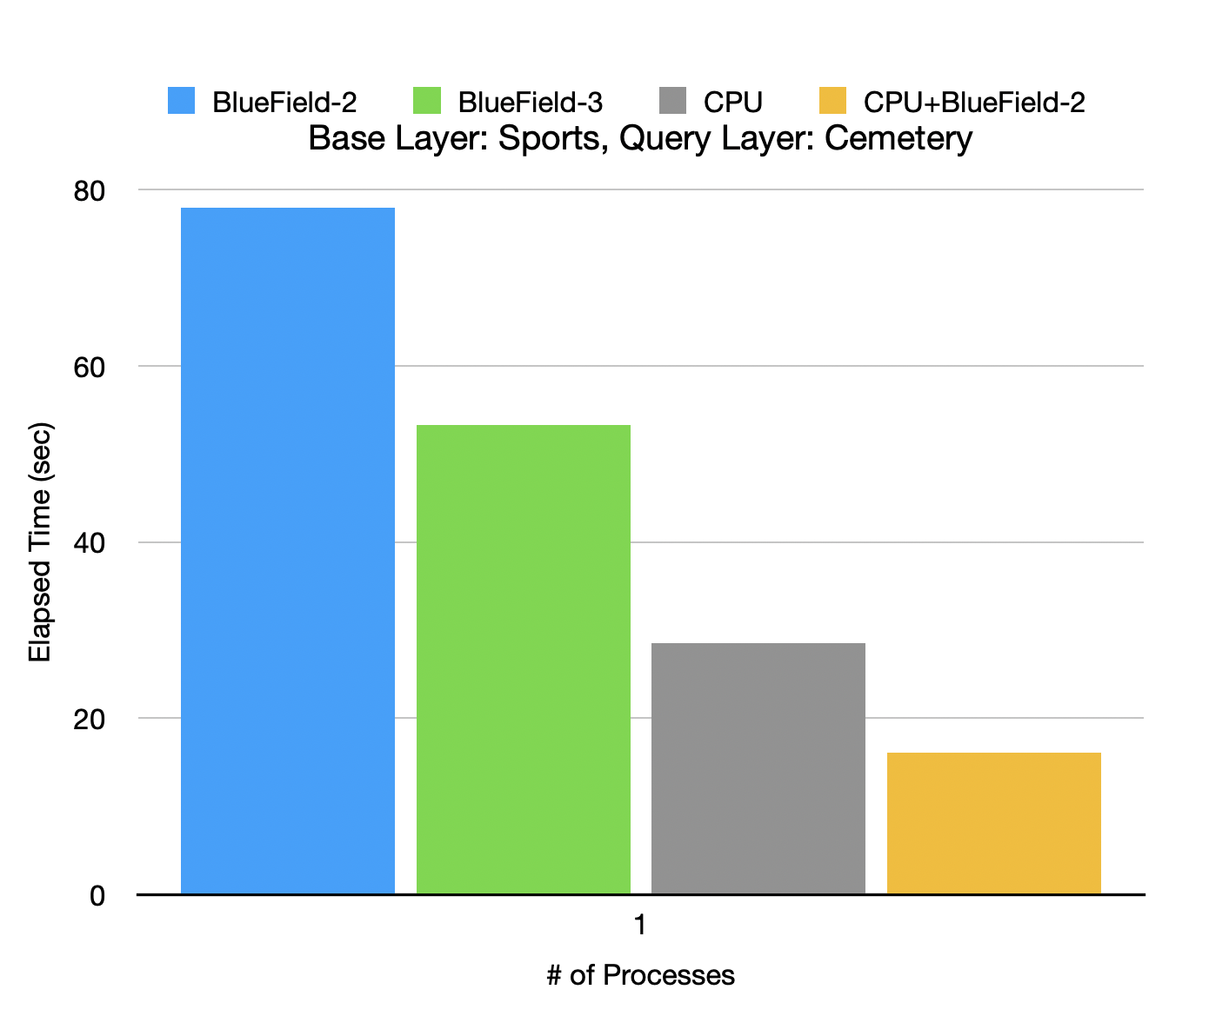
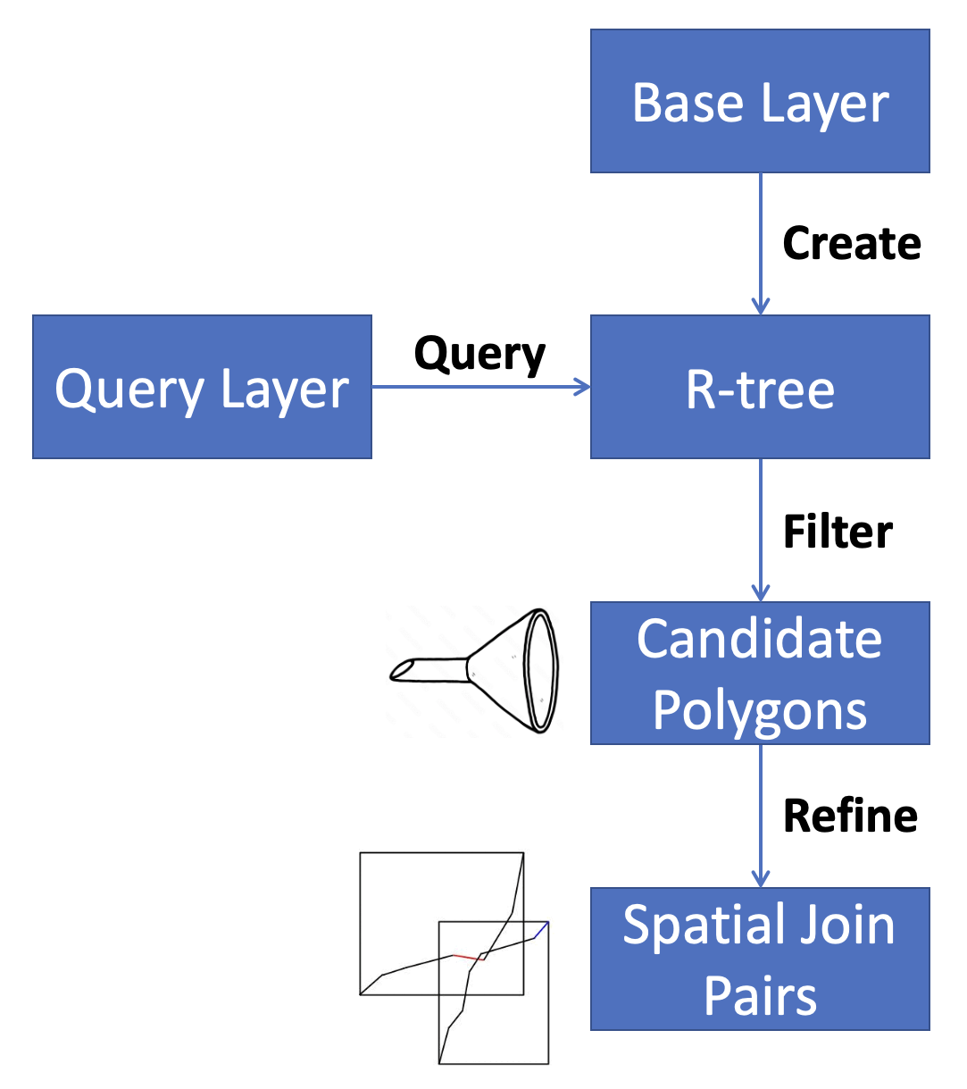
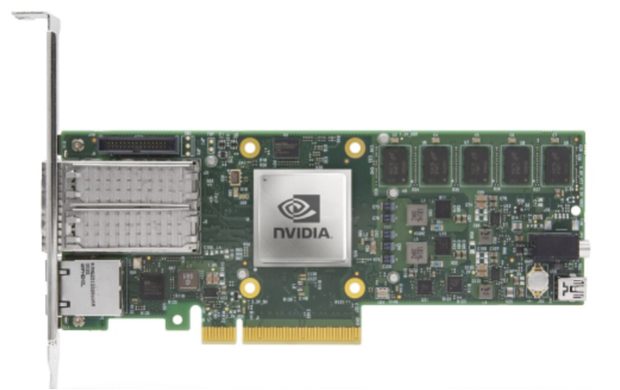
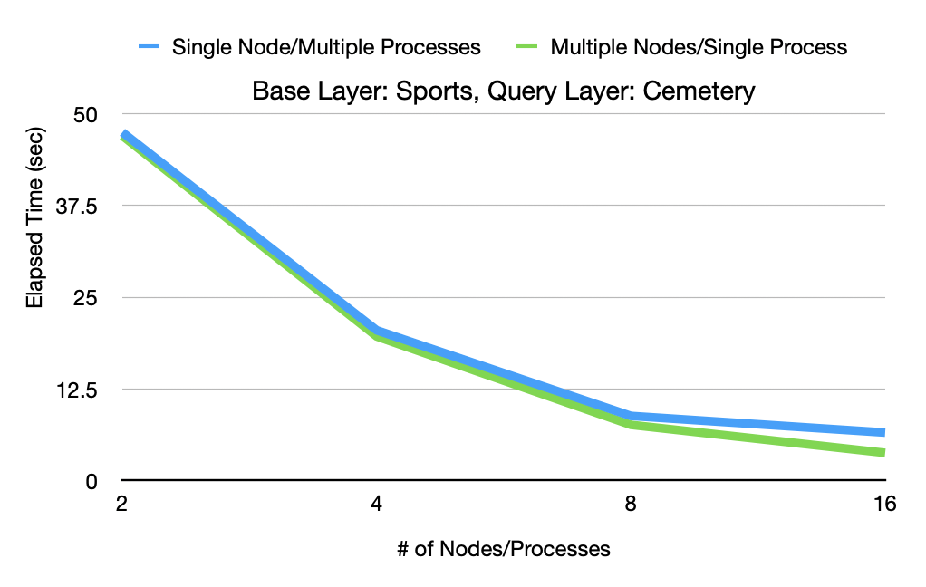
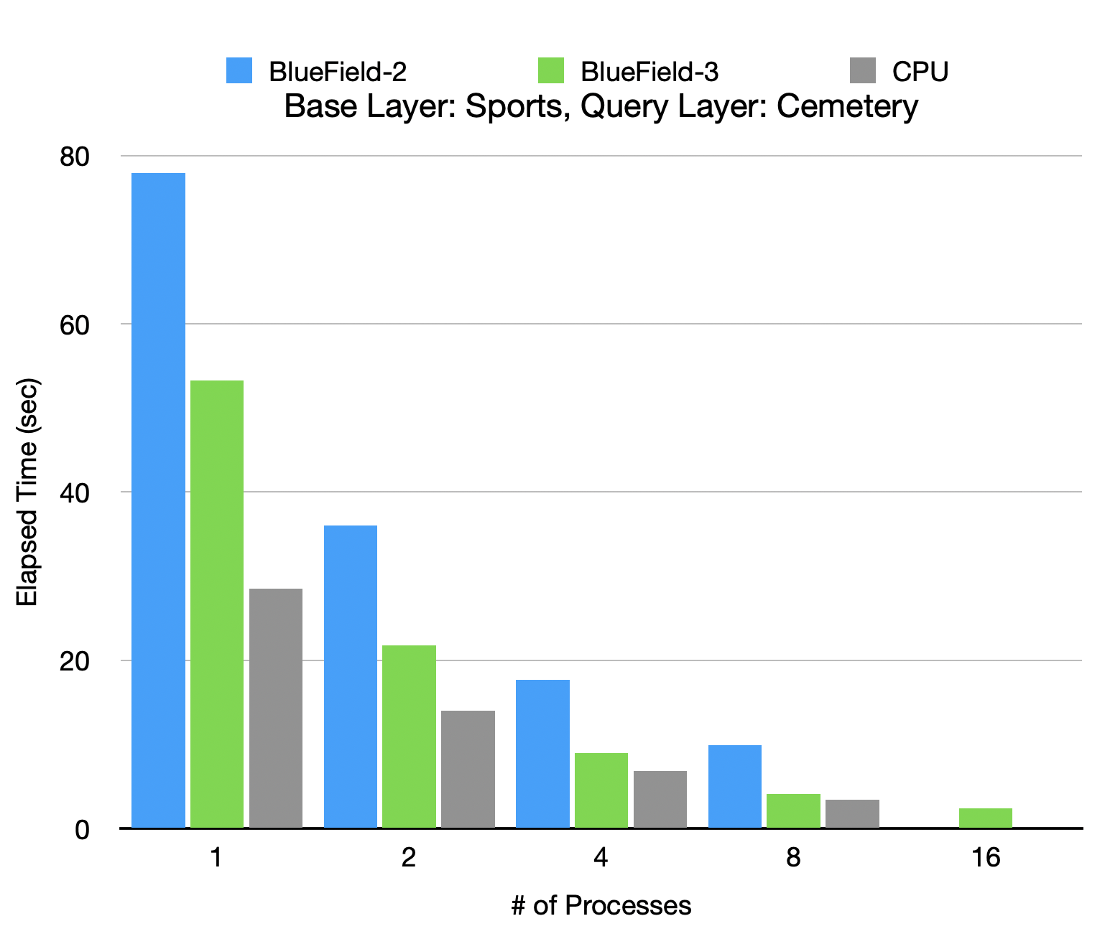
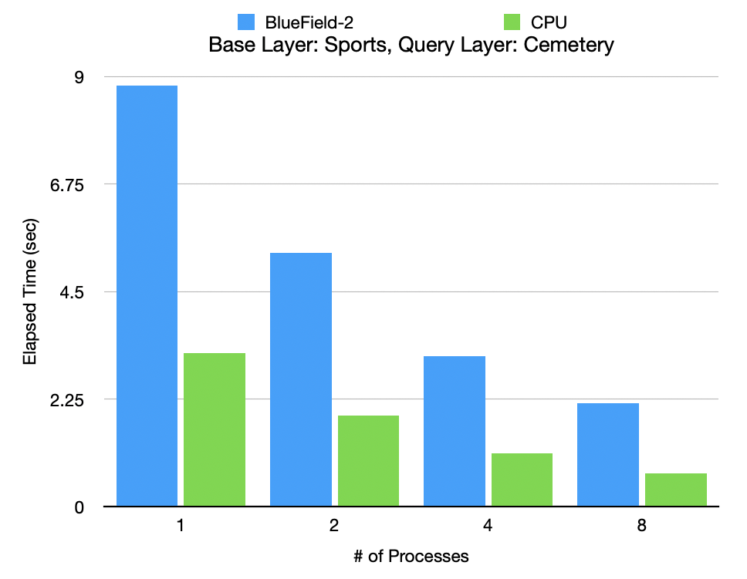
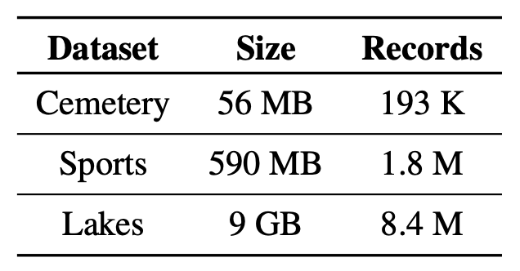
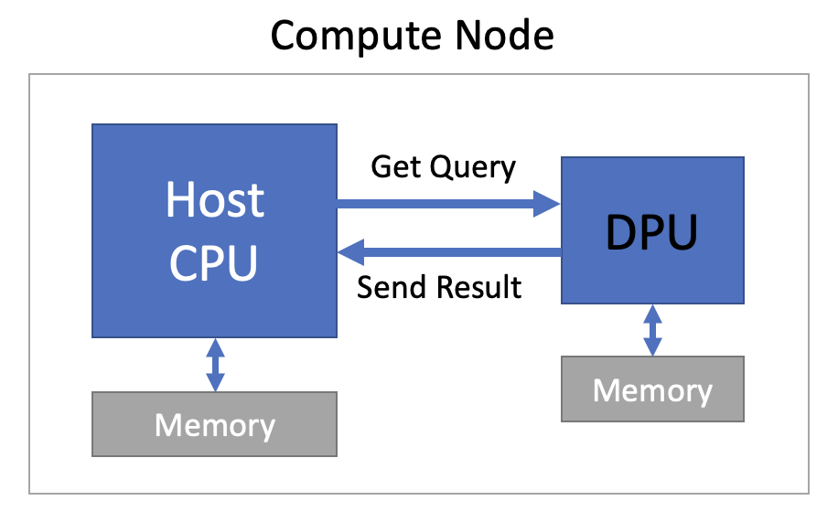
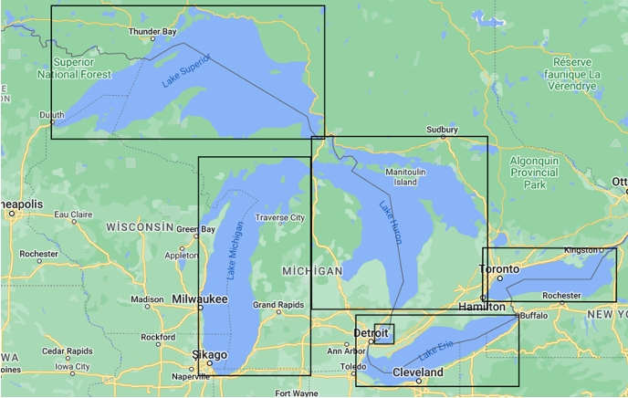
Geospatial Operations Performance of Data Processing Units
Derda Kaymak and Satish Puri, Marquette University
I. Introduction
III. Experimental Setup
IV. Experimental Results
Data in the world, and our work with data is increasing day by day. One of the areas where we use data a lot is geospatial operations. Therefore, it will be beneficial to be able to perform these heavy operations more effectively. In addition, new hardware is being developed to handle this accumulated data, one of which is data processing units (DPUs), shown in Fig. 1. In this study, the optimizations that can be achieved by performing these operations on data processing units and using high performance computing are discussed. For this, we have prepared a benchmarking tool that measures the performance of geospatial operations on different hardware and compared the results.
In this benchmarking tool, generally two files containing geospatial data are taken as input, various geospatial operations are performed on these data and the elapsed time is calculated. The time measured for this process includes creating the R-tree with the Base Layer, making a query for each geometry in the Query Layer using the MBRs in the R-tree and performing the specified operation such as intersection, overlap, touch, equality, covering etc. with the candidate geometries obtained as a result of the filtering (Fig. 3).
The benchmark was tested on the Thor cluster of the HPC Advisory Council, which has 32 Intel Broad-well E5-2697A chipset as CPU nodes, and 32 BlueField-2 and 16 BleuField-3 devices as DPU nodes. Our tool was run on these nodes using different data and parameters, and various test results were obtained. As a result, there are several number of experiments which are explained below.
Experiment #1: The base layer data is divided into 128 pieces with equal number of geometry and tested with the round robin method. Cores of a single node were used in this experiment, and only the intersection operation was performed. It can be seen that the CPU performs the same geospatial operation approximately 2.7 times faster than the BlueField-2 DPU regardless of the number of processes. However, while CPU is 1.9 times faster for single process, when we increase the number of the processes, the performance of BlueField-3 increases more than that of the CPU. This may be an indication that the DPU can be more scalable than the CPU (Fig. 6).
Fig. 7 Intersects performance of single node with different data pairs
Fig. 9 Intersects performance of different systems
Experiment #3: The previous experiment was repeated, but with the base layer data divided into the number of processes (Fig. 8). Although the performance ratio between CPU and DPU remained the same, unlike the previous experiment, it is observed that the performance increase was limited to 1.7 when the number of processes was doubled. This is because when the data is less split, the generated R-tree is larger, and the time complexity of the queries is reduced.
Experiment #5: Tests were conducted on BlueField-3 using different number of processes on a single node and using a different number of nodes, each containing a single process, keeping the total number the same. As a result of this experiment, it was observed that using many nodes gives better performance than using many processes in a single node (Fig. 10).
Fig. 1 NVIDIA BlueField-2 DPU
II. Dataset
To perform geospatial operations for benchmarking experiments, we used cemetery, sports and lakes data from UCR-STAR dataset^{[1]}. Since the data here is from the real world, it shows how large the data is handled by real applications that are using spatial data and the importance of optimizing these operations.
Fig. 4 Filtering and Refinement Algorithm
Tests were done using HPC, multiple cores of CPU and DPUs and multiple nodes were used in various experiments. While MPI library was used to communicate the same type of architectures, gRPC was used to provide communication between CPU and DPU.
Fig. 10 Performance difference between multiple nodes and multiple processes
Fig. 8 Performance of single node using data divided into number of processes
V. Conclusion
Experiment #4: Tests were carried out when CPU and DPU were used together. Dynamic load balancing is used here, and when each processing unit finishes the file it is processing, it takes the new file from the queue. In this experiment, a single node and a single process are used for each hardware. Considering the results of this experiment, although the same process takes about 76 seconds when done on the BlueField-2 and about 28 when done on the CPU, the process takes about 16 seconds when the CPU and DPU are used together (Fig. 9). According to these results, it is seen that the performance increase is above the expected.
Considering the results obtained from the experiments, it can be seen that the CPU is generally more powerful hardware than the DPUs in the market, but especially in the field of geospatial data analytics, with the use of high-performance computing, DPUs can provide performance increase by offloading the CPU.
Fig. 2 UCR-STAR Geospatial Datasets
Fig. 6 Intersects performance of single node using data divided into 128 partitions
Datasets | File Size (GB) | #Polygons, Polylines (Million) | Sequential I/O time (sec) | Parallel I/O time (sec) | # of MPI Processes
Road Network | 137 | 717 | 2873 | 47 | 160
All Map Objects | 92 | 263 | 4728.46 | 76.6 | 90
Roads | 24 | 72 | 786.34 | 23.28 | 75
Lakes | 9 | 8.4 | 328.63 | 14.72 | 45
Datasets | File Size (GB) | #Polygons, Polylines (Million) | Sequential I/O time (sec) | Parallel I/O time (sec) | # of MPI Processes
Road Network | 137 | 717 | 2873 | 47 | 160
All Map Objects | 92 | 263 | 4728.46 | 76.6 | 90
Roads | 24 | 72 | 786.34 | 23.28 | 75
Lakes | 9 | 8.4 | 328.63 | 14.72 | 45
Experiment #2: The base layer is divided into 128 pieces and different dataset pairs for base and query layers are tested. We see that the CPU performance for the Sports-Cemetery file pair is about 2.7 times better than that of the BlueField-2 and 1.9 times better than BlueField-3, but this ratio increases slightly as the size of the data pairs used increases (Fig. 7).
VI. References
Ghosh, Saheli and Vu, Tin and Eskandari, Mehrad Amin and Eldawy, Ahmed, "UCR-STAR: The UCR Spatio-Temporal Active Repository", 2019, doi: 10.1145/3377000.3377005.
Fig. 3 Lakes as Geospatial Objects and MBRs
Fig. 5 Heterogeneous Compute Node Used with gRPC

