Slide 1
GEOSPATIAL OPERATIONS USING Data ProcessIng UnIt AND HIGH PERFORMANCE COMPUTING
Derda Kaymak

Slide 2
AIM OF THE PROJECT
Examining the capabilities and performance characteristics of DPUs
Increasing performance by optimizing geospatial operations and load balancing
Effective use of heterogeneous systems in High Performance Computing

Slide 3
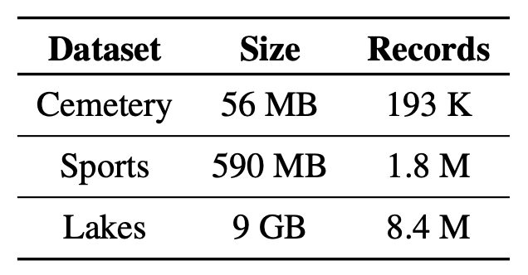
Data
The data used in the study is obtained from the UCR STAR : Geospatial Dataset.

Slide 4
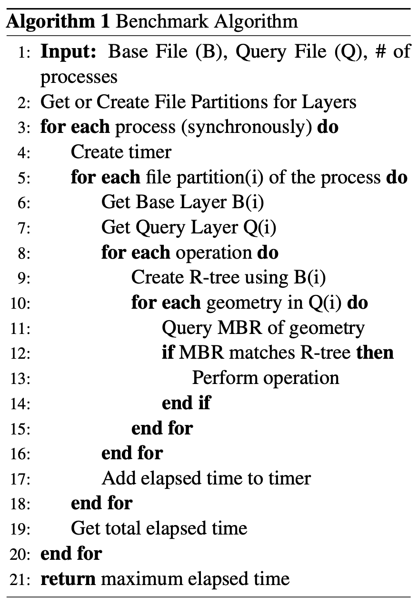
METHOD
Programs including geospatial operations were run in various scenarios and the elapsed time was calculated.

Slide 5
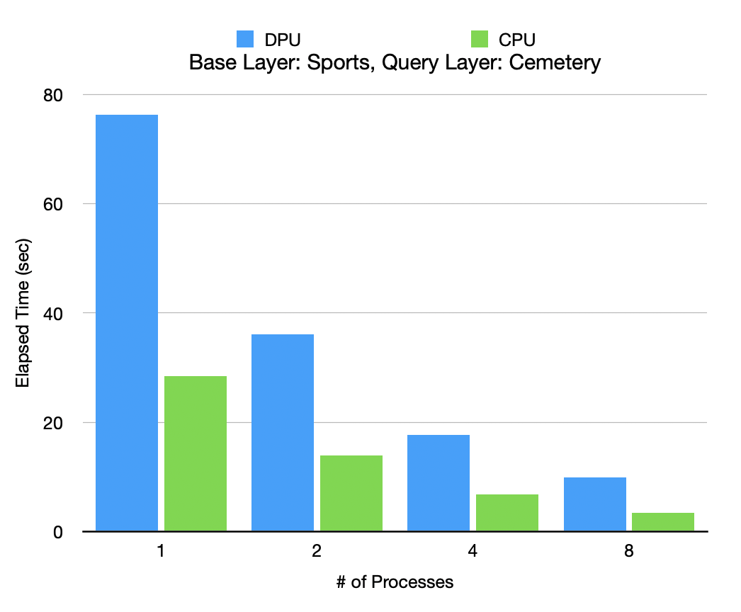
Results #1
Data was divided into 128 parts.
Round-robin method was used for load balancing.
Cores of a single node were used.
CPU performed ~2.6 times faster than DPU.

Slide 6
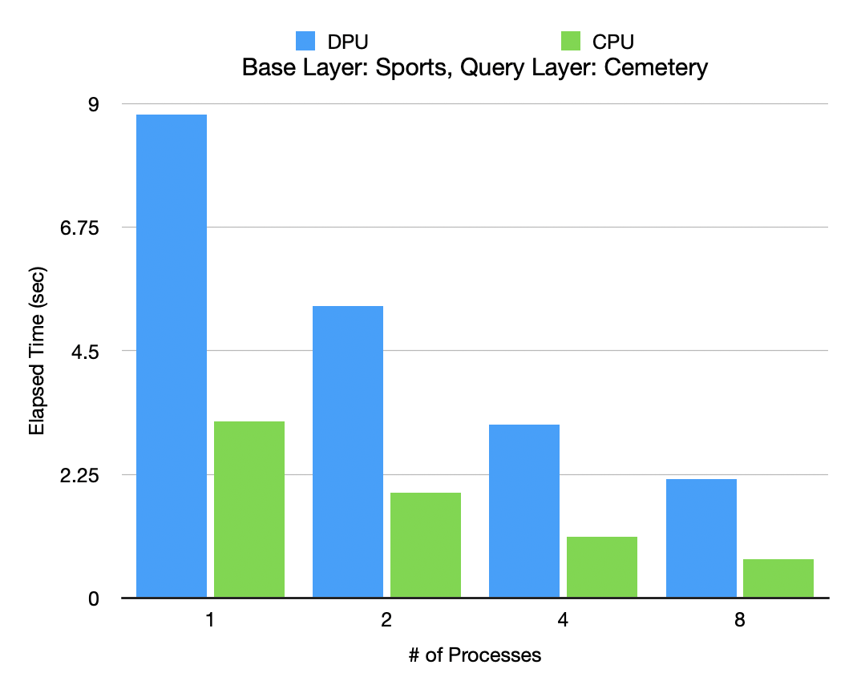
Results #2
Data was divided into number of processes.
Cores of a single node were used.
Speed increased ~1.7 times as the number of processes doubled.

Slide 7
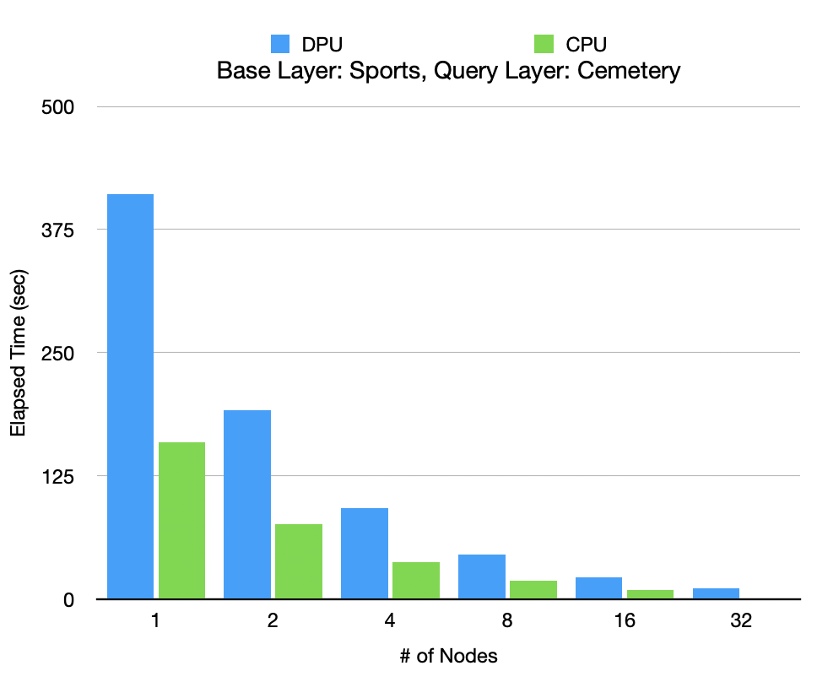
Results #3
Data was divided into 128 parts.
Round-robin method was used for load balancing.
Speedup is more than 2 due to the increase in cache.

Slide 8
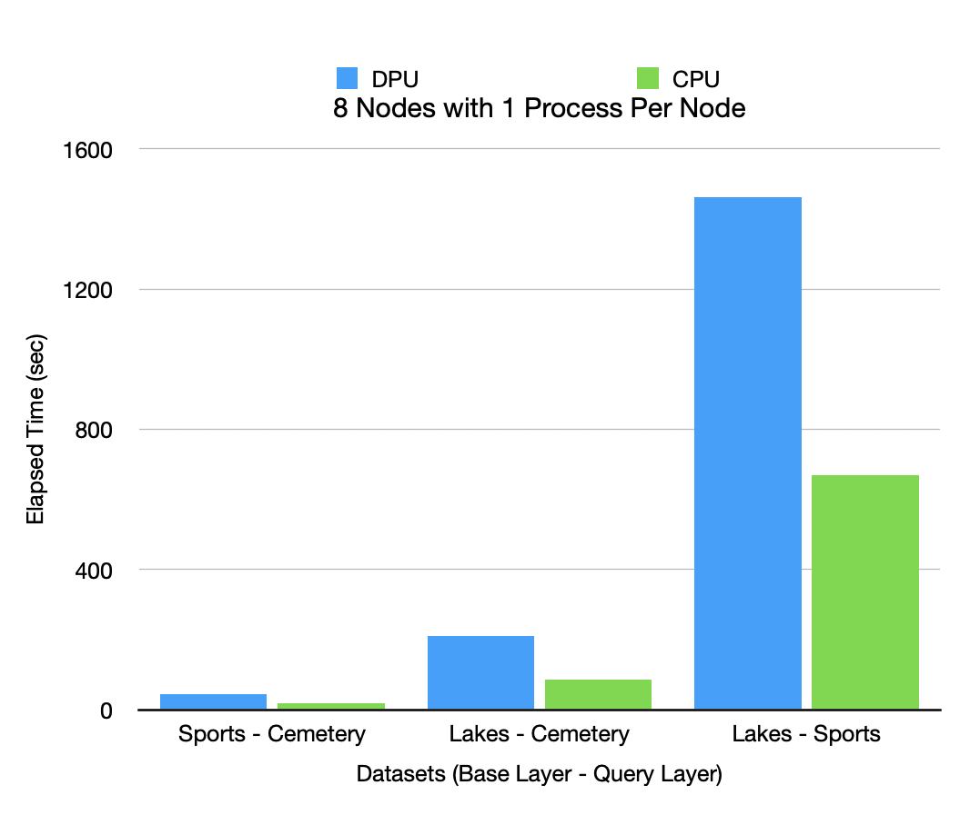
Results #4
Data was divided into partitions, each containing the same amount of geometry.
Performance difference ratio between CPU and DPU decreases as data size increases.

Slide 9
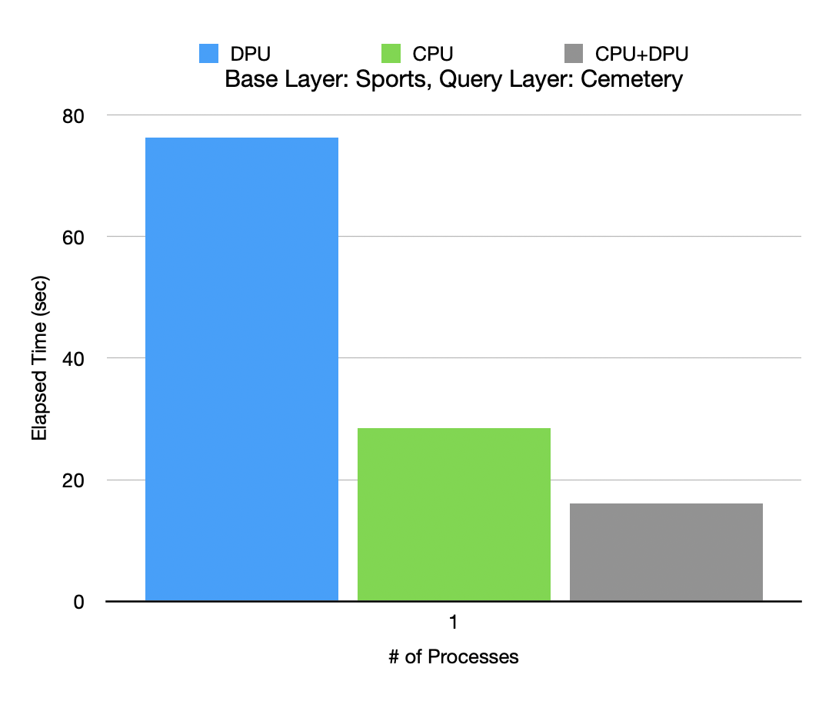
Results #5
Data was divided into 128 parts.
Dynamic load balancing was used for task sharing between CPU and DPU.
CPU only: 28 sec
CPU + DPU: 16 sec

Slide 10
CONCLUSION
CPUs are more powerful hardware than DPUs (~2.5 times).
It has been seen that performance increase can be achieved by using CPU and DPU together.
As future work, the capabilities of the DPU can be researched in more areas, and the communication performance of hardware with different architectures is an area open to improvement.

