Slide 1
GEOSPATIAL OPERATIONS USING Data ProcessIng UnIt AND HIGH PERFORMANCE COMPUTING
Derda Kaymak

Slide 2
AIM OF THE PROJECT
Examining the capabilities and performance characteristics of DPUs
Increasing performance by optimizing geospatial operations and load balancing
Effective use of heterogeneous systems in High Performance Computing

Slide 3
SUBJECTS
SUBJECT
Performance Characteristics of DPU
Geospatial Operations
Data and Specialized Data Structures
Load Balancing
Communication for HPC
Benchmarking Metrics

Slide 4
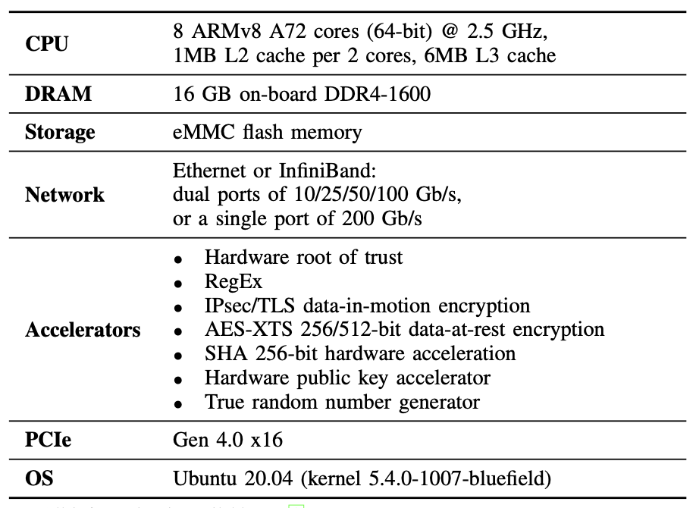
Performance Characteristics of Dpu
DPU is an enhanced version of NIC with computation power
Thanks to its accelerators, it can perform some operations more effectively than the CPU. ^{[1]}
It provides performance increase by being used with CPU in various areas. ^{[2][3]}
Specifications of Nvidia Bluefield-2 DPU ^{[1]}

Slide 5
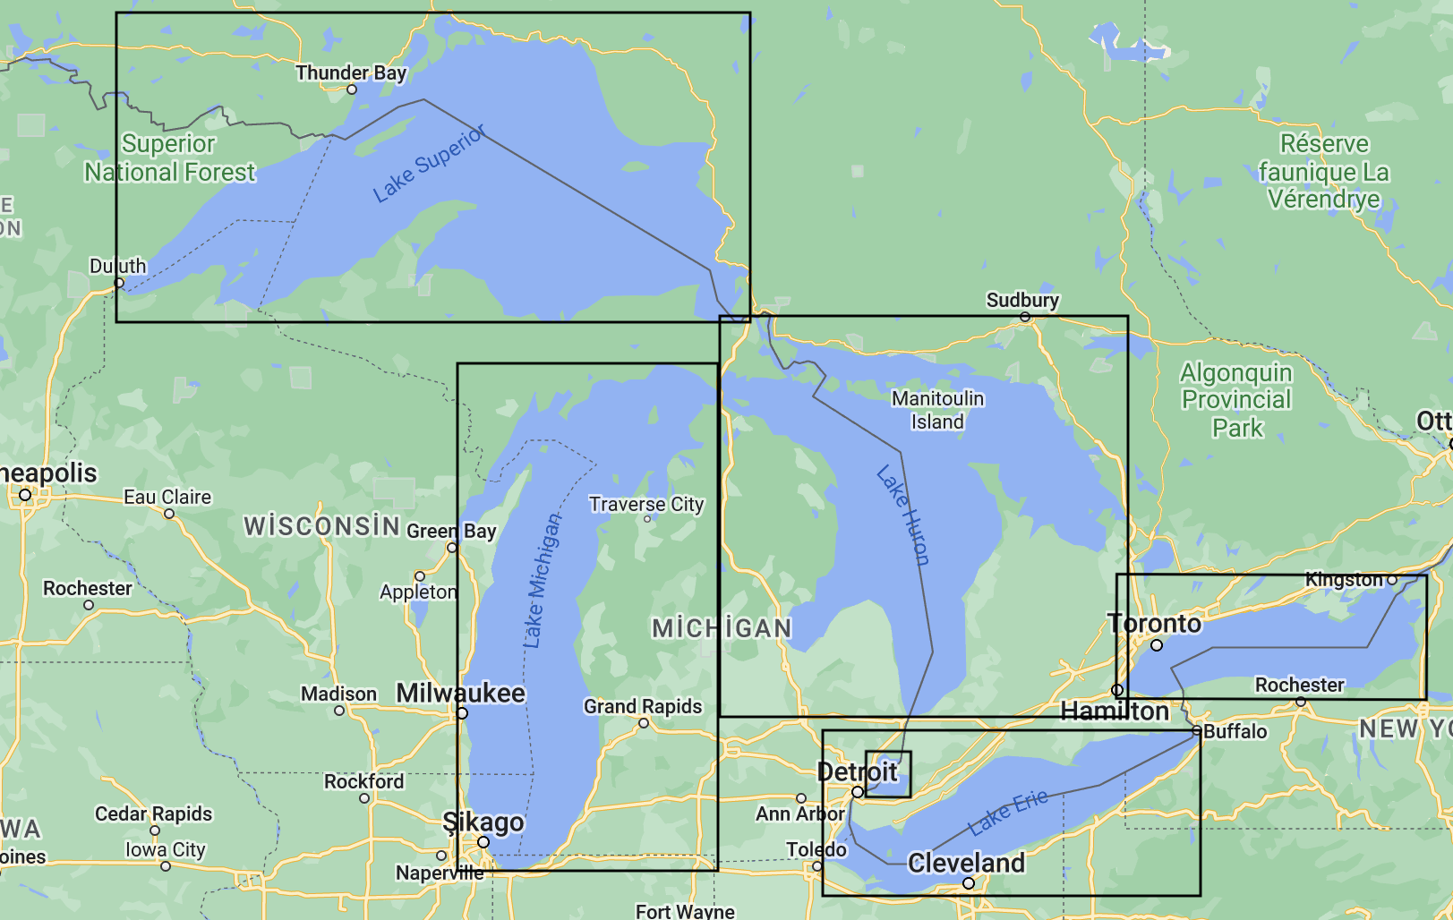
Geospatial Operations
It includes the examination of different features of landforms.
Micro Operations ^{[4]}
Overlap, Intersection, Cross, Touch, Spatial Join
Macro Operations ^{[4]}
Geocoding, Map Search and Flood Risk Analysis
Lakes as Geospatial Objects

Slide 6
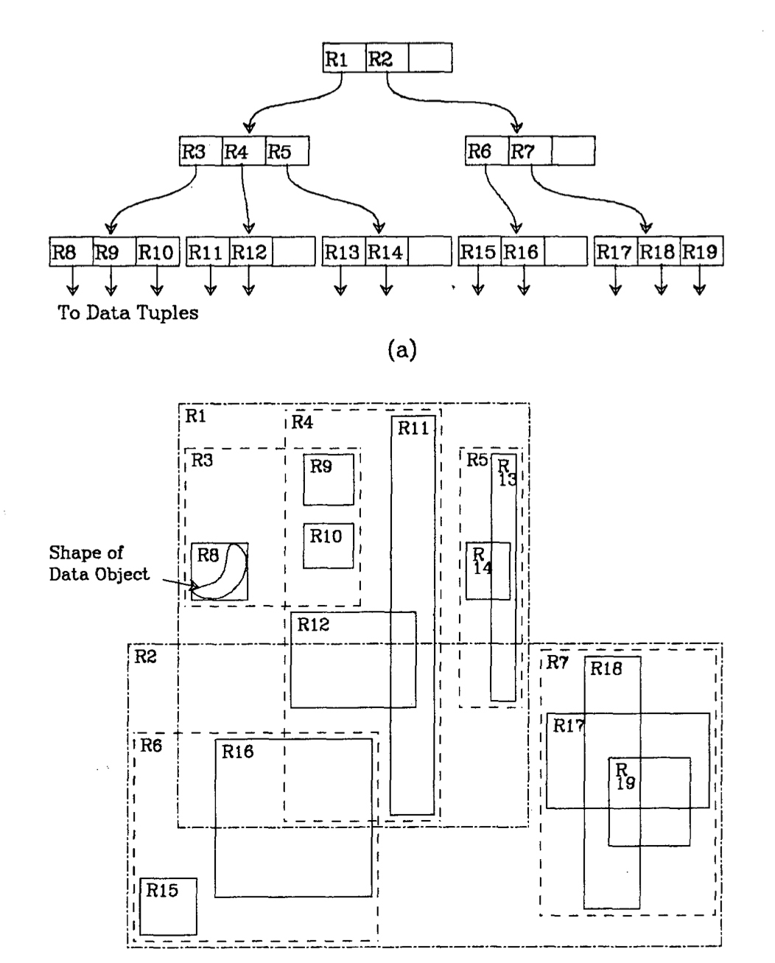
Data and Specialized Data Structures
UCR STAR: Geospatial Dataset ^{[5]}
SPIDER: Geospatial Data Generation Tool ^{[6]}
R-Tree: a popular data structure for geospatial operations ^{[7][8]}
R-Tree Data Structure ^{[7]}

Slide 7
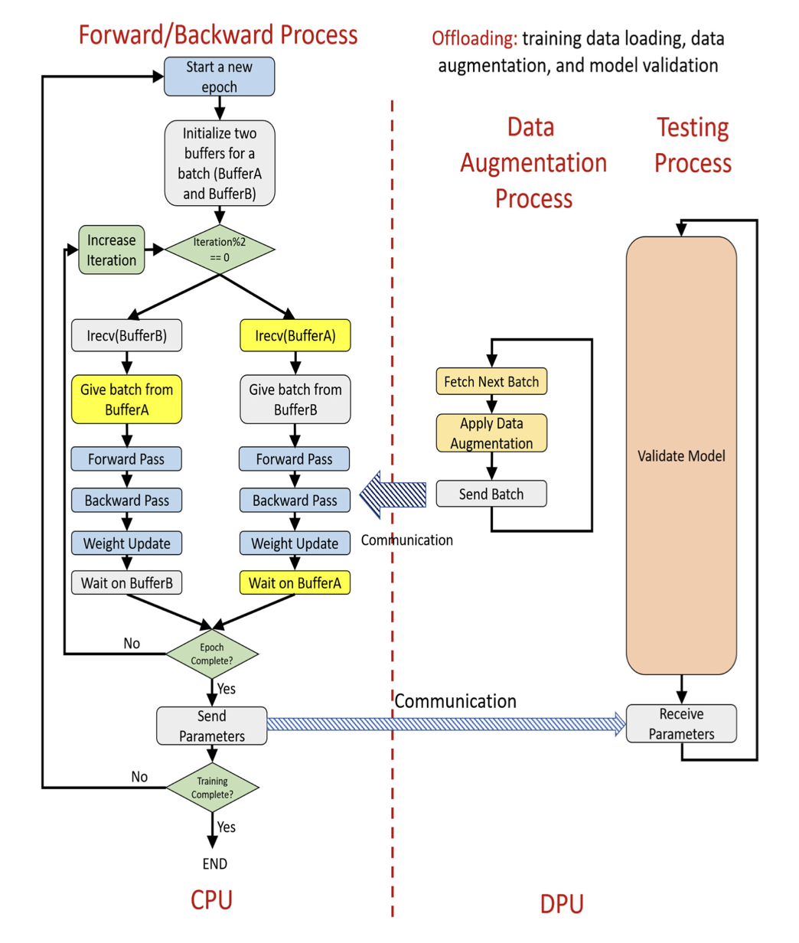
Load Balancing
Static and Dynamic Load Balancing ^{[8]}
Jain et al. provides 17.5% performance improvement thanks to their proper load balancing in the field of Deep Learning ^{[2]}
Load Balancing Between CPU and DPU ^{[2]}

Slide 8
Communication for HPC
Parallel Programming
Computation
Communication
Popular Communication Libraries
MPI (Message Passing Interface)
gRPC (Google Remote Procedure Calls)

Slide 9
Benchmarking Metrics
Jackpine: A Benchmark to Evaluate Spatial Database Performance ^{[4]}
Metrics for Geospatial Operations Using DPU
# of Nodes
Data Size
Query Size
Query Type
…

Slide 10
CONCLUSION AND Future WORK
DPUs are newly developing hardwares and their positive effects on performance have been observed in studies conducted in different fields.
Processing time can be reduced by using DPU in geospatial operations that require high processing power.
As future work, the capabilities of the DPU can be researched in more areas, and the communication performance of hardware with different architectures is an area open to improvement.

Slide 11
References
[1] Liu, J., Maltzahn, C., Ulmer, C., & Curry, M. L. (2021). Performance Characteristics of the BlueField-2 SmartNIC. arXiv preprint arXiv:2105.06619.
[2] A. Jain, N. Alnaasan, A. Shafi, H. Subramoni and D. K. Panda, "Optimizing Distributed DNN Training Using CPUs and BlueField-2 DPUs," in IEEE Micro, vol. 42, no. 2, pp. 53-60, 1 March-April 2022, doi: 10.1109/MM.2021.3139027.
[3] Karamati, S., Hughes, C., Hemmert, K. S., Grant, R. E., Schonbein, W., Levy, S., ... & Vuduc, R. W. (2022). " Smarter" NICs for faster molecular dynamics: a case study. arXiv preprint arXiv:2204.05959.
[4] S. Ray, B. Simion and A. Demke Brown, "Jackpine: A benchmark to evaluate spatial database performance," 2011 IEEE 27th International Conference on Data Engineering, 2011, pp. 1139-1150, doi: 10.1109/ICDE.2011.5767929.
[5] Ghosh, Saheli and Vu, Tin and Eskandari, Mehrad Amin and Eldawy, Ahmed, "UCR-STAR: The UCR Spatio-Temporal Active Repository", 2019, doi: 10.1145/3377000.3377005.
[6] Vu, T., Migliorini, S., Eldawy, A., & Belussi, A. (2021). Spatial Data Generators. Spatial Gems, Volume 1.
[7] Antonin Guttman. 1984. R-trees: a dynamic index structure for spatial searching. SIGMOD Rec. 14, 2 (June 1984), 47–57.
[8] D. Agarwal, S. Puri, X. He and S. K. Prasad, "A System for GIS Polygonal Overlay Computation on Linux Cluster - An Experience and Performance Report," 2012 IEEE 26th International Parallel and Distributed Processing Symposium Workshops & PhD Forum, 2012, pp. 1433-1439, doi: 10.1109/IPDPSW.2012.180.

