Slide 1
CHI-SQUARE

Slide 2
CHI-SQUARE
The Chi-Square test is a non-parametric statistical test used to check if there is a significant relationship between two categorical variables (e.g., gender & voting preference, education level & internet usage).
It checks if the numbers we see in each category are different from what we would expect if the two things were not related.
Example: Imagine you want to know if boys and girls in your class have the same favorite fruit.
You ask everyone, and the results are:

Slide 3
Scenario
Fruit Gender Count
Mango Boys 8
Mango Girls 4
Banana Boys 3
Banana Girls 6
Orange Boys 5
Orange Girls 7

Slide 4
CHI-SQUARE
If boys and girls had no difference in fruit preference, we would expect the numbers in each fruit column to be more balanced.
A Chi-square test checks whether the differences we see (like more boys liking mango) are just due to chance or if they show a real relationship between gender and favorite fruit.

Slide 5
Observed frequencies in Chi Square
What are observed frequencies?
They are the actual counts of people or things in each category — basically, what you see or count when you do a study or survey.
Example: Imagine you ask 10 friends about their favorite fruit:
4 say Mango
3 say Banana
3 say Orange
These numbers — 4, 3, and 3 — are the observed frequencies because they show how many people chose each fruit.

Slide 6
Expected frequencies in Chi Square
What are expected frequencies?
Expected frequencies are the numbers you would expect to see in each category if there were no real difference or relationship between the groups — basically, what you’d get by chance.
Example: Using the fruit example from before, if you asked 10 friends and thought everyone was equally likely to pick any fruit (Mango, Banana, or Orange), then:
You would expect about 3 or 4 people to pick each fruit (since 10 ÷ 3 ≈ 3.3).
If the actual observed numbers are very different from these expected numbers, it might mean there is a real preference for some fruits.

Slide 7
Analyze data (Chi-Square)
Analyze the Data
Go to Analyze → Descriptive Statistics → Crosstabs.
Put Fruit in the Rows box.
Put Gender in the Columns box.
Click Statistics… → tick Chi-square → Continue.
Click Cells… → under Counts, tick Observed and Expected → Continue.
Click OK.
SPSS Output (Example)
Chi-Square Tests

Slide 8
Interpretation
Chi-Square Tests Table
Conclusion
The p-value (0.294) > 0.05, indicating there is no significant association between gender and fruit preference in this dataset.
The differences in counts could be due to random variation rather than a real trend.

Slide 9
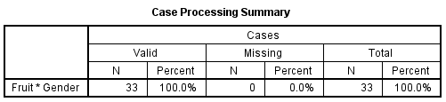
Case Processing Summary
Interpretation:
SPSS now counts all 33 students correctly (sum of Count column).
No missing data.

Slide 10
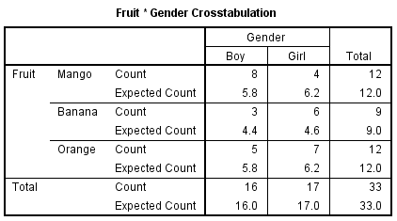
Crosstabulation Table

Slide 11
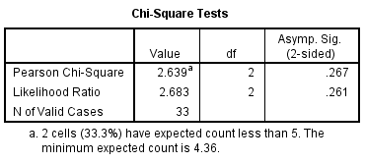
Chi-Square Test Table
Degrees of freedom (df) = (Rows-1)*(Columns-1) = 2
Chi-square statistic ≈ 2.639
p-value ≈ 0.267 > 0.05 → fail to reject H₀

Slide 12
Interpretation
Null Hypothesis (H₀): Fruit preference is independent of gender.
Result: p = 0.267 → not statistically significant.
Conclusion:
There is no significant association between gender and fruit preference in this dataset.

Slide 13
Two data entry methods for chi-square in SPSS:
1. Weight Cases Method
You enter one row per group, and include a column that tells SPSS how many times that group occurs.
Example: Favourite fruit by gender
Fruit | Gender | Count
Mango | Male | 8
Mango | Female | 4
Banana | Male | 3
Banana | Female | 6
Orange | Male | 5
Orange | Female | 7

Slide 14
Two data entry methods for chi-square in SPSS:
Above, each row summarizes a group, and the Count column tells SPSS how many people are in that group.
In SPSS, you then use Weight Cases by the Count variable.
Fruit | Gender
Mango | Male
Mango | Male
Mango | Male
Mango | Male
Mango | Male
Mango | Male
Mango | Male
Mango | Male
Mango | Female
Mango | Female
Mango | Female
Mango | Female
Banana | Male
Banana | Male
Banana | Male
Banana | Female
Banana | Female
Banana | Female
Orange | Male
Orange | Male
Orange | Male
Orange | Male
Orange | Female
Orange | Female
Orange | Female

Slide 15
Example Chi-Square
Transport Mode Choice by Employment Status
A local survey of 50 people was done to see if the mode of transport people use to get to work or school depends on whether they are employed or unemployed.
Transport Mode | Employed | Unemployed | Total
Walking | 8 | 15 | 23
Bicycle | 10 | 7 | 17
Public Bus | 10 | 0 | 10
Total | 28 | 22 | 50

Slide 16
Entering Data
Step 1: Entering data into SPSS
Create three variables:
Transport (1=Walking, 2=Bicycle, 3=Public Bus)
Employment (1=Employed, 2=Unemployed)
Count (the number of people for each combination)Enter this 6-row table:

Slide 17
Actual data set
Transport | Employment | Count
1 | 1 | 8
1 | 2 | 15
2 | 1 | 10
2 | 2 | 7
3 | 1 | 10
3 | 2 | 0
Step 2: Weighting cases in SPSS
(So SPSS knows to count the number of people per row.)
Click Data → Weight Cases → Weight cases by Count → OK.

Slide 18
Run Chi-Square
Step 3: Run Chi-square test
Analyze → Descriptive Statistics → Crosstabs
Put Transport in Rows, Employment in Columns
Click Statistics → tick Chi-square → Continue
Click Cells → tick Observed and Expected → Continue
Click OK

Slide 19
SPSS Output & Interpretation
Step 4: SPSS Output & Interpretation
Test | Value | df | Asymp. Sig. (2-sided)
Pearson Chi-Square | 12.114 | 2 | 0.002
Likelihood Ratio | 15.838 | 2 | 0.000
N of Valid Cases | 50
Interpretation:
p-value = 0.002 < 0.05 → There is a significant relationship between employment status and transport mode.
This means employed and unemployed people tend to use different transport methods.
For example, no unemployed people use public buses, while many employed people do.

