Slide 1
Introduction to Statistical Data Analysis Techniques (Using SPSS)
By the end of this lesson, students should be able to:
Understand what data analysis is and why it is important
Identify different types of data used in SPSS
Compute and interpret measures of location using SPSS
Compute and interpret measures of dispersion using SPSS

Slide 2
Introduction to Data Analysis
What is Data Analysis?
Data analysis is the process of:
Collecting
Organizing
Summarizing
Interpreting data
…in order to discover patterns, trends, and meaningful information for decision-making.

Slide 3
Data Analysis
Data Analysis
Data analysis is a systematic process of examining data in order to discover useful information, draw conclusions, and support decision-making. It involves the following key stages:
1. Collecting Data
This is the first step in data analysis and involves gathering raw data from various sources.
Data may be collected through:
Surveys and questionnaires
Experiments
Interviews
Observations
Existing records or databases
The quality of data analysis depends heavily on how accurate, relevant, and reliable the collected data is.
Data can be primary data (collected directly by the researcher) or secondary data (already existing data).

Slide 4
Data Analysis
2. Organizing Data
Once data is collected, it must be arranged in a structured and meaningful way.
This involves:
Sorting and classifying data
Coding responses (especially for questionnaires)
Entering data into software such as SPSS, Excel, R, or Python
Organization makes the data easier to manage and prepares it for analysis.
Examples include arranging data into tables, spreadsheets, or databases.

Slide 5
Data Analysis
3. Summarizing Data
Summarizing involves condensing large amounts of data into a simpler and more understandable form.
Common summarization techniques include:
Measures of central tendency (mean, median, mode)
Measures of dispersion (range, variance, standard deviation)
Frequency tables
Graphs and charts (bar charts, histograms, pie charts)
This step helps to highlight patterns, trends, and key characteristics of the data.

Slide 6
Data Analysis
4. Interpreting Data
Interpreting data means explaining what the summarized results mean in relation to the research problem or question.
It involves:
Identifying patterns, trends, and relationships
Drawing conclusions from statistical results
Making predictions or recommendations
Interpretation answers the question: What do the results tell us?
This step supports informed decision-making in fields such as business, health, education, and research.

Slide 7
Why Data Analysis is Important
Data analysis helps to:
Support decision making
Identify trends and relationships
Reduce uncertainty
Convert raw data into useful information
Real-life examples:
Exam results analysis (education)
Sales performance (business)
Disease trends (health)
Water point functionality (M&E projects)

Slide 8
Types of Data in SPSS
SPSS mainly works with:
Data Type | Description | Example
Nominal | Categories with no order | Gender, Region
Ordinal | Categories with order | Satisfaction level
Scale | Numeric (interval/ratio) | Age, Income, Scores
Measures of location and dispersion apply mainly to SCALE data

Slide 9
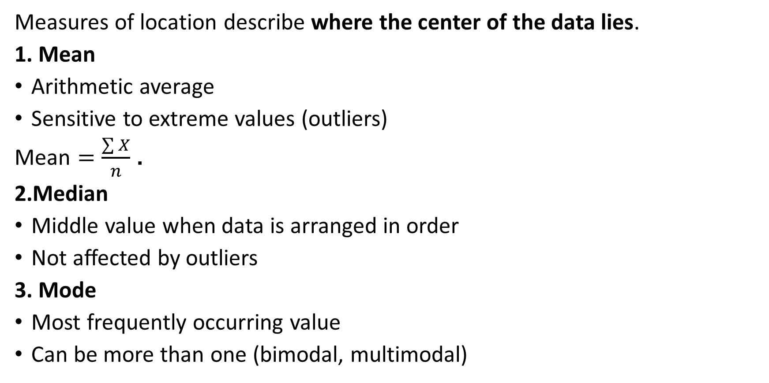
Measures of Location (Central Tendency)
Measures of location describe where the center of the data lies.
1. Mean
Arithmetic average
Sensitive to extreme values (outliers)
$\text{Mean}=\frac{\sum{X}}{n}$.
2.Median
Middle value when data is arranged in order
Not affected by outliers
3. Mode
Most frequently occurring value
Can be more than one (bimodal, multimodal)

Slide 10
Example Dataset
Student_ID | Score
1 | 65
2 | 72
3 | 80
4 | 75
5 | 68
6 | 72
7 | 90
8 | 85
9 | 72
10 | 60
11 | 70
12 | 75
13 | 88
14 | 65
15 | 78

Slide 11
SPSS Practical: Measures of Location
Step-by-Step in SPSS
Open SPSS
Enter a variable (e.g. Exam_Score)
Go to Analyze → Descriptive Statistics → Frequencies
Click Statistics
Tick:
Mean
Median
Mode
Click Continue → OK
Output Interpretation
Mean: Overall average score
Median: Middle score
Mode: Most common score

Slide 12
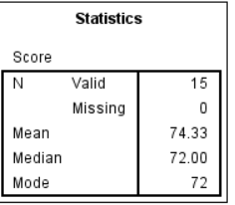
Result

Slide 13
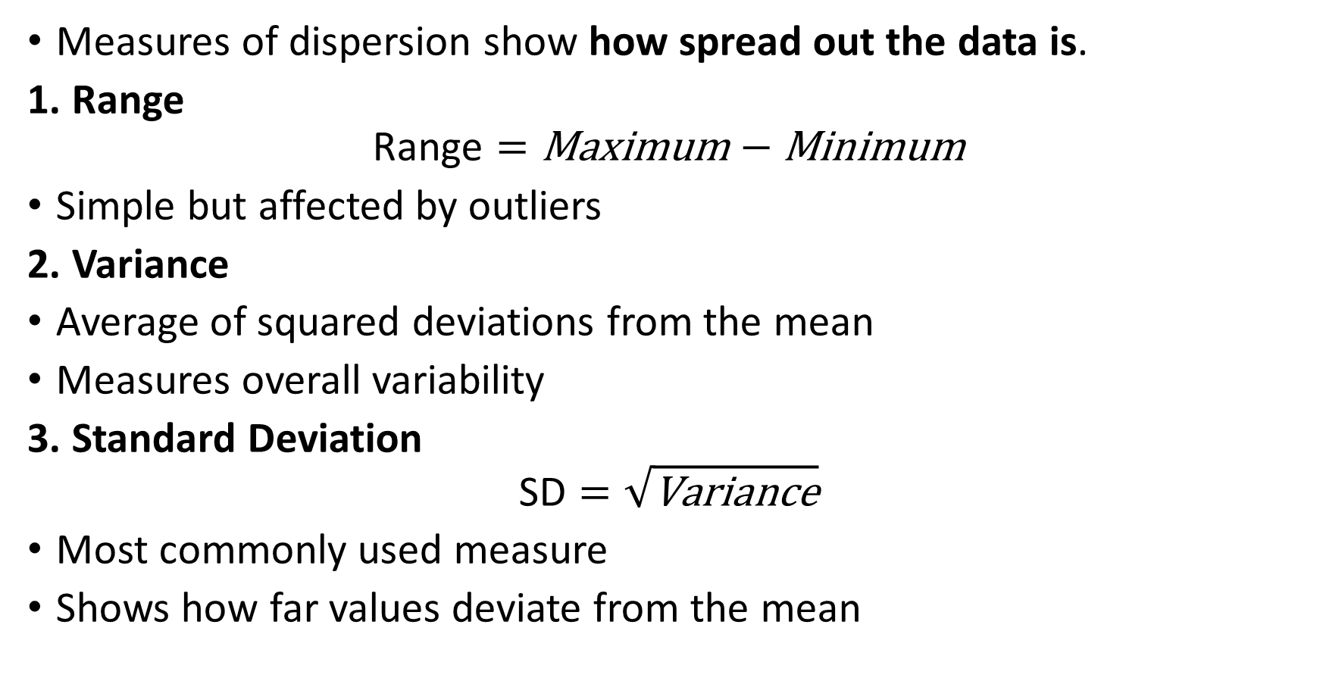
Measures of Dispersion (Variability)
Measures of dispersion show how spread out the data is.
1. Range
$$\text{Range}=\text{Maximum}−\text{Minimum}$$
Simple but affected by outliers
2. Variance
Average of squared deviations from the mean
Measures overall variability
3. Standard Deviation
$$\text{SD}=\sqrt{\text{Variance}}$$
Most commonly used measure
Shows how far values deviate from the mean

Slide 14
SPSS Practical: Measures of Dispersion
Method 1: Using Descriptives
Analyze → Descriptive Statistics → Descriptives
Move the variable to the right
Click Options
Select:
Standard deviation
Variance
Minimum
Maximum
Click Continue → OK

Slide 15
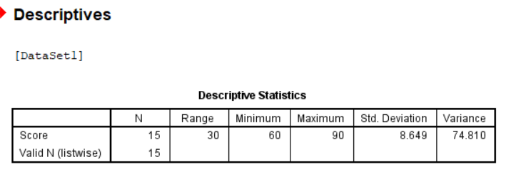
Result

Slide 16
SPSS Practical: Measures of Dispersion
Method 2: Using Explore (Recommended)
Analyze → Descriptive Statistics → Explore
Move variable to Dependent List
Click Statistics
Ensure Descriptives is selected
Click OK
This will gives:
Mean
Median
Standard Deviation
Range
IQR
Boxplot (if selected)

Slide 17
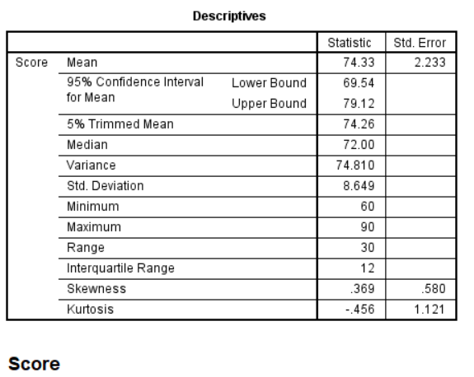
Resulting Table

Slide 18
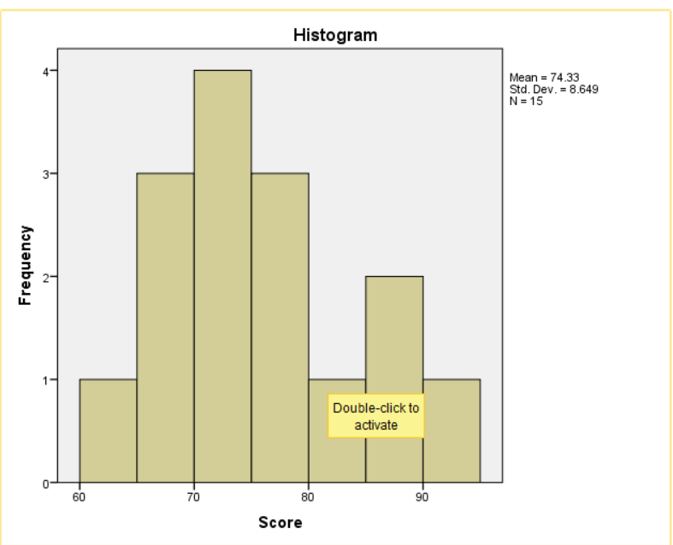
Resulting Graph

Slide 19
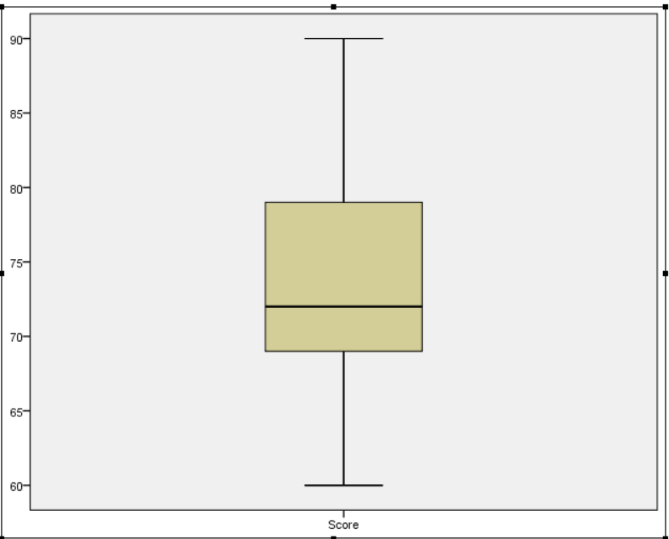
Resulting Boxplot
This figure is a box-and-whisker plot (boxplot) for students’ scores. It visually summarizes the distribution of the data using median, quartiles, spread, and possible outliers.

Slide 20
Interpreting Boxplot
1. Median (Middle Line in the Box)
The thick horizontal line inside the box represents the median score.
Here, the median is approximately 72.
This means 50% of students scored below 72 and 50% scored above 72.

Slide 21
Interpreting Boxplot
2. Lower Quartile (Q1) – Bottom of the Box
The bottom edge of the box represents the first quartile (Q1).
Q1 is approximately 69.
This means 25% of students scored 69 or below.
3. Upper Quartile (Q3) – Top of the Box
The top edge of the box represents the third quartile (Q3).
Q3 is approximately 79.
This means 75% of students scored 79 or below.

Slide 22
Interpreting Boxplot
4. Interquartile Range (IQR)
The height of the box (Q3 − Q1) represents the interquartile range.
IQR ≈ 79 − 69 = 10–12 marks
This shows the spread of the middle 50% of scores.
A moderate IQR indicates moderate variability among most students.

Slide 23
Interpreting Boxplot
5. Whiskers (Minimum and Maximum)
Lower whisker ≈ 60 → lowest score
Upper whisker ≈ 90 → highest score
This gives a range of about 30 marks, showing overall spread.

Slide 24
Interpretation Example
Explanation of the Descriptives Table (Score)
This table summarizes the key characteristics of students’ scores using measures of location, dispersion, and shape.
1. Measures of Central Tendency (Location)
Mean = 74.33 (Std. Error = 2.233)
The mean is the average score of all students.
On average, students scored 74.33 marks.
The standard error shows how much the sample mean may vary from the true population mean.

Slide 25
Interpretation Example
Median = 72.00
The median is the middle score when all scores are arranged in order.
Half of the students scored below 72, and half scored above 72.
Since the median is slightly lower than the mean, it suggests a slight right skew.

Slide 26
Interpretation Example
3. Measures of Dispersion (Spread)
Variance = 74.810
Variance measures how spread out the scores are from the mean.
A higher variance indicates greater variability.
Standard Deviation = 8.649
This shows that, on average, students’ scores deviate from the mean by about 8.65 marks.
Most scores lie roughly between 66 and 83 (Mean ± 1 SD).

Slide 27
In Summary
Concept | Purpose
Data Analysis | Converts raw data into information
Measures of Location | Show central value
Measures of Dispersion | Show data spread
SPSS | Tool for fast and accurate computation

