Slide 1
Using SPSS to calculate Descriptive statistics (frequencies, measures of central tendency, and measures of variability)
STC224

Slide 2
Introduction
Frequencies refer to the number of observations in each category of a variable.
If, for example, for a variable gender there were four males and six females in the data set, the frequency reported in SPSS for males would be 4 and for females would be 6.
Frequencies are typically obtained on categorical variables.
Notes:
categorical variables: These are variables which have limited values

Slide 3
Introduction cont’d
Measures of central tendency are used to describe the center (or central location) of a set of scores and consist of the mean, median, and the mode.
The mean is the arithmetic average (the sum of the scores divided by the total number of scores),
the median is the middle score (assuming the scores were ordered from lowest to highest), and
the mode is the most frequently occurring score (or scores) in the data set.

Slide 4
Introduction cont’d
Measures of variability are used to describe the amount of spread or variability in a set of scores.
The standard deviation and variance are two of the most commonly used measures of variability.
The standard deviation is a measure of how far, on average, scores vary from the mean, and the variance is equal to the standard deviation squared.
Other examples of measures of variability include the range (the difference between the highest and the lowest scores) and the interquartile range (the difference between the scores at the 25th and 75th percentiles of a distribution).

Slide 5
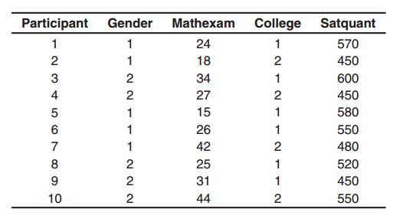
The sample data set
Notes:
How to calculate frequencies, measures of central tendency, and measures of variability in SPSS will be illustrated using the sample data set presented in the Figure

Slide 6
The Data
For each of the participants in Figure above, their gender, score on a math entrance exam (mathexam), whether they were attending college at home or away (college), and their score on the math portion of the SAT (satquant) were recorded.
Gender and college are categorical variables, and mathexam and satquant are continuous variables, with higher scores indicating better performance on both measures (the mathexam scores range from 0 to 50 and satquant scores range from 200 to 800).
For gender, males are assigned a “1” and females are assigned a “2”; for college, those attending college at home are assigned a “1” and those attending college away are assigned a “2.”

Slide 7
Create the Variables
Start SPSS.
Click the Variable View tab. In SPSS, four variables will be created. The variables will be named gender, mathexam, college, and satquant, respectively.
Using the process described previously, enter the variable names gender, mathexam, college, and satquant, respectively, in the first four rows of the Variable View window
Prior to entering the data, we’ll create value labels in SPSS for the categorical variables gender and college.
Using the process described previously, create value labels for gender and college. For gender, 1=“male” and 2=“female” For college 1= “home” , and 2=“away”

Slide 8
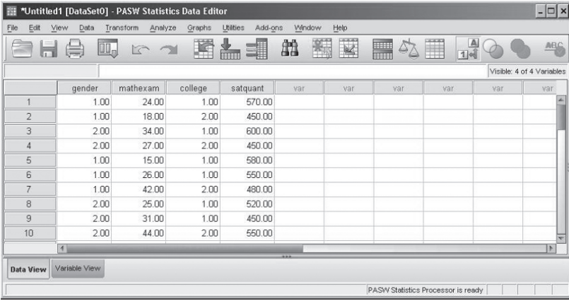
Enter the Data

Slide 9
Analyze the Data
In analyzing the data, first we’ll calculate frequencies for the categorical variables gender and college, and then we’ll calculate measures of central tendency and variability for the continuous variables mathexam and satquant.

Slide 10
Analyze the Data - Frequencies
To calculate frequencies for gender and college, from the menu bar, select
Analyze>Descriptive Statistics>Frequencies

Slide 11
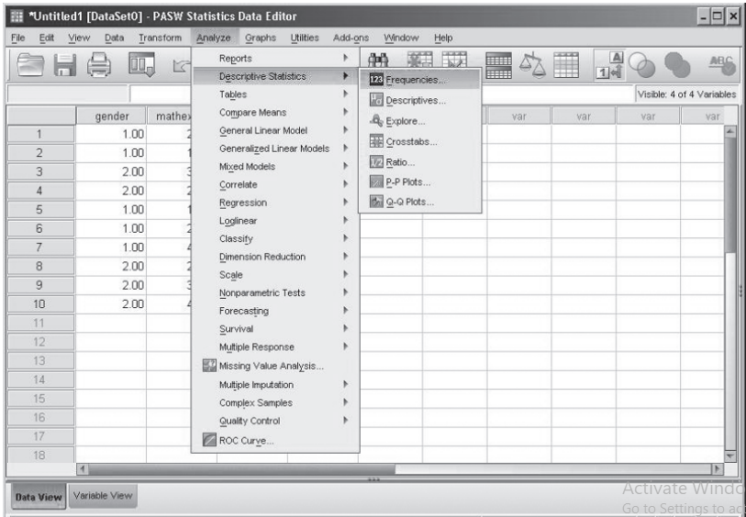
Menu commands for the Frequencies procedure

Slide 12
Analyze the Data cont’d
A Frequencies dialog box opens with the variables gender, mathexam, college, and satquant on the left-hand side of the dialog box

Slide 13
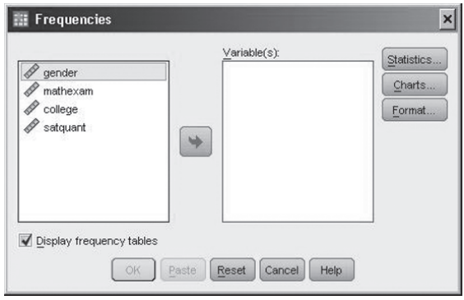
The Frequencies dialog box

Slide 14
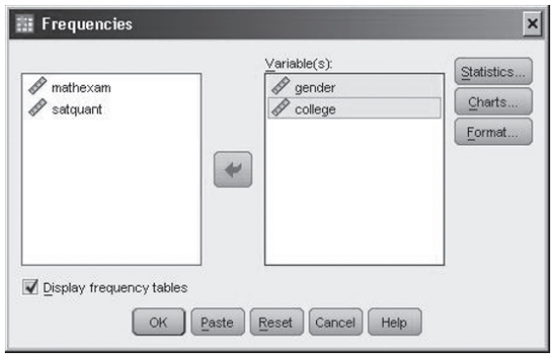
The Frequencies dialog box
Select the variable gender and then press and hold down the Ctrl key (the Ctrl key is located in the bottom left-hand corner of your keyboard).
Select the variable college (gender and college should now be selected). Click the right-arrow button ( ) to move the two variables to the Variable(s)box
Click OK

Slide 15
Frequencies cont’d
The Frequencies procedure runs and the results are presented in the Viewer window.
Prior to discussing the results of the Frequencies procedure for gender and college, we’ll obtain descriptive statistics for mathexam and satquant.

Slide 16
Measures of Central Tendency and Variability
Next we’ll obtain measures of central tendency and variability for the continuous variables mathexam and satquant using the Frequencies procedure
To obtain measures of central tendency and variability
From the menu bar select Analyze>Descriptive Statistics>Frequencies
The Frequencies dialog box opens. Click the Reset button to clear the existing variables from the Variable(s)box.
Select the variable mathexam and then press and hold down the Ctrl key. Select the variable satquant (both mathexam and satquant should now be selected). Click the right-arrow button ( ) to move the two variables to the Variable(s)

Slide 17
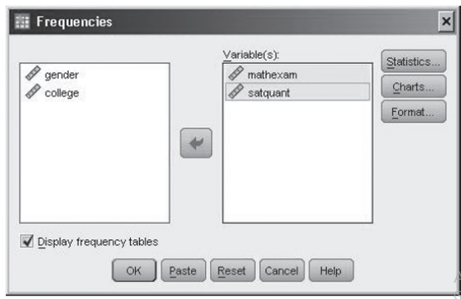
The Frequencies dialog box (continued)

Slide 18
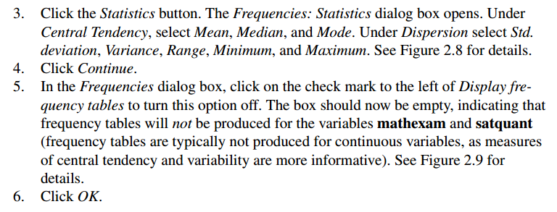
Measures of Central Tendency and Variability cont’d
The Frequencies procedure runs in SPSS and the results are presented in the Viewer window

Slide 19
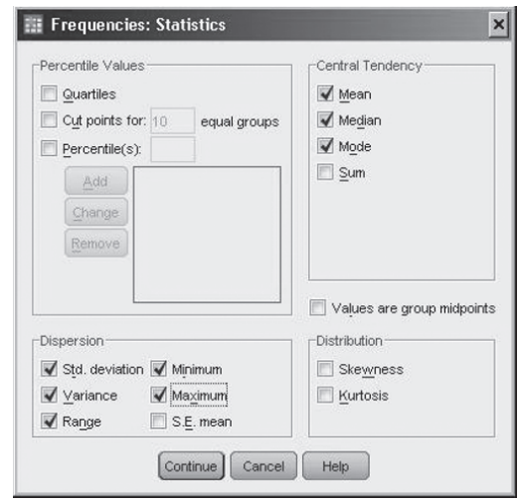
The Frequencies: Statistics dialog box

Slide 20
Analysis of Groups Using the Means Procedure
The Means procedure is useful for obtaining descriptive statistics separately for each group of a variable (or variables) of interest.
For example, instead of obtaining the mean satquant score for all participants, the mean satquant scores could be obtained separately for those who attended college at home and those who attended college away

Slide 21
Analysis of Groups Using the Means Procedure cont’d
To obtain the means procedure
Make the Data View window active (select Window>Untitled1 [DataSet0] –IBM SPSS Statistics Data editor
From the menu bar, select Analyze>Compare Means>Means
The Means dialog box opens
The variable that the mean and standard deviation will be obtained on (satquant) goes into the Dependent List box and the variable that contains the different groups (college) goes into the Independent List box

Slide 22
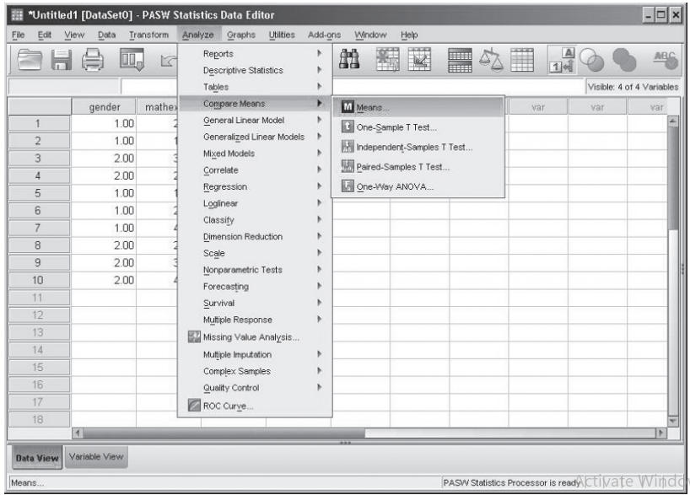
Menu commands for the Means procedure

Slide 23
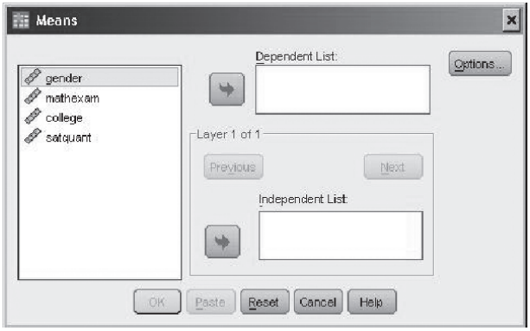
The Means dialog box

Slide 24
Analysis of Groups Using the Means Procedure cont’d
Select satquant and click the upper right-arrow button ( ) to move it to the Dependent List box.
Select college and click the lower right-arrow button ( ) to move it to the Independent List box
Click Options. The Means: Options dialog box opens

Slide 25
Analysis of Groups Using the Means Procedure cont’d
On the left-hand side of the dialog box (labeled Statistics) are a number of statistics that can be selected, and on the right-hand side (labeled Cell Statistics) are the statistics that are calculated by default.
Since the Mean and Standard Deviation are on the right-hand side already, we’ll leave the default options in place. (Number of Cases could be moved to the Statistics box by selecting it and clicking the arrow button, but we’ll leave it there since it won’t adversely affect our results.)
Click Continue.
Click OK.

Slide 26
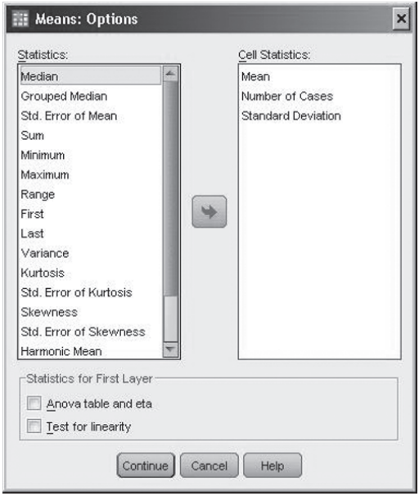
The Means: Options dialog box
Notes:
The Means procedure runs in SPSS and the results are presented in the Viewer window

Slide 27
Means procedure using the layered option
To perform the Means procedure using the layered option
Make the Data View window active (select Window>Untitled1 [DataSet0] –IBM SPSS Statistics Data editor
From the menu bar, select Analyze>Compare Means>Means
The Means dialog box opens with satquant in the Dependent List box and college in the Independent List box
Notes:
(Note: If you did not perform the previous Means procedure, you’ll need to move satquant and college to their
respective boxes.)

Slide 28
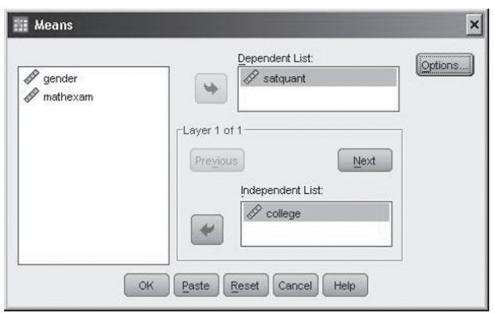
The Means dialog box

Slide 29
Means procedure using the layered option cont’d
To layer the results by gender, in the Layer 1 of 1 section of the dialog box, click the Next button (after clicking on Next, you should see ‘Layer 2 of 2’ above the Previous button). Select gender and click the lower-right arrow button ( ) to move it to the Independent List box
Click OK

Slide 30
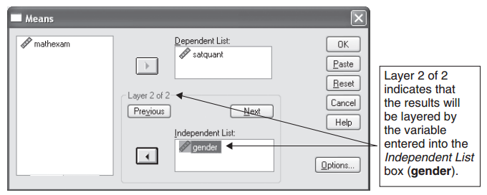
The Means dialog box using the layered option

Slide 31
Interpret the results
The Means procedure runs in SPSS and the results are presented in the Viewer window.
Next we’ll discuss the output for the four analyses we conducted. As a review, the four analyses were:
Frequencies on the variables college and gender.
Measures of central tendency and variability on mathexam and satquant.
Means and standard deviations on satquant for the different college groups.
Means and standard deviations on satquant for the different college groups layered by gender

Slide 32
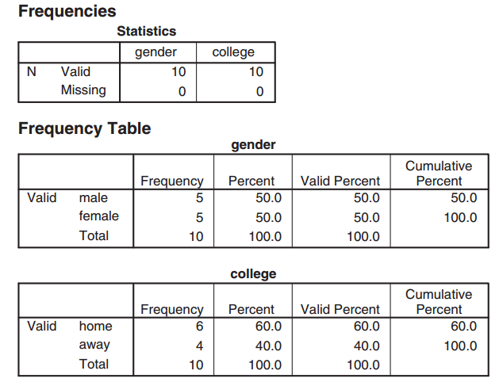
Analysis 1: Frequencies Procedure—Gender and College
Notes:
Output of the Frequencies procedure for gender and college

Slide 33
Frequencies—Statistics
The Statistics table displays the sample size for the variables gender and college.
The table indicates that there were 10 valid observations for gender and college (all 10 people had values on both variables).
The value of zero in the Missing row indicates that there were no missing values for either of the variables (a missing value for gender, for example, would indicate that the gender of one of the participants was not recorded).

Slide 34
Frequency Table—Gender
The frequency table for gender indicates the frequency, or number of participants, for each category of gender.
In the table there are five males and five females, with each gender representing 50% of the data set.

Slide 35
Frequency Table—College
The frequency table for college indicates the frequency for each category of college.
The table shows that six students attended college at home and four students attended college away from home, representing 60% and 40% of the data set, respectively

Slide 36
Analysis 2: Frequencies Procedure—Mathexam and Satquant
The Statistics table displays the results of the Frequencies procedure for the continuous variables mathexam and satquant. (Recall that we requested measures of central tendency and variability for these variables.)
The mean and standard deviation for mathexam is 28.60 and 9.38 (rounding to two decimal places) and for satquant is 520.00 and 58.31, respectively.
The minimum and maximum values indicate the lowest and highest values in the data set and are helpful for ensuring that all the data are within the possible range of values (a value outside of this range would most likely indicate that a data entry error has been made).
The minimum and maximum values of 15.00 and 44.00 for mathexam and 450.00 and 600.00 for satquant show that there were no out-of-range values for either variable (as indicated earlier, the range of possible scores for mathexam is 0 to 50 and for satquant is 200 to 800)

Slide 37
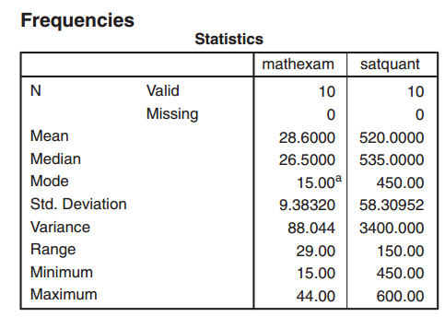
Output of the Frequencies procedure for mathexam and satquant
Notes:
A = Multiple modes exist. The smallest value is shown

Slide 38
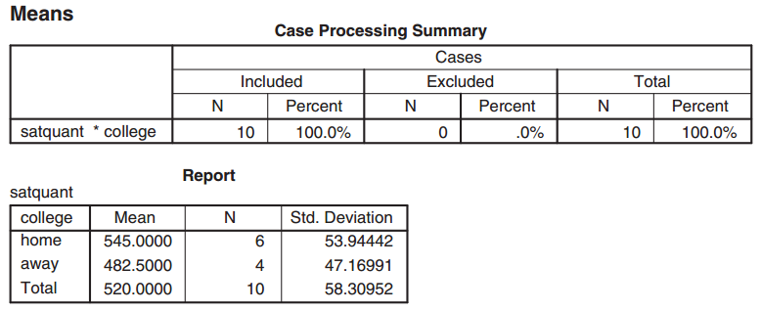
Analysis 3: Means Procedure—Satquant by College
Notes:
Output of the Means procedure on satquant for the college groups home and away

Slide 39
Case Processing Summary
The Case Processing Summary table indicates the number of observations included in the analysis (10), the number of observations excluded (0), and the total number of observations in the data set (10).
The table indicates that all 10 participants were included in the analysis (all 10 people had values on satquant and college)

Slide 40
Report
The Report table shows the mean, sample size (N), and standard deviation for the college groups home, away, and total (home and away combined).
Inspecting the means for the two groups shows that the six students who attended college at home had a higher mean satquant score (545.00) than the four students who attended college away (482.50).
Those who stayed at home for college also had satquant scores that were slightly more variable than those who attended college away (the standard deviation for home was 53.94 compared to a standard deviation of 47.17 for away).
The mean satquant score for the entire sample (Total) was 520.00 with a standard deviation of 58.31 (this agrees with the values obtained in our second analysis).

Slide 41
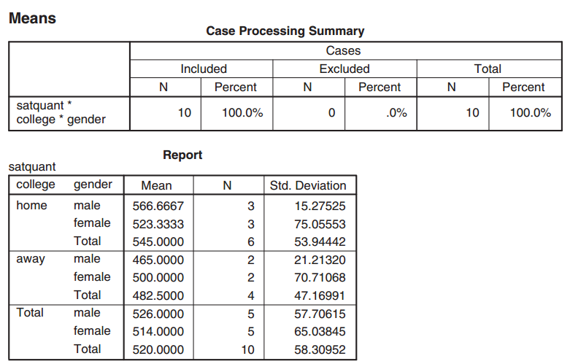
Analysis 4: Means Procedure—Satquant by College Layered by Gender
Notes:
Output of the Means procedure on satquant for college layered by gender

Slide 42
Case Processing Summary
The Case Processing Summary table indicates the number of observations included in the analysis (10), the number of observations excluded (0), and the total number of observations in the data set (10).
The table indicates that all 10 participants were included in the analysis (all 10 people had values on satquant, college, and gender).

Slide 43
Report
The Report table displays the mean, sample size (N), and standard deviation on satquant for college layered by gender.
The first section of the table displays the mean and standard deviation for males and females who attend college at home.
Notice that males have a higher mean score than females on satquant (566.67 vs. 523.33) and that females have a larger standard deviation (75.06 vs. 15.28).
The second section of the table displays the mean and standard deviation for males and females who attend college away from home.
For this group of students, females have a higher mean than males on satquant (500.00 vs. 465.00) and a larger standard deviation (70.71 vs. 21.21).

Slide 44
Report cont’d
Finally, the last section of the table displays the mean and standard deviation for males and females for home and away combined.
When the college groups are combined, males have a higher mean satquant score than females (526.00 vs. 514.00), while females have a larger standard deviation (65.04 vs. 57.71).

Slide 45
Activity
A soccer coach evaluated the impact of two different kicking methods (a toe kick and a heel kick) on the effectiveness of kicking a soccer ball. Four boys and four girls kicked a ball using one of the two methods and the distance (in feet) and accuracy (on a 1 to 10 scale) of the kicks were recorded.
The experience level of each child was also ascertained, with higher values indicating greater experience. Half of the children (two boys and two girls) kicked the ball using a toe kick and the other half kicked the ball using a heel kick. The data are provided in Figure below
For gender, 1=“boys” and 2=“girls” For method, 1=“toe kick” and 2 =“heel kick”

Slide 46
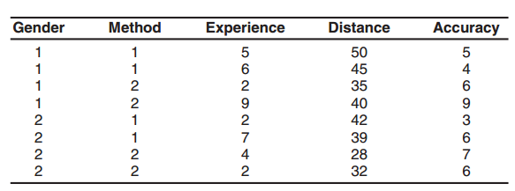
Activity cont’d

Slide 47
Activity cont’d
Enter the data in SPSS as shown in figure above and perform the appropriate analyses to answer each of the questions below. Enter value labels as appropriate for gender and method.
Report the frequencies for gender and method.
Report the mean and standard deviation for experience, distance, and accuracy for the entire sample
Report the mean and standard deviation for experience, distance, and accuracy separately for boys and girls. Which group has a higher mean on each of the three variables? Which group has a larger standard deviation?

Slide 48
Activity cont’d
Report the mean and standard deviation for experience, distance, and accuracy separately for the toe kicking and heel kicking methods. Which group has a higher mean on each of the three variables? Which group has a larger standard deviation?
Report the mean and standard deviation for experience, distance, and accuracy for gender layered by method. Which of the four conditions has the lowest mean experience and accuracy scores? Which has the highest mean kicking distance?

Slide 49


