Slide 1
Importing files from other programs (MS Access, MS Excel)
STC224

Slide 2
Importing Data into SPSS
If you already have data that are in an SPSS file format (file extension “.sav”), you can simply open that file to begin working with your data in SPSS.
However, if you have data stored in other types of files, such as an Excel spreadsheet or a text file, you will need to instruct SPSS how to read the file and then save it in the SPSS file format (“.sav”).
Below, we will cover how to import data from two common types of files: Excel files and text files.

Slide 3
Importing Data from an Excel File
To import data from an Excel spreadsheet into SPSS, first make sure your Excel spreadsheet is formatted according to these criteria:
The spreadsheet should have a single row of variable names across the top of the spreadsheet in the first row.
Variable names should include ordinary letters, numbers, and underscores (e.g., Gender, Grad_Date, Test_1) and not include special characters (e.g., "Graduation Date" would not be a valid variable name because it contains a space).
The data should begin in the first column, second row (beneath the variable names row) of the spreadsheet.
Anything that is not part of the data itself (e.g., extra text, labels, graphs, Pivot Tables) should be removed.
Missing values for string or numeric variables have blank (empty) cells, or an appropriate predetermined missing value code (such as -999).

Slide 4
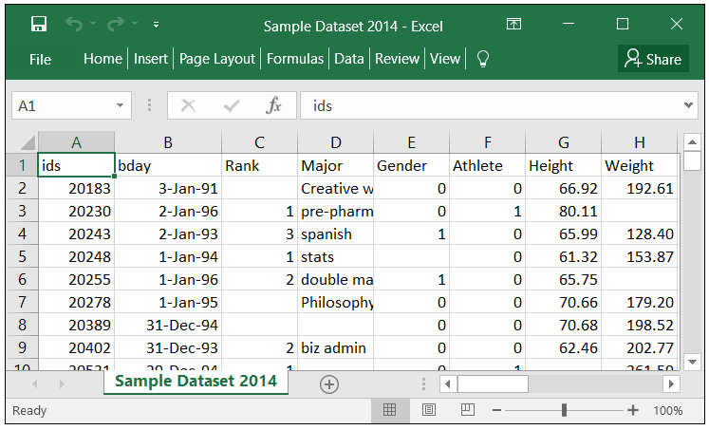
Here is an example of what properly formatted data looks like in Excel 2010

Slide 5
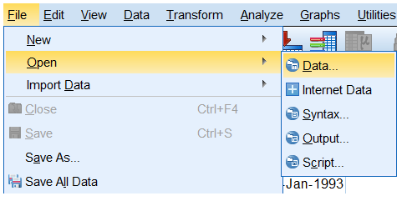
Importing Data from an Excel File cont’d
Once the data in your Excel file is formatted properly it can be imported into SPSS by following these steps:
Click File > Open > Data. The Open Data window will appear.

Slide 6
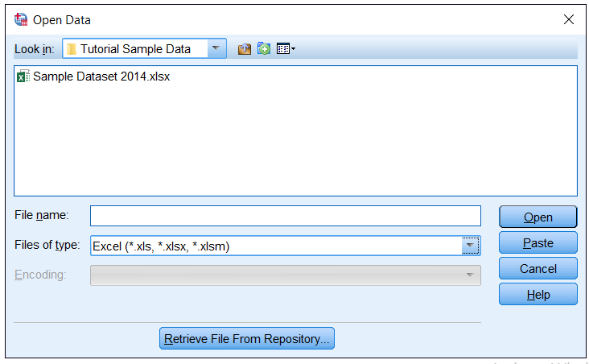
Importing Data from an Excel File cont’d
In the Files of type list select Excel (*.xls, *.xlsx, *.xlsm) to specify that your data are in an Excel file.
If you do not specify the type of file that you wish to open, your file will not appear in the list of available files. Locate and click on your file. The file name will appear in the File name field. Click Open.

Slide 7
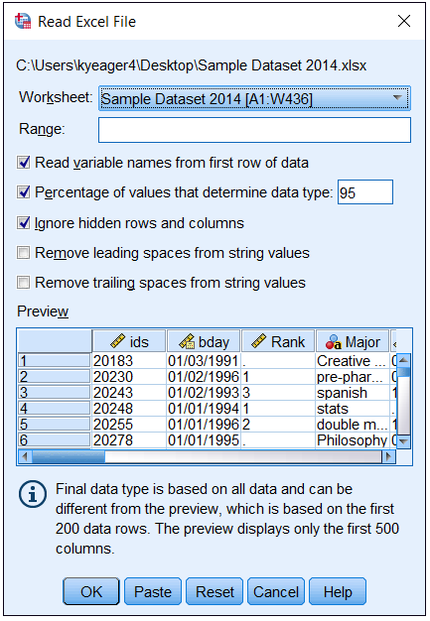
Importing Data from an Excel File cont’d
If you are using SPSS Version 25, the Read Excel File window will appear.

Slide 8
Importing Data from an Excel File cont’d
In the Worksheet dropdown menu, select the sheet from your Excel workbook that contains your data. (If you have not assigned names to the sheets in your Excel workbook, the labels you see here will usually be Sheet1, Sheet2, Sheet3, etc.) You can only import one sheet from your Excel file at a time.
If your variable names are in the first row of data, select the Read variable names from the first row of data check box.
The options Remove leading spaces from string values and Remove trailing spaces from string values only affect variables that are imported as strings.
The former will remove any whitespace characters that appear at the start of the string, and the latter will remove any whitespace characters at the end of the string. This is optional, but is often convenient, since leading and trailing spaces can appear invisible to the user, but cause SPSS to think that otherwise identical strings are distinct.
You may also specify the range of rows/columns to import if you wish. It is suggested to keep the default value unless you have a reason for altering it.
Click OK when you are finished.

Slide 9
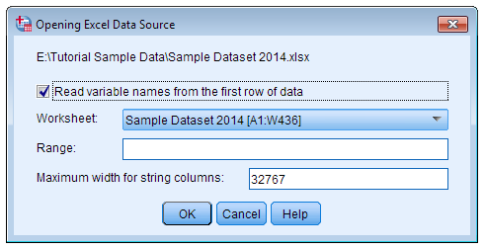
Importing Data from an Excel File cont’d
If you are using SPSS version 24 or earlier, you will instead see the Opening Excel Data Source window:

Slide 10
Importing Data from an Excel File cont’d
The meaning of Read variable names from the first row of data checkbox, the Worksheet dropdown, and the Range box are the same as above.
The Maximum width for string columns option determines how wide a string variable should be; it is suggested to keep the default value unless you have a reason for altering it.

Slide 11
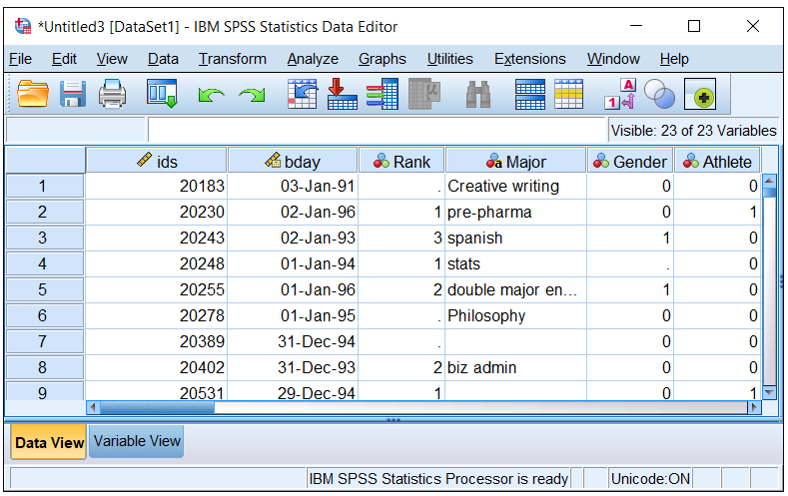
Importing Data from an Excel File cont’d
Now the data will appear in SPSS. Here is an example of how sample data appear in SPSS once the data have been imported:

Slide 12
IMPORTING EXCEL FILES USING SYNTAX
Alternatively, you can import Excel files into SPSS using syntax, instead of using the dropdown menus. The general syntax is:
GET DATA /TYPE=XLSX
/FILE='C:\path\to\file.xlsx'
/SHEET=name 'Name-of-Sheet'
/CELLRANGE=full /READNAMES=on
/ASSUMEDSTRWIDTH=32767.
EXECUTE.
DATASET NAME DataSetExcel WINDOW=FRONT.

Slide 13
Importing Data from a Text File
Data stored in text files have extensions such as *.txt, *.dat, or *.csv.
These types of data files are simple to create and are not tied to a proprietary software, so they are a popular choice for data files.
While many computers will automatically open these file types in a spreadsheet software like Microsoft Excel, they can be opened and edited using any text editor program.
Importing text files into SPSS is slightly different than importing data in Excel spreadsheets.
There are several different patterns used to delineate the start and end of a particular variable, and SPSS must know what pattern to follow in order to read the data correctly.

Slide 14
Importing Data from a Text File
In general, there are two patterns that SPSS recognizes:
Delimited data: Each observation is delimited, or separated, by a particular character. Common characters used for delimiters include commas, tabs, and whitespace.
ID,Age,Gender
A001,41,F
A009,36,M
C321,27,F

Slide 15
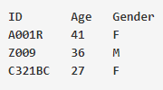
Importing Data from a Text File
Fixed-width data: Rather than using delimiters between observations, the values of the variables are aligned vertically, so that a given variable always begins in a certain column position.
In the below example, ID always begins in column 1; Age always begins in column 10; and Gender always begins in column 16.

Slide 16
Importing Data from a Text File
Files with the extension *.txt are called text files.
This file type can contain fixed-width or delimited data.
A common variation for *.txt files is tab-delimited data; that is, each observation is separated by a tab (created using the Tab key on the keyboard).
However, *.txt files do not always use tabs as delimiters -- in fact, *.txt files can use any character as a delimiter, including commas.
Files with the extension *.csv are called comma-delimited files; in this type of file, the observations are delimited by a comma.
Traditionally, the first row of a CSV file contains the variable names (separated by a comma), and the first row of data begins on the second line.
Missing values are denoted using adjacent delimiters.

