Slide 1
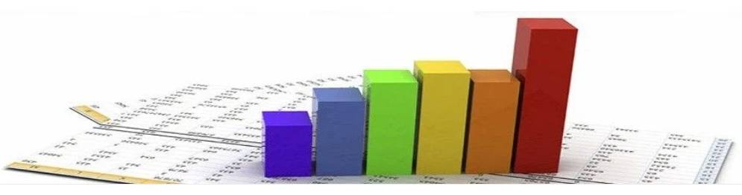
Basics of statistics
STC224

Slide 2
Introduction
Statistics is the science concerned with developing and studying methods for collecting, analyzing, interpreting and presenting empirical data.
Two fundamental ideas in the field of statistics are uncertainty and variation.
There are many situations that we encounter in science (or more generally in life) in which the outcome is uncertain.
In some cases the uncertainty is because the outcome in question is not determined yet (e.g., we may not know whether it will rain tomorrow) while in other cases the uncertainty is because although the outcome has been determined already we are not aware of it (e.g., we may not know whether we passed a particular exam).

Slide 3
What is Univariate Analysis?
Univariate analysis is the simplest form of analyzing data.
“Uni” means “one”, so in other words your data has only one variable.
It doesn’t deal with causes or relationships (unlike regression ) and it’s major purpose is to describe;
It takes data, summarizes that data and finds patterns in the data.

Slide 4
What is a variable in Univariate Analysis?
A variable in univariate analysis is just a condition or subset that your data falls into.
You can think of it as a “category.”
For example, the analysis might look at a variable of “age” or it might look at “height” or “weight”.
However, it doesn’t look at more than one variable at a time otherwise it becomes bivariate analysis (or in the case of 3 or more variables it would be called multivariate analysis).

Slide 5
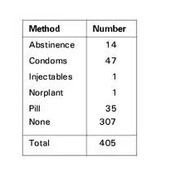
Univariate Analysis cont’d
The following frequency distribution table shows one variable (left column) and the count in the right column.
Notes:
A frequency chart.

Slide 6
Univariate Analysis cont’d
You could have more than one variable in the above chart.
For example, you could add the variable “Location” or “Age” or something else, and make a separate column for location or age.
In that case you would have bivariate data because you would then have two variables.

Slide 7
Univariate Descriptive Statistics
Some ways you can describe patterns found in univariate data include central tendency (mean, mode and median) and dispersion: range , variance, maximum, minimum, quartiles (including the interquartile range), and standard deviation.
In short, basic descriptive statistics include:
Measures of central tendency: mean, median, mode, midrange.
Measures of dispersion: range, standard deviation, variance.
Notes:
Descriptive statistics, in short, help describe and understand the features of a specific data set by giving short summaries about the sample and measures of the data.

Slide 8
Univariate Descriptive Statistics cont’d
There are several other options for describing data with univariate data (using Descriptive Statistics):
Frequencies and Distribution
Other basic Univariate procedures
Explore, Crosstab
Notes:
Frequency Distribution Tables.
Bar Charts.
Histograms.
Frequency Polygons.
Pie Charts.

Slide 9
Central Tendency…
Basic Descriptive Statistics
Measures of Central Tendency
Measures of central tendency are used to describe the centre (or central location) of a set of scores
Statisticians use samples taken from populations; however, when populations are small, it is not necessary to use samples since the entire population can be used to gain information
Measures found by using all the data values in the population are called parameters.
Measures obtained by using the data values from samples are called statistics
Suppose an insurance manager wanted to know the average weekly sales of all the company’s representatives. If the company employed a large number of salespeople, say, nationwide, he would have to use a sample and make an inference to the entire sales force. If the company had only a few salespeople, say, only 87 agents, he would be able to use all representatives’ sales for a randomly chosen week and thus use the entire population

Slide 10
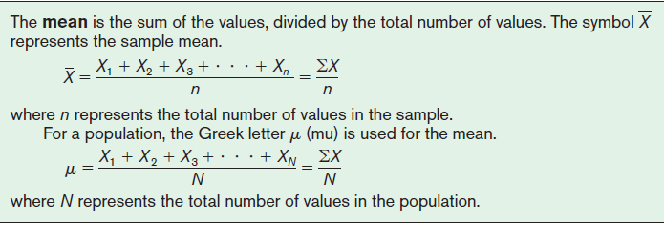
Central Tendency…
Basic Descriptive Statistics…
The Mean
The mean, also known as the arithmetic average
Found by adding the values of the data and dividing by the total number of values
In statistics, Greek letters are used to denote parameters, and Roman letters are used to denote statistics

Slide 11
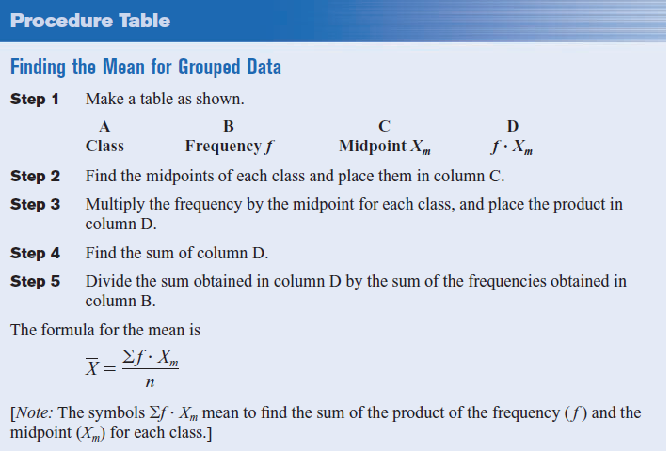
Central Tendency…
Mean for Grouped Data
The procedure for finding the mean for grouped data assumes that the mean of all the raw data values in each class is equal to the midpoint of the class
Using this procedure will give an acceptable approximation of the mean

Slide 12
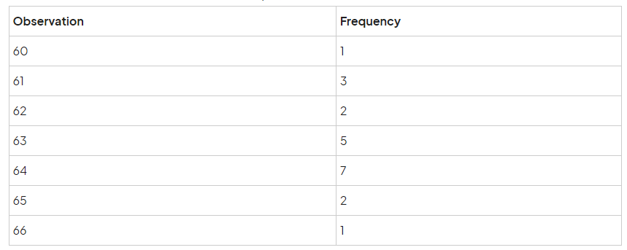
Grouped Data with data sets that list individual observations
Written out, this data would look like the following:
60, 61, 61, 61, 62, 62, 63, 63, 63, 63, 63, 64, 64, 64, 64, 64, 64, 64, 65, 65, 66

Slide 13
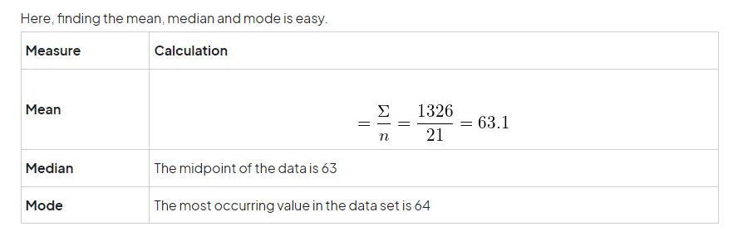
Grouped Data with data sets that list individual observations cont’d

Slide 14
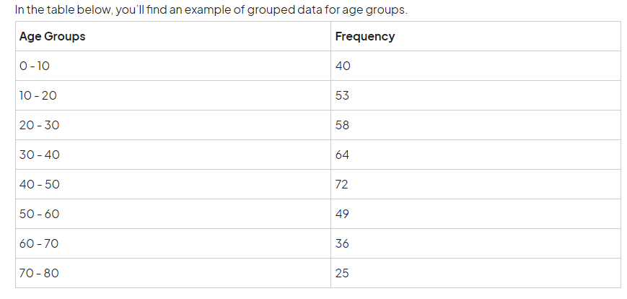
Grouped Data
Notes:
Keep in mind that in each group, only the first value, or the lower limit, of the interval is included up until the value before the upper limit, or the last value, of the group. Meaning, while 0 is included in the interval 0 through 10, 10 is not included. Instead, 9 is included, meaning there are 10 values in each group because we start counting at 0.

Slide 15
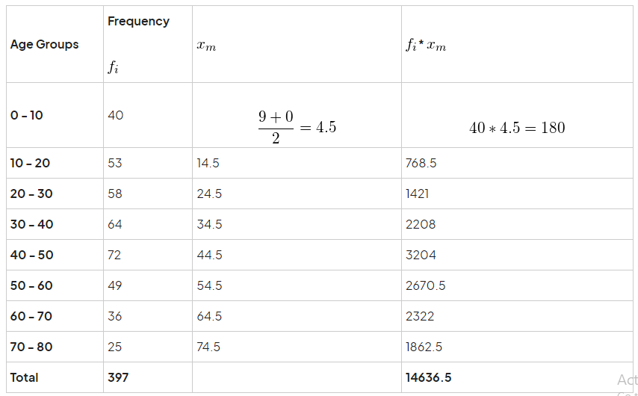
Using the example from above, we get the group mean performing the following steps.

Slide 16
Central Tendency…
The Median
A measure of central tendency means that one-half of the sample items are more than and one-half are less than measure such as the mean.
The median is the halfway point in a data set
Before you can find this point, the data must be arranged in order
The median either will be a specific value in the data set or will fall between two values
When the middle point falls halfway between two numbers, find the median by adding the two values and dividing by 2
The Mode
The mode is the value that occurs most often in the data set
A data set that has only one value that occurs with the greatest frequency is said to be unimodal
A data set with two values that occur with the same greatest frequency, both values are considered to be the mode and the data set is said to be bimodal
Notes:
If a data set has more than two values that occur with the same greatest frequency, each value is used as the mode, and the data set is said to be multimodal
When no data value occurs more than once, the data set is said to have no mode
For grouped data, a class with the largest frequency is referred to as the modal class. Often the midpoint of the modal class is used as the mode rather than the class boundaries

Slide 17
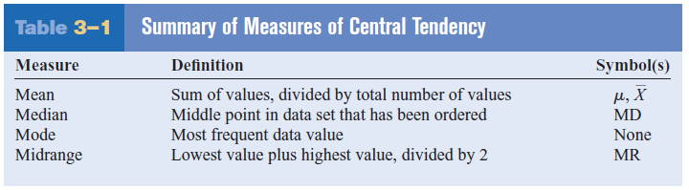
Central Tendency…
The Midrange
The midrange is a rough estimate of the middle (Median)
It is found by adding the lowest and highest values in the data set and dividing by 2
It is a very rough estimate of the average and can be affected by one extremely high or low value
Summary of Measures of Central Tendency

Slide 18
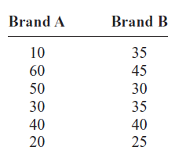
Measures of Variation
Measures of variability are used to describe the amount of spread or variability in a set of scores
A testing lab wishes to test two experimental brands of outdoor paint to see how long each will last before fading. The testing lab makes 6 gallons of each paint to test. Since different chemical agents are added to each group and only six cans are involved, these two groups constitute two small populations.

Slide 19
Measures of Variation cont’d
The Range
The range is the simplest of the three measures
The range is the highest value minus the lowest value
Variance and Standard Deviation
Variance is actually the average of the square of the distance that each value is from the mean
If the values are near the mean, the variance will be small
The squared distances are used to calculate variance instead of the actual distances. One reason is that the sum of the distances will always be zero
When each value is squared, the negative signs are eliminated.

Slide 20
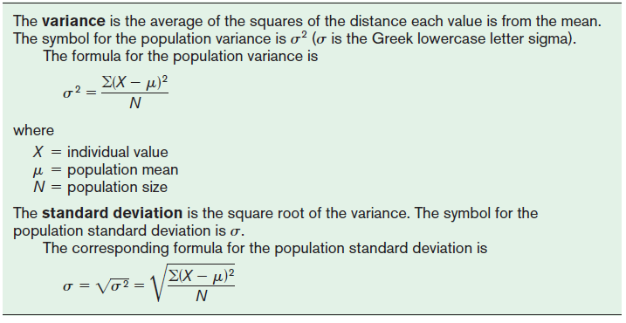
Measures of Variation cont’d

Slide 21
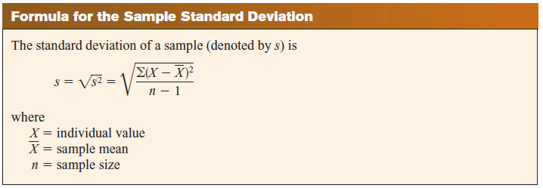
Measures of Variation cont’d
Sample Variance and Standard Deviation

Slide 22
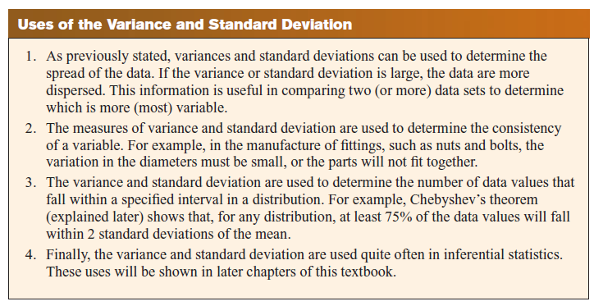
Measures of Variation cont’d

Slide 23
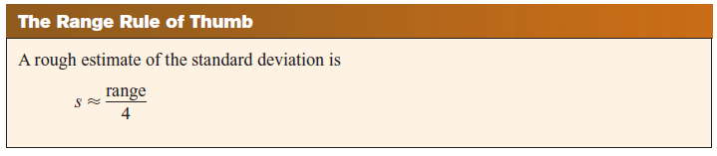
Measures of Variation cont’d
Range
The range can be used to approximate the standard deviation
The approximation is called the range rule of thumb.
If the range is divided by 4, an approximate value for the standard deviation is obtained

Slide 24
Activity
Find the variance and standard deviation of the following scores on an exam:
92, 95, 85, 80, 75, 50
Find the median, mode, range, midrange of the scores above

Slide 25

Questions

