Slide 1
STC224
Introduction to SPSS

Slide 2
What is SPSS
A computer software package used for statistical analysis of data.
SPSS stands for Statistical Package for the Social Sciences

Slide 3
What SPSS is used for
Some of its features are
Plotting charts
Summarizing data using descriptive statistics
Drawing associations and inferences using inferential statistics
As a database

Slide 4
Installing IBM SPSS Statistics 20
Browse to the folder that contains the SPSS software
Go to the folder “Setup”, double-click the file “Setup.exe”
Read instructions and press next until it (the wizard) finishes installing
Open the program “IBM SPSS Statistics 20” from the Windows Start Menu
Apply the license available on readme text file

Slide 5
SPSS interface - Windows
Data Editor window
When SPSS opens, the Data Editor window is presented on the screen
The Data Editor window is used to create variables and enter data in SPSS.
At the very top of the window the SPSS filename is displayed (the name Untitled indicates that the file hasn’t been given a name yet).
Located below the filename is the menu bar, which contains several different menu options (File, Edit, View, etc.) that are used to complete a variety of tasks in SPSS (such as saving files, printing results, etc.).
Directly below the menu bar are a number of toolbar buttons that provide quick access to several different options in SPSS.
The main area of the Data Editor window consists of a number of white rectangular objects (known as cells) which are used for entering data.

Slide 6
Data Editor window cont’d
The Data Editor consists of two different windows,
the Data View window and
the Variable View window.
Each of these windows may be accessed by clicking on the appropriate tab at the bottom left-hand corner of the screen.
The tab that has the gold-colored background indicates which of the two windows is currently open (notice in Figure below that the Data View window is currently open).
If the Data View window is not currently open on your computer, click the Data View tab to open it.

Slide 7
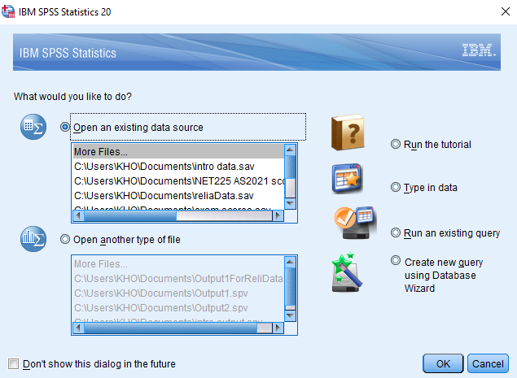
The SPSS 20 for Windows “What would you like to do?” dialog box

Slide 8
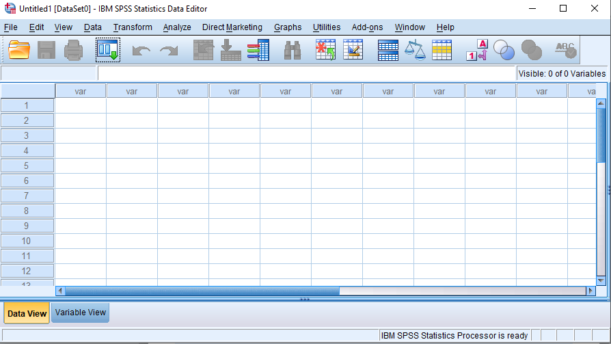
The Data Editor window in SPSS (with the Data View tab selected)

Slide 9
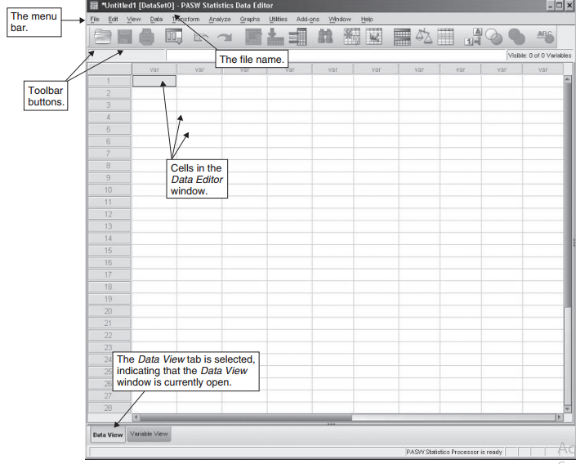

Slide 10
The Data View Window
The main area of the Data View window shown in Figure below consists of a number of cells, which are used to enter data (data usually consists of numbers but can also be letters or symbols).
The rows of the Data View window are numbered (with rows 1 to 39 shown in below), and the columns all initially have the name var.
The first cell (the cell in the upper left-hand corner) has a gold-colored background, indicating that it is active or ready to receive input

Slide 11
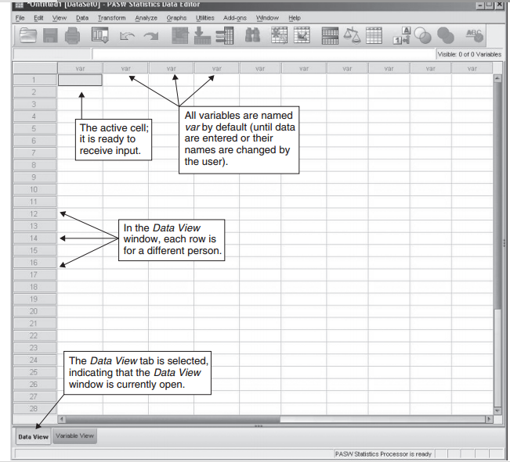
Data View window—The window in SPSS that is used for entering data

Slide 12
The Variable View Window
The Variable View window is used for creating variables in SPSS and adding information to a data file.
The Variable View window is accessed by clicking the Variable View tab at the bottom of the screen.
Since the Data View window is currently open, we’ll need to click on the Variable View tab to open the Variable View window.

Slide 13
The Variable View Window cont’d
Open the Variable View window by clicking on the Variable View tab.
The Variable View window is presented in Figure below

Slide 14
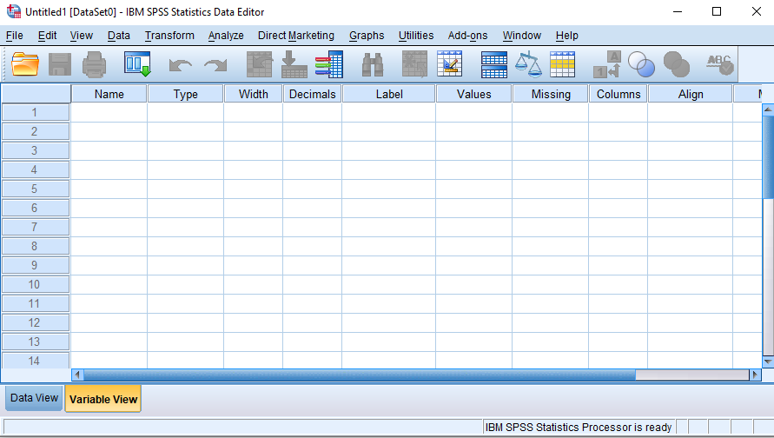
In the Variable View window, each row is for a different variable.
The Variable
View tab
is selected.

Slide 15
The Variable View Window cont’d
As is the case with the Data View window, each of the rows of the Variable View window is numbered, and the main area of the window consists of a number of cells.
Unlike the Data View window, however, each of the columns in the Variable View window has a different name and function.

Slide 16
NB
Remember: In the Data Editor, the Variable View window is for creating variables and the Data View window is for entering data.

Slide 17
Creating Data Files in SPSS
An SPSS data file is a computer file that contains information (data) on one or more variables.
Data file—A computer file that contains information on one or more variables.
Variable—An attribute or characteristic that takes on two or more values.

Slide 18
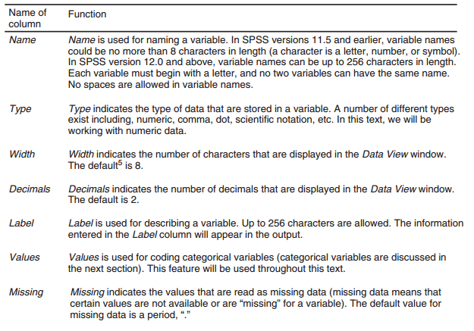
The name and function of the different columns of the Variable View window.

Slide 19
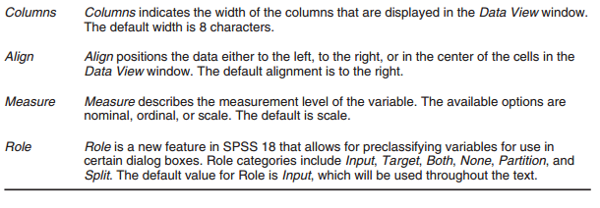
The name and function of the different columns of the Variable View window cont’d

Slide 20
Entering data :: Creating the questionnaire template
This is the first step in creating your data file
Switch to the variable view
Variable name – do not input spaces, cannot start with a number, keep them short
Variable type – the data type of the variable
Width – has to do with the display of variables in the data view
Decimals – The number of decimals for the numeric variables
Label – the display name for the variable. Can contain any character with spaces

Slide 21
Entering data :: Creating the questionnaire template […]
Values – These are options provided on a categorical variable e.g. Male, Female or Agree, Disagree, Strongly agree
Missing – Specify the value that will be entered for missing values
Columns – Width of the column holding data for the variable
Align – How the data will be aligned in the data view
Role – How the variable will be treated in specific dialog boxes. E.g. as dependent or independent variables

Slide 22
Entering data :: Creating the questionnaire template […]
Measure – The levels of measurement of the variable
Nominal : There is no intrinsic ranking to the categories e.g. Sex, religious affiliation
Ordinal : There is intrinsic order to the categories e.g. level of satisfaction (satisfied, highly satisfied) or confidence (agree, strongly agree)
Scale : Continuous values with meaningful metric e.g. salary, age

Slide 23
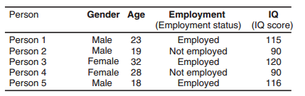
Figure below is sample data set to be entered into SPSS. (Note: The Person column is included for illustration but will not be entered into SPSS.)

Slide 24
Entering Data in SPSS
Notice in Figure above that the variables age and iq are in numeric form (i.e., they have numbers for values), while gender and employment are in character form (i.e., they have words for values).
An important point to remember (for the vast majority of the procedures covered in this text) is that to perform analyses on a variable in SPSS, it must be in numeric form.
Therefore, before entering the data into SPSS, we’ll need to change the variables that are currently in character form (gender and employment) to numeric form.

Slide 25
Assigning Numbers to the Categories of Gender and Employment
We’ll begin by assigning numbers to the different categories of gender.
As far as the rules for assigning numbers are concerned, any number can be assigned to the different categories of a variable as long as each category is assigned a different number (you may recognize this as an example of a nominal scale of measurement).
To illustrate this process, we’ll assign males a 1 and females a 2.
Therefore, for every male in the data set we’ll enter a 1, and for every female we’ll enter a 2

Slide 26
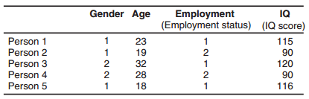
Entering Data in SPSS cont’d

Slide 27
Entering Data in SPSS cont’d
Variables such as gender and employment are known as categorical variables.
Categorical Variables take on a limited number of values; categorical variables that take on only two values (such as gender and employment) are known as dichotomous variables.
The variables age and iq are continuous variables.
Continuous variables take on a large number of different values.

Slide 28
In short
Categorical variable—A variable that has a limited number of values.
Dichotomous variable—A categorical variable that has only two values.
Continuous variable—A variable that has a large number of different values

Slide 29
Data Entry and Analysis
With all the variables now in numeric form, we can enter and analyze the data in SPSS.
Throughout this text, the process of data entry and analysis will be divided into the following four steps:
Create the variables,
Enter the data,
Analyze the data,
Interpret the results.

Slide 30
Step 1: Create the Variables
We’ll start by creating the variables gender, age, employment, and iq.
To create variables in SPSS, follow the instructions below.

Slide 31
Creating variables in SPSS
Make sure the Variable View window is open. If it isn’t open, click the Variable View tab at the bottom left-hand corner of the screen.
The first cell in the upper left-hand corner of the Variable View window should be active. If the first cell is not active, click on it.
In the first row of the Variable View window, enter the name gender and press the Enter key. Notice that all the cells to the right are automatically filled in with the default values (the default value for Label is an empty cell).

Slide 32
Creating variables in SPSS cont’d
In row 2, enter the name age and press the Enter key.
In row 3, enter the name employment and press the Enter key.
In row 4, enter the name iq and press the Enter key. The four variables are now created in SPSS. See Figure below for details

Slide 33
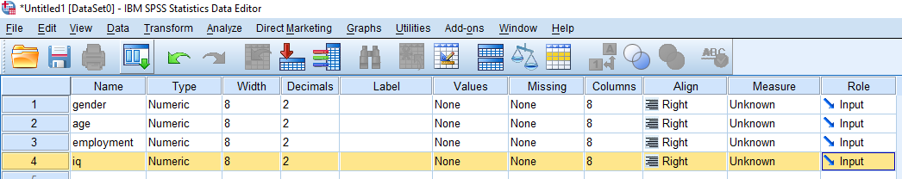
The Variable View window with the variables gender, age, employment, and iq entered

Slide 34
Value Labels
Recall that we assigned numbers (i.e., 1, 2) to the different categories of gender and employment because they needed to be changed to numeric form to be analyzed in SPSS.
You may also recall that the numbers we assigned were arbitrary (any two numbers could have been chosen), as they served only to differentiate between the categories of the variable.
To help us keep track of our numeric assignments more easily, we’ll enter the categories that the different numbers represent into SPSS (e.g., that 1 is for males and 2 is for females), a process known as creating value labels.
We’ll create value labels for the categorical variables gender and employment

Slide 35
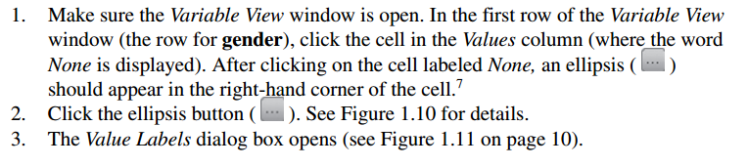
Creating value labels for gender

Slide 36
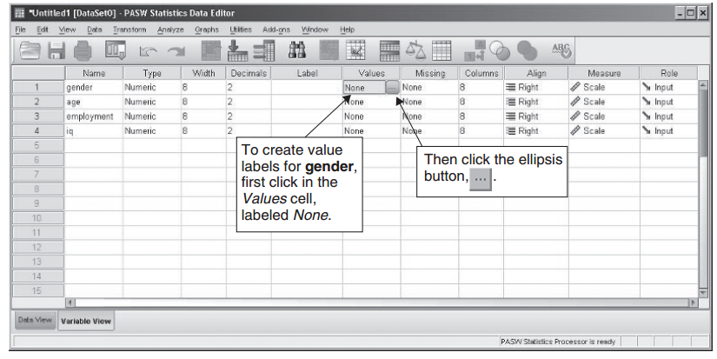
Selecting the Values cell for gender.

Slide 37
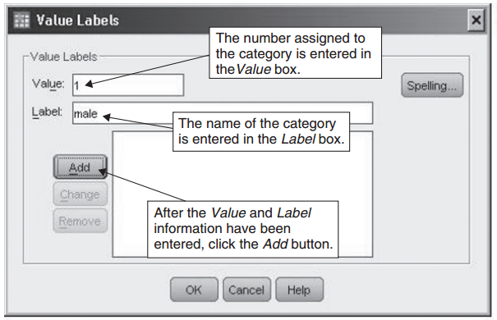
The Value Labels dialog box

Slide 38
Step 2: Enter the Data
To enter the data into SPSS
Click the Data View tab to open the Data View window
In the Data View window, notice that the first four columns are named gender, age, employment and iq, which correspond to the four variables we created earlier in SPSS.
Recall that in the Data View window each row corresponds to a different person in the data set, so that when the data are entered, row 1 will contain the values for the first person, row 2 will contain the values for the second person, and so on.

Slide 39
Enter the data for the remaining three participants by consulting the figure below

Slide 40
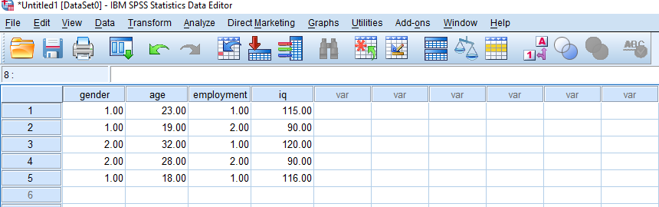
The completed data file in SPSS

Slide 41
Step 3: Analyze the Data
Throughout this text, we’ll be using the pull-down menus in SPSS to perform statistical analyses of our data.
For our first analysis, we’ll start with a basic procedure in SPSS—producing a summary report of each of our variables using the Case Summaries procedure.

Slide 42
Analyze the Data cont’d
To perform the Case Summaries procedure in SPSS
From the menu bar, select Analyze> Reports> Case Summaries (see Figure below). (When the menu commands are provided, the sign indicates the next selection to make. In this case, “” reads, “Select Analyze, then select Reports, then select Case Summaries.”)

Slide 43
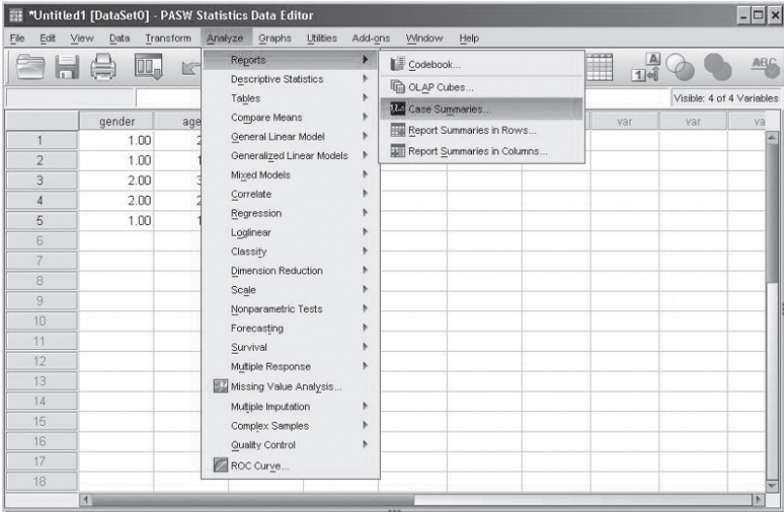
Menu commands for the Case Summaries procedure in SPSS

Slide 44
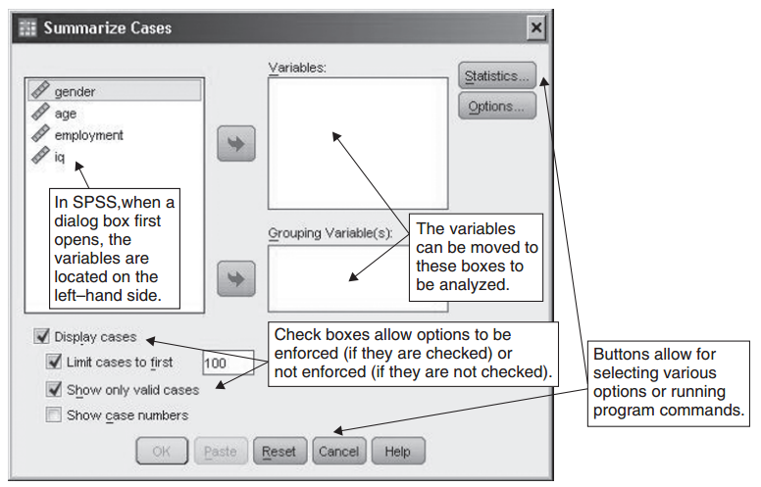
The Summarize Cases dialog box

Slide 45
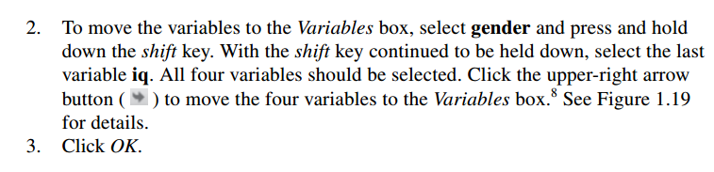
Analyze the Data cont’d

Slide 46
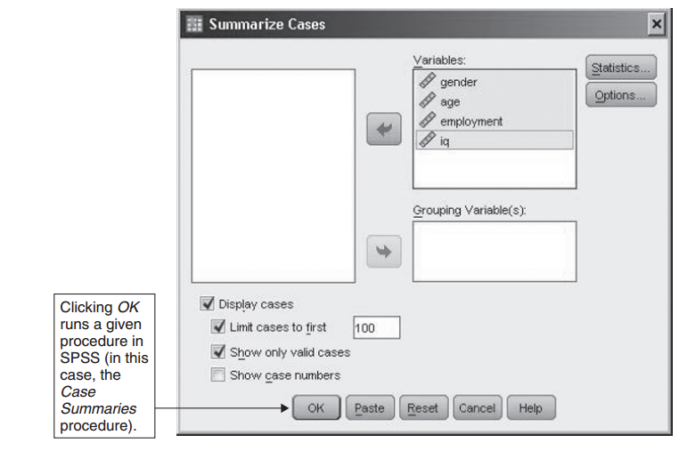
Analyze the Data cont’d
SPSS opens a new window containing the output— called the Viewer window — that presents the results of the Case Summaries procedure

Slide 47
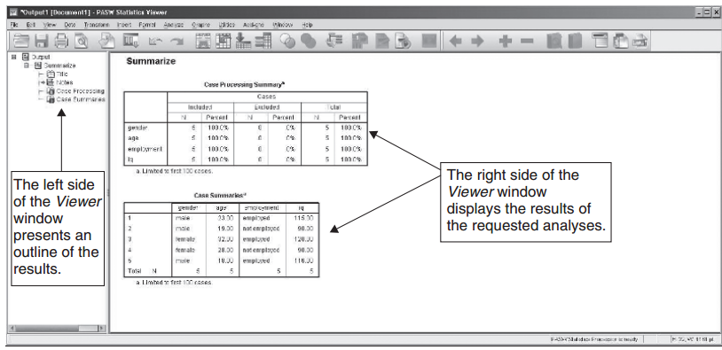
The SPSS Viewer window with the results of the Case Summaries procedure shown

Slide 48
Step 4: Interpret the Results
Viewer window
In SPSS, the Viewer window is divided into two different sections, with the left side of the window containing an outline of the requested analyses, and the right side of the window displaying the results of the analyses.
We’ll focus our attention throughout this text on the results shown in the right side of the Viewer window which, in this case, consist of the Case Processing Summary and Case Summaries tables.

Slide 49
Interpret the Results cont’d
Summarize
At the top of the output is the title, Summarize, which indicates the procedure we selected in SPSS (the Case Summaries procedure).

Slide 50
Interpret the Results cont’d
Case Processing Summary
The first table of results, Case Processing Summary, displays the number of participants (i.e., cases) in the data file for each of the variables.
The first column, Included, reports an N of 5 for each of the variables (N corresponds to the number of participants or cases in the data file), indicating that five people were included in the analysis for each variable.
The Excluded column reports an N of 0 for each variable, indicating that none of the participants were excluded from the analyses (everyone had values on all four variables).
The last column, Total, displays the total number of participants in the data set, which is equal to 5.

Slide 51
Interpret the Results cont’d
Case Summaries
The second table, Case Summaries, displays the values for each of the participants on the four variables of interest.
Notice that the value labels we created for gender and employment are displayed in the table instead of the numeric values (i.e., 1 and 2) we originally entered into SPSS, which makes it easier to read the results.
This concludes the discussion of the Case Summaries procedure in SPSS.

Slide 52
Saving files
In SPSS, output files and data files are saved separately using different file extensions.
File extensions commonly consist of three or four letters at the end of a file name and are preceded by a period (e.g., “.docx,” “.html,” and “.mp3”).
In SPSS, the file extension for data files is “.sav” and the file extension for output files is “.spv.”
We’ll practice saving both data files and output files in SPSS. Let’s start by saving an output file.
To save the output file, first make sure the Viewer(output) window is active. (If the Viewer window is active, you should see it on your screen with a dark blue bar at the top of its window.)
If the Viewer window is not active, click on it.

Slide 53
Printing files
Next, how to print an output file in SPSS will be illustrated.
To print the output, we’ll first need to make the Viewer window active

Slide 54


