Slide 1
Computer networks (NET-225)
Introduction to WANs

Slide 2
Introduction
One way to categorize networks based on scale (or distance they span) is to divide them into local-area networks (LAN) and wide-area networks (WAN).
LANs typically are connected workstations, printers, and other devices within a limited geographic area such as a building.
All the devices in the LAN are under the common administration of the owner of that LAN, such as a company or an educational institution.
Most LANs today are Ethernet LANs.
WANs are networks that span a larger geographic area and usually require the services of a common carrier.
Examples of WAN technologies and protocols include Frame Relay, ATM, and DSL

Slide 3
What is a WAN?
A WAN is a data communications network that operates beyond the geographic scope of a LAN.
Connect devices that are separated by a broader geographical area than a LAN.
Use carriers (phone companies, cable companies, network providers).
Use serial connections of various types.

Slide 4
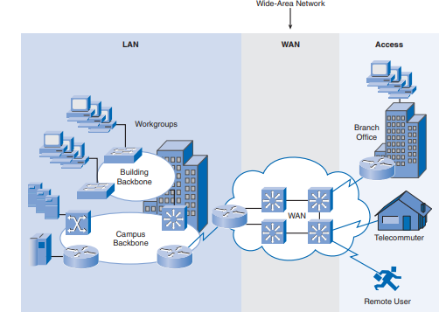
What is a WAN? Cont’d

Slide 5
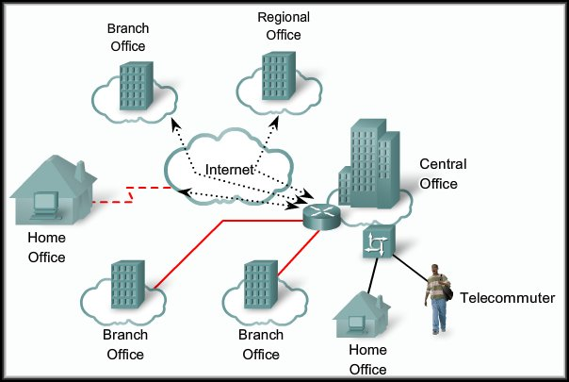
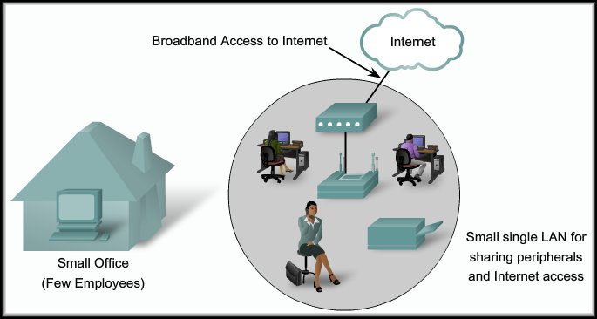
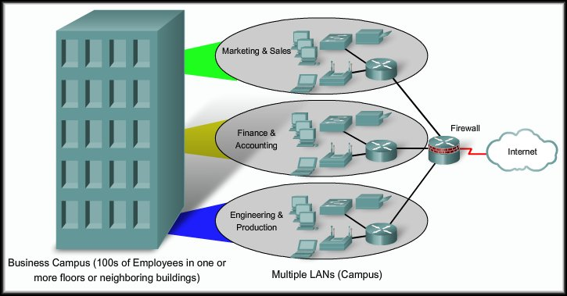
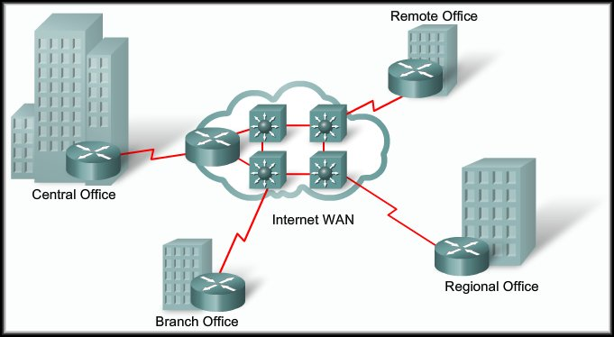
The Evolving Enterprise
As companies grow, they hire more employees, open branch offices, and expand into global markets.
These changes also influence their requirements for integrated services and drive their network requirements.

Slide 6
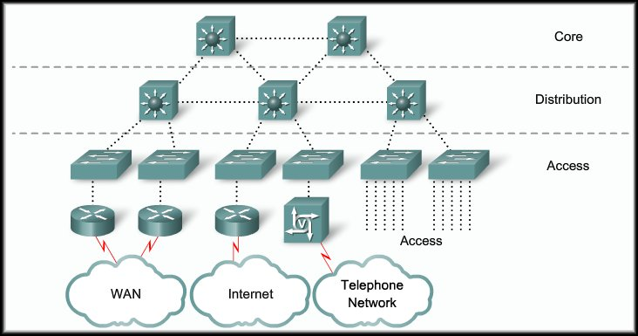
The Evolving Network Model
As networks grow, the hierarchical design model must grow with it.
Fast switching, availability, scalability.
Policies to aggregate WAN traffic.
User Access to network devices.

Slide 7
WAN Services
Option: | Description | Advantages | Disadvantages | Bandwidth range | Sample protocols used
Leased line | Point-to-Point connection between two computers or Local Area Networks (LANs) | Most secure | Expensive |  | PPP, SDLC, HDLC,HNAS
Circuit switching | A dedicated circuit path is created between end points. Best example is dialup connections | Less Expensive | Call Setup | 28 - 144 kbps | PPP, ISDN
Packet switching | Devices transport packets via a shared single point-to-point or point-to-multipoint link across a carrier internetwork. Variable length packets are transmitted over Permanent Virtual Circuits (PVC) or Switched Virtual Circuits (SVC) |  | Shared media across link |  | X.25 Frame-Relay
Cell relay | Similar to packet switching, but uses fixed length cells instead of variable length packets. Data is divided into fixed-length cells and then transported across virtual circuits | Best for simultaneous use of voice and data | Overhead can be considerable |  | ATM
Notes:
Synchronous Data Link Control (SDLC) created by IBM
HDLC= High-Level Data Link Control is adopted from SDLC (improved SDLC by ISO): Is a bit-oriented code-transparent synchronous data link layer protocol. It provides connection-oriented and connectionless service
In telecommunications, a point-to-point connection refers to a communications connection between two communication endpoints or nodes. An example is a telephone call, in which one telephone is connected with one other, and what is said by one caller can only be heard by the other. This is contrasted with a point-to-multipoint or broadcast connection, in which many nodes can receive information transmitted by one node. Other examples of point-to-point communications links are leased lines and microwave radio relay.

Slide 8
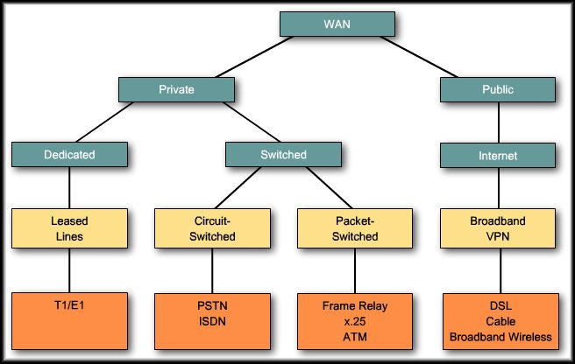
WAN Connection Options

Slide 9
WAN Link Connection Options
Dedicated or leased- line networks are the simplest of the implementations.
A dedicated point-to- point link is provided by the vendor.
Bandwidth is guaranteed between the end points.
Leased lines are also used to connect the subscriber to the vendor to make use of other technologies.

Slide 10
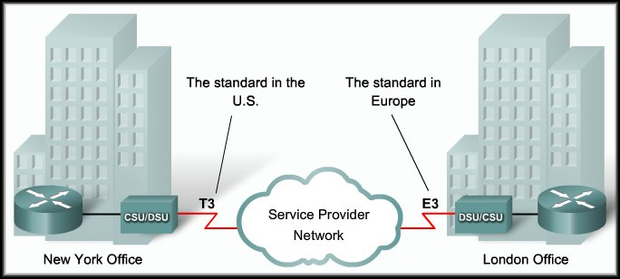
Dedicated Connection Link Options
Dedicated or Leased Line Connection
A point-to-point link is used to provide a pre-established WAN communications path from the customer premises through the provider network to a remote destination.
Point-to-point links are usually more expensive than shared services.

Slide 11
WAN Link Connection Options
Switched communication links can be either circuit switched or packet switched.
Circuit Switched:
PSTN
ISDN
Packet Switched:
Frame Relay
X.25
ATM
Notes:
Public Switched Telephone Network (PSTN) is an aggregate of the worlds circuit-switched telephone networks that are operated by national, regional or local telephony operators providing infrastructure and services for public telecommunication. E.g. telephone lines, fiber optic cables, switching centers, cellular networks, satellites and cable systems (It is analogue and voice oriented)
Integrated Services Digital Network (ISDN) is a set of communication standards for simultaneous digital transmission of voice, video, data and other network services over the traditional circuits of the public switched telephone network

Slide 12
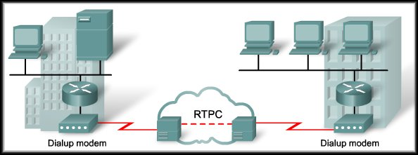
Circuit-Switched Link Options
Analog Dial-Up
Interrupted, low-volume data transfers.
Limited to less than 56 kb/s.
Advantages: simplicity, availability, low implementation cost.
Disadvantages: low data rates, long connection time.

Slide 13
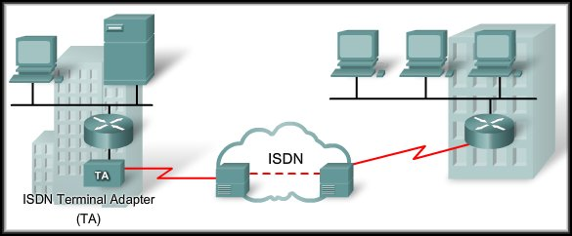
Circuit-Switched Link Options
Integrated Services Digital Network (ISDN)
Enables the local loop to carry end-to-end digital signals.
Higher capacity connections.
ISDN changes the internal connections of the PSTN from carrying analog signals to digital signals.

Slide 14
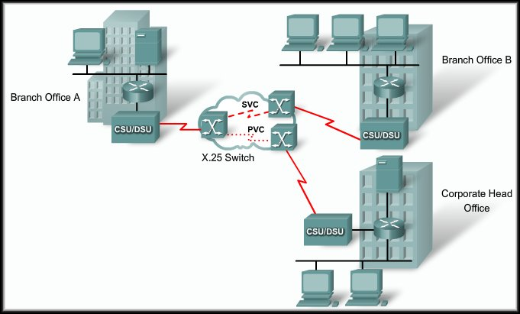
Packet-Switched Connection Options
X.25:
Legacy network layer protocol.
Typical applications are point-of-sale card readers.
Speeds vary from 2400 b/s up to 2 Mb/s.
Now in dramatic decline.
They are still in use in many portions of the developing world.
X.25

Slide 15
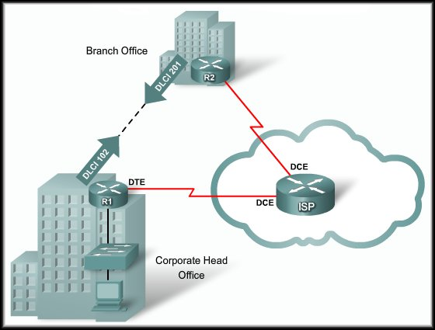
Packet-Switched Connection Options
Frame Relay
Frame Relay:
Much simpler protocol at the data link layer.
Implements no error or flow control.
Data rates up to 4 Mb/s.
The router on the LAN needs only a single interface.
The short-leased line to the Frame Relay network edge allows cost-effective connections between widely scattered LANs.

Slide 16
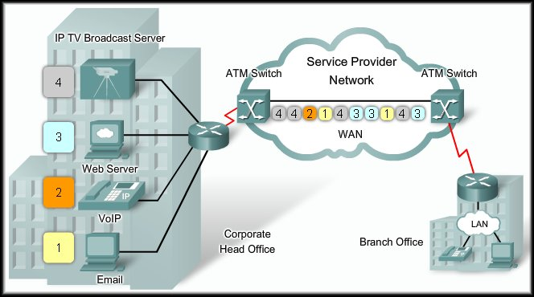
Packet-Switched Connection Options
ATM
Asynchronous Transfer Mode (ATM):
ATM technology is capable of transferring voice, video, and data simultaneously through private and public networks.
It is built on a cell-based architecture.

Slide 17
Packet-Switched Connection Options
ATM
Asynchronous Transfer Mode (ATM):
ATM cells are always a fixed length of 53 bytes.
5 byte ATM header.
48 bytes of ATM payload.

Slide 18
Packet-Switched Connection Options
ATM
Asynchronous Transfer Mode (ATM):
The ATM cell is less efficient than the bigger frames and packets of Frame Relay and X.25.
Needs almost 20 percent greater bandwidth than Frame Relay to carry the same amount of data.

Slide 19
Packet-Switched Connection Options
ATM
Asynchronous Transfer Mode (ATM):
ATM was designed to be extremely scalable and can support link speeds of (622 Mb/s) and higher.

Slide 20
WAN Link Connection Options
Public: Public connections use the global Internet infrastructure.
Until the development of VPN technology, the Internet was not a viable connection option. Security issues prevented its use.
The Internet is now an inexpensive and secure option for connecting to tele-workers and remote offices where performance guarantees are not critical.
DSL, Cable Broadband Wireless
Notes:
Broadband refers to high-speed internet access that is faster than the traditional dial-up access. It includes high speed transmission technologies such as Digital Subscriber Liner (DSL), Cable modem, Fiber, Wireless, Satellite, Broadband over Powerlines (BPL)
Dial-up access is a form of internet access that uses the facilities of the public switched telephone network (PSTN) to establish a connection to an internet service provider (ISP) by dialing a telephone number on a conventional telephone line

Slide 21
WAN Switching Concepts
WAN switched networks fall into two categories:
Circuit switched.
PSTN, ISDN
Packet switched.
Frame Relay, ATM, X.25

Slide 22
Circuit Switching
A circuit-switched network is one that establishes a dedicated circuit (or channel) between nodes and terminals before the users may communicate.
As an example, when a subscriber makes a telephone call, the dialed number is used to set switches in the exchanges along the call’s route so that a continuous circuit exists from the caller to the called party.
Because of the switching operation used to establish the circuit, the telephone system is called a circuit-switched network.
If the telephones are replaced with modems, the switched circuit can carry computer data.

Slide 23
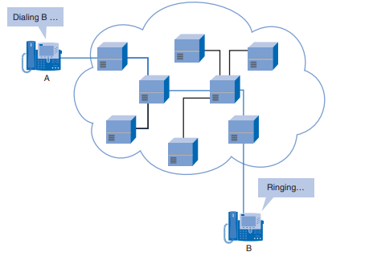
Circuit Switching

Slide 24
Packet Switching
In contrast to circuit switching, packet switching splits traffic data into packets that are routed over a shared network.
Packet-switching networks do not require a circuit to be established, and they allow many pairs of nodes to communicate over the same channel.
The switches in a packet-switched network determine which link the packet must be sent on next from the addressing information in each packet.

Slide 25
Packet Switching cont’d
There are two approaches to this link determination:
Connectionless systems, such as the Internet, carry full addressing information in each packet. Each switch must evaluate the address to determine where to send the packet.
Connection-oriented systems predetermine a packet’s route, and each packet only has to carry an identifier. In the case of Frame Relay, these are called Data Link Connection Identifiers (DLCI).
The switch determines the onward route by looking up the identifier in tables held in memory. The set of entries in the tables identifies a particular route or circuit through the system. If this circuit exists only while a packet travels through it, it is called a virtual circuit (VC).
A virtual circuit is a logical circuit between two network devices to help ensure reliable communications.

Slide 26
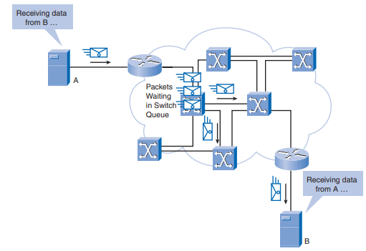
Packet Switching cont’d

Slide 27
WAN Technology Concepts
As described in relation to the OSI reference model, WAN operations focus primarily on Layer 1 and Layer 2

Slide 28
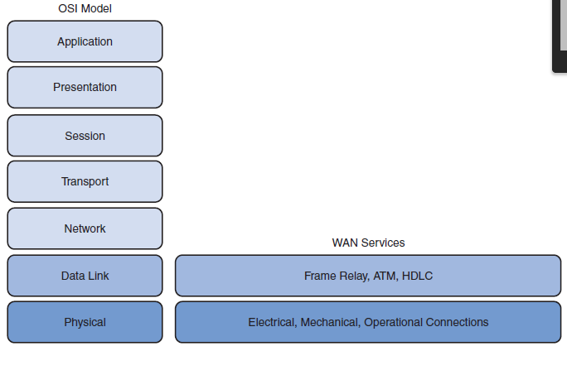
OSI and WAN Services

Slide 29
Cont’d
The physical layer (OSI Layer 1) protocols describe how to provide electrical, mechanical, operational, and functional connections to the services of a communications service provider.
The data link layer (OSI Layer 2) protocols define how data is encapsulated for transmission toward a remote location and the mechanisms for transferring the resulting frames.
A variety of technologies are used, such as Frame Relay and Asynchronous Transfer Mode (ATM).
Some of these protocols use the same basic framing mechanism, High-Level Data Link Control (HDLC), an ISO standard, or one of its subsets or variants.

Slide 30
WAN data-link protocols
The most common WAN data-link protocols are as follows:
Frame Relay
ATM
X.25
HDLC
Point-to-Point Protocol (PPP)

Slide 31
Packet-Switched Connection Options
The most common packet-switching technologies used in today’s enterprise WANs include legacy X.25, Frame Relay, and ATM, as described in the following slides.
X.25 is a legacy network-layer protocol that provides subscribers with a network address.
Virtual circuits can be established through the network with call request packets to the target address.

Slide 32
Frame Relay
A Data Link Layer (layer 2) protocol which uses packet-switching connection to implement no error or flow control
The simplified handling of frames leads to reduced latency, and measures taken to avoid frame buildup at intermediate switches help reduce jitter.
Frame Relay offers data rates up to 4 Mbps, with some providers offering even higher rates.

Slide 33
Frame Relay cont’d
Frame Relay provides permanent, shared, medium-bandwidth connectivity that carries both voice and data traffic.
Frame Relay is ideal for connecting enterprise LANs.
The short-leased line to the Frame Relay network edge allows cost-effective connections between widely scattered LANs.

Slide 34
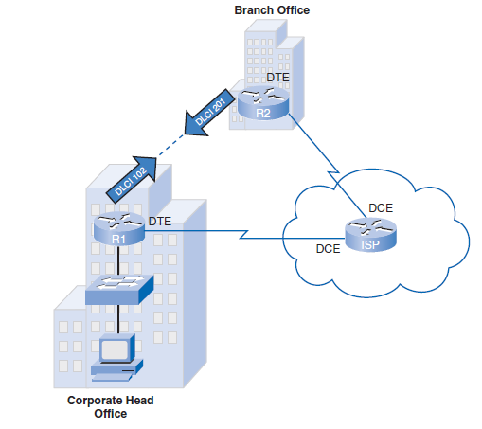
Frame Relay network

Slide 35
Asynchronous Transfer Mode (ATM)
Asynchronous Transfer Mode (ATM) technology is a Data Link Layer (layer 2) protocol which uses packet-switching connection to transfer voice, video, and data through private and public networks
It is built on a cell-based architecture rather than on a frame-based architecture.
ATM cells are always a fixed length of 53 bytes.
The ATM cell contains a 5-byte ATM header followed by 48 bytes of ATM payload.
Small, fixed-length cells are well suited for carrying voice and video traffic, because this traffic is intolerant of delay.
Video and voice traffic do not have to wait for a larger data packet to be transmitted.

Slide 36
Asynchronous Transfer Mode (ATM) cont’d
The 53-byte ATM cell is less efficient than the bigger frames and packets of Frame Relay and X.25.
Furthermore, the ATM cell has at least 5 bytes of overhead for each 48-byte payload.
When the cell is carrying segmented network layer packets, the overhead is higher, because the ATM switch must be able to reassemble the packets at the destination.
A typical ATM line needs almost 20 percent more bandwidth than Frame Relay to carry the same volume of network layer data.

Slide 37
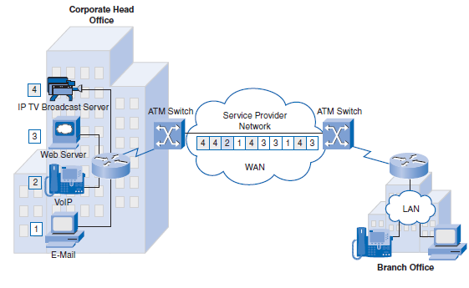
ATM Network

Slide 38
VPN Technology
Security risks are incurred when a teleworker or remote office uses broadband services to access the corporate WAN over the Internet.
To address security concerns, broadband services provide capabilities for using Virtual Private Network (VPN) connections to a VPN server, which typically is located at the corporate site.
A VPN is an encrypted connection between private networks over a public network such as the Internet.
Instead of using a dedicated Layer 2 connection such as a leased line, a VPN uses virtual connections called VPN tunnels, which are routed through the Internet from the company’s private network to the remote site or employee host.
Notes:
VPN solves the limitation of geographic disperse working environments

Slide 39
VPN Benefits
Benefits of VPN include the following:
Cost savings
VPNs enable organizations to use the global Internet to connect remote offices and remote users to the main corporate site, thus eliminating expensive dedicated WAN links and modem banks.
Security
VPNs provide the highest level of security by using advanced encryption and authentication protocols that protect data from unauthorized access.

Slide 40
VPN Benefits cont’d
Scalability
Because VPNs use the Internet infrastructure within ISPs and devices, it is easy to add new users. Corporations can add large amounts of capacity without adding significant infrastructure.
Compatibility with broadband technology:
VPN technology is supported by broadband service providers such as DSL and cable, so mobile workers and telecommuters can take advantage of their home high-speed Internet service to access their corporate networks. Business-grade, high-speed broadband connections can also provide a cost effective solution for connecting remote offices.

Slide 41
Types of VPN Access
Two types of VPN access exist:
Site-to-site VPNs
Remote-access VPNs

Slide 42
Site-to-site VPNs:
Site-to-site VPNs connect entire networks to each other.
For example, they can connect a branch office network to a company headquarters network
Each site is equipped with a VPN gateway, such as a router, firewall, VPN concentrator, or security appliance.
In the figure below, a remote branch office uses a site-to-site VPN to connect with the corporate head office.

Slide 43
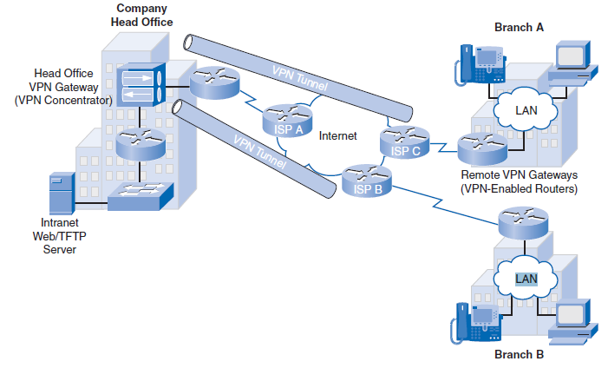
Site-to-site VPNs cont’d

Slide 44
Remote-access VPNs
Remote-access VPNs enable individual hosts, such as telecommuters, mobile users, and extranet consumers, to access a company network securely over the Internet, as shown in the Figure below.
Each host typically has VPN client software loaded or uses a web-based client.

Slide 45
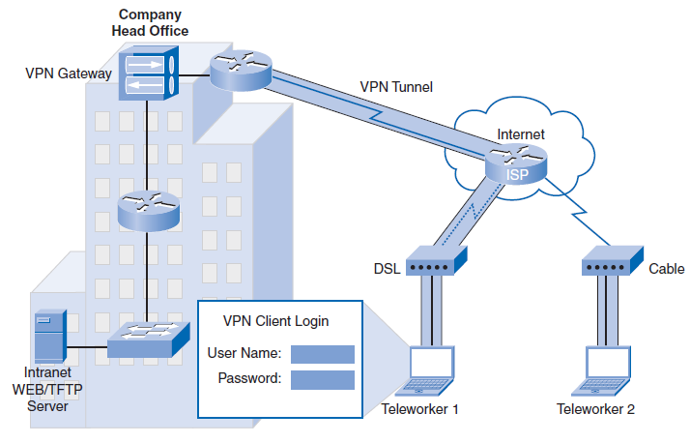
Remote-access VPNs cont’d

Slide 46

Questions

