Slide 1
MANIPULATING/TRANSFORMING DATA IN SPSS
STC224

Slide 2
Introduction (SPSS windows)
The Start Screen
The Data Editor Window Where you create the template (enter variables) and enter the data
The Output Viewer Window Where you view and edit output produced by a data analysis command e.g. charts, tables etc.
The Syntax Editor Window Where you enter and run custom command syntax (SPSS language)
The Script Editor Window Where you type scripts (in BASIC and Python) that extend the functionality of IBM SPSS Statistics e.g. automating some features like opening and saving data files

Slide 3
Introduction cont’d
Measure – The levels of measurement of the variable
Nominal : There is no intrinsic ranking to the categories e.g. Sex, religious affiliation
Ordinal : There is intrinsic order to the categories e.g. level of satisfaction (satisfied, highly satisfied) or confidence (agree, strongly agree)
Scale : Continuous values with meaningful metric e.g. salary, age

Slide 4
Creating files in the Syntax Editor Window
An alternate way to create data files is to use the SPSS Syntax Editor Window.
The Syntax Editor works much like a word processor, such as Windows Notepad or a scaled-down version of Microsoft Word.
That is, you can just type the data into this window as you would in creating any text file.

Slide 5
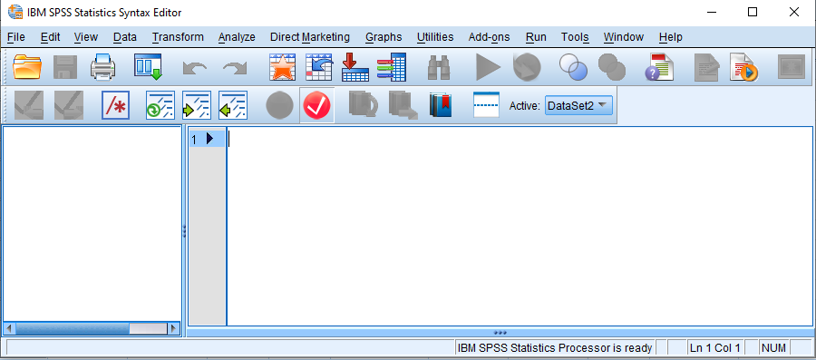
Accessing the Syntax Editor
Select File, New, Syntax from the drop-down menu at the top of the Data Editor window as shown below
A new window will open

Slide 6
Syntax Editor cont’d
Note that in addition to typing text/data directly into the Syntax Editor window, you can "cut-and-paste" data into this editor.
That is, just as you can cut-and-paste text from one Word file into another Word file, you can also cut-and-paste data into the Syntax Editor.
Thus, data files that were created in a text editor such as Windows Notepad (called ASCI II files) can be cut-and-pasted into this Syntax Editor.
However, as mentioned, we will create this Syntax Editor file from scratch by typing the text and data directly into this editor.

Slide 7
Entering Commands & Data in the Syntax File
We will be working with the Data Editor window, so we will not discuss the Syntax Editor in detail here.
For now, just type the file exactly as it appears in in Figure below into your blank Syntax Editor.

Slide 8
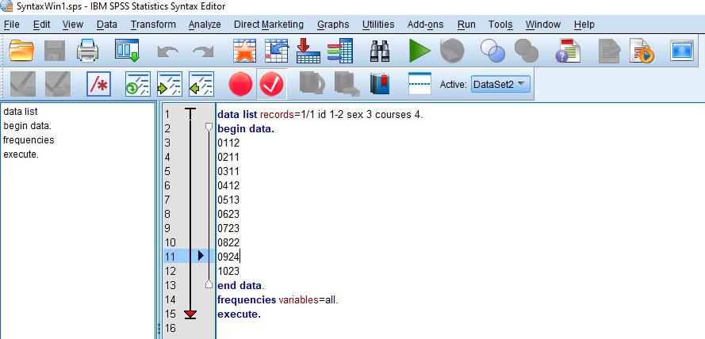
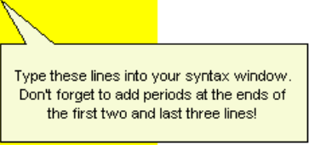
Entering Commands & Data in the Syntax File cont’d

Slide 9
Entering Commands & Data in the Syntax File cont’d
data list records=1/1 id 1-2 sex 3 courses 4.
begin data.
0112
0211
0311
0412
0513
0623
0723
0822
0924
1023
end data.
frequencies variables=all.
execute.
Notes:
data list records=1/1 id 1-2 sex 3 courses 4.
This tells SPSS how to read the raw data.
data list → Command to read data from typed (“inline”) entries.
records=1/1 → Each case (row) has one record and SPSS should read from line 1 only of each case.
id 1-2 → Variable id occupies columns 1 to 2.
sex 3 → Variable sex is in column 3.
courses 4 → Variable courses is in column 4.
begin data.
This tells SPSS: ➡️ “The next lines are the raw data.”
end data.
This tells SPSS that the raw data block is finished.
frequencies variables=all.
This command produces frequency tables for all variables:
id
sex
courses
execute.
Forces SPSS to run the commands immediately.

Slide 10
Entering Commands & Data in the Syntax File cont’d
The first line of this file consists of syntax code, or SPSS commands, called the DATA LIST statement.
This instructs SPSS how to read the data in the file.
Note that the three variables (ID, Sex, and Courses) are defined on this line.
The actual lines of data (scores) are always sandwiched between a Begin Data and an End Data syntax commands.
That is, each line of data (or row) consists of each student’s ID number, code for sex, and number of psychology courses.

Slide 11
Entering Commands & Data in the Syntax File cont’d
The last two lines instruct SPSS to generate frequency tables of each variable.
Note that except for the lines listing the data, the lines containing syntax code must all end with a period.
After you have created your file, you will be ready to save it as a syntax file.
Saving Files in the Syntax Editor: The .SPS File extension is used

Slide 12
Generating an output file
Let’s go ahead and run the Frequencies procedure specified in this Syntax file so that we can generate an output file to view.
To generate this output, we need to instruct SPSS to run the procedure specified in the Frequencies syntax line at the end of the file.
To do this, select Run, All from the dropdown menu at the top of this Syntax Editor Window

Slide 13
MANIPULATING/TRANSFORMING DATA
Recoding
Binning
Computing
Selecting (Excluding)
Splitting

Slide 14
Recoding (Transforming) Variables
Sometimes you will want to transform a variable by combining some of its categories or values together.
For example, you may want to change a continuous variable into an ordinal categorical variable, or you may want to merge the categories of a nominal variable.
In SPSS, this type of transform is called recoding.
In SPSS, there are three basic options for recoding variables:
Recode into Different Variables
Recode into Same Variables
DO IF syntax
Notes:
Recode in SPSS is a command used to change the values of a variable:
✔ Into the same variable (overwrite values)
or
✔ Into a new variable (keep original and create a recoded version)
It is one of the most important data-cleaning and data-transformation tools in SPSS.

Slide 15
Recoding (Transforming) Variables cont’d
Each of these options allows you to re-categorize an existing variable.
Recode into Different Variables and DO IF syntax create a new variable without modifying the original variable, while Recode into Same Variables will permanently overwrite the original variable.
In general, it is best to recode a variable into a different variable so that you never alter the original data and can easily access the original data if you need to make different changes later on

Slide 16
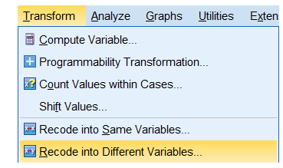
Recode into Different Variables
Recoding into a different variable transforms an original variable into a new variable.
That is, the changes do not overwrite the original variable; they are instead applied to a copy of the original variable under a new name.

Slide 17
Example
Class ranks for high schools and colleges are nicknames for what year of study the person is completing: "freshman" (first-year), "sophomore" (second-year), "junior" (third-year), "senior" (fourth-year).
Class ranks are also sometimes divided into "underclassmen" (first or second-year students) and "upperclassmen" (third or fourth-year students).
In the sample dataset, the variable Rank has the categories Freshman (1), Sophomore (2), Junior (3), and Senior (4).
Let's use Recode into Different Variables to merge the categories and create a new indicator variable called RankIndicator with the levels Underclassman (1) and Upperclassman (2).

Slide 18
Solution
Using the Dialog Windows
This method tells SPSS exactly how to map each old category onto a new category.
Click Transform > Recode into Different Variables.
Double-click on variable Rank to move it to the Input Variable -> Output Variable box. In the Output Variable area, give the new variable the name RankIndicator. Define the label as ​Class Rank (binary), ​and then click Change.
Click the Old and New Values button.
Handle missing values first: In the Old Value area click System-missing; in the New Value area click System-missing. Then click Add.
Define the underclassmen group (1):
In the Old Value area click Value and enter 1; in the New Value area click Value and enter 1. Then click Add.
In the Old Value area click Value and enter 2; in the New Value area click Value and enter 1. Then click Add.
Define the upperclassmen group (2):
In the Old Value area click Value and enter 3; in the New Value area click Value and enter 2. Then click Add.
In the Old Value area click Value and enter 4; in the New Value area click Value and enter 2. Then click Add.
When finished, click Continue.
Click OK.

Slide 19
Recode into Same Variables
Recoding into the same variable (Transform > Recode into Same Variables) works the same way as described above, except for that any changes made will permanently alter the original variable.
That is, the original values will be replaced by the recoded values.
In general, it is good practice not to recode into the same variable because it overwrites the original variable. If you ever needed to use the variable in its original form (or wanted to double-check your steps), that information would be lost.

Slide 20
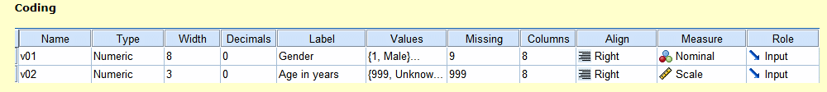
Data editing Visual Binning
Through Visual Binning you can in an easy and visual way create classes for a scale variable.
The labels for the classes are automatically added by SPSS.
In our example data file the variable v02 contains the age of the respondent in years.
Notes:
Visual Binning in SPSS is a point-and-click tool used to convert a continuous variable into categories (bins) using a graphical interface.
It is essentially a visual way to create grouped variables—much easier than writing a RECODE command manually.
You use it to turn continuous values into categories, such as:
Ages → age groups (e.g., 0–17, 18–25, 26–40…)
Income → low, medium, high
Scores → pass/fail or percentile groups
Continuous ranges → buckets or intervals
It is often used in descriptive statistics, regression preparation, and data simplification.

Slide 21
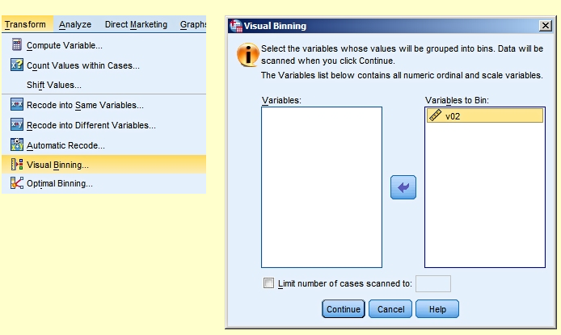
Using Visual Binning
Choose Transform > Visual Binning and select variable v02.

Slide 22
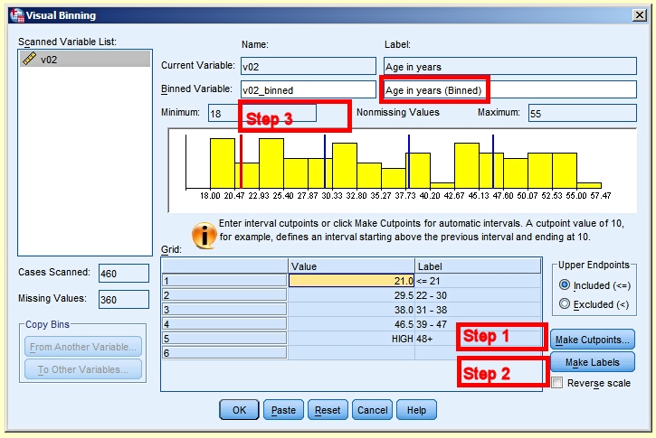
Data editing Visual Binning cont’d
Click Continue.
Now you come to the actual Visual Binning dialog box. Complete it as shown below, following steps 1, 2 and 3.

Slide 23
Compute
Sometimes you might want to create a new variable based on some mathematical calculations of two or more variables. E.g. adding all household members to a household members total.
To compute a new variable by summing scores on several variables, simply select Transform, Compute from the Data Editor menu
Notes:
COMPUTE in SPSS is a command used to create new variables or modify existing variables using formulas, arithmetic, logic, or functions.
It is the main tool in SPSS for performing calculations.
You use COMPUTE when you want to:
Create a new variable based on math (e.g., total = score1 + score2)
Create ratios (e.g., bmi = weight / (height**2))
Transform variables (log, square root, standardize, etc.)
Create conditional variables
Create dummy variables
Modify existing values
Anything involving calculation or formulas → use COMPUTE.

Slide 24
File Splitting
The split file procedure is used when we want to run the analysis on several groups or segments of the entire population. (The Split File command is used to separate the output of SPSS tests according to a group variable.)
The best example would be to split the output according to sex.
By doing this in SPSS, through the use of the Split File command, you will get two separate outputs for subsequent analyses, one for males and the other for females.
To be able to perform a split file command, you must have a grouping (nominal) variable, such as sex (male/female), age (young/old), treatment group (control/treated) etc.
There can be more than two groups within the variable.
Notes:
File Splitting is a way to temporarily organize your dataset by grouping cases based on the values of one or more variables.
It allows SPSS to:
Run analyses separately on different groups (subsets) of cases
Automatically split output by the groups
Without actually creating separate files, it splits the file in memory based on your grouping variables.

Slide 25
How to use the Split File command in SPSS
To use the Split File command within SPSS, firstly go to Data > Split File ....
A new window should open. Here, select the Organize output by groups option. Now you can drag the grouping variable you want to split the file by into the box called Groups Based on:.
Click the OK button. Any analyses performed from now on will be split into separate outputs based on the grouping variable.

Slide 26
Selecting cases (excluding)
For some reasons, you might want to select some cases and exclude others from your analyses e.g.
They are extreme outliers
You only want to produce charts or some other analyses that contain a count of cases that gave a particular response to a question e.g. only those who said they have a bicycle or only those that are below 45 years of age.

Slide 27
Selecting cases (excluding) cont’d
To select only those 45 years old and below
Go to “Data”, “Select Cases”
On the “Select” box, choose “If condition is satisfied”. Click [If].
From the variable list, select “age” and move it to the selection box.
On the virtual Keypad, click [<=] (Less or equal to). Then type 45. Then click [Ok]
Cases with age 45 and above will be crossed out and will not be included in any analysis

Slide 28
Selecting cases (excluding) cont’d
To select only those who said they have a bicycle
First clear out the last filter by going to “Data”, “Select Cases”, and choose “All cases” and click [Ok]
Go to “Data”, “Select Cases”
On the “Select” box, choose “If condition is satisfied”. Click [If].
From the variable list, select “has Bicycle” and move it to the selection box.
Since this is a dichotomous variable, those who said they have a bicycle indicated 1.
Hence on the virtual Keypad, click [=] (equals). Then type 1. Then click [Ok]
Respondents without bicycles will be crossed out and will not be included in any analysis

Slide 29

Questions

