Slide 1
CON-225
Networking hardware

Slide 2
Different networking devices/hardware
Different networking devices have different roles to play in a computer network.
These network devices also work at different segments of a computer network performing different works.
We’ll talk about different networking devices like a switch, router, hub, bridge etc.
Computer networking devices are known by different names such as networking devices, networking hardware, network equipment etc.
However, all of the names mean the same but have got different purposes.

Slide 3
Cont’d
Network hardware is the individual components of a network system that are responsible for transmitting data and facilitating the operations of a computer network
Although a network contains many hardware components, there are several basic categories that make up the complete operations of a network system
Here are some of the different categories and how they contribute as a whole to the overall functioning of a network system.

Slide 4
Network Hub:
Network Hub is a networking device which is used to connect multiple network hosts.
A network hub is also used to do data transfer. The data is transferred in terms of packets on a computer network. So when a host sends a data packet to a network hub, the hub copies the data packet to all of its ports connected to.
Like this, all the ports know about the data and the port for whom the packet is intended, claims the packet.
However, because of its working mechanism, a hub is not so secure and safe. Moreover, copying the data packets on all the interfaces or ports makes it slower and more congested which led to the use of network switch.

Slide 5
Cont’d
There are two types of HUB
Passive HUB:- It forwards the data signal from all ports except the port on which signal arrived. It doesn’t interfere in data signal.
Active HUB:- It also forwards the data signal from all ports except the port on which signal arrived. But before forwarding, it improves the quality of data signal by amplifying it. Due to this added features active HUB is also known as repeaters.

Slide 6
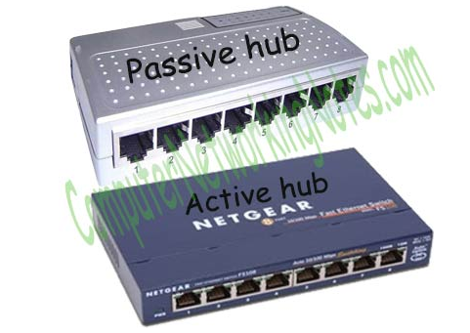
Cont’d

Slide 7
Network Switch
Like a hub, a switch also works at the layer of LAN (Local Area Network) but you can say that a switch is more intelligent than a hub.
While hub just does the work of data forwarding, a switch does ‘filter and forwarding’ which is a more intelligent way of dealing with the data packets.

Slide 8
Cont’d
So, when a packet is received at one of the interfaces of the switch, it filters the packet and sends only to the interface of the intended receiver.
For this purpose, a switch also maintains a CAM (Content Addressable Memory) table and has its own system configuration and memory.
CAM table is also called as forwarding table or forwarding information base (FIB).

Slide 9
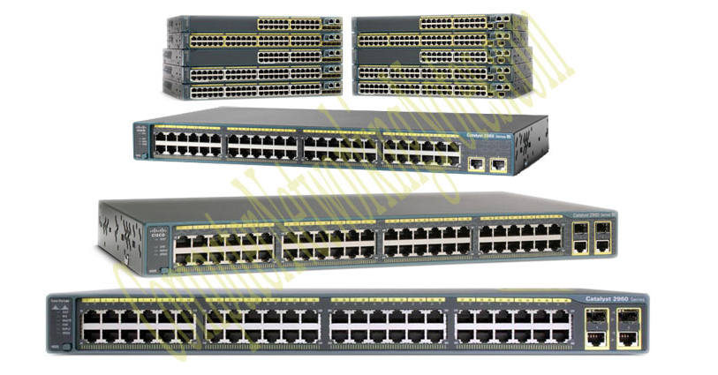
Cont’d

Slide 10
Switches support three methods of switching.
Store and Forward
Cut and Through
Fragment Free

Slide 11
Store and Forward
This is the basic mode of switching.
In this mode, the Switch buffers entire frame into the memory and run FCS (Frame Check Sequence) to ensure that frame is valid and not corrupted.
A frame less than 64 bytes and higher than 1518 bytes is invalid. Only valid frames are processed and all invalid frames are automatically dropped.
Among these three methods, this method has highest latency.
Latency is the time taken by device in passing frame from it.

Slide 12
Cut and Through
This has lowest latency. In this method, Switch only reads first six bytes from frame after the preamble.
These six bytes are the destination address of frame. This is the fastest method of switching.
This method also processes invalid frames.
Only advantage of this method is speed.

Slide 13
Fragment Free
This is a hybrid version of Store and Forward method and Cut and Through method.
It takes goodies from both methods and makes a perfect method for switching.
It checks first 64 bytes of frame for error. It processes only those frames that have first 64bytes valid.
Any frame less than 64 bytes is known as runt.
Runt is an invalid frame type.
This method filters runt while maintaining the speed.

Slide 14
Modem
A Modem is somewhat a more interesting network device in our daily life. So if you have noticed around, you get an internet connection through a wire (there are different types of wires) to your house. This wire is used to carry our internet data outside to the internet world.
However, our computer generates binary data or digital data in forms of 1s and 0s and on the other hand, a wire carries an analog signal and that’s where a modem comes in.
A modem stands for (Modulator + Demodulator).
That means it modulates and demodulates the signal between the digital data of a computer and the analog signal of a telephone line.

Slide 15
Network Router
A router is a network device which is responsible for routing traffic from one to another network.
These two networks could be a private company network to a public network.
You can think of a router as a traffic police who directs different network traffic to different directions.

Slide 16
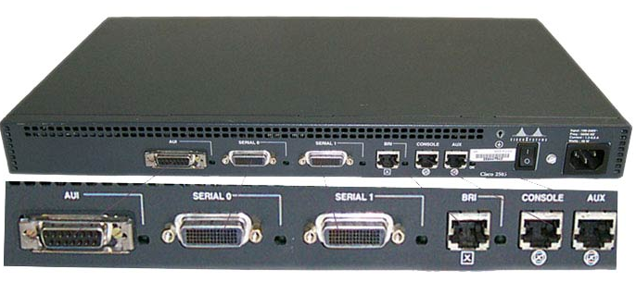
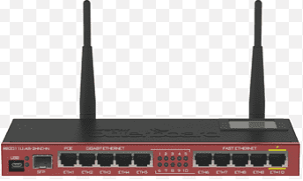
Cont’d

Slide 17
Basically routers are used :-
To connect different network segments.
To connect different network protocols such as IP and IPX.
To connect several smaller networks into a large network (known as internetwork)
To break a large network in smaller networks (Known as subnet usually created to improve the performance or manageability)
To connect two different media types such as UTP and fiber optical.
To connect two different network architectures such as token ring and Ethernet.
To connect LAN network with Telco company’s office (Known as DTE device).
To access DSL services (known as DSL Router).

Slide 18
Bridge
If a router connects two different types of networks, then a bridge connects two subnet-works as a part of the same network.
You can think of two different labs or two different floors connected by a bridge.

Slide 19
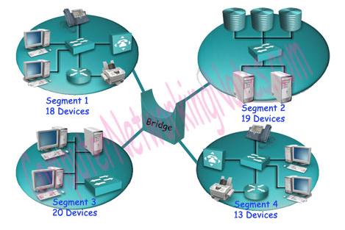
Cont’d

Slide 20
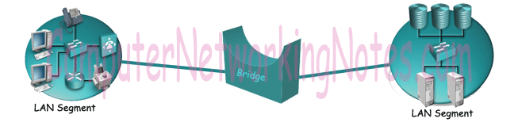
Types of bridges
Local Bridge :- This bridge connects two LAN segments directly. In Ethernet Implementation it is known as Transparent bridge. In Token Ring network it is called Source-Routed bridge.

Slide 21
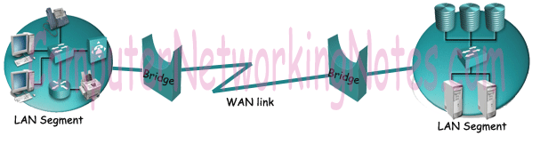
Cont’d
Remote Bridge :- This bridge connects with another bridge over the WAN link.

Slide 22
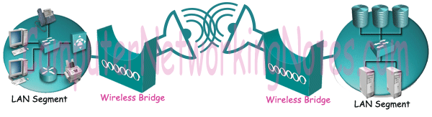
Cont’d
Wireless Bridge :- This bridge connects with another bridge without wiring between them.

Slide 23
Repeater
A repeater is an electronic device that amplifies the signal it receives.
In other terms, you can think of repeater as a device which receives a signal and retransmits it at a higher level or higher power so that the signal can cover longer distances.
For example, inside a college campus, the hostels might be far away from the main college where the ISP line comes in.
If the college authority wants to pull a wire in between the hostels and main campus, they will have to use repeaters if the distance is much because different types of cables have limitations in terms of the distances they can carry the data for.

Slide 24
Gateway
The general name for a machine that makes a connection between two or more networks and provides the necessary translation, both in terms of hardware and software, is a gateway.
Gateways are distinguished by the layer at which they operate in the protocol hierarchy.
Notes:
A network device that connects computers with different protocols. AKA protocol converter

Slide 25
Network Interface Card
Network interface cards are used to connect each computer to the network so they can communicate with the network router to receive information packets.
The interface cards determine the infrastructure of a local area network (LAN) and allow all of the computers to connect to the network.
There are many different types of network interface cards that perform different functions within the network which include Ethernet cards and wireless network interface cards

Slide 26
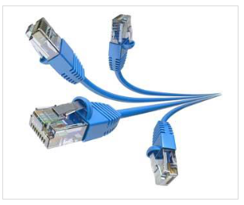
Network Cables
Network cables are the transmission media to transfer data from one device to another.
A commonly used network cable is category 6cable with RJ – 45 connector, as shown in the image below:

Slide 27
To be continued..

Slide 28

Questions

