Slide 1
TOPIC 1: Uses of Computer Networks

Slide 2
Learning Outcomes
Definition of Computer Networks
Business applications
Home applications
Mobile applications
Social applications

Slide 3
Computer Networks Definition
Connection of two or more computing devices in order to share resources.
Devices are connected by transmission media and channels, and are guided by a set of rules for communication purposes that allow users to communicate with each other and share resources.

Slide 4
Uses: Business Applications
Resource sharing
Communication
Buying and Selling online (E-commerce)
Online Transaction Processing

Slide 5
Uses: Home Applications
Personal communication
Entertainment
Security

Slide 6
Uses: Mobile Applications
Global Positioning System (GPS):
Mobile maps to search for locations and geo-tagging.
Vehicle Tracking Systems
Taxis and Trucks (to charge for rentals and hiring)
Cellular Networks:
Communication
Connecting to remote computers, etc.
Mobile Phones:
Texting through SMSs
Calling, etc.

Slide 7
Uses: Mobile Applications
Smart Phones:
Fast data services
Advanced handling of phone calls.
Wireless Hotspots:
Provide internet access in public places like Hotels, Airports, Coffee shops, etc.
Military:
Installing own networks instead of relying on local network for the enemy for security purposes.

Slide 8
Uses: Mobile Applications
Mobile Commerce:
Vending machines
Movie tickets.
Sensor Networks:
For example, your car might gather data on its location, speed, vibration, and fuel efficiency from its on-board diagnostic system and upload this information to a database. This data can help find potholes, plan trips around congested roads, and tell you if you are a ‘‘gas guzzler’’ compared to other drivers on the same stretch of road.

Slide 9
Uses: Mobile Applications
Wearable computers:
Such as smart watches, pacemakers, and insulin pumps.
Handheld computers:
Inventory Management
Stock Management

Slide 10
Uses: Social or Personal Life
Online Dating
Social Networking

Slide 11
TOPIC 2: Telecommunication Systems

Slide 12
Learning Outcomes
Components and functions of telecommunication systems
Data Transmission Modes
Communication networks
Network hardware
Network topologies
Private branch exchange

Slide 13
Communication
Communication is the exchange of information between a sender and a receiver.
Communication can be done locally (face to face), or remotely (over a distance).
On the other hand, data communication is the transmission of a signal by way of a medium from a sender to a receiver.

Slide 14
Telecommunication
The term telecommunication is used to refer to communication that takes place between two devices located far from each other.
Tele is a Greek word for “Far”
A telecommunication system allows distant communication using electrical signals or electromagnetic waves and some basic components to support the system.
Examples include telephone, telegraph and television.

Slide 15
Components and Functions of Telecommunication Systems
Sender:
Device that originates, or generates information transfer to one or more receivers. Takes in information and converts it to a signal ready for transmission.
Channel:
Physical path by which a message travels from the sender to the receiver, e.g. twisted pair cable, coaxial cable, fiber-optic, radio waves, etc.
Receiver:
Takes the signal from the channel and converts it back into usable information. Receives the signal or message coming from the sender.
Multiplexer (MUX):
Can receive multiple input signals and combine them into a single output signal in a recoverable manner for each input signal.

Slide 16
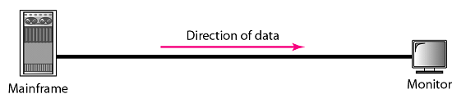
Data Transmission Modes
Simplex (one way street)
The communication is unidirectional
Only one device on a link can transmit; the other can only receive
Use the entire capacity of the channel to send data
Example: Keyboards, Monitors
Data

Slide 17

Data Transmission Modes Cont’d
Half-Duplex (one-lane with two-directional traffic)
Each station can both transmit and receive, but not at the same time
When one device is sending, the other can only receive, and vice versa
The entire capacity of a channel is taken over by the transmitting device
Example: Walkie-talkies
Data
Data

Slide 18

Data Transmission Modes Cont’d
Full-Duplex (Duplex) (two-way street)
Both stations can transmit and receive at same time
Signals going in either direction sharing the capacity of the link
Sharing can occur in two ways:
Link has two physically separate transmission paths
One for sending and the other for receiving
The capacity of the channel is divided between signals travelling in both directions
Example: Telephone network
Data
Data

Slide 19
Communication Networks
Two main types of communication signals:
Analogue transmission transmits data using an information signal that is continuously varying. The signals are continuous in both values and time.
Digital transmission transmits data over a transmission medium discretely (one at a time). The signals are not continuous but discrete in value and time.

Slide 20
Analogue Vs. Digital Signals
Analogue Signals | Digital Signals
Continuous signals | Discrete signals
Represented by sine waves | Represented by square waves
Examples include human voice, natural sound, analogue electronic devices | Examples include computers, optical drives, and other electronic devices
Continuous range of values | Discontinuous values
Records sound waves as they are | Converts into a binary waveform
Only used in analog devices. | Suitable for digital electronics like computers, mobiles and more

Slide 21
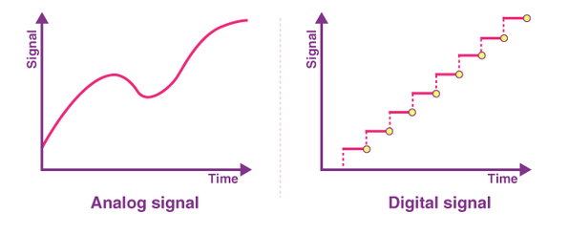
Analogue Vs. Digital Signals

Slide 22
Computer Network Components

Slide 23
Computer Network Components Hardware
Computer networks components comprise both physical parts as well as the software, for installing computer networks, both at organizations and at home.
The hardware components are the server, client, peer, transmission medium, and connecting devices.
The software components are operating system and protocols.

Slide 24
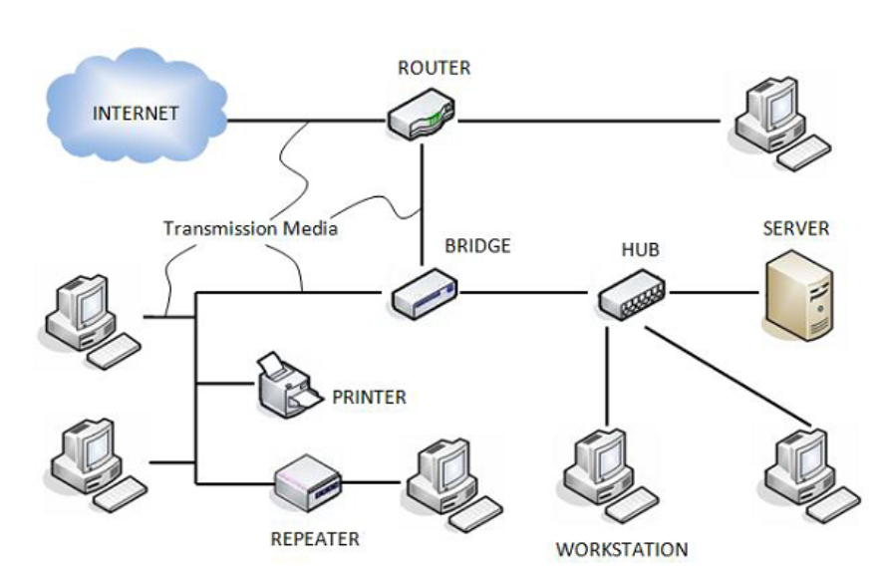
Computer Network Components

Slide 25
Network Hardware Components
Hardware components is said to the physical parts of a computer or electronic system, which work together to perform various tasks.

Slide 26
Network Hardware Components
Servers:
Servers are high-configuration computers that manage the resources of the network. The network operating system is typically installed in the server and so they give user accesses to the network resources. Servers can be of various kinds: file servers, database servers, print servers etc.

Slide 27
Network Hardware Components
Clients:
Clients are computers that request and receive service from the servers to access and use the network resources.
Peers:
Peers are computers that provide as well as receive services from other peers in a workgroup network.

Slide 28
Network Hardware Components
Transmission Media:
Transmission media are the channels through which data is transferred from one device to another in a network.
Transmission media may be guided media like coaxial cable, fibre optic cables etc; or maybe unguided media like microwaves, infra-red waves etc.

Slide 29
Network Hardware Components
Connecting Devices:
Connecting devices act as middleware between networks or computers, by binding the network media together.
Some of the common connecting devices are: Routers, Bridges, Hubs, Repeaters, Gateways and Switches.

Slide 30
Network Connecting Devices
Connecting devices provides an intermediaries for communication between different networks or computers by linking various devices, this helps to travel data across multiple systems and network efficiently.

Slide 31
Network Connecting Devices
Switches
Switches are networking devices operating at layer 2 or a data link layer of the OSI model.
They connect devices in a network and use packet switching to send, receive or forward data packets or data frames over the network.

Slide 32
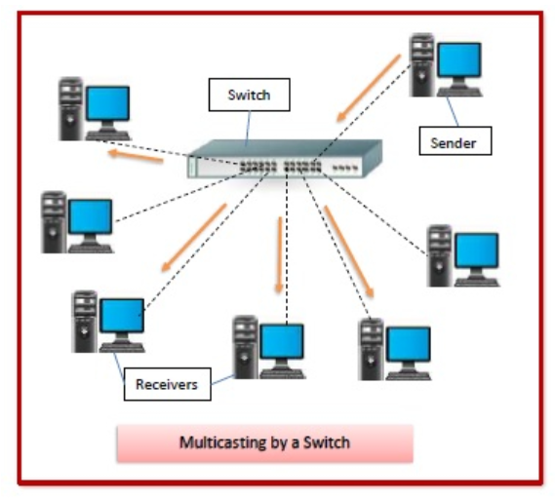
Network Connecting Devices
Switch has many ports, to which computers are plugged in.
When a data frame arrives at any port of a network switch, it examines the destination address, performs necessary checks and sends the frame to the corresponding device(s).
It supports unicast, multicast as well as broadcast communications.

Slide 33
Network Connecting Devices
Features of Switches
A switch operates in the layer 2, i.e. data link layer of the OSI model.
It is an intelligent network device that can be conceived as a multiport network bridge.
It uses MAC addresses (addresses of medium access control sublayer) to send data packets to selected destination ports.
It uses packet switching technique to receive and forward data packets from the source to the destination device.
It is supports unicast (one-to-one), multicast (one-to-many), and broadcast (one-to-all) communications.
Transmission mode is full duplex, i.e. communication in the channel occurs in both the directions at the same time. Due to this, collisions do not occur.
Switches are active devices, equipped with network software and network management capabilities.
Switches can perform some error checking before forwarding data to the destined port.
The number of ports is higher 24/48.

Slide 34
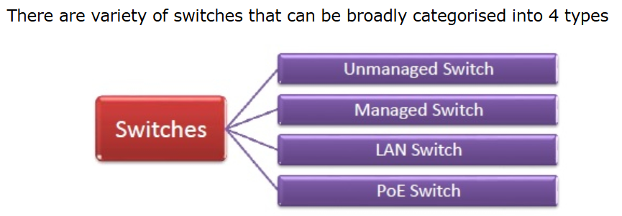
Network Connecting Devices Types of Switches
Unmanaged Switch:
These are inexpensive switches commonly used in home networks and small businesses.
They can be set up by simply plugging in to the network, after which they instantly start operating.
When more devices needs to be added, more switches are simply added by this plug and play method.
They are referred to as u managed since they do not require to be configured or monitored.

Slide 35
Network Connecting Devices Types of Switches
Managed Switch:
These are costly switches that are used in organisations with large and complex networks, since they can be customized to augment the functionalities of a standard switch.
The augmented features may be QoS (Quality of Service) like higher security levels, better precision control and complete network management.
Despite their cost, they are preferred in growing organizations due to their scalability and flexibility.
Simple Network Management Protocol (SNMP) is used for configuring managed switches.

Slide 36
Network Connecting Devices Types of Switches
LAN Switch:
Local Area Network (LAN) switches connects devices in the internal LAN of an organization.
They are also referred as Ethernet switches or data switches.
These switches are particularly helpful in reducing network congestion or bottlenecks.
They allocate bandwidth in a manner so that there is no overlapping of data packets in a network.

Slide 37
Network Connecting Devices Types of Switches
PoE Switch:
Power over Ethernet (PoE) switches are used in PoE Gogabit Ethernets.
PoE technology combine data and power transmission over the same cable so that devices connected to it can receive both electricity as well as data over the same line.
PoE switches offer greater flexibility and simplifies the cabling connections

Slide 38
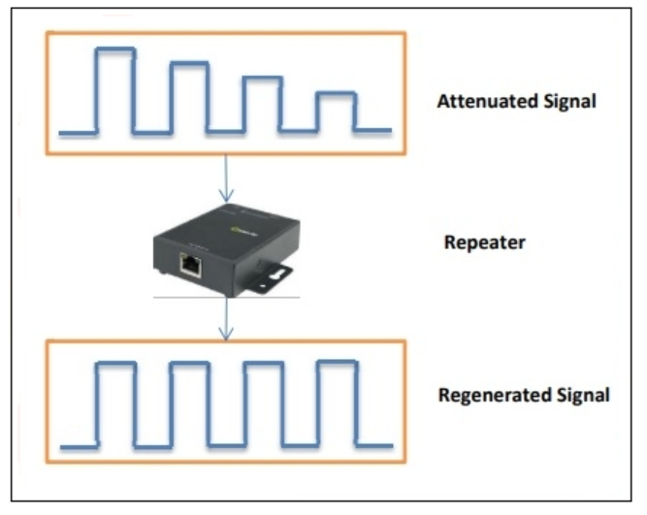
Network Connecting Devices Repeaters
Repeaters are network devices operating at physical layer of the OSI model that amplify or regenerate an incoming signal before retransmitting it.
They are incorporated in networks to expand its coverage area.
They are also known as signal boosters.

Slide 39
Network Connecting Devices Repeaters Why are Repeaters needed?
When an electrical signal is transmitted via a channel, it gets attenuated depending upon the nature of the channel or the technology.
This poses a limitation upon the length of the LAN or coverage area of cellular networks.
This problem is alleviated by installing repeaters at certain intervals.
Repeaters amplifies the attenuated signal and then retransmits it.
Digital repeaters can even reconstruct signals distorted by transmission loss.
So, repeaters are popularly incorporated to connect between two LANs thus forming a large single LAN.

Slide 40
Network Connecting Devices Repeaters Types of Repeaters
According to the types of signals that they regenerate, repeaters can be classified into two categories:
Analog Repeaters
They can only amplify the analog signal.
Digital Repeaters
They can reconstruct a distorted signal.
According to the types of networks that they connect, repeaters can be categorized into two types:
Wired Repeaters
They are used in wired LANs.
Wireless Repeaters
They are used in wireless LANs and cellular networks.

Slide 41
Network Connecting Devices Repeaters Types of Repeaters
According to the domain of LANs they connect, repeaters can be divided into two categories
1)Local Repeaters
They connect LAN segments separated by small distance.
2) Remote Repeaters
They connect LANs that are far from each other.

Slide 42
Network Connecting Devices Repeaters
Advantages of Repeaters
Repeaters are simple to install and can easily extend the length or the coverage area of networks.
They are cost effective.
Repeaters dont require any processing overhead. The only time they need to be investigated is in case of degradation of performance.
They can connect signals using different types of cables.
Disadvantages of Repeaters
Repeaters cannot connect dissimilar networks.
They cannot differentiate between actual signal and noise.
They cannot reduce network traffic or congestion.
Most networks have limitations upon the number of repeaters that can be deployed.

Slide 43
Network Connecting Devices Gateways
A gateway is a network node that forms a passage between two networks operating with different transmission protocols.
The most common type of gateways, the network gateway operates at layer 3, i.e. network layer of the OSI (open systems interconnection) model.
However, depending upon the functionality, a gateway can operate at any of the seven layers of OSI model.
It acts as the entry exit point for a network since all traffic that flows across the networks should pass through the gateway. Only the internal traffic between the nodes of a LAN does not pass through the gateway.

Slide 44
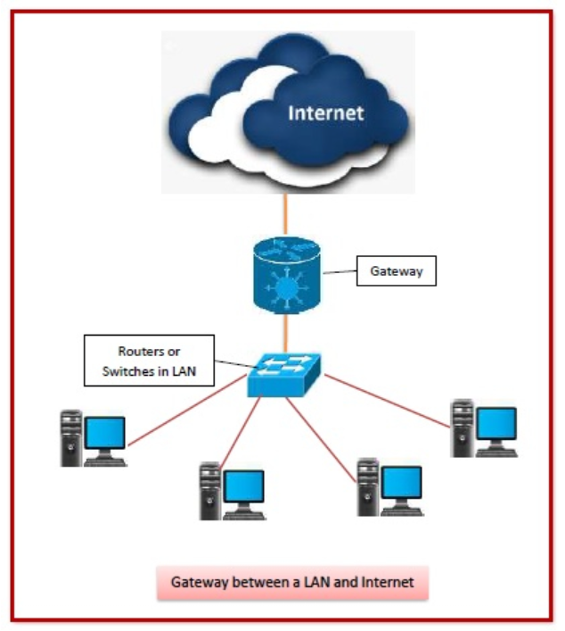
Network Connecting Devices Gateways
A gateway is a network node that forms a passage between two networks operating with different transmission protocols.

Slide 45
Network Connecting Devices Gateways Features
Gateway is located at the boundary of a network and manages all data that inflows or outflows from that network.
It forms a passage between two different networks operating with different transmission protocols.
A gateway operates as a protocol converter, providing compatibility between the different protocols used in the two different networks.
The feature that differentiates a gateway from other network devices is that it can operate at any layer of the OSI model.
It also stores information about the routing paths of the communicating networks.
When used in enterprise scenario, a gateway node may be supplemented as proxy server or firewall.
A gateway is generally implemented as a node with multiple NICs (network interface cards) connected to different networks. However, it can also be configured using software.
It uses packet switching technique to transmit data across the networks.

Slide 46
Network Connecting Devices Gateways Types
On basis of direction of data flow, gateways are broadly divided into two categories:
1) Unidirectional Gateways
They allow data to flow in only one direction. Changes made in the source node are replicated in the destination node, but not vice versa. They can be used as archiving tools.
2) Bidirectional Gateways:
They allow data to flow in both directions. They can be used as synchronization tools.

Slide 47
Network Connecting Devices Gateways Types
On basis of functionalities, there can be a variety of gateways, the prominent among them are as follows:
Network Gateway
This is the most common type of gateway that provides as interface between two dissimilar networks operating with different protocols. Whenever the term gateway is mentioned without specifying the type, it indicates a network gateway.
2) Cloud Storage Gateway
It is a network node or server that translates storage requests with different cloud storage service API calls, such as SOAP (Simple Object Access Protocol) or REST (REpresentational State Transfer).It facilitates integration of private cloud storage into applications without necessitating transfer of the applications into any public cloud, thus simplifying data communication.

Slide 48
Network Connecting Devices Gateways Types
On basis of functionalities, there can be a variety of gateways, the prominent among them are as follows:
3) Internet-To-Orbit Gateway (I2O)
It connects devices on the Internet to satellites and spacecraft orbiting the earth. Two prominent I2O gateways are Project HERMES and Global Educational Network for Satellite Operations (GENSO).
4) IoT Gateway
IoT gateways assimilates sensor data from IoT (Internet of Things) devices in the field and translates between sensor protocols before sending it to the cloud network. They connect IoT devices, cloud network and user applications.
5) VoiP Trunk Gateway
It facilitates data transmission between plain old telephone service (POTS) devices like landline phones and fax machines, with VoIP (voice over Internet Protocol) network.

Slide 49
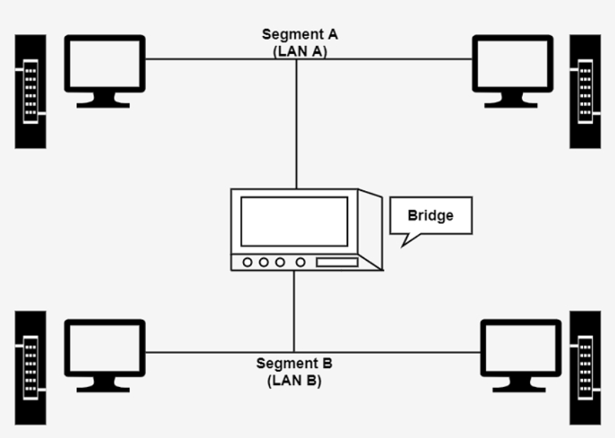
Network Connecting Devices Bridges
Bridges are used to connect two subnetworks that use interchangeable protocols.
It combines two LANs to form an extended LAN.
The main difference between the bridge and repeater is that the bridge has a penetrating efficiency.

Slide 50
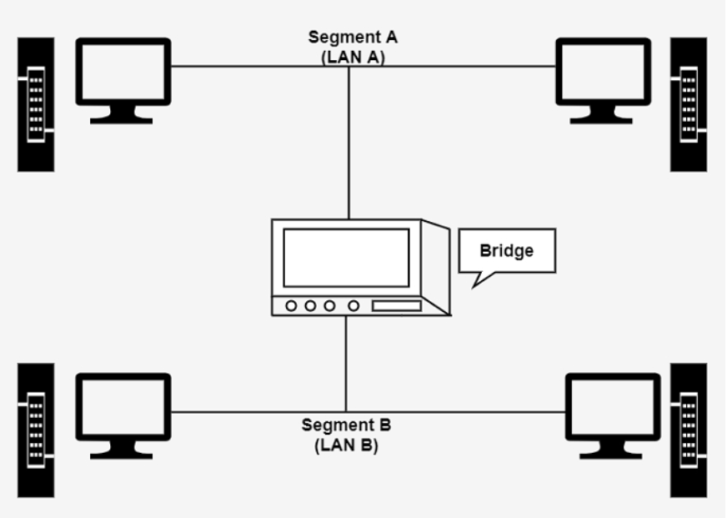
Network Connecting Devices Gateways Types
Working of Bridges
A bridge accepts all the packets and amplifies all of them to the other side.
The bridges are intelligent devices that allow the passing of only selective packets from them.
A bridge only passes those packets addressed from a node in one network to another node in the other network.

Slide 51
Network Connecting Devices Bridge Types
A bridge performs in the following aspect
A bridge receives all the packets or frame from both LAN (segment) A and B.
A bridge builds a table of addresses from which it can identify that the packets are sent from which LAN (or segment) to which LAN.
The bridge reads the send and discards all packets from LAN A sent to a computer on LAN A and that packets from LAN A send to a computer on LAN B are retransmitted to LAN B.
The packets from LAN B are considered in the same method.

Slide 52
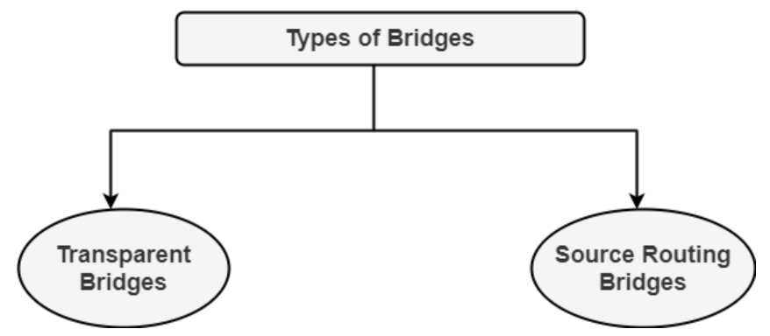
Network Connecting Devices Bridge Types
1. Transparent Bridges
It is also called learning bridges. Bridge construct its table of terminal addresses on its own as it implements connecting two LANs. It facilitates the source location to create its table. It is self-updating. It is a plug and plays bridge.
2. Source Routing Bridge
This sending terminal means the bridges that the frames should stay. This type of bridge is used to prevent looping problem.

Slide 53
Network Connecting Devices Bridge Uses
Uses of Bridges
Bridges are used to divide large busy networks into multiple smaller and interconnected networks to improve performance.
Bridges also can increase the physical size of a network.
Bridges are also used to connect a LAN segment through a synchronous modem relation to another LAN segment at a remote area.

Slide 54
Network Connecting Devices Socket
A network socket is a software component within a computer network node that acts as an endpoint for delivering and receiving data.
An application programming interface (API) for the networking architecture defines the structure and properties of a socket.
Sockets are only produced over the lifespan of a process in a node-based application.
Because the TCP/IP protocols were standardized during the creation of the Internet, the word "network socket" is most often used in the context of the Internet Protocol suite, and it is hence referred to as an "Internet Socket".
In this context, a socket's address, which is the triad of the transport protocol, IP address, and port number, is used to externally identify it to other hosts.

Slide 55
Network Connecting Devices Socket Types
1. Datagram Socket
A datagram socket is a type of network socket in which packets are sent and received without the use of a link.
It resembles a mailbox. Letters (data) are gathered and delivered (transmitted) to a mailbox (receiving socket).
It is a connection-less socket.
2. Stream Socket
A stream socket is a type of network socket in a computer operating system that provides a connection-oriented, sequenced, and unique flow of data without record boundaries, as well as well-defined mechanisms for creating and destroying connections and detecting errors. It is comparable to a telephone. Between the phones (two ends), a link is created.

Slide 56
Network Interface Card (NIC)
A network interface card (NIC) is a hardware component without which a computer cannot be connected over a network.
It is a circuit board installed in a computer that provides a dedicated network connection to the computer.
It is also called network interface controller, network adapter, or LAN adapter.

Slide 57
Network Interface Card (NIC) Purpose
Purpose of Using Network Interface Card (NIC)
NIC allows both wired and wireless communications.
NIC allows communications between computers connected via local area network (LAN) as well as communications over large-scale network through Internet Protocol (IP).
NIC is both a physical layer and a data link layer device, i.e. it provides the necessary hardware circuitry so that the physical layer processes and some data link layer processes can run on it.

Slide 58
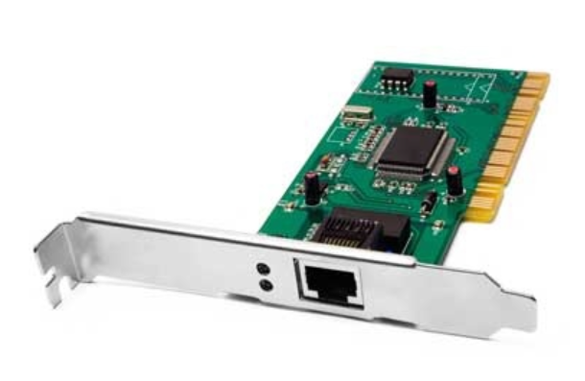
Network Interface Card (NIC) Types
NIC cards are of two types:
1. Internal Network Cards
In internal networks cards, motherboard has a slot for the network card where it can be inserted.
It requires network cables to provide network access. Internal network cards are of two types.
The first type uses Peripheral Component Interconnect (PCI) connection, while the second type uses Industry Standard Architecture (ISA).
Internal Network Cards

Slide 59
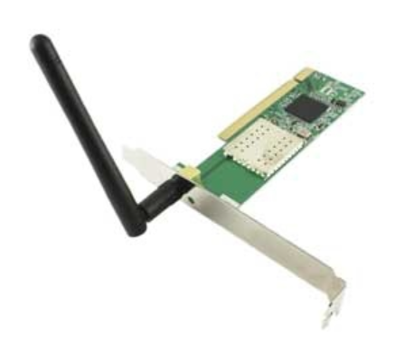
Network Interface Card (NIC) Types
NIC cards are of two types:
2) External Network Cards
In desktops and laptops that do not have an internal NIC, external NICs are used.
External network cards are of two types: Wireless and USB based. Wireless network card needs to be inserted into the motherboard, however no network cable is required to connect to the network.
They are useful while traveling or accessing a wireless signal.
External Network Cards

Slide 60
Network Interface Card (NIC) Types
NIC cards are of two types:
2) External Network Cards
In desktops and laptops that do not have an internal NIC, external NICs are used.
External network cards are of two types: Wireless and USB based. Wireless network card needs to be inserted into the motherboard, however no network cable is required to connect to the network.
They are useful while traveling or accessing a wireless signal.
External Network Cards

Slide 61
Network Interface Card (NIC) Advantages
Faster network Speed
One of the major benefits of NICs is that they offer quicker transfer rates than other networking equipment like modems and routers.
Reliability
A good quality NIC can provide more reliable network connectivity than built-in adaptors.
Security
Some network interface cards (NICs) have security features like hardware-based encryption that can add a layer of security to network communications
Compatibility
Ethernet connections are standardized and widely compatible, and they are used by the majority of NICs.
Lower CPU usage
NICs can offload some processing tasks from the CPU, which can reduce CPU usage and improve overall system performance.
One example is CRC (Cyclic redundancy check) is done by NIC for this task which saves so many clocks of the CPU.

Slide 62
Network Interface Card (NIC) Disadvantages
Limited transfer speed
NICs are constrained by the network interface's top performance. For high bandwidth apps like streaming video, large file transfers, or gaming, this can be a bottleneck.
Limited compatibility
NICs are constrained by the network interface's top performance. For high bandwidth apps like streaming video, large file transfers, or gaming, this can be a bottleneck.
Driver issues
Like any hardware, NICs require drivers to function properly. These drivers may be incompatible with certain operating systems or may require frequent updates.
Cost
NICs can be expensive, especially if you need high-speed, high-bandwidth connections.
Power consumption
Particularly when several NICs are installed in a system, NICs can use a lot of electricity.
Maintenance
NICs may require regular maintenance, such as updating drivers or replacing hardware components.
Security risks
NICs can be a potential point of vulnerability for your network, especially if they are not properly secured.

Slide 63
Network Interface Card (NIC)

Slide 64
Network Hardware: Hubs
Receives data packets and passes on all the information it receives to all the other computers connected to it, including the sender.

Slide 65
Networks Hardware: Switches
More intelligent than a hub.
Able to identify the destination of a data packet. Switches send information only to the destination computer.
Performs transparent bridging at up to the speed of the hardware.
Come in different categories depending on their transmission speed. Speeds include 10, 100, or 1000 mbps.
Types include:
Managed switches
Unmanaged switches
Intelligent or Smart switches

Slide 66
Networks Hardware: Routers
More intelligent than many network devices.
The primary function is to connect two or more networks (or network segments in a very large network) and direct traffic between them.
Receives data from the user, looks for the remote address of the other computer making routing decisions along the way, and finally forwards the user data out to a different interface that is closer to the remote computer.
Routers act like traffic controllers, working to cut down congestion throughout the network and keeping everything flowing smoothly along the best path.

Slide 67
Networks Hardware: Repeaters
Used to regenerate the signal over the same network before the signal becomes too weak or corrupted so as to extend the length to which the signal can be transmitted over the same network.
Does not amplify or boost the signal.
Usually a 2-port device.

Slide 68
Networks Hardware: Modems
Comes from modulator and demodulator. It is therefore a short form of modulator-demodulator.
Converts data from a digital format into a format suitable for an analog transmission medium, and converts back analogue signals to digital data on the receiving end.
A very good example of a modem is the device that connects your home to your dial-up internet service provider (ISP) and translates the digital signals from your ISP so your computer can understand them.

Slide 69
Networks Hardware: Gateways
Provides a remote network with connectivity and access to the host network.
It is a passage that connects two networks together working upon different networking models.
Just as the router, gateways use forwarding tables to determine where data packets are to be sent. Gateways can be routers or computers with special software and configuration.

Slide 70
Networks Topologies
It is the physical layout of computer networks
Two or more links form a topology
The topology of a network is the geometric representation of the relationship of all the links and linking devices (nodes) to one another.
Four topologies : Mesh, Star, Bus, and Ring

Slide 71
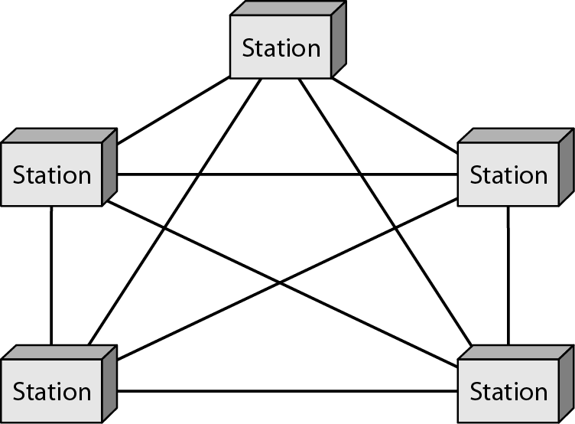
Mesh Topology
Every link is dedicated point-to-point link
The term dedicated means that the link carries traffic only between the two devices it connects

Slide 72
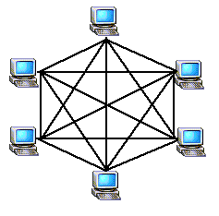
Mesh Topology cont’d
To link n devices fully connected mesh has:
n ( n - 1) / 2 physical channels (Full-Duplex)
Every Device on the network must have
n - 1 ports

Slide 73

Mesh Topology cont’d
Example:
8 devices in mesh has links: n(n-1) / 2
number of links = 8 (8-1)/2 = 28
number of ports per device = n – 1 = 8 –1 = 7

Slide 74
Mesh Topology cont’d
Advantages
Each connection carry its own data load (no traffic problems)
A mesh topology is robust
Privacy or security
Fault identification and fault isolation

Slide 75
Mesh Topology cont’d
Disadvantages
Big amount of cabling
Big number of I/O ports
Installation and reconnection are difficult
Sheer bulk of the wiring can be greater than the available space
Hardware connect to each I/O could be expensive

Slide 76
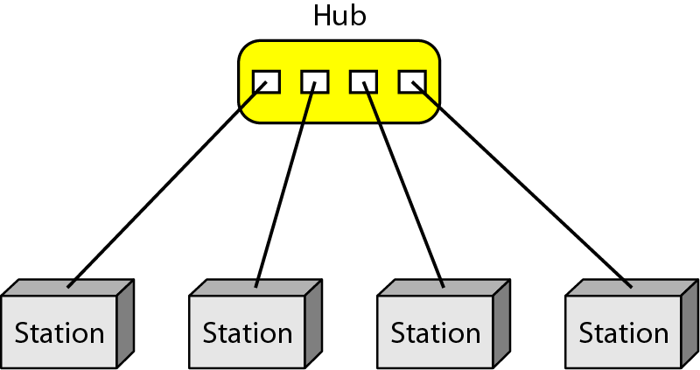
Star Topology
Dedicated point-to-point to a central controller (Hub)
No direct traffic between devices
The control acts as an exchange

Slide 77
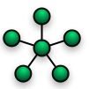
Star Topology cont’d
Advantages
Less expensive than mesh (1 Link + 1 port per device)
Easy to install and reconfigure
Less cabling
Additions, moves, and deletions require one connection
Robustness : one fail does not affect others
Easy fault identification and fault isolation

Slide 78
Star Topology cont’d
Disadvantages
Dependency of the whole topology on one single point (hub)
More cabling than other topologies ( ring or bus)

Slide 79
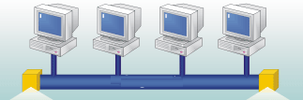
Bus Topology
It is multipoint
One long cable acts as a backbone
Used in the design of early LANS, and Ethernet LANs

Slide 80
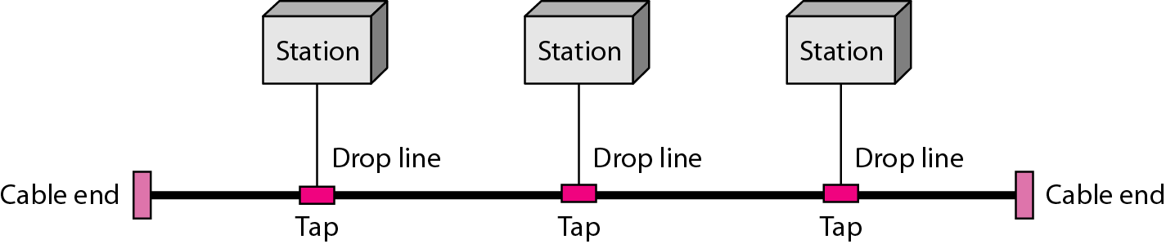
Bus Topology cont’d
Nodes connect to cable by drop lines and taps
Signal travels along the backbone and some of its energy is transformed to heat
Limit of number of taps and the distance between taps

Slide 81

Bus Topology cont’d
Advantages
Ease of installation
Less cables than mesh, star topologies
Disadvantages
Difficult reconnection and fault isolation ( limit of taps)
Adding new device requires modification of backbone
Fault or break stops all transmission
The damaged area reflects signals back in the direction of the origin, creating noise in both directions

Slide 82
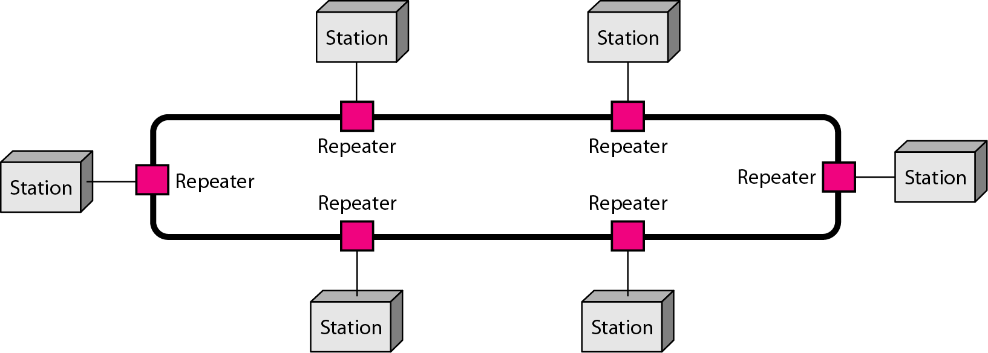
Ring Topology
Each device has dedicated point-to-point connection with only the two devices on either side of it
A signal is passed along the ring in one direction from device to device until it reaches its destination
Each devices incorporates a Repeater

Slide 83

Ring Topology cont’d
Advantages
Easy of install and reconfigure
Connect to immediate neighbors
Move two connections for any moving (Add/Delete)
Easy of fault isolation
Disadvantage
Unidirectional
One broken device can disable the entire network. This weakness can be solved by using a dual ring or a switch capable of closing off the break

Slide 84
Private Branch Exchange (PBX)
Common internal phone switching system for medium to large-sized businesses.
Provides advanced intelligent features to telephone users.
PBX systems collect dialed digits and intelligently decide how to route calls for lowest cost possible.

Slide 85
Advanced Features of PBX
Voice mail:
Routes incoming calls to the best station set (automatic call distribution). It also provides recorded messages and responds to touch-tone requests (automated attendant).
Automated Attendant:
Plays a recorded greeting and offers a set of options. In addition, it lets the caller enter an extension directly (touch tone or voice) and bypass an operator.
Also forwards the caller to a human operator if the caller does not have a touch tone phone.
Automatic Call Distributor:
Used in systems which receive large volumes of incoming calls.
Works to prioritise calls in order of their calling sequence and accords you the chance to be attended to at your own time, based on the skills of the agent.
Interactive Voice Response:
Allows the caller to access or modify database information. For example, a customer can call their bank to inquire about an account balance.

