Slide 1
Computer networks
Components and functions of telecommunication systems

Slide 2
Introduction
Some take the view that telecommunication deals only with voice telephony, and the typical provider of this service is the local telephone company.
But we hold with a wider interpretation.
Telecommunication encompasses the electrical communication at a distance of voice, data, and image information (e.g., TV and facsimile).

Slide 3
What is telecommunication
Telecommunication systems is a specialized system for communicating at a distance.
Such as by telegraph, radio or television.
The term telecommunication is sometimes also referred to as telecom.
It refers to the exchange of information by electronic and electrical medium over a significant distance.
An arrangement which is made up of two or more stations with equal number of transmitter and receiver devices is a telecommunication system.
Telecommunication devices are telephones, telegraph, radio, microwave communication arrangements, fibre optics, satellites and the internet.

Slide 4
Cont’d
Telecommunication is a vast range of information-transmitting technology such as mobile phones, land line telephone, VOIP and broadcast network.
Data is transmitted in the form of electrical signals known as carrier waves, which are modulated into analog or digital signals to transmit information

Slide 5
Components of Telecommunication
Telecommunication systems is emphasis of some of the essential components that transmit data from one end to another through an electronic medium and each component perform a different task.

Slide 6
Components of Telecommunication cont’d
One of the most important component required is computers to process information.
Then input or output devices to send and receive data which are also referred as terminals. Input and output are starting and stopping poles of any communication.
In networks these terminals are known as nodes which can be a computer or peripheral devices and if we take real life example then mobile phone/landline is as example of terminals.
Telecommunication channels that link the terminals by the various ways of cables and wireless radio frequencies to transmit and receive data.

Slide 7
Components of Telecommunication cont’d
Telecommunication processor like modem which provide control and support functions and help to convert the signal from one form to another by providing communication support for data transmission and reception.
Telecommunication Software is used to manage the network and specify the protocol which handle the telecommunication system also handle and control the activities and functionality.

Slide 8
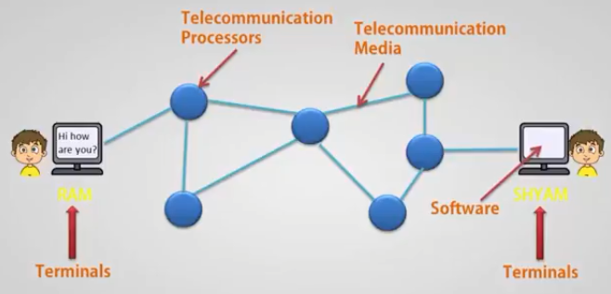
Components of Telecommunication cont’d

Slide 9
Functions of Telecommunication
The primary function of telecommunication systems is to transmit information to far distance and establish interface between sender and receiver by some means of transmission mode or way.
Since terminals and nodes are connected randomly in the network so this system routes the message along the most efficient paths that take minimum time to send message to the receiver end.
Transmission of the data and reception of the message is done in uninterrupted way and come shortest path and minimum time.
This system also ensures that the right message is received by right user only and while transmitting is also checked for transmission errors.

Slide 10
Functions of Telecommunication cont’d
As we know network use different software and hardware to transmit data via communication channels and that vary with the different medium so the telecommunication is responsible for converting and managing the speed of transmission independent to the platform.
Also convert message from one format to another because information is represented in different ways to the different platform.
Control the flow of information that depend on the communication channels and the terminals used to transmit information. So this system control both of them accordingly

Slide 11
Types of Communication Medium Used in Networks
Communication medium refers to the physical channel through which data is sent and received.
Data is sent in the form of voltage levels which make up the digital signal. A digital signal consists of 0s and 1s; essentially, a 1 corresponds to a high voltage, while a 0 corresponds to a low voltage.
The speed of data transmission or data rate depends upon the type of medium being used in the network.

Slide 12
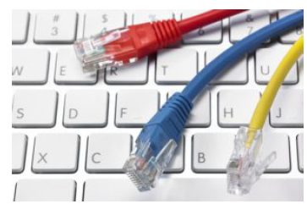
Types of Communication Media Used in telecommunication
There are basically two types of communication media used in telecommunication:
Wired
Wireless

Slide 13
Wired media
Twisted Pair
It consists of a pair of copper wires twisted around each other; the wires are around 1 to 2 mm thick and they are twisted to reduce the interference from the surrounding wires.
Remember that a current carrying wire has a magnetic field around it that can interfere with that of another wire when in close proximity.
Invented by Alexander Graham Bell, this form of wire has been in use since the 19th century and is currently the cheapest mediums available.
Twisted pairs are also used in telephone wires, but they only consist of four wires or two pairs. In computer networks, eight wires or four pairs are utilized.
This is also known as the Ethernet cable or RJ-45 cable.
The pairs of wires are bundled together and covered by a protective shield

Slide 14
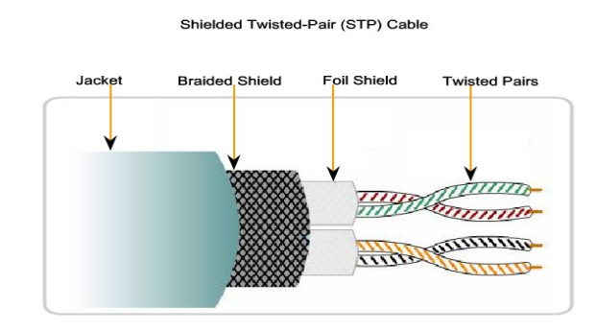
Twisted Pair cables

Slide 15
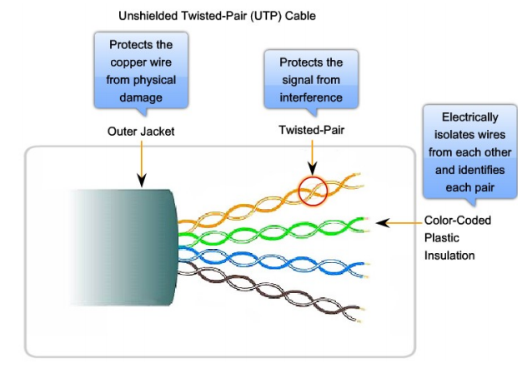
Unshielded twisted Pair cables

Slide 16
Coaxial Cable
Coaxial cable consists of a copper conductor surrounded by a layer of flexible insulation.
Over this insulating material is a woven copper braid, or metallic foil, that acts as the second wire in the circuit and as a shield for the inner conductor.
This second layer, or shield, also reduces the amount of outside electromagnetic interference. Covering the shield is the cable jacket.
All the elements of the coaxial cable encircle the center conductor.
Because they all share the same axis, this construction is called coaxial, or coax for short

Slide 17
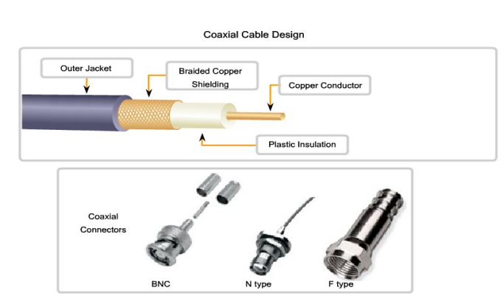
Coaxial Cable cont’d

Slide 18
Uses of Coaxial Cable
The coaxial cable design has been adapted for different purposes.
Coax is an important type of cable that is used in wireless and cable access technologies.
Coax cables are used to attach antennas to wireless devices.
The coaxial cable carries radio frequency (RF) energy between the antennas and the radio equipment.
Coax is also the most widely used media for transporting high radio frequency signals over wire, especially cable television signals.
Traditional cable television, exclusively transmitting in one direction, was composed completely of coax cable.

Slide 19
Fiber Optic
It is the most expensive of wired mediums and offers the highest rates of data transmission.
They are often used in long distance communications and are never affected by any electromagnetic fields. This is because it involves light.
A fiber optic cable is a thin, flexible, transparent medium made of very fine glass or plastic fibers.
It utilizes the principle of total internal reflection.
Unlike twisted pairs or coaxial cables, a fiber optic uses light pulses generated by laser or an injection diode to transmit data.
Each pulse of light represents a single bit of data.

Slide 20
Optical fiber media implementation issues include:
More expensive (usually) than copper media over the same distance (but for a higher capacity)
Different skills and equipment required to terminate and splice the cable infrastructure
More careful handling than copper media
At present, in most enterprise environments, optical fiber is primarily used as backbone cabling for high-traffic point to-point connections between data distribution facilities and for the interconnection of buildings in multi-building campuses.
Because optical fiber does not conduct electricity and has low signal loss, it is well suited for these uses.

Slide 21
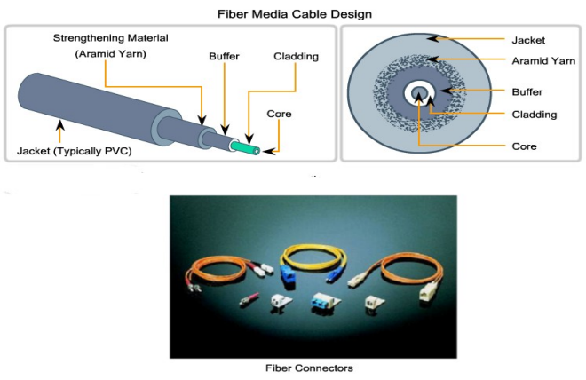
Fiber optic

Slide 22
Power lines
The convenience of using power lines for networking should be clear.
Simply plug a TV and a receiver into the wall, which you must do anyway because they need power, and they can send and receive movies over the electrical wiring.
This configuration is shown in Fig. below.
There is no other plug or radio. The data signal is superimposed on the low-frequency power signal (on the active or ‘‘hot’’ wire) as both signals use the wiring at the same time
Notes:
The telephone and cable television networks are not the only sources of wiring that can be reused for data communication.
There is a yet more common kind of wiring: electrical power lines.
Power lines deliver electrical power to houses, and electrical wiring within houses distributes the power to electrical outlets.
The use of power lines for data communication is an old idea. Power lines have been used by electricity companies for low-rate communication such as remote metering for many years, as well in the home to control devices (e.g., the X10 standard).
In recent years there has been renewed interest in high-rate communication over these lines, both inside the home as a LAN and outside the home for broadband Internet access

Slide 23
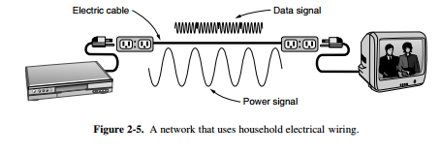
Power lines cont’d
Notes:
The difficulty with using household electrical wiring for a network is that it was designed to distribute power signals. This task is quite different than distributing data signals, at which household wiring does a horrible job. Electrical signals are sent at 50–60 Hz and the wiring attenuates the much higher frequency (MHz) signals needed for high-rate data communication.

Slide 24
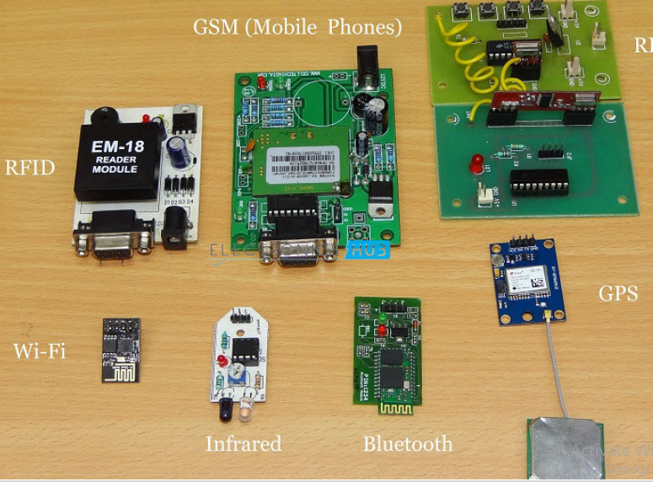
Wireless Media intro

Slide 25
What is Electromagnetic Wave?
Electromagnetic Waves carry the electromagnetic energy of electromagnetic field through space.
Electromagnetic Waves include Gamma Rays (γ – Rays), X – Rays, Ultraviolet Rays, Visible Light, Infrared Rays, Microwave Rays and Radio Waves.
Electromagnetic Waves (usually Radio Waves) are used in wireless communication to carry the signals.
An Electromagnetic Wave consists of both electric and magnetic fields in the form of time varying sinusoidal waves.
Both these fields are oscillating perpendicular to each other and the direction of propagation of the Electromagnetic Wave is again perpendicular to both these fields.
Notes:
The electromagnetic spectrum is the range of frequencies (the spectrum) of electromagnetic radiation and their respective wavelengths and photon energies
The electromagnetic spectrum covers electromagnetic waves with frequencies ranging from below one hertz to above 10²⁵ hertz, corresponding to wavelengths from thousands of kilometers down to a fraction of the size of an atomic nucleus.
This frequency range is divided into separate bands, and the electromagnetic waves within each frequency band are called by different names; beginning at the low frequency (long wavelength) end of the spectrum these are: radio waves, microwaves, infrared, visible light, ultraviolet, X-rays, and gamma rays at the high-frequency (short wavelength) end.

Slide 26
Wireless media
Today, people need Mobile Phones for many things like talking, internet, multimedia etc.
All these services must be made available to the user on the go i.e. while the user is mobile. With the help of these wireless communication services, we can transfer voice, data, videos, images etc.
Wireless Communication Systems also provide different services like video conferencing, cellular telephone, paging, TV, Radio etc.
Due to the need for variety of communication services, different types of Wireless Communication Systems are developed.

Slide 27
Wireless media
Wireless media carry electromagnetic signals at radio and microwave frequencies that represent the binary digits of data communications.
As a networking medium, wireless is not restricted to conductors or pathways, as are copper and fiber media.
Wireless data communication technologies work well in open environments.
However, certain construction materials used in buildings and structures, and the local terrain, will limit the effective coverage.
In addition, wireless is susceptible to interference and can be disrupted by such common devices as household cordless phones, some types of fluorescent lights, microwave ovens, and other wireless communications

Slide 28
Wireless media cont’d
Further, because wireless communication coverage requires no access to a physical strand of media, devices and users who are not authorized for access to the network can gain access to the transmission.
Therefore, network security is a major component of wireless network administration

Slide 29
Wireless media cont’d
Some of the important Wireless Communication Systems available today are:
Television and Radio Broadcasting
Satellite Communication
Radar
Mobile Telephone System (Cellular Communication)
Global Positioning System (GPS)
Infrared Communication
WLAN (Wi-Fi)
Bluetooth
Paging
Cordless Phones
Radio Frequency Identification (RFID)

Slide 30
Television and Radio Broadcasting
Radio is considered to be the first wireless service to be broadcast.
It is an example of a Simplex Communication System where the information is transmitted only in one direction and all the users receiving the same data

Slide 31
Satellite Communication
Satellite Communication System is an important type of Wireless Communication.
Satellite Communication Networks provide worldwide coverage independent to population density.
Satellite Communication Systems over telecommunication (Satellite Phones), positioning and navigation (GPS), broadcasting, internet, etc.
Other wireless services like mobile, television broadcasting and other radio systems are dependent of Satellite Communication Systems.

Slide 32
Radio Detection and Ranging (RADAR)
It is a system that uses electromagnetic waves to detect the presence, direction, distance and speed of aircrafts, ships and other objects by sending out pulses of radio waves which are reflected off the object back to the source.

Slide 33
Mobile Telephone Communication System
Perhaps, the most commonly used wireless communication system is the Mobile Phone Technology.
The development of mobile cellular device changed the World like no other technology.
Today’s mobile phones are not limited to just making calls but are integrated with numerous other features like Bluetooth, Wi-Fi, GPS, and FM Radio.

Slide 34
Global Positioning System (GPS)
GPS is solely a subcategory of satellite communication.
GPS provides different wireless services like navigation, positioning, location, speed etc. with the help of dedicated GPS receivers and satellites.

Slide 35
Bluetooth
Bluetooth is another important low range wireless communication system.
It provides data, voice and audio transmission with a transmission range of 10 meters.
Almost all mobile phones, tablets and laptops are equipped with Bluetooth devices.
They can be connected to wireless Bluetooth receivers, audio equipment, cameras etc.

Slide 36
Paging
A pager (also known as a beeper, bleeper or pocket bell ) is a wireless telecommunications device that receives and displays alphanumeric or voice messages.
Although it is considered an obsolete technology, paging was a major success before the wide spread use of mobile phones.
Paging provides information in the form of messages and it is a simplex system i.e. the user can only receive the messages.
Notes:
One-way pagers can only receive messages, while response pagers and two-way pagers can also acknowledge, reply to and originate messages using an internal transmitter.
Pagers operate as part of a paging system which includes one or more fixed transmitters (or in the case of response pagers and two-way pagers, one or more base stations), as well as a number of pagers carried by mobile users. These systems can range from a restaurant system with a single low-power transmitter, to a nationwide system with thousands of high-power base stations.

Slide 37
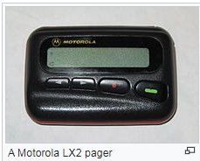
Pager example

Slide 38
Wireless Local Area Network (WLAN)
Wireless Local Area Network or WLAN (Wi-Fi) is an internet related wireless service.
Using WLAN, different devices like laptops and mobile phones can connect to an access point and access internet.

Slide 39
Infrared Communication
Infrared Communication is another commonly used wireless communication in our daily lives.
It uses the infrared waves of the Electromagnetic (EM) spectrum.
Infrared (IR) Communication is used in remote controls of Televisions, cars, audio equipment etc.
Notes:
The electromagnetic spectrum is the range of frequencies (the spectrum) of electromagnetic radiation and their respective wavelengths and photon energies
The electromagnetic spectrum covers electromagnetic waves with frequencies ranging from below one hertz to above 10²⁵ hertz, corresponding to wavelengths from thousands of kilometers down to a fraction of the size of an atomic nucleus.
This frequency range is divided into separate bands, and the electromagnetic waves within each frequency band are called by different names; beginning at the low frequency (long wavelength) end of the spectrum these are: radio waves, microwaves, infrared, visible light, ultraviolet, X-rays, and gamma rays at the high-frequency (short wavelength) end.
The electromagnetic waves in each of these bands have different characteristics, such as how they are produced, how they interact with matter, and their practical applications.

Slide 40
Activity
Explore the Radio Frequency Identification (RFID) wireless communication media guided by:
Components of RFID
Application areas of RFID
Advantages and limitations
Compare it to other wireless communication systems (Bluetooth, WIFI, etc)

Slide 41
CISCO Packet Tracer
Cisco Packet Tracer is a network simulation tool that allows users to create, configure, and troubleshoot network topologies and imitate modern computer networks
The tool is designed by Cisco Systems and is used to prepare for Cisco exams and improve network knowledge
The tool provides a simulated command line interface and a visual representation of the network

Slide 42

Questions

