Slide 1
Computer networks
internet

Slide 2
The Internet
Internet is a worldwide collection of interconnected networks (internetworks or internet for short), cooperating with each other to exchange information using common standards.
Through telephone wires, fiber optic cables, wireless transmissions, and satellite links, Internet users can exchange information in a variety of forms.
The Internet is a conglomerate of networks and is not owned by any individual or group.
Notes:
The Internet is not really a network at all, but a vast collection of different networks that use certain common protocols and provide certain common services.

Slide 3
History of the internet
The story begins in the late 1950s.
At the height of the Cold War, the U.S. DoD wanted a command-and-control network that could survive a nuclear war.
At that time, all military communications used the public telephone network, which was considered vulnerable
To understand what happened next, we have to go back all the way to October 1957, when the Soviet Union beat the U.S. into space with the launch of the first artificial satellite, Sputnik

Slide 4
History of the internet cont’d
Here the black dots represent telephone switching offices, each of which was connected to thousands of telephones.
These switching offices were, in turn, connected to higher-level switching offices (toll offices), to form a hierarchy with only a small amount of redundancy.
The vulnerability of the system was that the destruction of a few key toll offices could fragment it into many isolated islands.

Slide 5
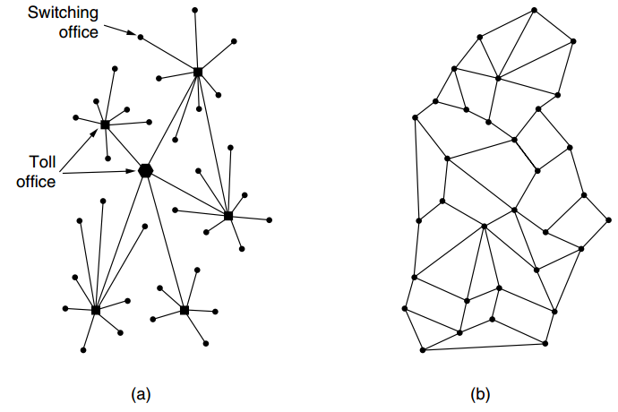
Notes:
(a) Structure of the telephone system. (b) Baran’s proposed distributed switching system

Slide 6
History of the internet cont’d
In short, the story begun in the late 1950s particularly in 1957 when Soviet Union Launched the first artificial satellite Sputnik.
In 1969 ARPANET (Advanced Research Projects Agency) connected Computers at UCLA, Stanford Research Institute.
ARPANET is the grandparent of all wide area computer networks
In 1985, National Science Foundation (NSF) used ARPANET Technology to create a larger Network, Connecting entire LANs to each other.
The NSF network was internet, as this network grew throughout the world, it became Internet.
Notes:
The story begins in the late 1950s. At the height of the Cold War, the U.S. DoD wanted a command-and-control network that could survive a nuclear war.
To understand what happened next, we have to go back all the way to October 1957, when the Soviet Union beat the U.S. into space with the launch of the first artificial satellite, Sputnik

Slide 7
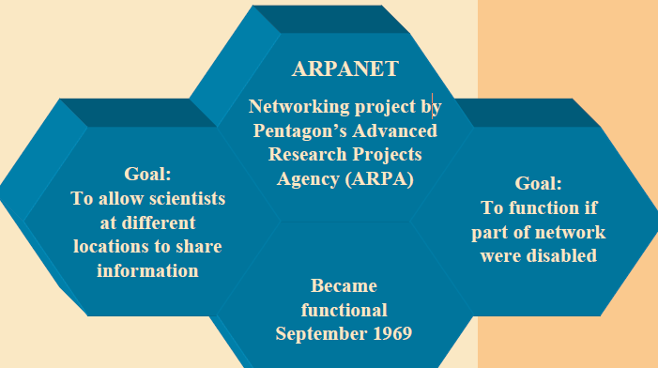
Internet Background (Cont’d)

Slide 8
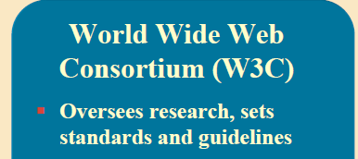
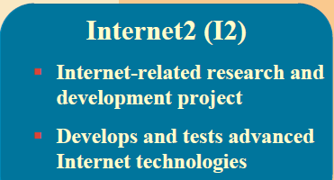
Internet Infrastructure
Internet is not owned or operated by any single organisation or government. It is network connected to other networks and to the internet backbone.
Several organizations set standards

Slide 9
Cont’d
These organizations include the Internet Engineering Task Force (IETF), Internet Corporation for Assigned Names and Numbers (ICANN), and the Internet Architecture Board (IAB)

Slide 10
Requirements for connecting to the Internet
Modem: A modem is a peripheral device that allows a computer to connect and communicate with other computers. Modem stands for Modulator Demodulator.
Web Browser: A browser is a software program that is necessary in order to view web pages on the web. Ex: Internet Explorer, Netscape Navigator, Mozilla Firefox, Microsoft outlook express etc.
Telephone line: A telephone line is required to transfer data from one computer to another. The computer is connected to a modem, which, in turn, connected to a telephone line.
Subscription with Internet service provider (ISP): ISP‘s are companies that provide access to the internet. We need subscription with any ISP to get an Internet connection. Some of the ISPs in India are VSNL, MTNL, Sify, Specrta Net etc.

Slide 11
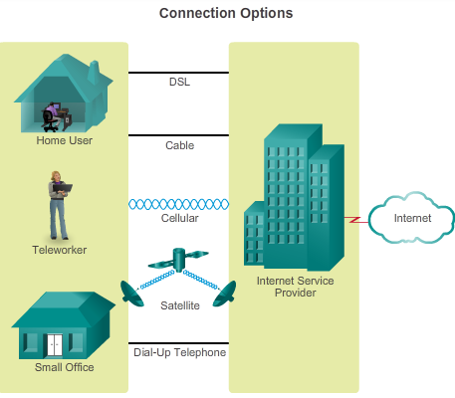
Internet Access Technologies
Connecting Remote Users to the Internet
There are many different ways to connect users and organizations to the Internet.
Cable
DSL ( three lines: voice, downlink, uploading & sending information)
Cellular
satellite
Dial-up Telephone

Slide 12
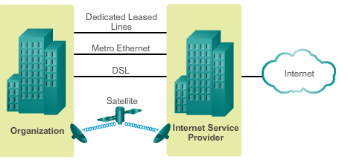
Connecting Businesses to the Internet
Corporate connection:

Slide 13
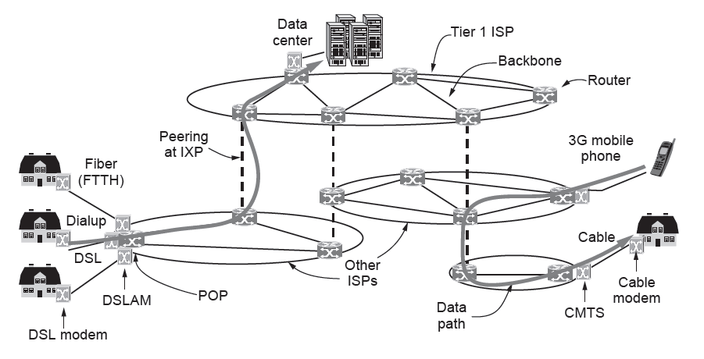
Overview of the Internet architecture
Overview of the Internet architecture

Slide 14
Overview of the Internet architecture cont’d
Let us examine this figure piece by piece, starting with a computer at home (at the edges of the figure).
To join the Internet, the computer is connected to an Internet Service Provider, or simply ISP, from who the user purchases Internet access or connectivity.
This lets the computer exchange packets with all of the other accessible hosts on the Internet.
The user might send packets to surf the Web or for any of a thousand other uses, it does not matter.
There are many kinds of Internet access, and they are usually distinguished by how much bandwidth they provide and how much they cost, but the most important attribute is connectivity.

Slide 15
Overview of the Internet architecture cont’d
The computer is connected to a device called a DSL modem that converts between digital packets and analog signals that can pass unhindered over the telephone line.
At the other end, a device called a DSLAM(Digital Subscriber Line Access Multiplexer) converts between signals and packets.

Slide 16
Overview of the Internet architecture cont’d
Several other popular ways to connect to an ISP are shown in Fig. above.
DSL is a higher-bandwidth way to use the local telephone line than to send bits over a traditional telephone call instead of a voice conversation.
That is called dial-up and done with a different kind of modem at both ends.
The word modem is short for ‘‘modulator demodulator’’ and refers to any device that converts between digital bits and analog signals.

Slide 17
Overview of the Internet architecture cont’d
Another method is to send signals over the cable TV system.
Like DSL, this is a way to reuse existing infrastructure, in this case otherwise unused cable TV channels.
The device at the home end is called a cable modem and the device at the cable headend is called the CMTS(Cable Modem Termination System).

Slide 18
Overview of the Internet architecture cont’d
DSL and cable provide Internet access at rates from a small fraction of a megabit/sec to multiple megabit/sec, depending on the system.
These rates are much greater than dial-up rates, which are limited to 56 kbps because of the narrow bandwidth used for voice calls.
Internet access at much greater than dial-up speeds is called broadband.
The name refers to the broader bandwidth that is used for faster networks, rather than any particular speed.

Slide 19
Overview of the Internet architecture cont’d
The access methods mentioned so far are limited by the bandwidth of the ‘‘last mile’’ or last leg of transmission.
By running optical fiber to residences, faster Internet access can be provided at rates on the order of 10 to 100 Mbps.
This design is called FTTH(Fiber to the Home).
For businesses in commercial areas, it may make sense to lease a high-speed transmission line from the offices to the nearest ISP.
For example, in North America, a T3 line runs at roughly 45 Mbps.

Slide 20
Overview of the Internet architecture cont’d
Wireless is used for Internet access too.
An example we will explore shortly is that of 3G mobile phone networks. They can provide data delivery at rates of 1 Mbps or higher to mobile phones and fixed subscribers in the coverage area.
We can now move packets between the home and the ISP.
We call the location at which customer packets enter the ISP network for service the ISP’s POP (Point of Presence).
We will next explain how packets are moved between the POPs of different ISPs. From this point on, the system is fully digital and packet switched.

Slide 21
Overview of the Internet architecture cont’d
ISP networks may be regional, national, or international in scope.
We have already seen that their architecture is made up of long-distance transmission lines that interconnect routers at POPs in the different cities that the ISPs serve.
This equipment is called the backbone of the ISP.
If a packet is destined for a host served directly by the ISP, that packet is routed over the backbone and delivered to the host. Otherwise, it must be handed over to another ISP.

Slide 22
Overview of the Internet architecture cont’d
ISPs connect their networks to exchange traffic at IXPs(Internet eXchange Points). The connected ISPs are said to peer with each other.
There are many IXPs in cities around the world. They are drawn vertically in Fig. above because ISP networks overlap geographically. Basically, an IXP is a room full of routers, at least one per ISP.
A LAN in the room connects all the routers, so packets can be forwarded from any ISP backbone to any other ISP backbone. IXPs can be large and independently owned facilities.
One of the largest is the Amsterdam Internet Exchange, to which hundreds of ISPs connect and through which they exchange hundreds of gigabits/sec of traffic.

Slide 23
Overview of the Internet architecture cont’d
The peering that happens at IXPs depends on the business relationships between ISPs. There are many possible relationships.
For example, a small ISP might pay a larger ISP for Internet connectivity to reach distant hosts, much as a customer purchases service from an Internet provider. In this case, the small ISP is said to pay for transit.
Alternatively, two large ISPs might decide to exchange traffic so that each ISP can deliver some traffic to the other ISP without having to pay for transit.
One of them any paradoxes of the Internet is that ISPs who publicly compete with one another for customers often privately cooperate to do peering

Slide 24
Overview of the Internet architecture cont’d
At the top of the food chain are a small handful of companies, like AT&T and Sprint, that operate large international backbone networks with thousands of routers connected by high-bandwidth fiber optic links. These ISPs do not pay for transit.
They are usually called tier 1 ISPs and are said to form the backbone of the Internet, since everyone else must connect to them to be able to reach the entire Internet.

Slide 25
Overview of the Internet architecture cont’d
Companies that provide lots of content, such as Google and Yahoo!, locate their computers in data centers that are well connected to the rest of the Internet.
These data centers are designed for computers, not humans, and may be filled with rack upon rack of machines called a server farm.
Colocation or hosting data centers let customers put equipment such as servers at ISP POPs so that short, fast connections can be made between the servers and the ISP backbones.

Slide 26
Internet Protocols
Rules that govern communication on the Internet.
The Internet uses a variety of communications protocols to support basic data transport and services, such as e-mail, web access and downloading.
Some of the main Protocols used on the Internet include:
Transmission Control Protocol (TCP)
Creates connections and exchange packets of data
2. Internet Protocol (IP)
Provides devices with unique addresses

Slide 27
Internet Protocols (Cont’d)
3. User Datagram Protocol (UDP)
Alternative to TCP used for DNS, VoIP and File Sharing
4. Hypertext Transfer Protocol (HTTP)
Exchanges information over the web
5. File Transfer protocol(FTP)
Transfers files between local and remote host computers

Slide 28
Internet Protocols (Cont’d)
6. Post Office Protocol (POP)
Transfers mail from an e-mail server to client Inbox
7.Simple Mail Transfer Protocol (SMTP)
Transfers e-mail messages from client computers to an e-mail server.
8. Voice over Internet Protocol (VoIP)
Transmits voice conversations over the Internet
9. Internet Relay Chat (IRC)
Transmits text messages in real time between online users.

Slide 29
Protocol Suite
Is a combination of protocols that work together, example TCP/IP.
TCP Breaks a message or file into packets. IP is responsible for addressing the packets so that they can be routed to their destination.
TCP/IP provides a protocol standard for the internet that is public, free, extensible and easy to implement.

Slide 30
Types of Internet Connections (Cont’d)
i. Cable
A cable Modem allows access to high speed Internet services through the cable television network.
ii. Fiber-optic connection
Uses optical fibers instead of metal wires, and transmits pulses of light rather than electrical signals.
iii. Broadband
Broadband is characterized by a high-speed data transfer, permanent access to the Internet, and thus the risk of unauthorized access to the network or your personal computer.

Slide 31
Internet Access Technologies
Connecting Remote Users to the Internet
There are many different ways to connect users and organizations to the Internet.
Cable
DSL ( three lines: voice, downlink, uploading & sending information)
Cellular
satellite
Dial-up Telephone

Slide 32
Connecting Businesses to the Internet
Corporate connection:

Slide 33
Characteristics underlying internet architectures (Design criteria)
Networks must support a wide range of applications and services, as well as operate over many different types of physical infrastructures.
The term network architecture, in this context, refers to both the technologies that support the infrastructure and the programmed services and protocols that move the messages across that infrastructure.
As the Internet, and networks in general, evolve, we are discovering that there are four basic characteristics that the underlying architectures (Design criteria) need to address in order to meet user expectations: fault tolerance, scalability, quality of service, and security.

Slide 34
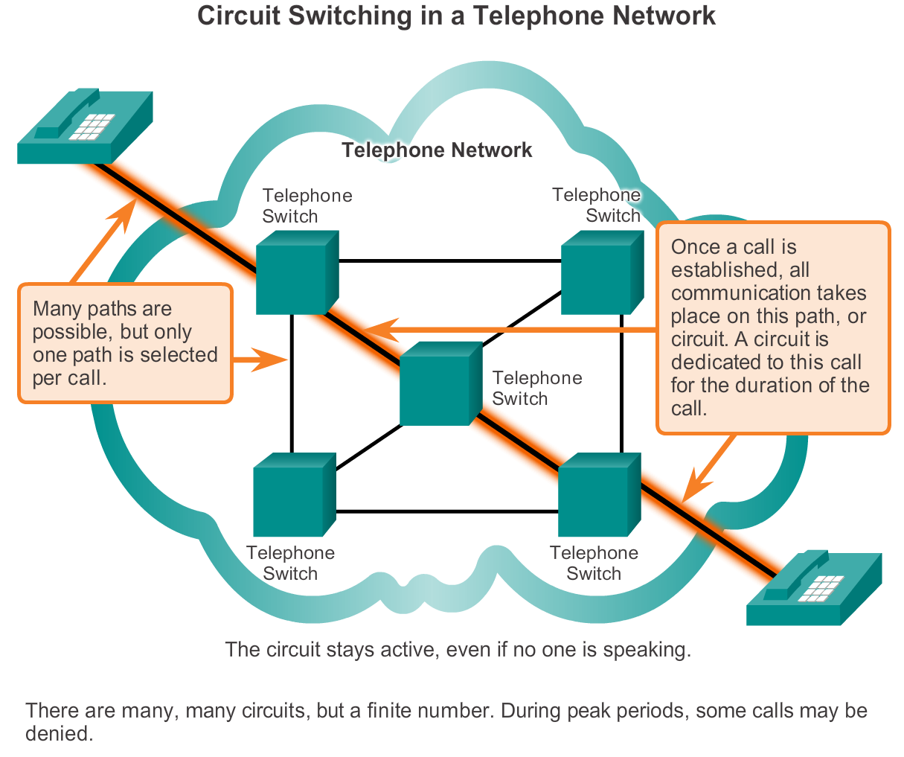
Reliable Network Fault Tolerance in Circuit Switched Network
Notes:
1.3.2.2 Fault Tolerance in Circuit Switched Networks

Slide 35
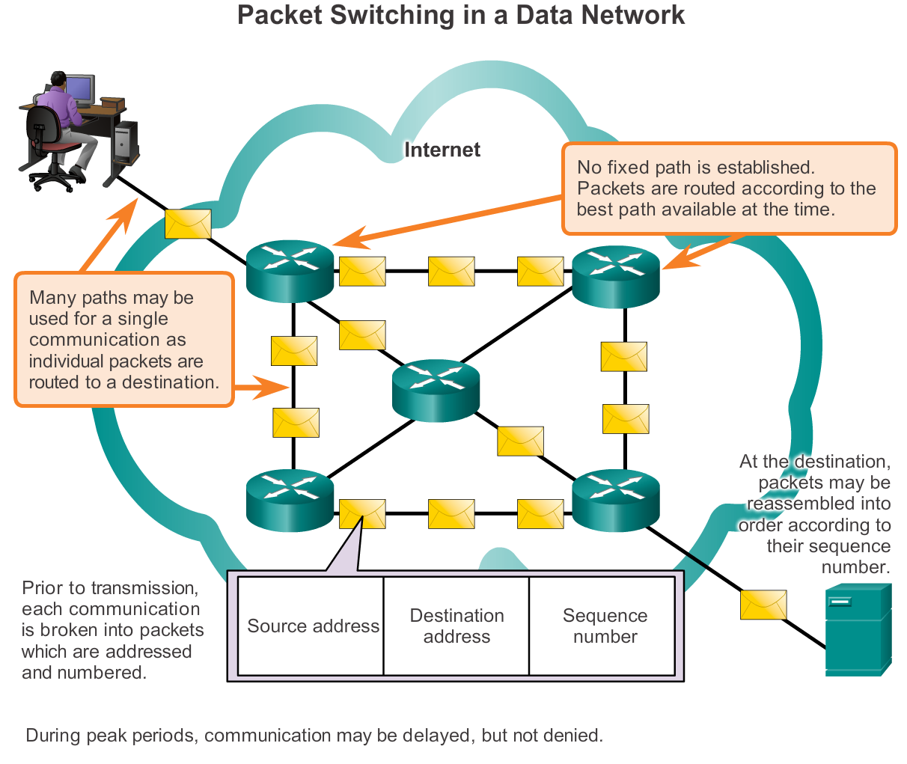
Reliable Network Packet-Switched Networks
Notes:
1.3.2.3 Fault Tolerance in Packet-Switched Networks

Slide 36

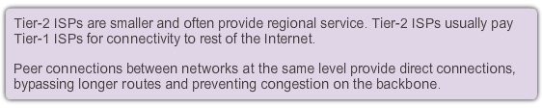
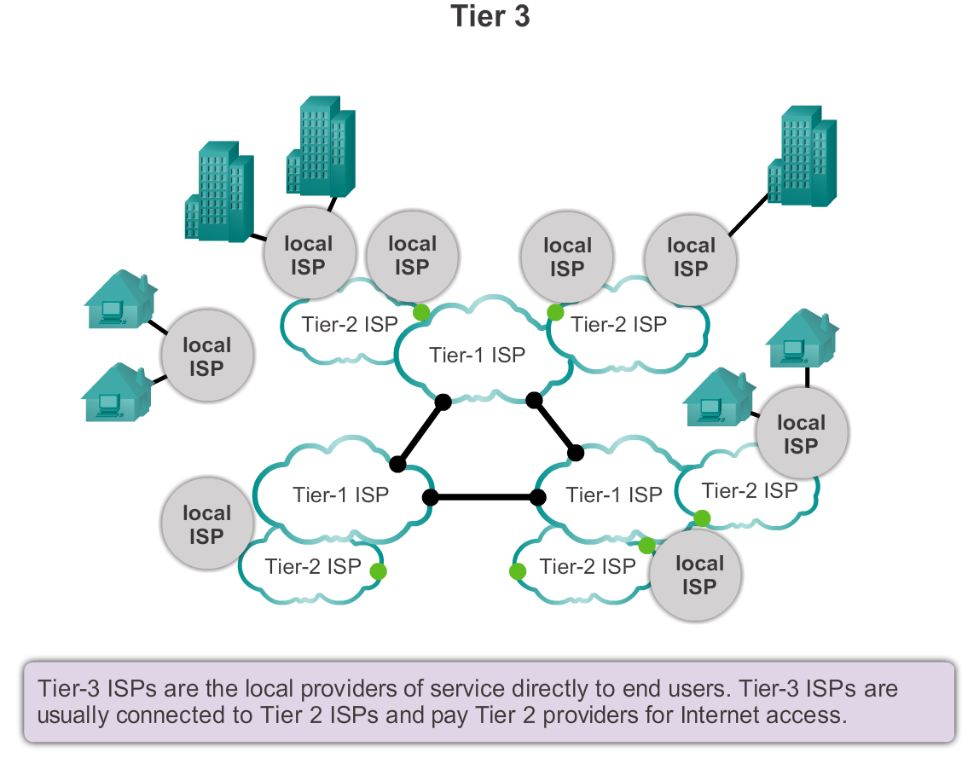
Reliable Network Scalable Networks
Notes:
1.3.2.4 Scalable Networks

Slide 37
Reliable Network Providing QoS
Examples of priority decisions for an organization might include:
Time-sensitive communication - increase priority for services like telephony or video distribution.
Non time-sensitive communication - decrease priority for web page retrieval or email.
High importance to organization - increase priority for production control or business transaction data.
Undesirable communication - decrease priority or block unwanted activity, like peer-to-peer file sharing or live entertainment.
Notes:
1.3.2.5 Providing QoS

Slide 38
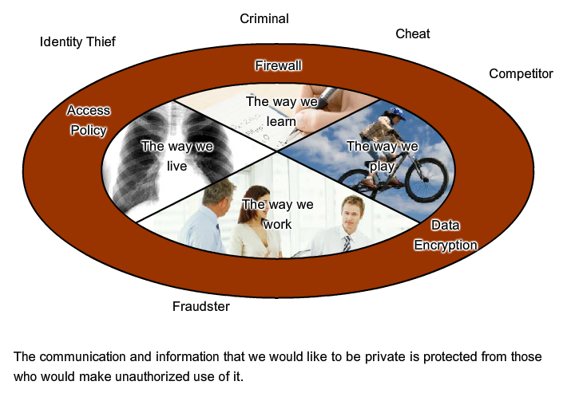
Reliable Network Providing Network Security
Notes:
1.3.2.6 Providing Network Security

Slide 39
Intranet and Extranet
•Intranet
•Extranet
Intranet is a term often used to refer to a private connection of LANs and WANs that belongs to an organization, and is designed to be accessible only by the organization's members, employees, or others with authorization.
Intranets are basically an internet which is usually only accessible from within the organization
Intranets usually help eliminate paperwork and speed up workflows.
The intranet may be accessible to staff working outside of the organization by using secure connections to the internal network
An organization may use an extranet to provide secure and safe access to individuals who work for a different organizations, but require company data. Examples of extranets include:
A company providing access to outside suppliers/contractors.
A hospital providing a booking system to doctors so they can make appointments for their patients.
A local office of education providing budget and personnel information to the schools in its district.

Slide 40
World Wide Web (WWW)
It refers to the collection of information accessible on the internet. The web is similar to a library.
It consists of millions & millions of pages of text, pictures, sounds and animation on various topics.
These pages, called web pages are stored on different computers that are connected to the internet.
The web pages have links between them i.e when we click a certain word or picture in a page, it will take us to another page.
These words or pictures that help to move from one page to another are called hyperlinks.

Slide 41
Cont’d
A collection of related web pages is known as a web site. A web site can be accessed by means of a unique name assigned to it.
Internet was initially designed for the transmission of text basing on the protocols mentioned.
In order to transmit a graphically designed web page complete with pictures, embedded sound and animation a special language was designed which is referred to as Hyper Text Mark up Language (HTML).
HTML uses special text codes to define the various elements of a web page.

Slide 42
Cont..
The WWW support a protocol called Hyper Text Transfer Protocol (HTTP).
All internet servers cannot support HTTP and so the web can be regarded as a subset of the larger internet.
HTTP provides a method of transmitting a professionally laid out page over the text based internet.
Uniform Resource Locator: (URL): Each web site has a unique address commonly referred to as a URL.
A URL specifies the exact location of the web page on the internet.
A typical web address or URL looks as http:// Explanation of the example URL:

Slide 43
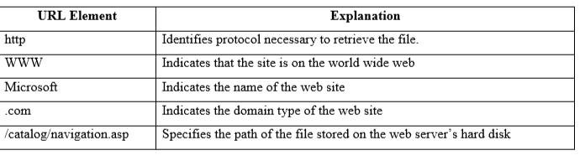
Cont..

Slide 44
Addressing Schemes
In order to communicate across the Internet, a computer must have a unique address.
Every computer on the Internet has a unique numeric identifier, called an Internet Protocol (IP) address.
Each IP address has four parts – each part a number between 0 and 255.
An IP address might look like this: 205.46.117.104.

Slide 45
Domains and Subdomains
In addition to an IP address, most Internet hosts or servers have a Domain Name System (DNS) address, which uses words
A domain name identifies the type of institution that owns the computer.
An Internet server owned by University of Columbus might have the domain name columbus.com.
Some enterprises have multiple servers, and identify them with subdomains, such as students.colombus.com.

Slide 46

Questions

