Slide 2
TOPIC 3: Network Categories

Slide 3
Learning Outcomes
Personal Area Networks (PAN)
Local Area Network (LAN)
Metropolitan Area Network (MAN)
Wide Area Networks (WAN)
Intranets and Extranets
Virtual Private Networks (VPN)
Internetworks
Practical (setting up a network)

Slide 4
Classification of Networks
Computer networks are classified based on a number of factors.
Some factors include:
Size – also referred to as category by some authors;
Physical layout (topology), and
Content access and Security.

Slide 5
Categories of Networks Based on Size
Personal Area Networks (PAN)
Local Area Networks (LAN)
Metropolitan Area Networks (MAN)
Wide Area Networks (WAN)

Slide 6
Personal Area Network (PAN)
Allow devices to communicate over the range of a person.
A common example is a wireless network that connects a computer with its peripherals.
Peripherals (components) attached to computers include the monitor, mouse, keyboard and printer.
PAN devices mostly use Bluetooth technology to connect to the host computers

Slide 7
Local Area Network (LAN)
Privately owned
Links devices in the same office, building, or campus
Simple LAN: 2 PCs & 1 printer in home or office
Size is limited to a few kilometers
Allow resources to be shared (hardware, software, or data)

Slide 8
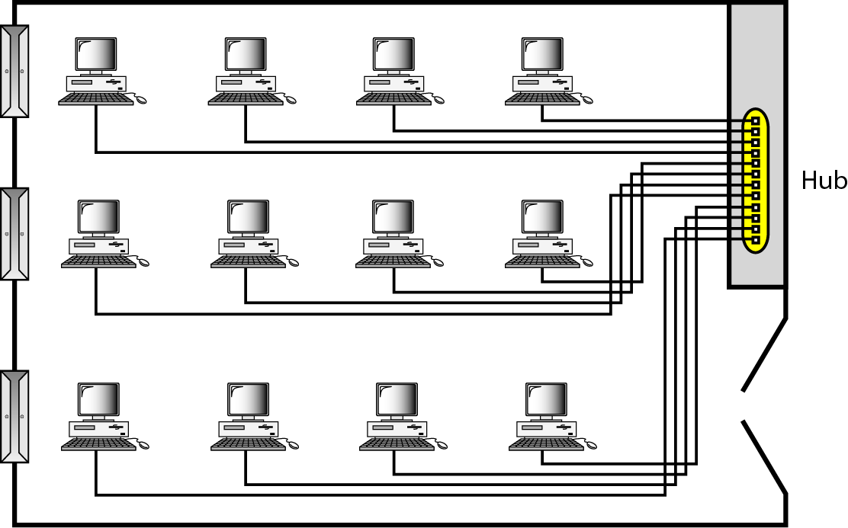
Local Area Network (LAN)
An isolated LAN connecting 12 computers to a hub in a closet

Slide 9
Metropolitan Area Networks (MAN)
Size between LAN and WAN
Inside a town or a city
Example: the part of the telephone company network that can provide a high-speed DSL to the customer

Slide 10
Wide Area Networks (WAN)
Provides long-distance transmission of data over large geographic areas (country, continent, world).
It connects multiple networks that are geographically separated.

Slide 11
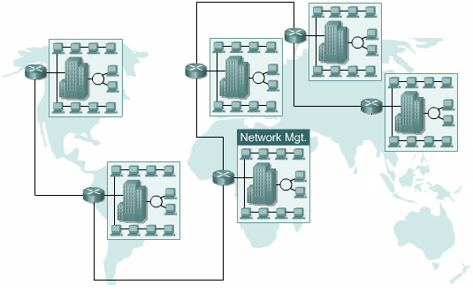
Wide Area Networks (WAN) Cont’d
An example of WAN is the internet as it connects different networks from different countries and continents.

Slide 12
Internetworks
Two or more networks connected together.
Internetworking is the practice of interconnecting multiple computer networks, such that any pair of hosts in the connected networks can exchange messages irrespective of their hardware-level networking technology.
The resulting system of interconnected networks are called an internetwork, or simply an internet.

Slide 13
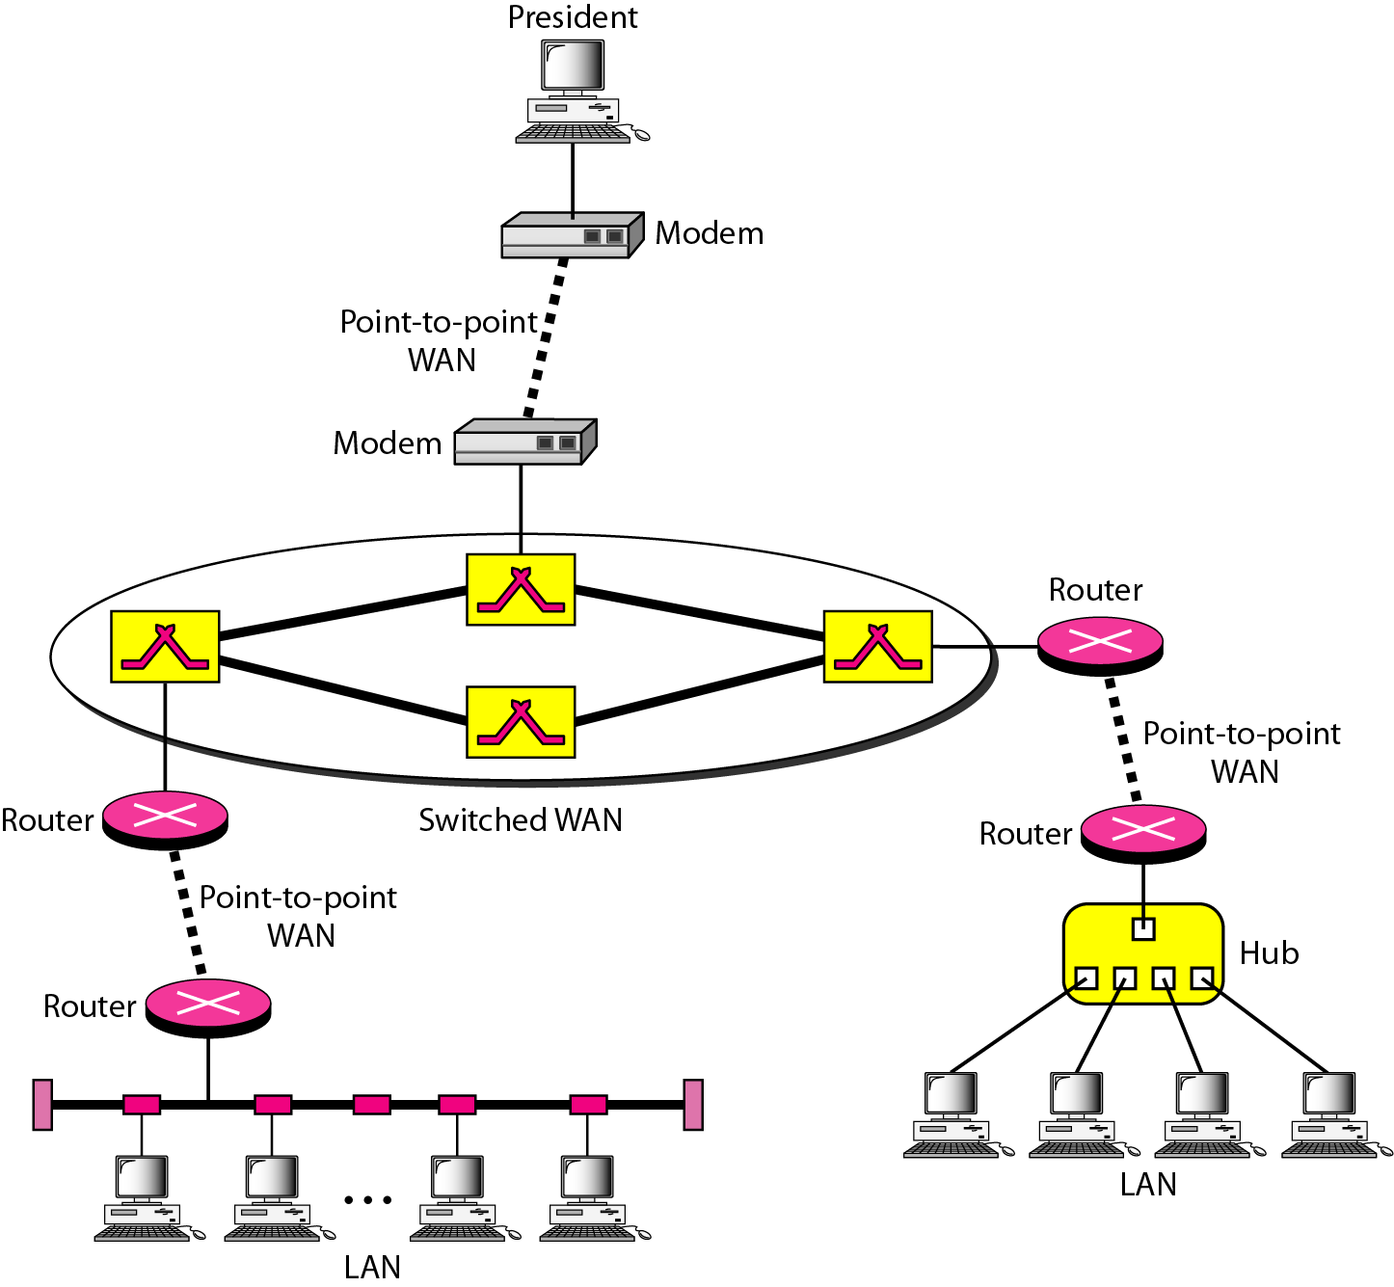
Internetworks Cont’d

Slide 14
Classification of Networks Based on Content Access and Security
Some companies invest in computer networks in order to protect their privacy and provide enough security to their information resources.
Such networks include:
Intranets
Extranets
Virtual Private Networks (VPN)

Slide 15
Intranet
It is a Private network specific to an organisation.
It is regulated by an organization.
Thus content in the network is accessible only to members of organization.
It is small network with minimal number of connected devices.
It is owned by single organization.

Slide 16
Intranet cont’d
It is means of sharing sensitive information throughout organization.
Security is enforced via a firewall.
Example: Airtel using internal network for its business operations.
Users should have valid username/password to access Intranet.
Intranet is regulated by the organization policies.

Slide 17
Intranet cont’d
It is means of sharing sensitive information throughout organization.
It may span over one building, one area, or one country. In addition, there are many multinational organizations that maintain Intranets between countries using dedicated fiber optic connections.

Slide 18
Extranet
It is a Private network that uses public network to share information with suppliers and vendors.
It is regulated by multiple organization.
The content in the network is accessible to members of organization & external members with access to the network.

Slide 19
Extranet cont’d
The number of devices connected is comparable with Intranet.
It is owned by single/multiple organization.
It is means of sharing information between members and external members.
Security is enforced via a firewall that separates internet & extranet.

Slide 20
Extranet cont’d
Example: HP and Intel using network for business related operations.
Users should have valid username/password to access Extranet.
Extranet is also regulated by contractual agreements between organizations.
Example: HP and Intel using network for business related operations.

Slide 21
Extranet cont’d
It is controlled and managed by an organization to provide secure access to Intranet from the outside world.
Many business organizations need their business partners and customers to connect to Intranet to enhance communication and efficiency.
Generally, external users are given limited access over the Intranet.

Slide 22
Virtual Private Networks (VPN)
A VPN is a service which uses private networks on top of public networks (internet) to provide a channel for data transmission.
A VPN is called virtual because it is a mere illusion, just as virtual circuits are not real circuits and virtual memory is not real memory.

Slide 23
VPNs cont’d
A VPN would be better understood by looking at water distribution pipes. A VPN is like a small tunnel (pipe) passing through a bigger tunnel or pipe. The smaller pipe acts as a private network which will be used only by the private consumers who have privately paid for such a service.
The bigger pipe is the public network (internet) which can be accessed by anyone.

Slide 24
VPNs cont’d
VPS are protected by firewalls at both end for maximum protection of information since they pass through the internet.

Slide 25
TOPIC 4: WIRED AND WIRELESS NETWORKS

Slide 26
Learning Outcomes
Wired communication media
Wireless communications media
The electronic spectrum
Practical Lessons

Slide 27
Wired Communication
Wired communication refers to the communication that happens with the use of physical wires also known as cables.

Slide 28
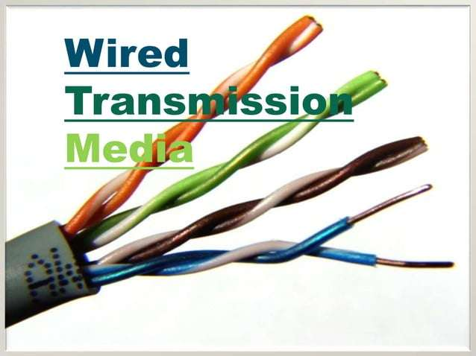

Slide 29
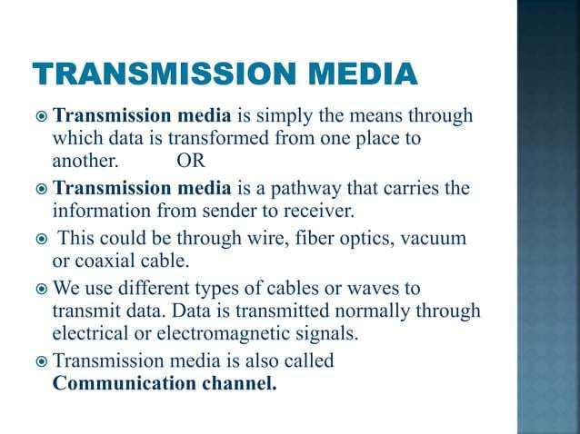

Slide 30
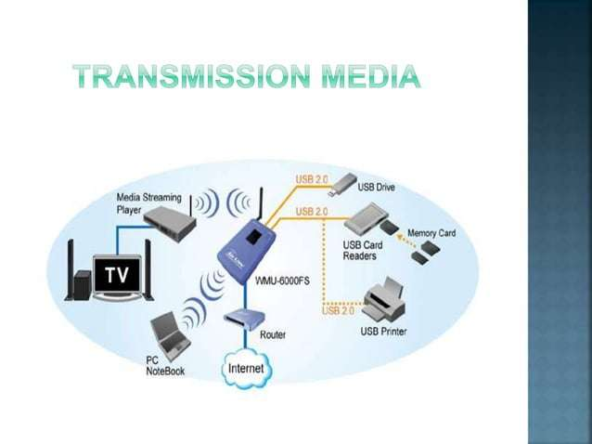

Slide 31
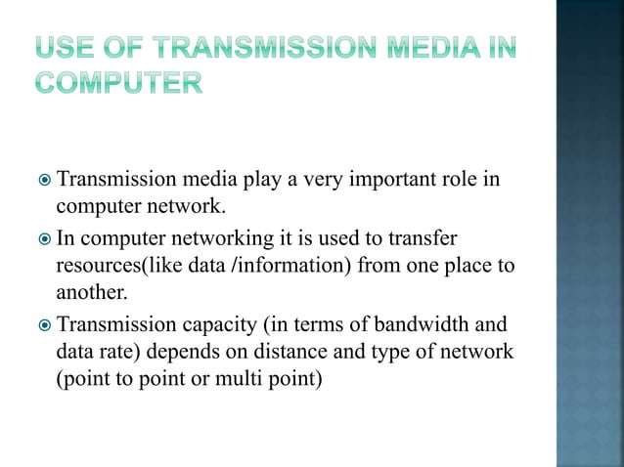

Slide 32
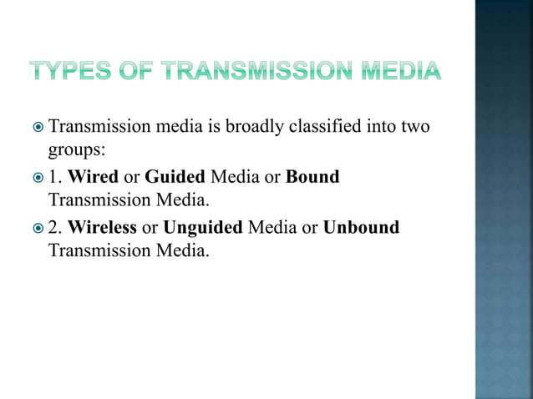

Slide 33
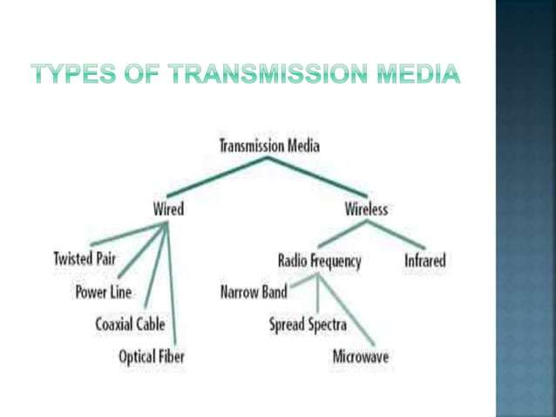

Slide 34
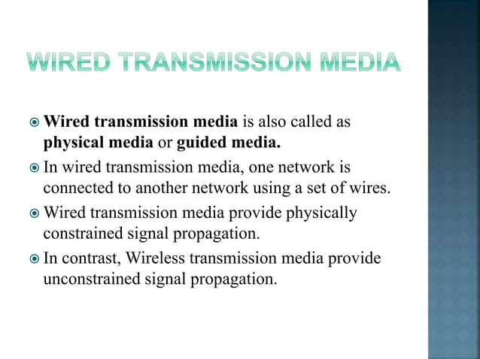

Slide 35
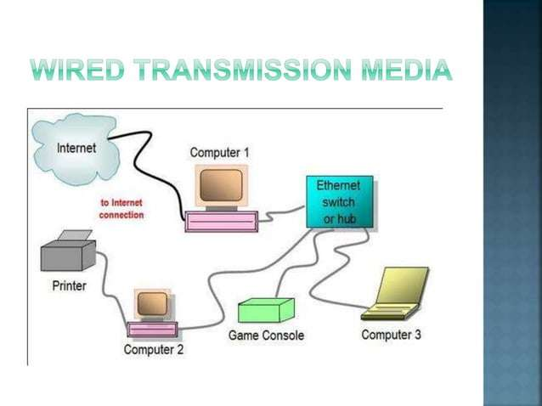

Slide 36
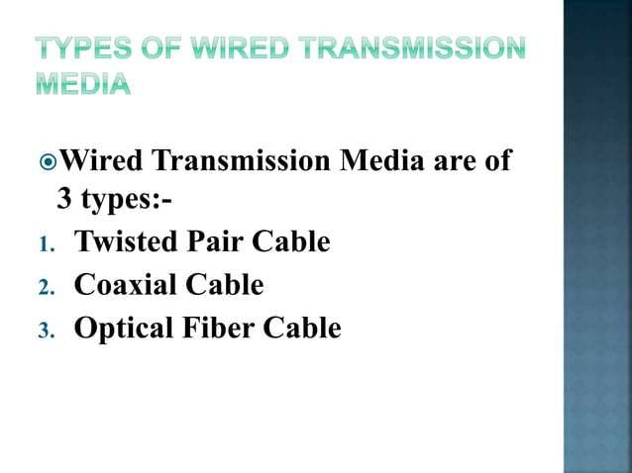

Slide 37
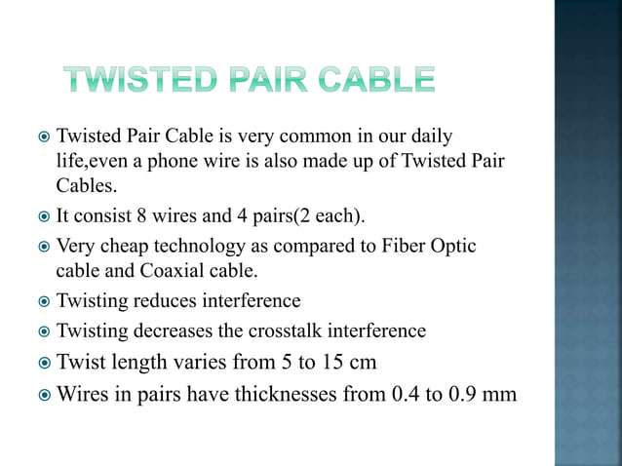

Slide 38
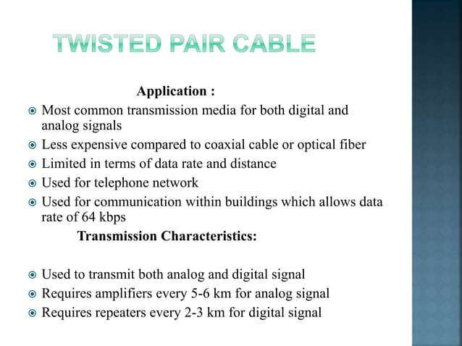

Slide 39
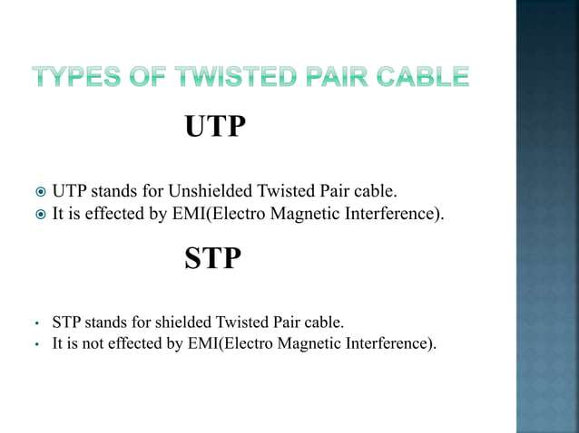

Slide 40
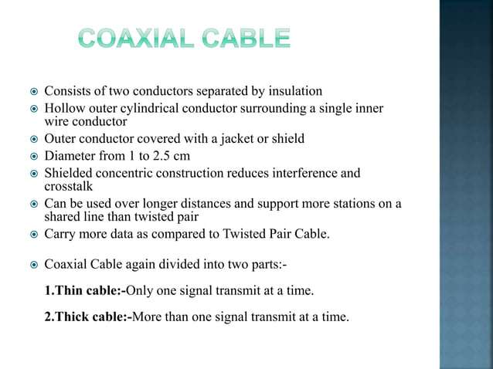

Slide 41
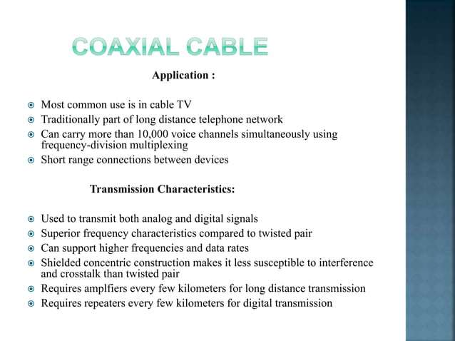

Slide 42
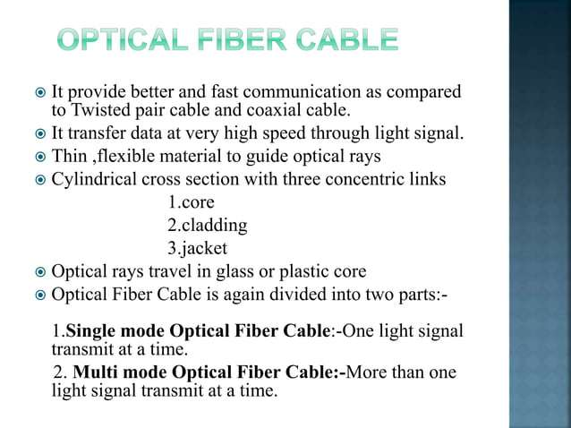

Slide 43
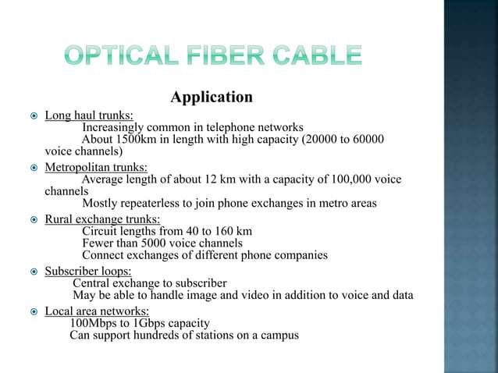

Slide 44
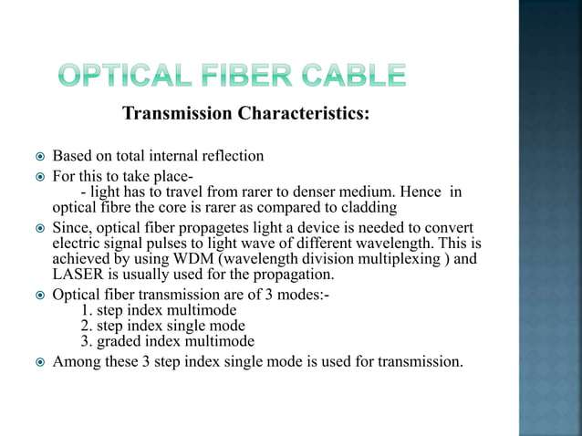

Slide 45
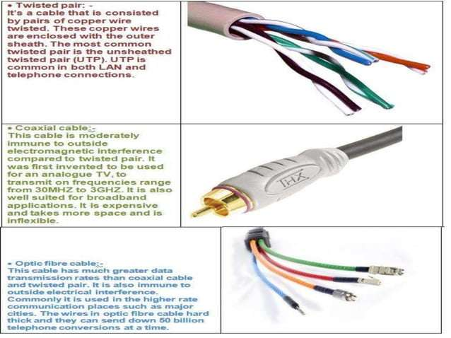

Slide 46
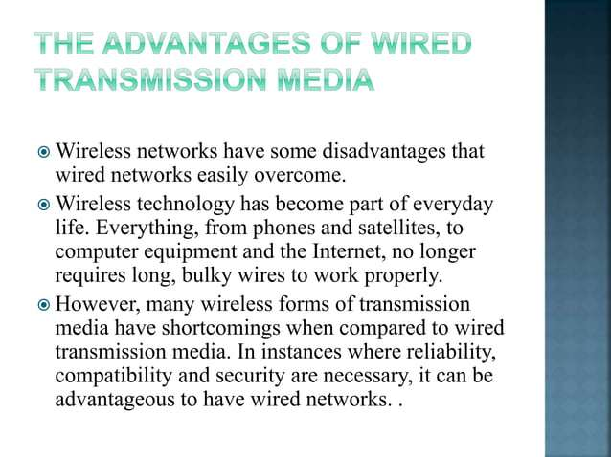

Slide 47
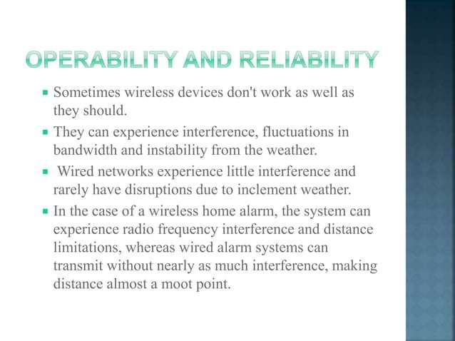

Slide 48
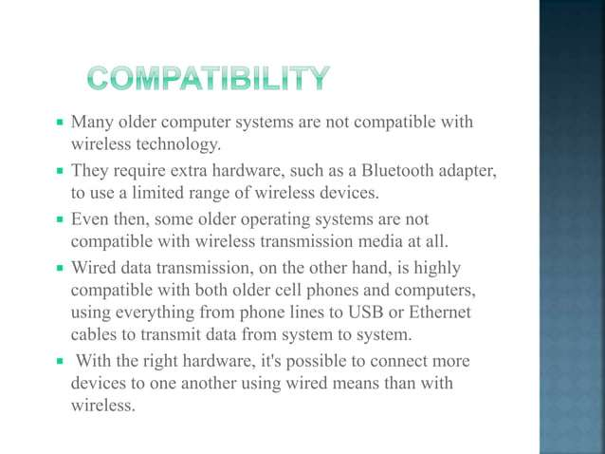

Slide 49
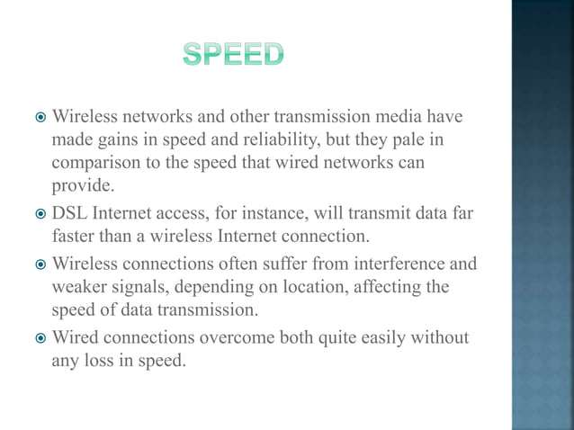

Slide 50
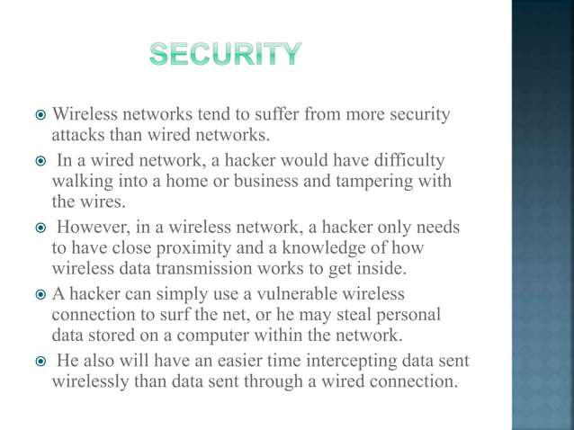

Slide 51
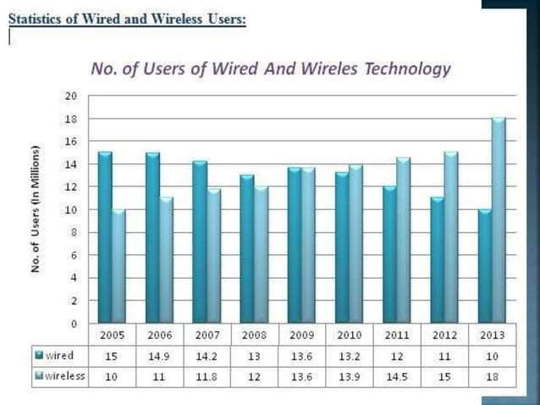

Slide 52
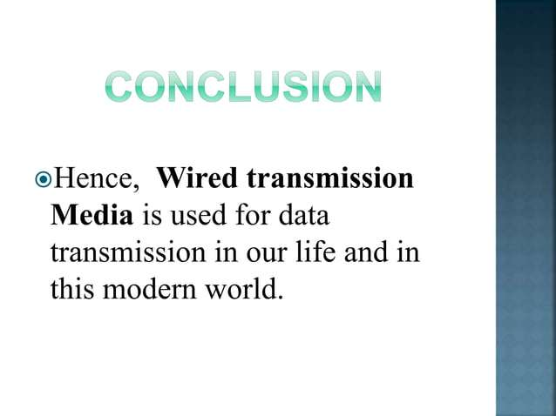

Slide 53
Wired Communication Media
Unshielded Twisted Pair(UTP):
Copper cable consisting of unshielded twisted pairs surrounded by an outer jacket. Have no internal shielding but an outer insulating jacket that protects the cables from physical damage.
Shielded Twisted Pair(STP):
Copper cables that have been twisted together and enclosed in some sort of shield. The shield can be in form of foil or mesh. Shielded cables are able to overcome electromagnetic interference and crosstalk with other nearby cables.
Coaxial cables:
Is a cable with a copper conductor and an insulator which shields around it and a braided metal mesh that prevents signal interference and cross talk.
Fiber optic cables:
Is a network cable that contains strands of glass fibers inside an insulated casing. Designed for long-distance, high-performance data networking, and telecommunications.

Slide 54
Wireless Communication
Wireless communication refers to communication that happens with the use of wireless communication devices, without physical wires.

Slide 55
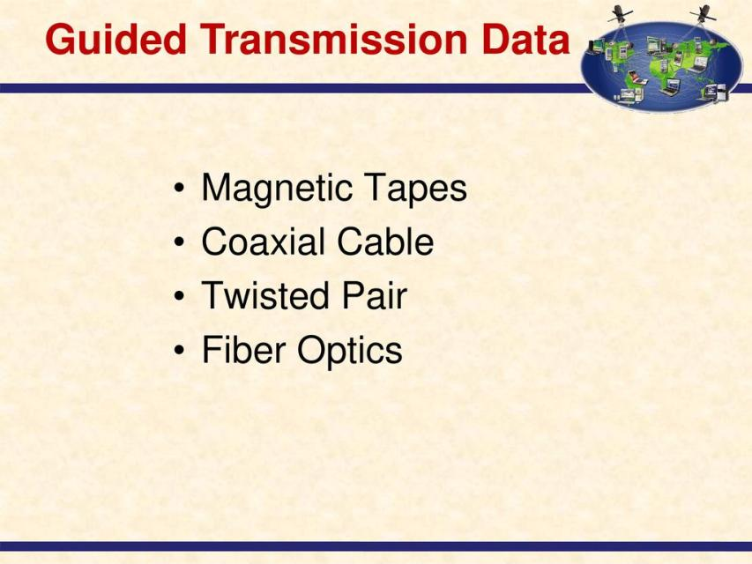

Slide 56
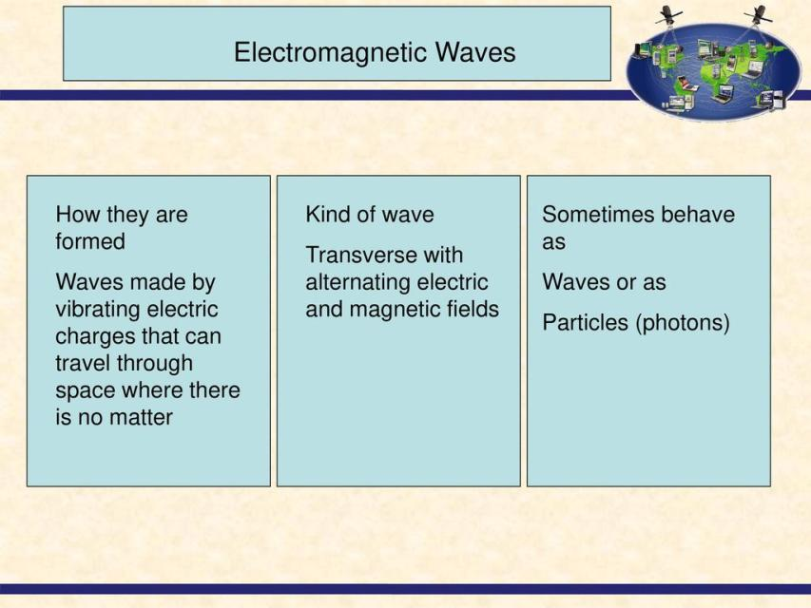

Slide 57
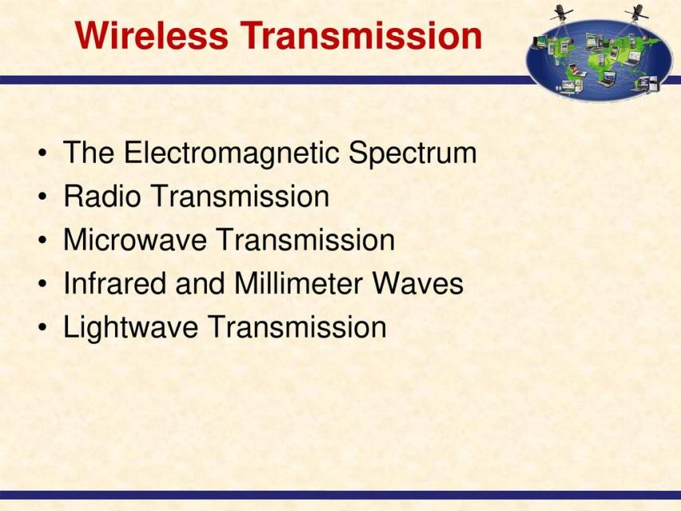

Slide 58
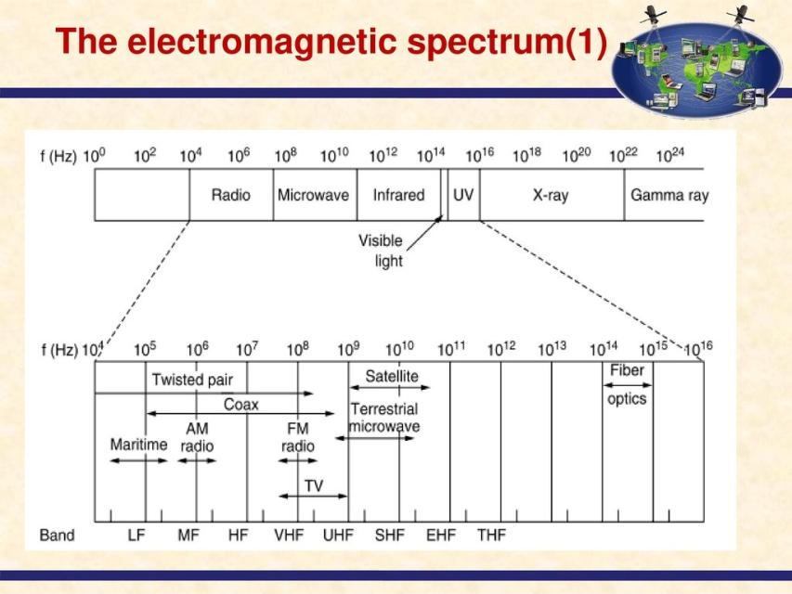

Slide 59
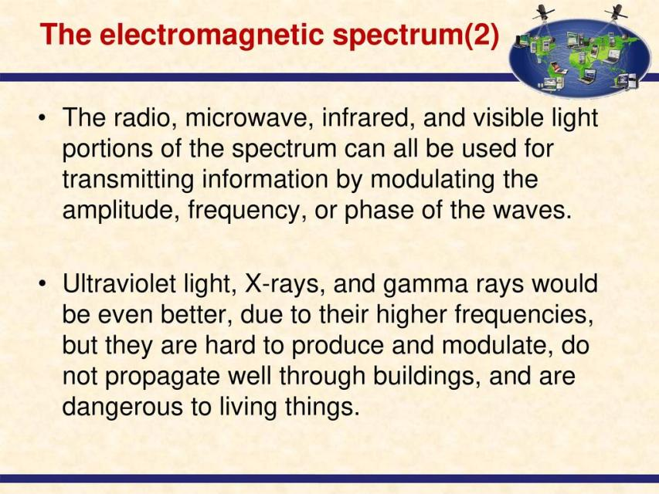

Slide 60
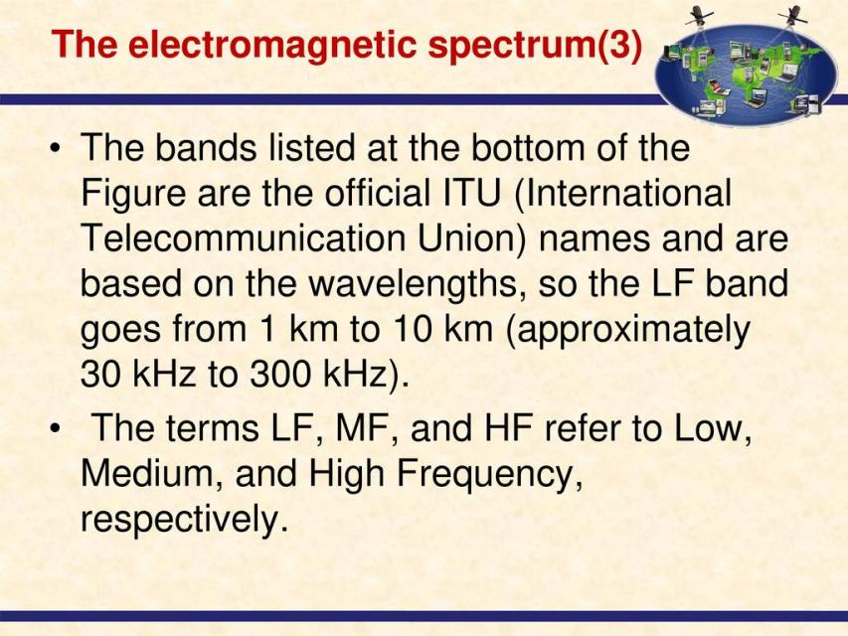

Slide 61
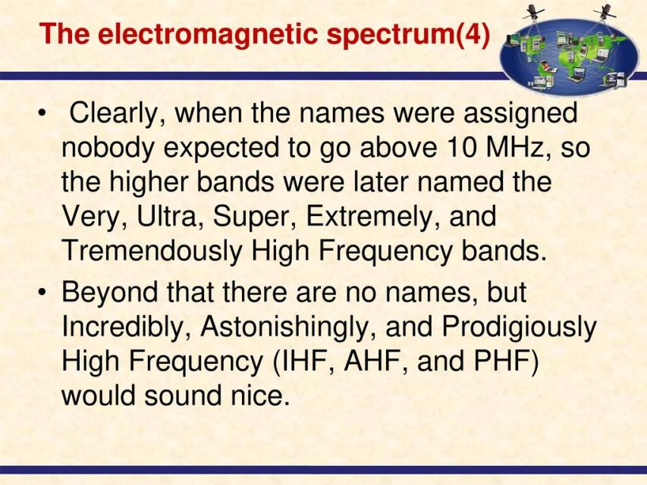

Slide 62
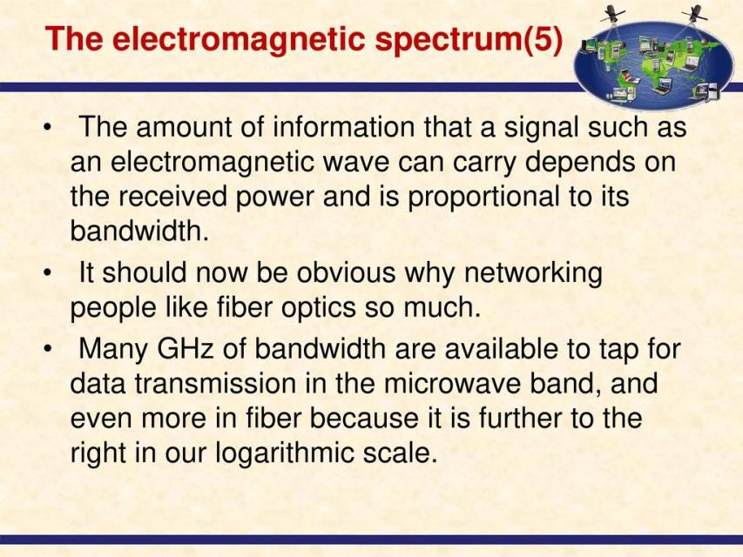

Slide 63
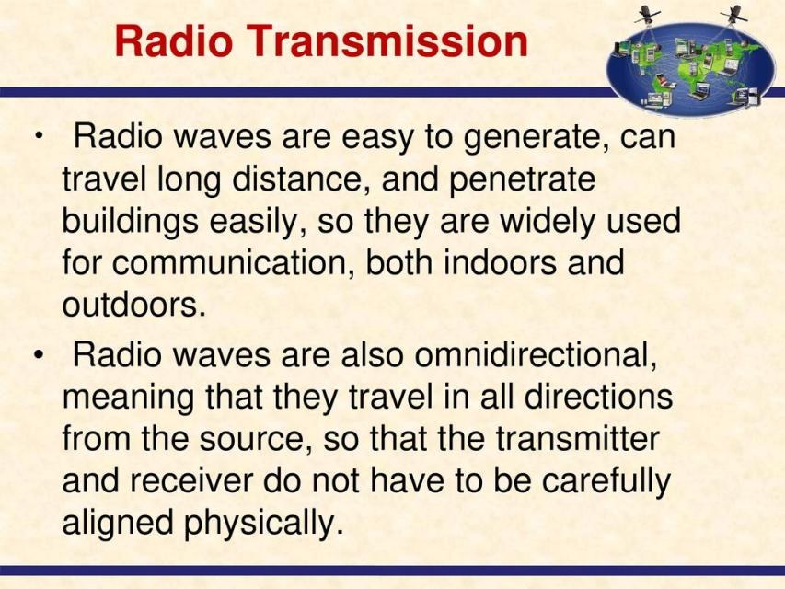

Slide 64
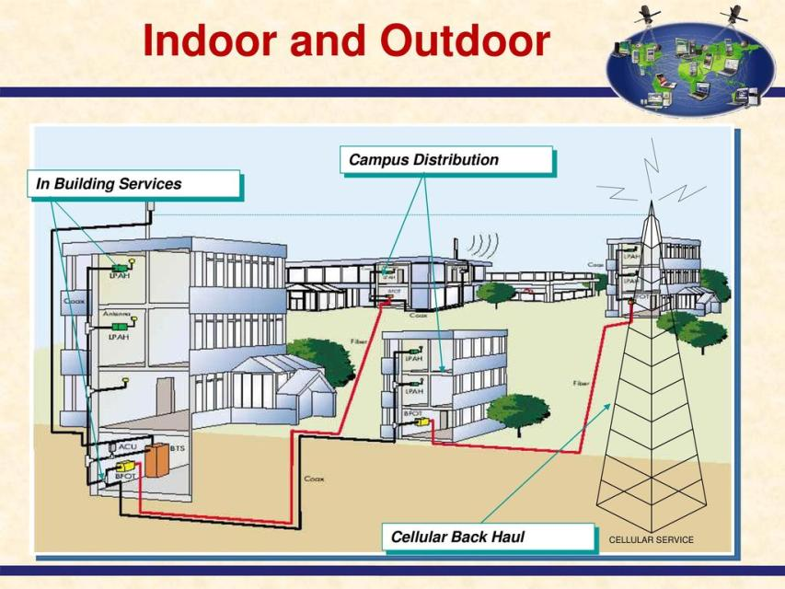

Slide 65
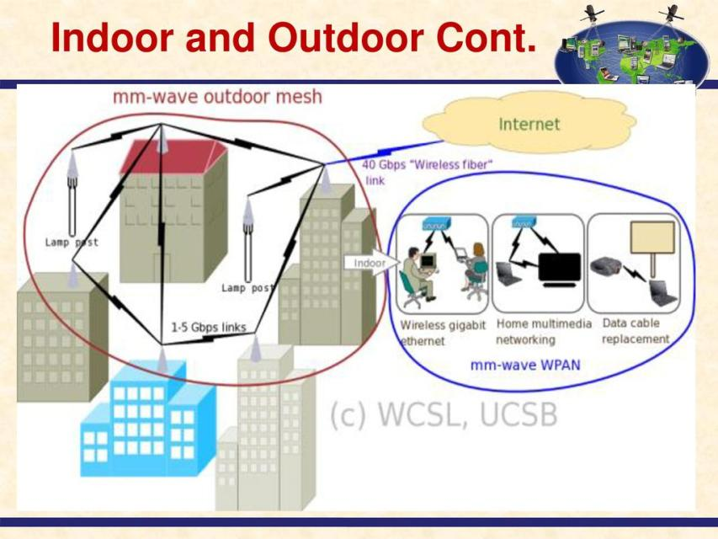

Slide 66
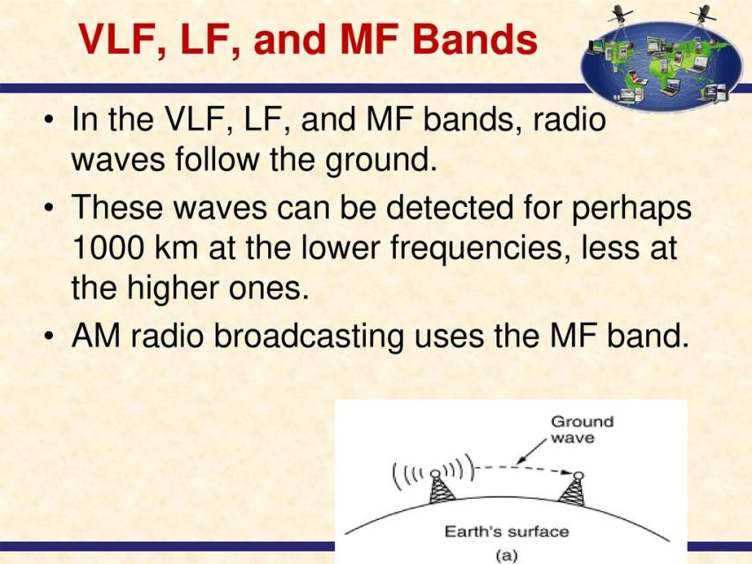

Slide 67
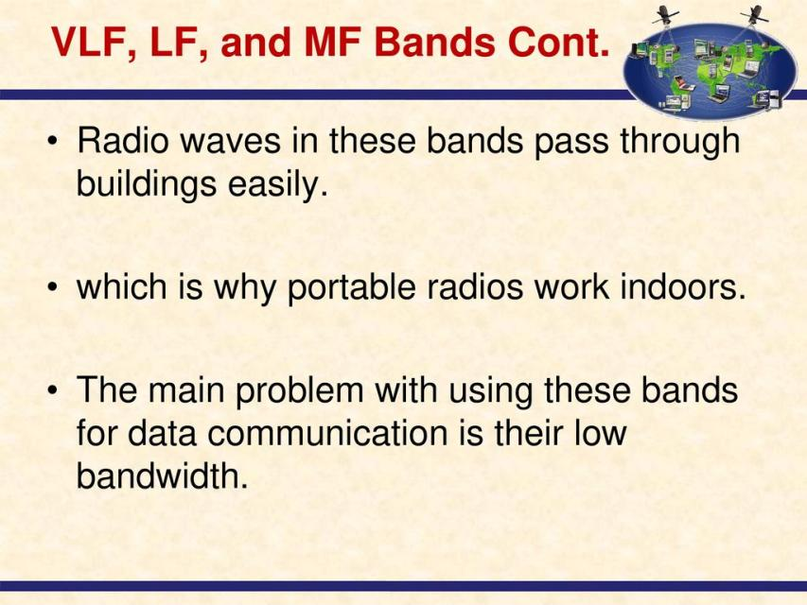

Slide 68
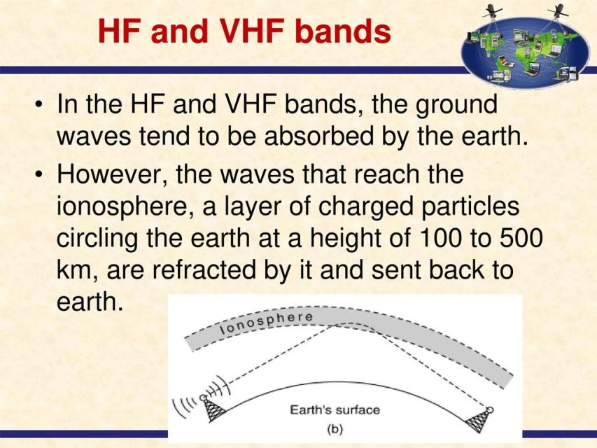

Slide 69
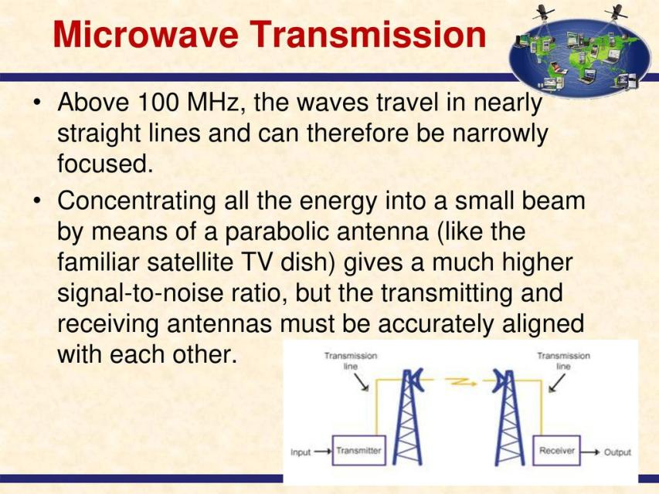

Slide 70
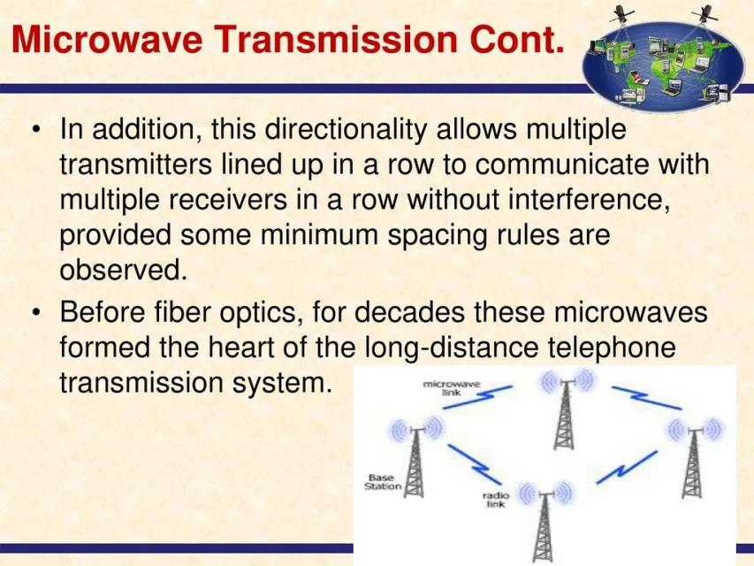

Slide 71
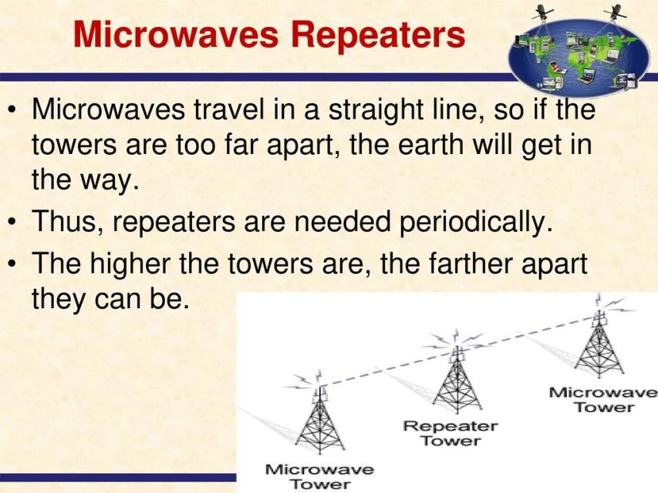

Slide 72
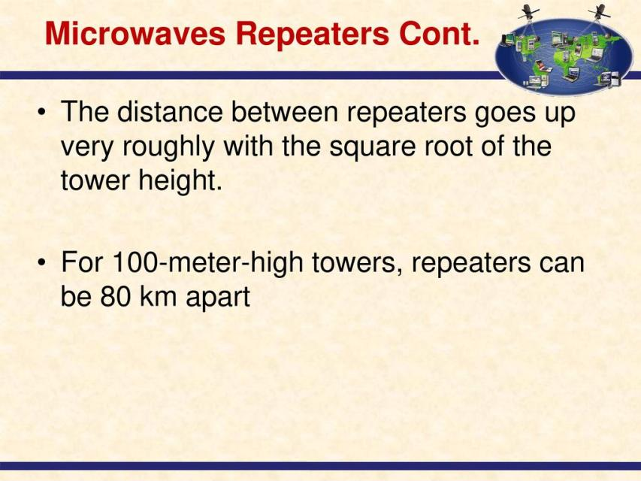

Slide 73
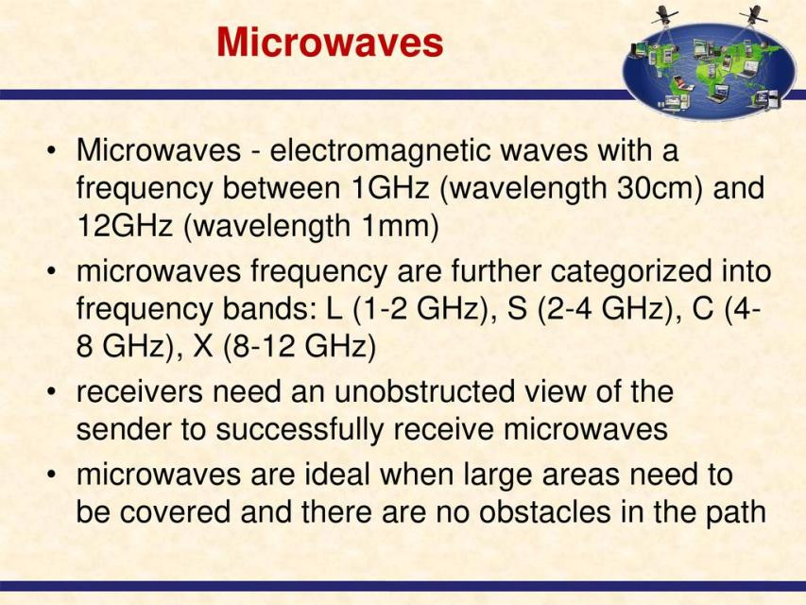

Slide 74
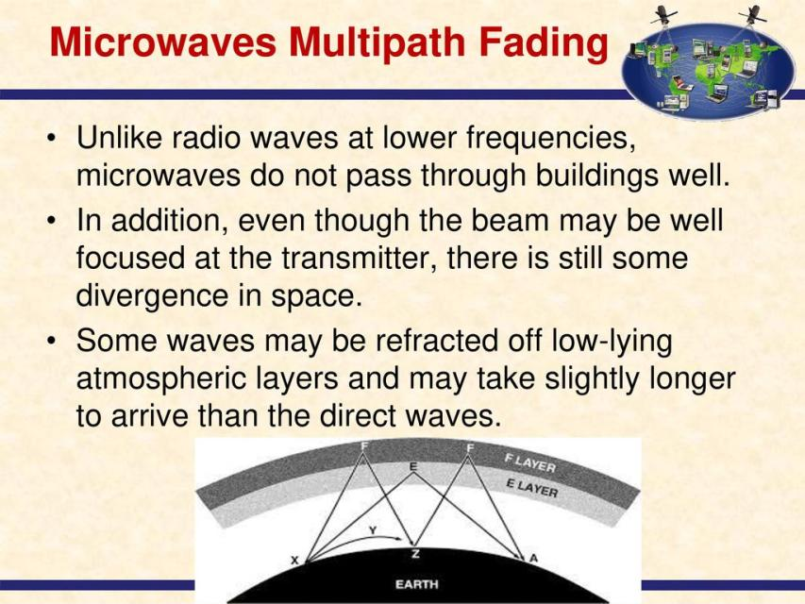

Slide 75
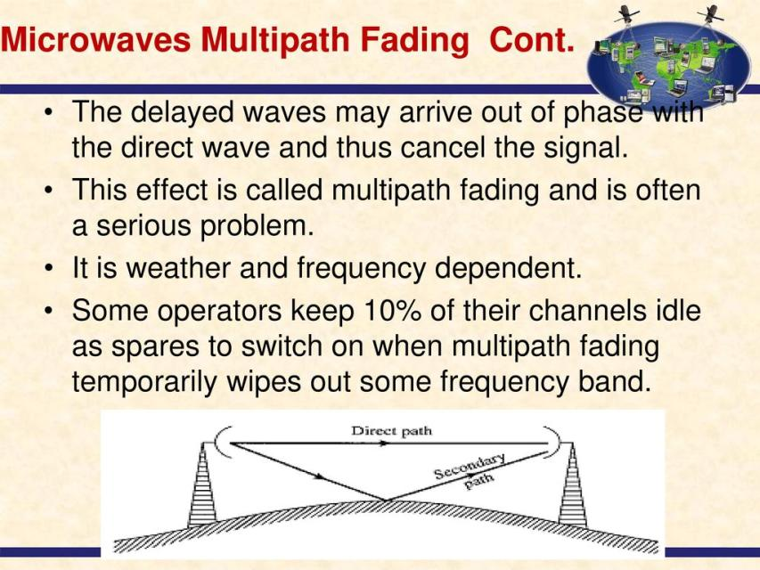

Slide 76
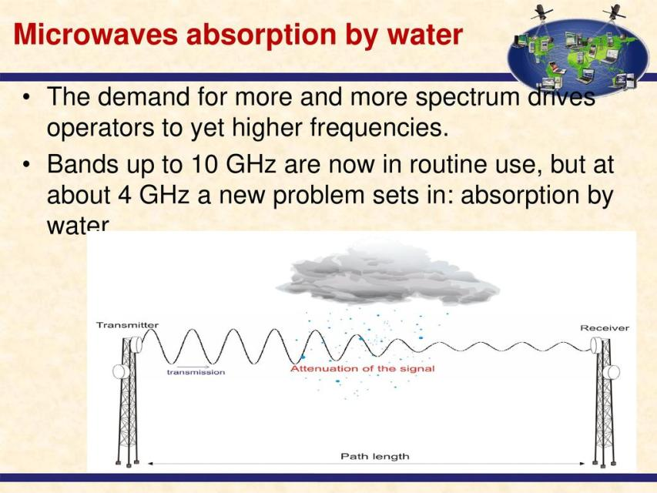

Slide 77


Slide 78


Slide 79


Slide 80


Slide 81


Slide 82


Slide 83


Slide 84


Slide 85


Slide 86
Wireless Communication Media
Bluetooth:
Type of communication medium used to for short-range wireless communication between electronic devices including earbuds, earphones, mouse, keyboard, speakers, smart watch, and alarm systems.
Infrared:
Also called infrared light, is an electromagnetic radiation with wavelengths longer than those of visible light.
Wi-Fi:
A wireless networking technology that uses radio waves to provide wireless high speed internet access.

Slide 87
Wireless Communication Media Cont’d
Radio:
Make use of a radiating antenna which is used to convert a time-varying electric current into an electromagnetic wave or field, which freely propagates through a non-conducting medium such as air or space.
In a broadcast radio channel, an omnidirectional antenna radiates a transmitted signal over a wide service area.
Microwave:
Consists of antennae centered within reflective dishes that are attached to structures such as towers or buildings.
Cables connect the antennae to the actual transmitting (receive) equipment.

Slide 88
Wireless Communication Media Cont’d
Satellite:
A satellite is simply an object in space that orbits or moves around a bigger object.
A communication satellite is an artificial satellite that relays and amplifies radio telecommunication signals via a transponder.
A communication satellite creates a communication channel between a source transmitter and a receiver at different locations on earth.

Slide 89

Satellite Operation

Slide 90
Wireless Communication Media Cont’d
Cellular:
A form of communication technology that enables the use of mobile phones. A mobile phone is a bidirectional radio that enables simultaneous transmission and reception.
Cellular communication is based on the geographic division of the communication coverage area into cells, and within cells.

Slide 91
The Electronic Spectrum
Electronic or Electromagnetic spectrum is the classification and arrangement of electromagnetic waves arranged according to their various wavelengths or frequencies.
Wavelength is inversely related to frequency, which refers to the number of wave cycles per second.
The higher the frequency of the signal, the shorter the wavelength.

Slide 92
TOPIC 5: NETWORK TECHNOLOGIES

