Slide 2
TOPIC 5: NETWORK TECHNOLOGIES

Slide 3
Learning Outcomes
Network Technologies and Network Services
Network Switching: Circuit switching, Message Switching and Packet Switching
Broadband Technologies
Value Added Networks
Frame Relay and Asynchronous Transfer Mode
Integrated Service Digital Network (ISDN)
Digital Subscriber Line (DSL)
Cable modem and T1 line
Convergence Network and Unified Messaging

Slide 4
Network Technologies - Definition
A network technology embroils the use of data systems to manage and deliver digital resources over a computer network.
It allows institutions and businesses to send data digitally with the help of information systems.

Slide 5
Network Services - Definition
A network service is an application running at the network application layer and above.
It provides data storage, manipulation, presentation, communication or other capability which is often implemented using a client–server or peer-to-peer architecture.
It is based on application layer network protocols.

Slide 6
Network Services - Examples
IP addressing
Domain Name Systems (DNS), used to convert domain names to IP addresses.
Email services
Internet access
Web content filtering
Security tools such as firewalls, VPNs and Intrusion Prevention Systems.

Slide 7
Network Switching
Switching is the process used to forward packets coming in from one port to a port leading towards the destination.
When data comes on a port, it is called ingress, and when data leaves a port or goes out it is called egress.
A communication system may include a number of switches and nodes.
At broad level, switching can be divided into two major categories:
Connectionless: The data is forwarded on behalf of forwarding tables. No previous handshaking is required and acknowledgements are optional.
Connection Oriented: Before switching data to be forwarded to destination, there is a need to pre-establish a circuit along the path between both endpoints. Data is then forwarded on that circuit. After the transfer is completed, circuits can be kept for future use or can be turned down immediately.

Slide 8
Circuit Switching
When two nodes communicate with each other over a dedicated communication path, it is called circuit switching.
There is a need for pre-specified route from which data will travel and no other data is permitted.
In circuit switching, to transfer the data, a circuit must be established so that the data transfer can take place.
Circuits can be permanent or temporary. Applications which use circuit switching may have to go through three phases, namely:
Establish a circuit
Transfer the data
Disconnect the circuit

Slide 9
Circuit Switching Cont’d
Circuit switching was designed for voice applications.
Telephone is the best suitable example of circuit switching.
Before a user can make a call, a virtual path between the caller and the receiver is established over the network.

Slide 10
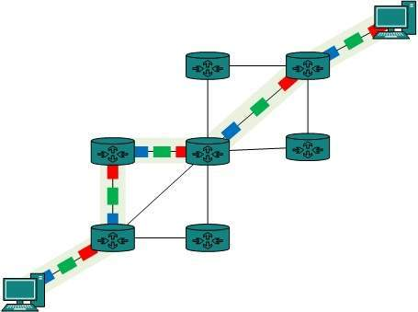
Circuit Switching Diagram

Slide 11
Message Switching
Stands in the middle of circuit switching and packet switching.
In message switching, the whole message is treated as a data unit and is switched or transferred in its entirety.
A switch working on message switching first receives the whole message and buffers it until there are resources available to transfer it to the next hop. If the next hop is not having enough resource to accommodate a large sized message, the message is stored and the switch waits.

Slide 12
Message Switching Cont’d
Message switching has the following drawbacks:
Every switch in transit path needs enough storage to accommodate the entire message.
Because of store-and-forward technique and waiting included until resources are available, message switching is very slow.
Message switching is not the best solution for streaming media and real-time applications.

Slide 13
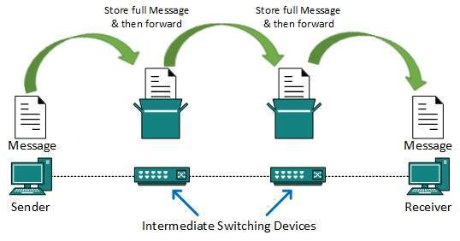
Message Switching Diagram

Slide 14
Packet Switching
The drawbacks of message switching led to the development of packet switching.
The entire message is broken down into smaller chunks called packets.
The switching information is added in the header of each packet and transmitted independently.
It is easier for intermediate networking devices to store small size packets as they do not take much resources either on carrier path or in the internal memory of switches.

Slide 15
Packet Switching Cont’d
The internet uses packet switching technique.
Packet switching enables the user to differentiate data streams based on priorities.
Packets are stored and forwarded according to their priority to provide quality of service.

Slide 16
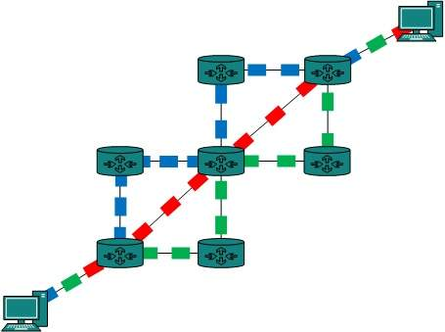
Packet Switching Diagram

Slide 17
Broadband Technologies - Definition
The term broadband commonly refers to high-speed Internet access that is always on and faster than the traditional dial-up access.
​​​​​​​​Broadband technology allows for high-speed transmission of voice, video and data over networks and ICT applications.

Slide 18
Types of Broadband Technologies
Digital subscriber line (DSL)
Cable modem
Fiber
Wireless
Satellite
Broadband Over Power Lines (BPL).

Slide 19
Value Added Networks
A value-added network (VAN) is a private, hosted service that provides companies with a secure way to send and share data with other partners.
Value-added networks are often used for electronic data interchanging between companies.
VANs make the communication process easier with communication between fewer parties.
VANs are important for managing supply chains.

Slide 20
Uses of Value Added Networks
Value-added networks are generally used by large companies for efficient supply chain management with their suppliers, or by industry consortiums or telecommunications companies.

Slide 21
Frame Relay Transmission
This is a transmission mode during which information is transferred through an electric circuit layer, within the style of packets.
Does not provide error control.
Does not provide flow control.
Variable packet size.
Low cost.
Longer packet delay.
Low packet transfer speed.
Low throughput.

Slide 22
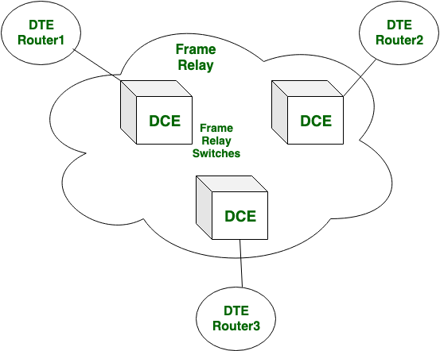
Frame Relay Diagram

Slide 23
Asynchronous Transmission Mode (ATM)
ATM has fixed packet size.
Provides error management.
Provides flow management.
It’s reliable than frame relay.
Higher cost than frame relay.
Higher throughput.
Higher packet transfer speed.

Slide 24
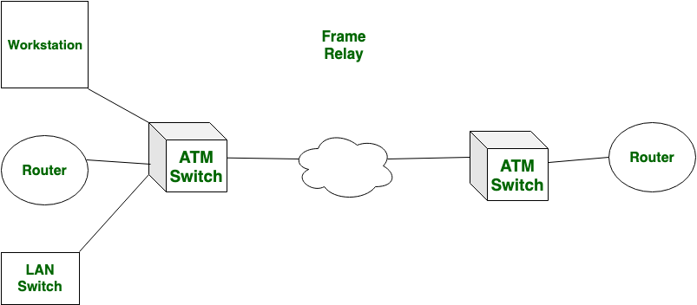
ATM Diagram

Slide 25
Integrated Services Digital Network (ISDN)
ISDN is a circuit-switched telephone network system that transmits both data and voice over a digital line.
It is a set of communication standards to transmit data, voice, and signaling.
ISDN was an earlier attempt to provide digital service via copper lines in homes and small offices around the world.
It was eventually replaced by DSL and cable modems.

Slide 26
Digital Subscriber Line (DSL)
DSL is a technology for high-speed network or Internet access over telephone lines.
DSL is more widely used than ISDN because of its higher speeds, which can reach 10 megabits per second and above..

Slide 27
Digital Subscriber Line (DSL) Cont’d
Common Types of DSL:
Symmetric Digital Subscriber Line (SDSL; also called Single-Line DSL), with matching upload and download speeds;
Asymmetric Digital Subscriber Line (ADSL), featuring faster downloads than uploads; and
Very High Rate Digital Subscriber Line (VDSL), featuring much greater asymmetric speeds.
High Data Rate Digital Subscriber Line (HDSL), which matches SDSL speeds using two pairs of copper; it is used to provide inexpensive T1 service.

Slide 28
T1 Line
A T1 line is a dedicated transmission connection between a service provider and client.
Uses an advanced telephone line to carry more data than a traditional standard analog line that carries a single channel of data at 64 Kbps.
T1 line speed is consistent and constant.
A T1 line can carry 24 voice channels for telephone calls or digital data at a rate of 1.544 Mbps, and with usage of compression, carried channels double to 48.
Developed by AT&T Bell Laboratories in the late 1960s.
Most new installations use optical fiber, instead of copper pair.

Slide 29
Cable Modem
A cable modem delivers high-speed Internet to your devices by using coaxial cables that connect to the back of the modem and the bolt-like outlet in your wall or on your cable box.

Slide 30
Convergence Network and Unified Messaging
In networking, convergence occurs when one network provider delivers networking services for voice, data, and video in a single network connection, instead of providing a separate network for each of these services.
This allows a business to use one network from one provider for all communication and cloud-based services.
Also referred to as unified communications

Slide 31
Unified Messaging
Unified Messaging is the integration of voice, fax, and e-mail messages into the user's Inbox.
Unified messaging uses unified communication platforms.
Unified communication platforms combine the software that supports both synchronous and asynchronous communications to enable the end-user to easily access all the tools, from whatever device is in use, in one place.
This, in turn, enhances business communication, collaboration, and productivity.

Slide 32
TOPIC 6: LAYERED ARCHITECTURE AND REFERENCE MODELS

Slide 33
Learning Outcomes
Understanding the Models
Open system Interconnection Model
TCP/IP Protocol suite
Services of TCP/IP layers to layers above them

Slide 34
Two Reference Models
Open Systems Interconnection Model (OSI)
Transmission Control Protocol/ Internet Protocol (TCP/ IP).
The TCP / IP model became a common choice and the OSI model was rejected due to the slower formal standardization process compared to the TCP / IP model.
Today, the world of computer networks uses only one network model, the TCP/ IP.

Slide 35
The Open System Interconnection Model (OSI)
The OSI Model (Open Systems Interconnection Model) is a conceptual framework used to describe the functions of a networking system.
The OSI model characterizes computing functions into a universal set of rules and requirements in order to support interoperability between different products and software.
It contains seven layers.
Designed by the International Organization for Standardization (ISO).

Slide 36
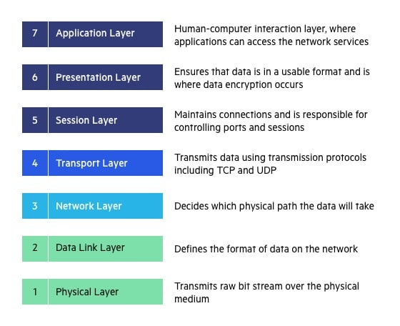
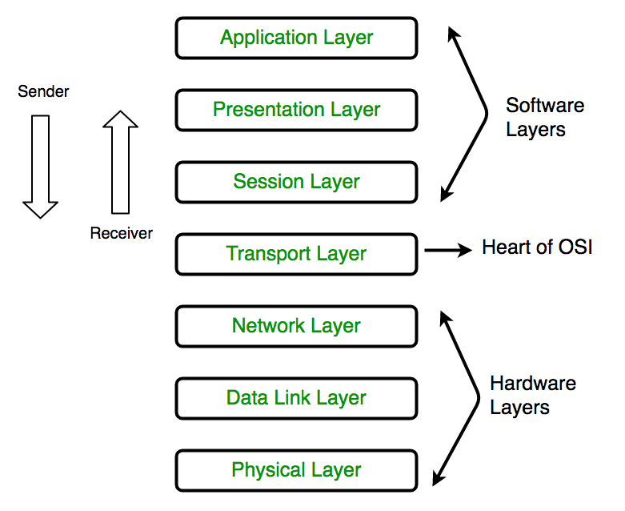
The Open System Interconnection Model (OSI)

Slide 37
Physical Layer
The lowest layer of the OSI reference model is the physical layer.
Defines the electrical and physical specifications of the data connection: E.g., the relationship between a device and a physical transmission medium (e.g., a copper or fiber optical cable, radio frequency).
Bit synchronization: Provides the synchronization of the bits by providing a clock.
Bit rate control: Defines the transmission rate i.e. the number of bits sent per second.
Physical topologies: Specifies the way in which the different, devices/nodes are arranged in a network i.e. bus, star, or mesh topology.
Transmission mode: Defines data flow between two connected devices.

Slide 38
Data Link Layer
The data link layer is responsible for the node-to-node delivery of the message.
Data Link Layer is divided into two sublayers:
Logical Link Control
Media Access Control
Other Functions include:
Framing
Physical addressing
Error control
Flow Control
Access control

Slide 39
Network Layer
Works for the transmission of data from one host to the other located in different networks.
Also takes care of packet routing i.e. selection of the shortest path to transmit the packet, from the number of routes available.
Other functions include:
Routing
Logical Addressing

Slide 40
Transport Layer
Provides services to the application layer and takes services from the network layer.
The data in the transport layer is referred to as Segments.
Responsible for the End to End Delivery of the complete message.
Provides the acknowledgement of the successful data transmission and re-transmits the data if an error is found.
Other functions include:
Segmentation and Reassembly: Accepts the message from the (session) layer, and breaks the message into smaller units.
Service Point Addressing: In order to deliver the message to the correct process, the transport layer header includes a type of address called service point address or port address.
At the sender’s side, this layer receives the formatted data from the upper layers, performs Segmentation, and also implements Flow & Error control to ensure proper data transmission.
At receiver’s side, it reads the port number from its header and forwards the Data which it has received to the respective application.

Slide 41
Session Layer
Responsible for the establishment of connection, maintenance of sessions, authentication, and also ensures security.
Other functions include:
Session establishment, maintenance, and termination: Allows the two processes to establish, use and terminate a connection.
Synchronization: This layer allows a process to add checkpoints which are considered synchronization points into the data.
Dialog Controller: Allows two systems to start communication with each other in half-duplex or full-duplex.

Slide 42
Presentation Layer
Also called the Translation layer.
The data from the application layer is extracted here and manipulated as per the required format to transmit over the network.
Other functions include:
Translation: For example, ASCII to EBCDIC.
Encryption/ Decryption: Data encryption translates the data into another form or code. The encrypted data is known as the ciphertext and the decrypted data is known as plain text. A key value is used for encrypting as well as decrypting data.
• Compression: Reduces the number of bits that need to be transmitted on the network.

Slide 43
Application Layer
Found at the very top of the OSI Reference Model.
Implemented by Network Applications.
These applications produce the data, which has to be transferred over the network.
Other functions include:
Network Virtual Terminal
FTAM-File transfer access and management
Mail Services
Directory Services

Slide 44
TCP/IP Reference Model
Set of rules that governs the connection of computer systems to the internet.
Commonly known as TCP/IP. Stands for Transmission Control Protocol/Internet Protocol.
The TCP/IP model is a concise version of the OSI model.
Main protocols in the suite include:
Transmission Control Protocol
Internet Protocol
User Datagram Protocol.
Designed and developed by Department of Defense (DoD) in 1960s and is based on standard protocols.
Contains four layers.

Slide 45
TCP/IP Layers
Application Layer
Transport Layer
Internet Layer
Network Access

Slide 46
Network Access Layer
This layer corresponds to the combination of Data Link Layer and Physical Layer of the OSI model.
It looks out for hardware addressing and the protocols present in this layer allows for the physical transmission of data.

Slide 47
Internet Layer
This layer parallels the functions of OSI’s Network layer.
It defines the protocols which are responsible for logical transmission of data over the entire network.
The main protocols residing at this layer are:
IP: Internet Protocol, including IPv4 and IPv6
ICMP: Internet Control Message Protocol
ARP: Address Resolution Protocol

Slide 48
Transport Layer
Also known as Host-To-Host Layer
This layer is analogous to the transport layer of the OSI model. It is responsible for end-to-end communication and error-free delivery of data.
The main protocols residing at this layer are:
Transmission Control Protocol (TCP)
User Datagram Protocol (UDP)

Slide 49
Application Layer
Performs the functions of top three layers of the OSI model: Application, Presentation and Session Layer.
Responsible for node-to-node communication and controls user-interface specifications.
The protocols residing at this layer include:
HTTP: Hypertext transfer protocol
HTTPS: Hypertext transfer protocol-secure
Telnet: Teletype Network Protocol
SSH: Secure Shell
NTP: Network Time Protocol

Slide 50
Comparison of OSI and TCP / IP Reference Models
Similarities | Differences
Both the reference models are based upon layered architecture. | OSI model distinguishes the three concepts, namely, services, interfaces, and protocols. TCP/IP does not have a clear distinction between these three.
In both the models, protocols are defined in a layer-wise manner. | OSI model gives guidelines on how communication needs to be done, while TCP/IP protocols layout standards on which the Internet was developed, therefore, TCP/IP is a more practical model.
In both models, data is divided into packets and each packet may take the individual route from the source to the destination. | In OSI, the model was developed first and then the protocols in each layer were developed. In the TCP/IP suite, the protocols were developed first and then the model was developed.
The layers in the models are compared with each other. The physical layer and the data link layer of the OSI model correspond to the link layer of the TCP/IP model. The network layers and the transport layers are the same in both the models. The session layer, the presentation layer and the application layer of the OSI model together form the application layer of the TCP/IP model. | The OSI has seven layers while the TCP/IP has four layers.
 | OSI model is a generic model that is based upon functionalities of each layer, while TCP/IP model is a protocol-oriented standard.

