Slide 1
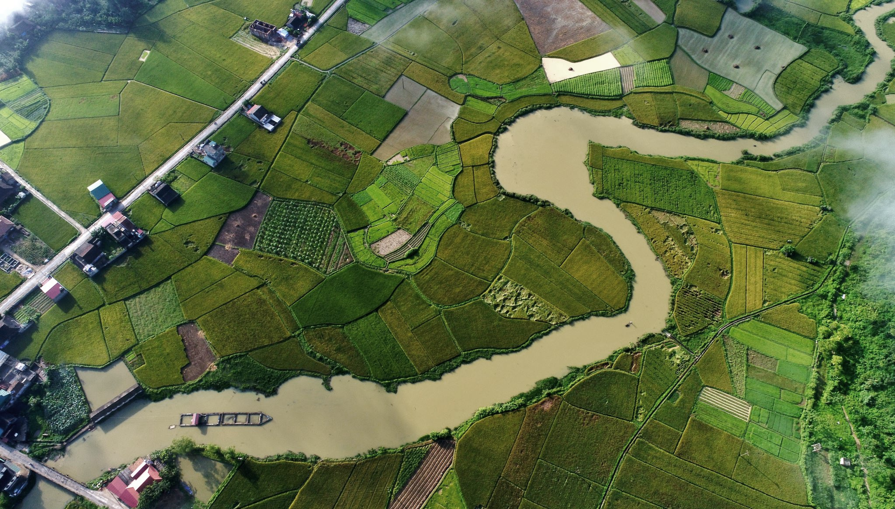



T-Route Workshop
Session 1: Introduction to the NextGen Framework and T-Route
Bong Chul Seo & Md Saiduzzaman
July 15, 2026

Slide 2
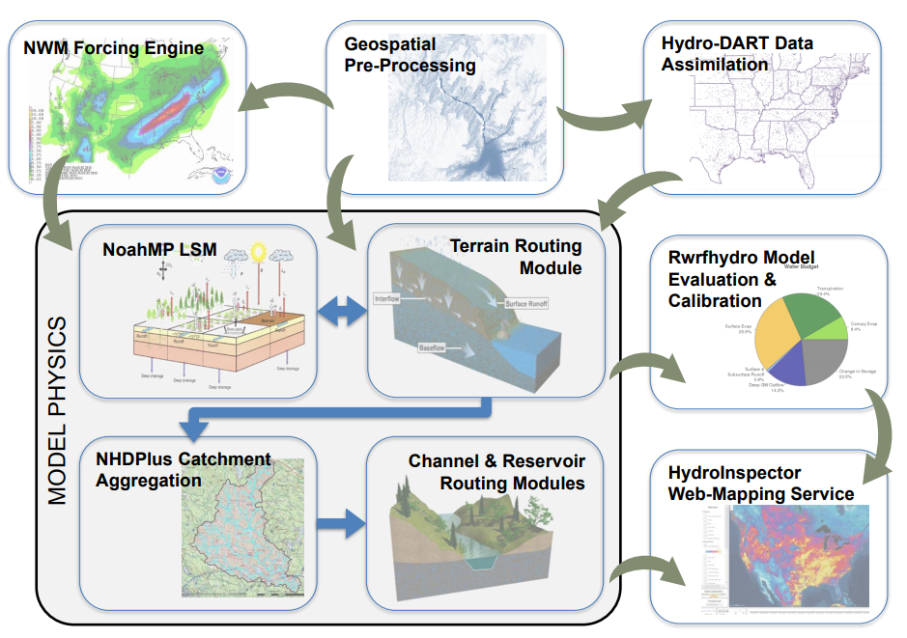
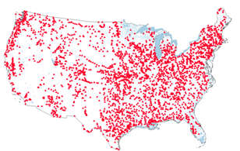
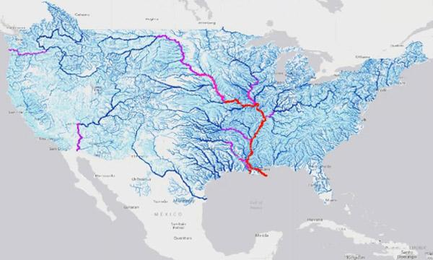


National Water Model (NWM)
About 3,600 forecast points
NWM: about 2.7 M points

Slide 3

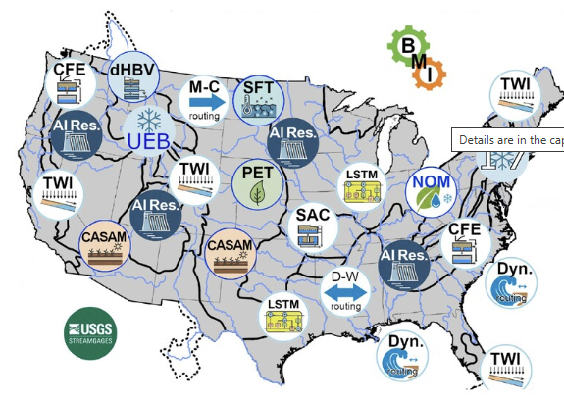
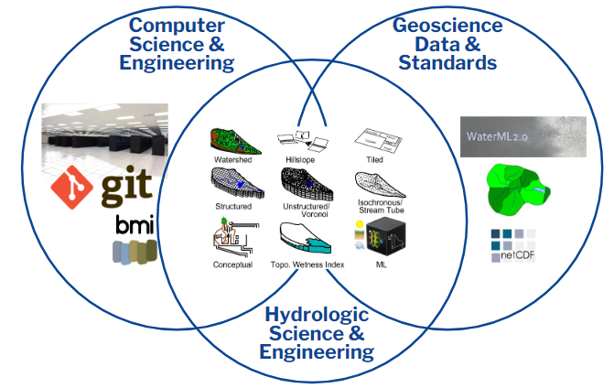
NextGen Framework
Forecasts &
Inundation
Forcing
Hydraulic
Model
Hydrologic
Model
Notes:
BMI enables model coupling, interoperability (C, Fortran, and Python) of different language/code-based model, and input and output data standardization.

Slide 4
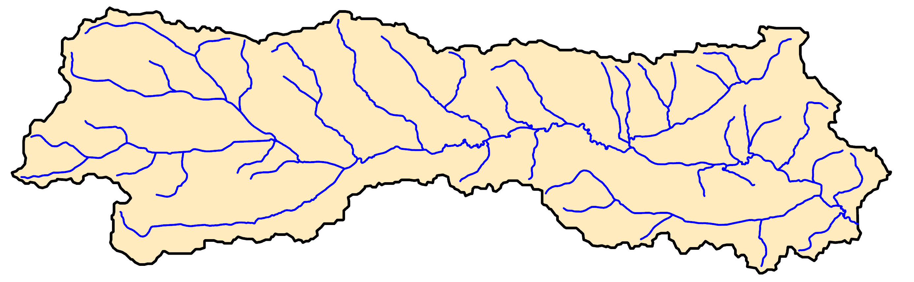
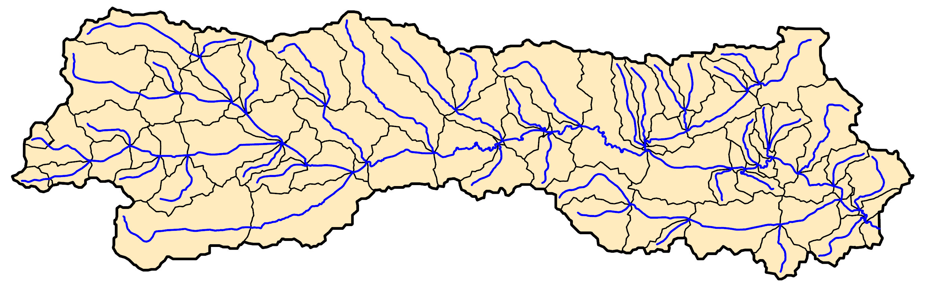
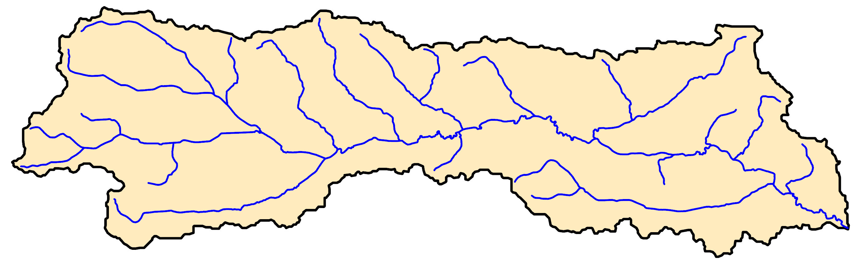
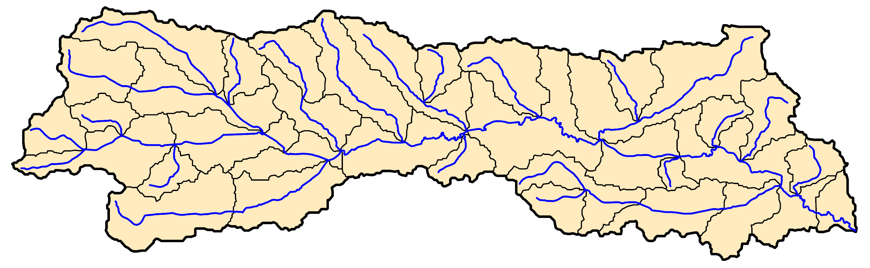
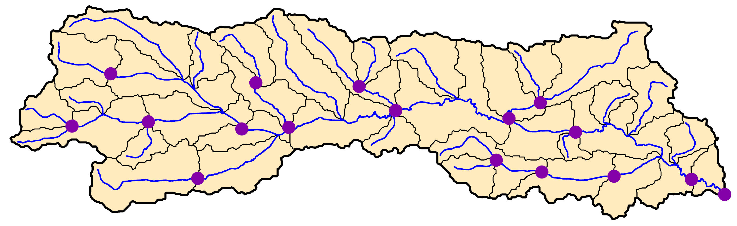
Hydrofabric
NHDPlus
Stream
links
Sub-catchments
90
135
vs.
Hydrofabric
34
34
Flowpath
Divide
Nexus
Notes:
National Hydrography datasets (NHDPlus vs. Hydrofabric) Is it refactored?
Hydro-Features (HY_Features): a conceptual data model, aligned with Open Geospatial Consortium (OGC) standards, that identifies and describes surface water features.
Hydrofabric: explicit network that organizes hydro-features

Slide 5
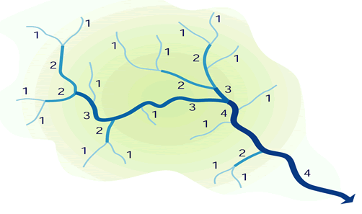









Muskingum-Cunge
T-Route
$$up$$
$$Q_{d}(t)=$$
${C_{1}Q}_{u}(t−1)$ + $C_{2}Q_{u}(t)$
Hybrid routing
$$down$$
+ $C_{3}Q_{d}(t−1)+ \left(\frac{q_{l}dt}{D}\right)$
$$t−1$$
$$t$$
Hydraulic routing
$$\frac{∂Q}{∂x}+\frac{∂A}{∂t}=0$$
http://bookofmormonresources.blogspot.com/2014/12/strahler-stream-order.html
$$\frac{∂Q}{∂t}+\frac{∂}{∂x}\left(\frac{Q^{2}}{A}\right)+gA\frac{∂y}{∂x}−gA\left(S_{0}−S_{f}\right)=0$$
kinematic wave
diffusive wave
dynamic wave
Notes:
Diffusive wave: ignore two acceleration (local and convective) terms and consider pressure gradient term

Slide 6
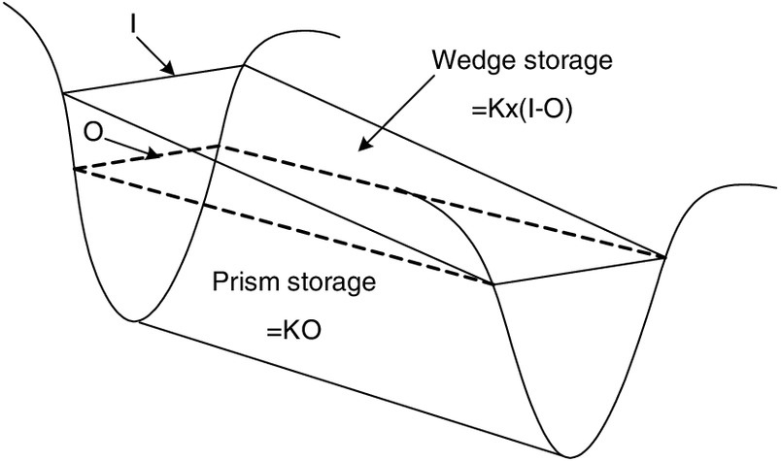
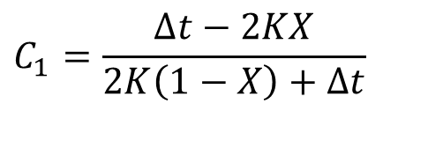
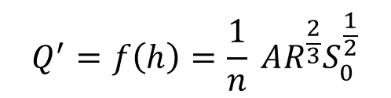
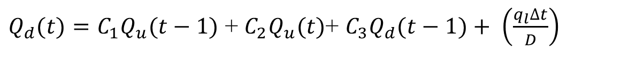





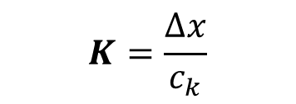
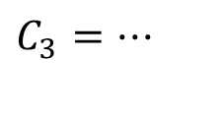

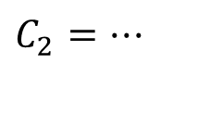

Muskingum-Cunge (MC)
${{Q_{d}(t)=C}_{1}Q}_{u}(t−1)$ + $C_{2}Q_{u}(t)$+ $C_{3}Q_{d}(t−1)+ \left(\frac{q_{l}∆t}{D}\right)$
$$up$$
$$down$$
$$S=K\left[XI+\left(1−X\right)O\right]$$
$$C_{1}=\frac{∆t−2KX}{2K\left(1−X\right)+∆t}$$
$$t−1$$
$$t$$
$$C_{2}=⋯$$
https://ascelibrary.org/doi/10.1061/%28ASCE%29HE.1943-5584.0001507
$$C_{3}=⋯$$
$$Q^{′}=f\left(h\right)=\frac{1}{n} AR^{\frac{2}{3}}S_{0}^{\frac{1}{2}}$$
$$K=\frac{∆x}{c_{k}}$$
$$c_{k}=f\left(h,⋯\right)$$
$$X=f\left(h,Q^{′},c_{k}\right)$$
Notes:
Muskingum–Cunge routing is an extension of Muskingum routing that makes the method physically based by linking its parameters to channel properties and flow conditions.
K: Storage constant (travel time),
x: attenuation factor (0: reservoir, more attenuation, 0.5: more wave translation, less attenuation)

Slide 7
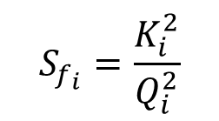





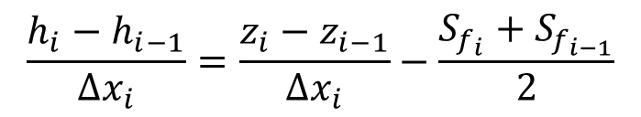






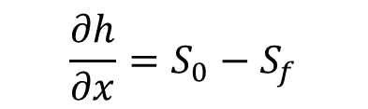
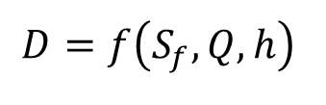

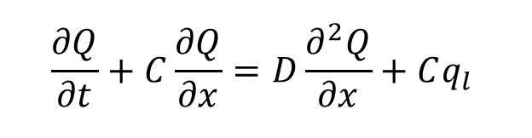



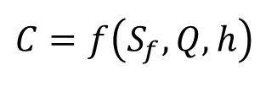


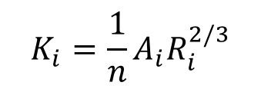




Diffusive Wave (DW)
$$\frac{∂Q}{∂t}+C\frac{∂Q}{∂x}=D\frac{∂^{2}Q}{∂x}+Cq_{l}$$
$$\frac{∂h}{∂x}=S_{0}−S_{f}$$
Crank-Nicolson (CNS)
Discretization
$$t$$
$$Q_{i−1}^{n+1}$$
$$Q_{i}^{n+1}$$
$$Q_{i+1}^{n+1}$$
$$\frac{{h_{i}−h}_{i−1}}{Δx_{i}}=\frac{{z_{i}−z}_{i−1}}{Δx_{i}}−\frac{S_{f_{i}}+S_{f_{i−1}}}{2}$$
$$n+1$$
$$Q$$
$$H$$
$$Q_{i−1}^{n}$$
$$Q_{i}^{n}$$
$$Q_{i+1}^{n}$$
$$Δt$$
$$n$$
$$Q_{ε}$$
$$S_{f_{i}}=\frac{K_{i}^{2}}{Q_{i}^{2}}$$
$$K_{i}=\frac{1}{n}A_{i}R_{i}^{2/3}$$
$$n−1$$
$$∆X_{j−1}$$
$$∆X_{j}$$
$$x$$
Celerity and
Diffusivity
$$i−1$$
$$i$$
$$i+1$$
$$Q_{d}=f\left(Q_{up},D,C\right)$$
$$C=f\left(S_{f},Q,h\right)$$
$$D=f\left(S_{f},Q,h\right)$$
Notes:
Diffusive wave equation (continuity + momentum) → Crank-Nicolson over Space (CNS)
H calculation: momentum eq. (Sf is calculated using conveyance and Q from manning’s eq).
Celerity is the speed at which a wave or perturbation propagates (wave speed), while diffusivity is the rate at which that wave attenuates or spreads out as it travels.

Slide 8

Thank you!
MSTHydroLab

