Slide 1




T-Route Workshop
Session 2: Data Acquisition for NextGen and T-Route
Md Saiduzzaman
July 15, 2026

Slide 2
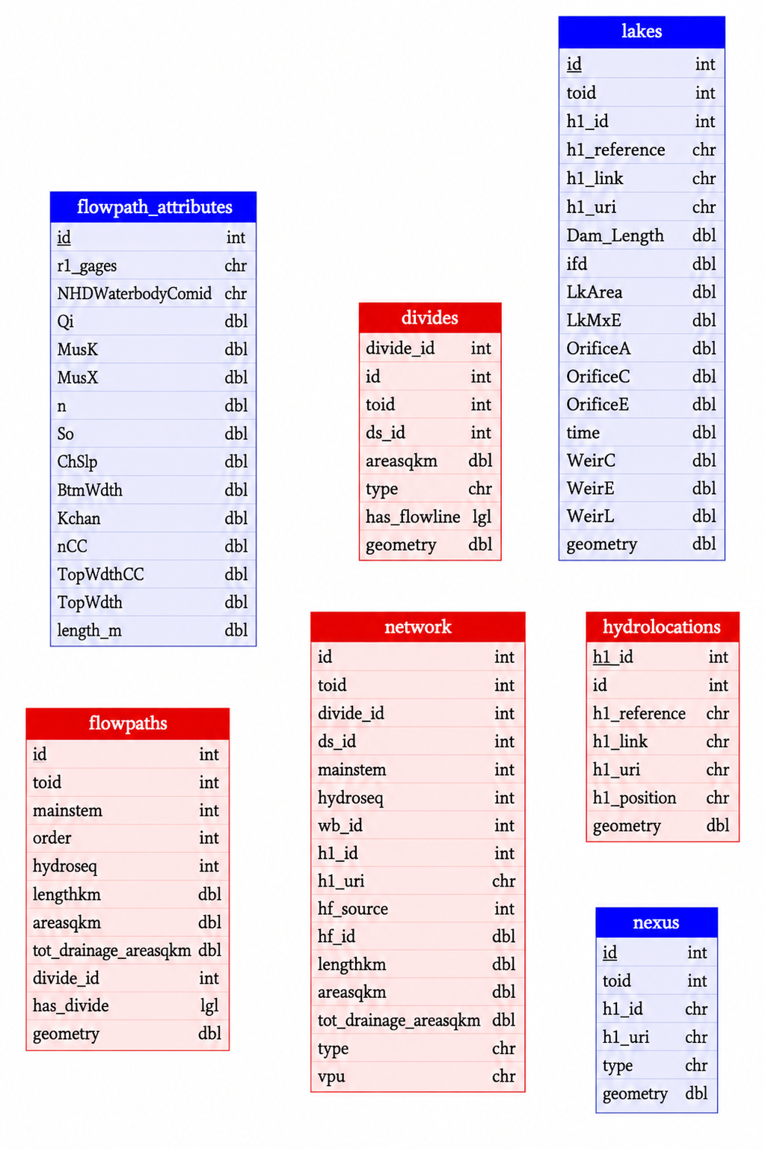

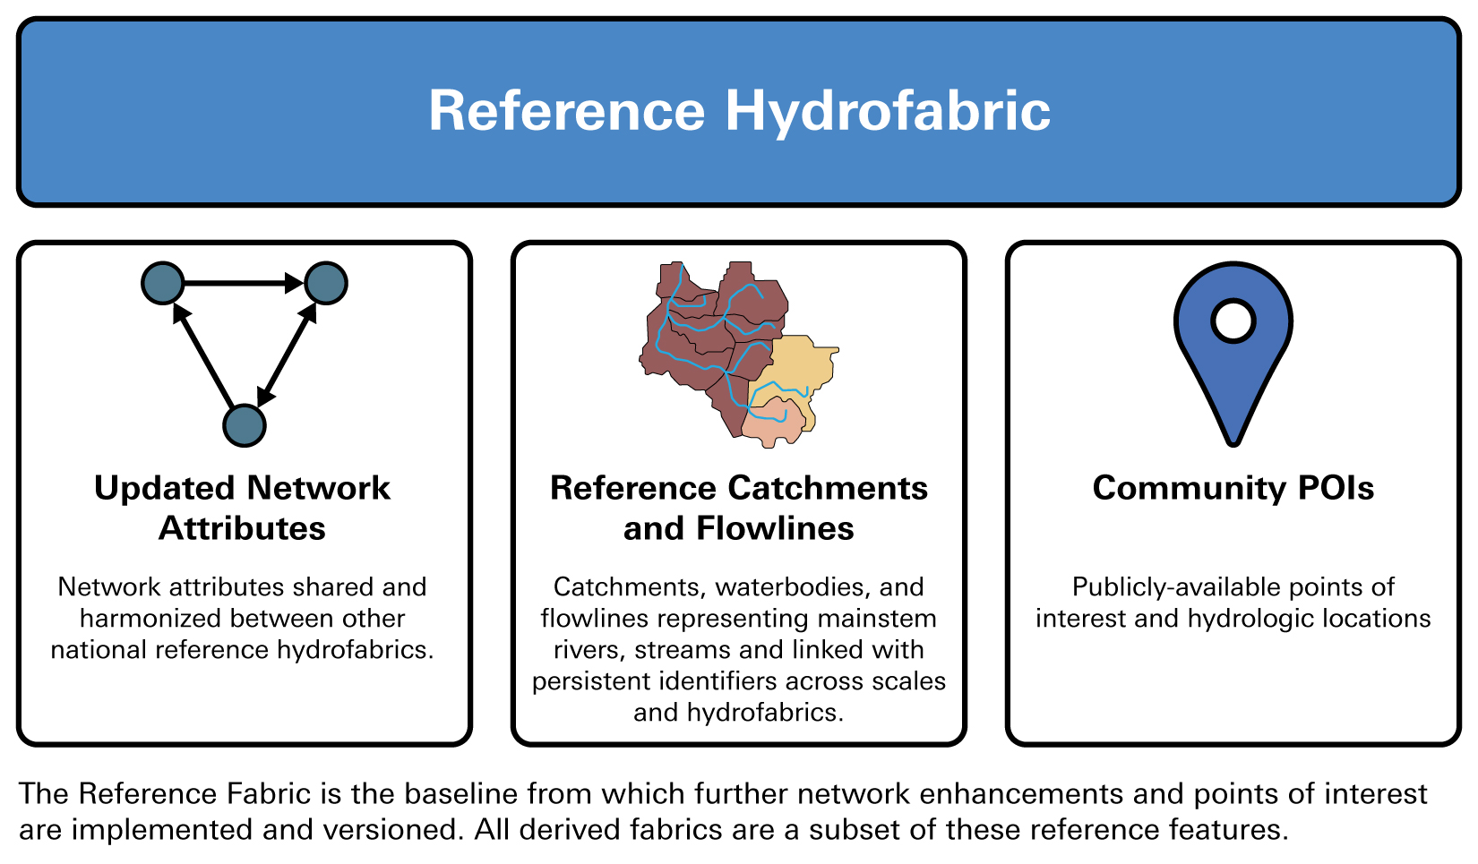
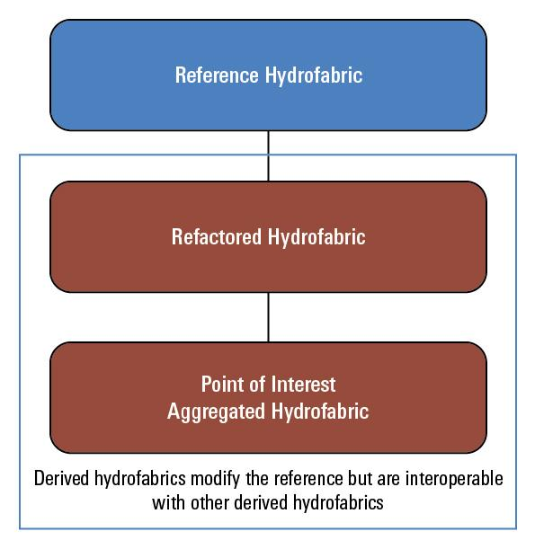
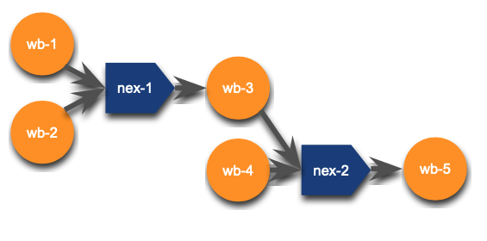
River Network Data
NextGen Hydrofabric v2.2
OGC WaterML 2 - Surface Hydrology Features (HY_Features) - Conceptual Model

Slide 3
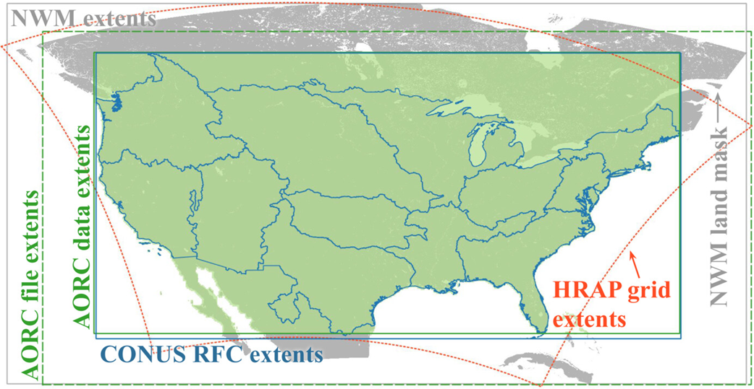
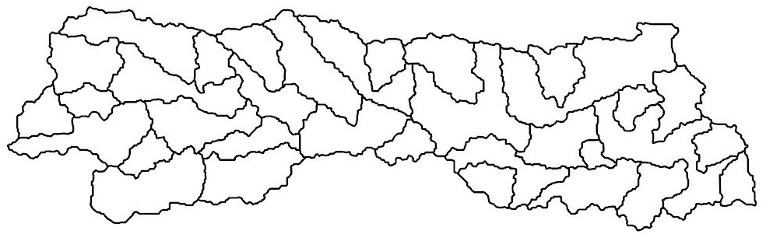
Meteorological Forcing (AORC)
Spatial coverage: CONUS RFC Extents
Spatial resolution: Grid/raster: ≤1 km2
Temporal coverage: 1979-present
Temporal Resolution: 1h
Meteorological Variables:
  Total Precipitation
  Downward shortwave & longwave radiation
  Pressure
  2-m air temperature
  2-m Specific humidity
  Zonal (U) wind
  Meridional (V) wind
J American Water Resour Assoc, Volume: 59, Issue: 6, Pages: 1246-1272, First published: 09 July 2023, DOI: (10.1111/1752-1688.13143)
Basin Average Value

Slide 4
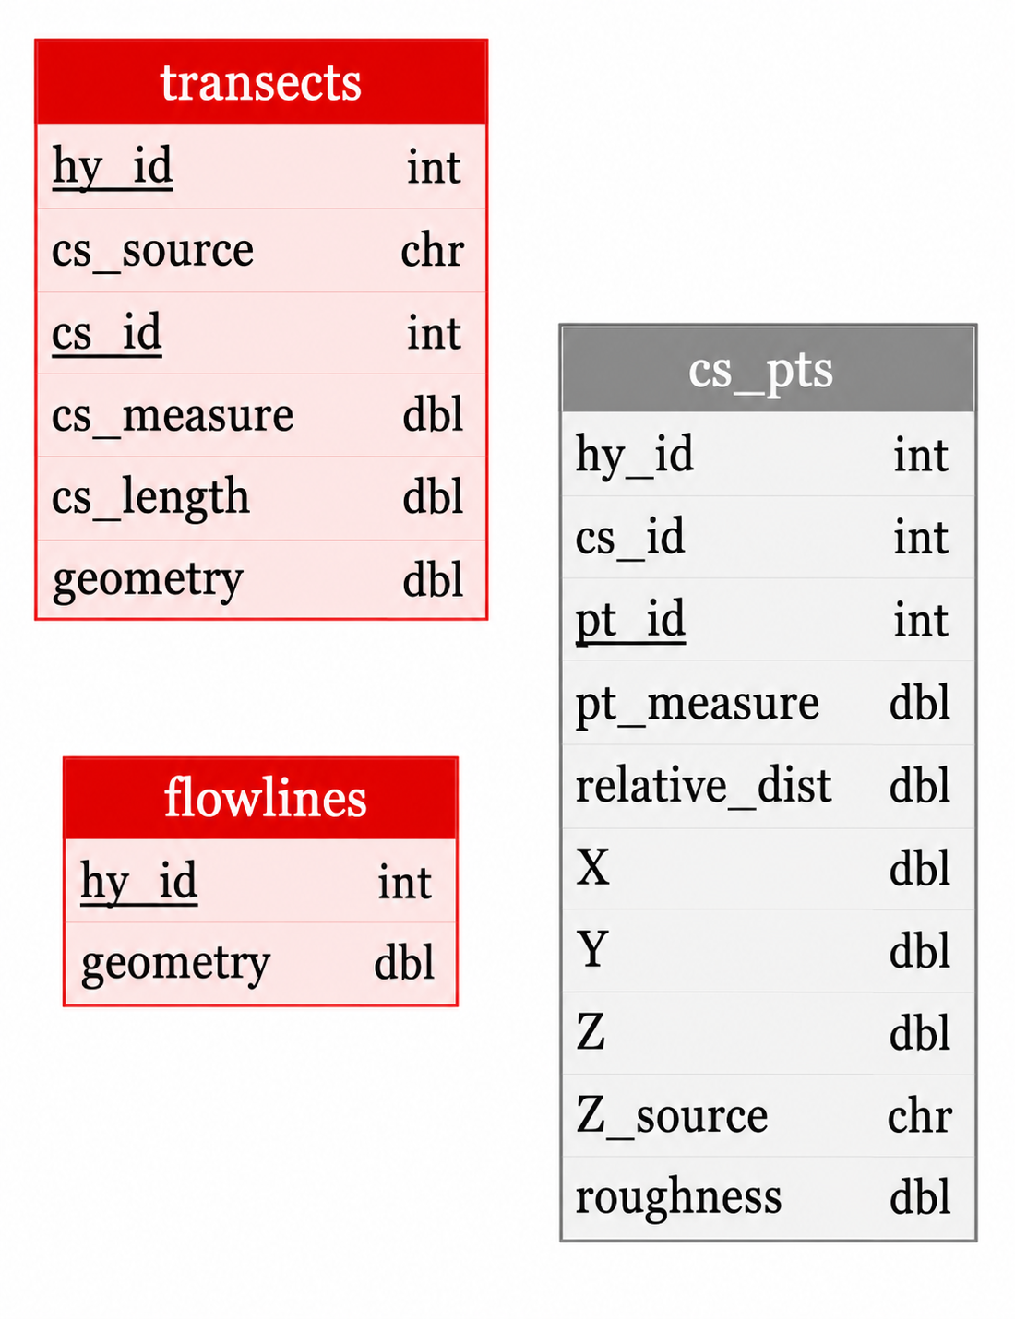
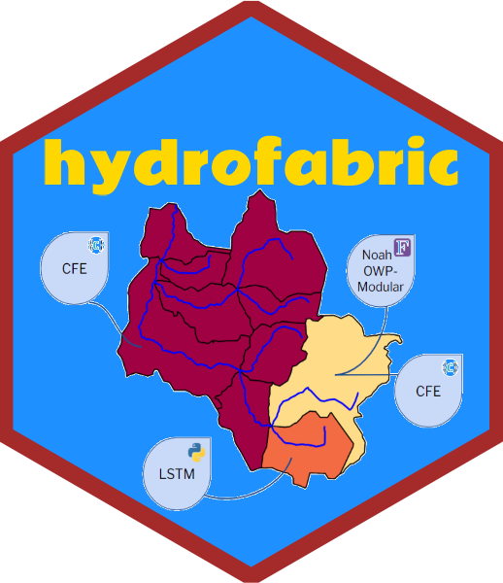
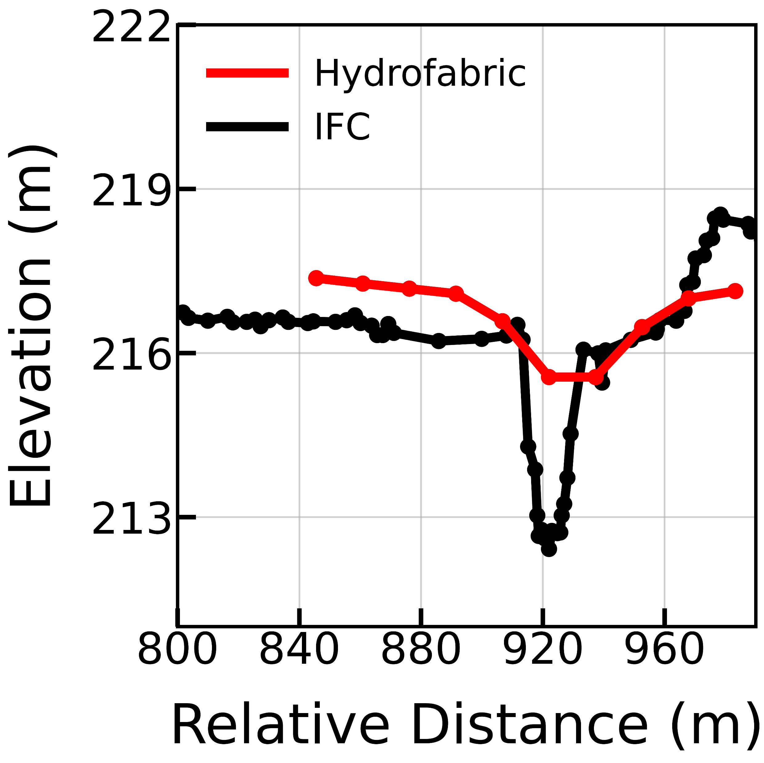
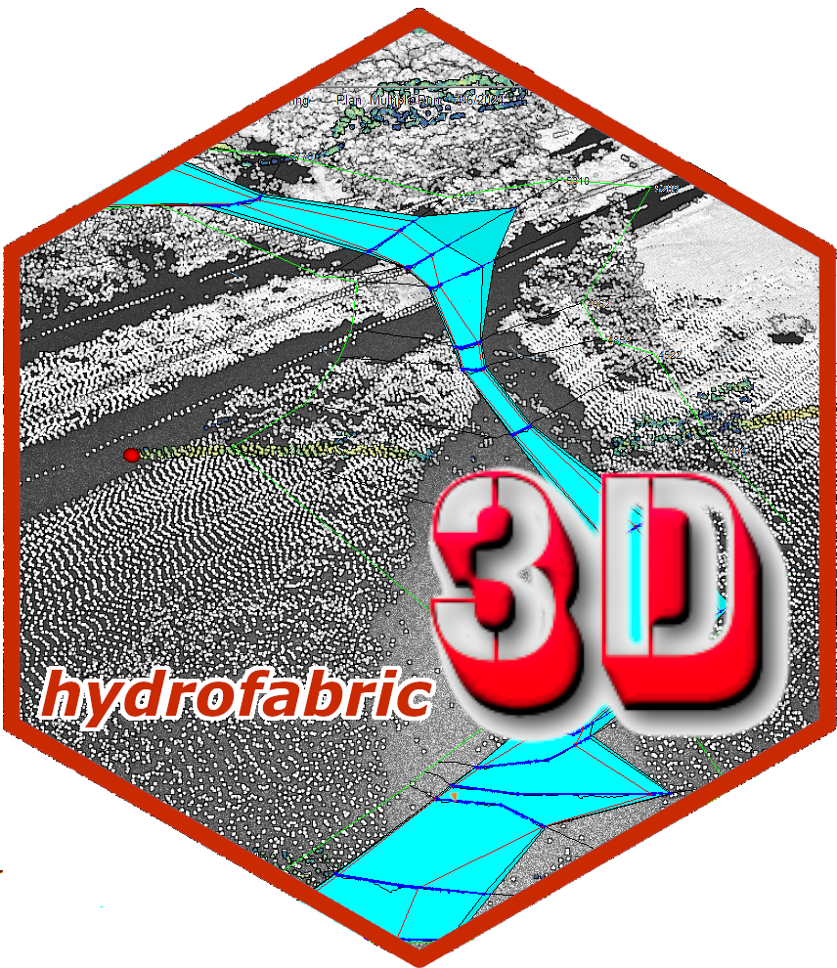
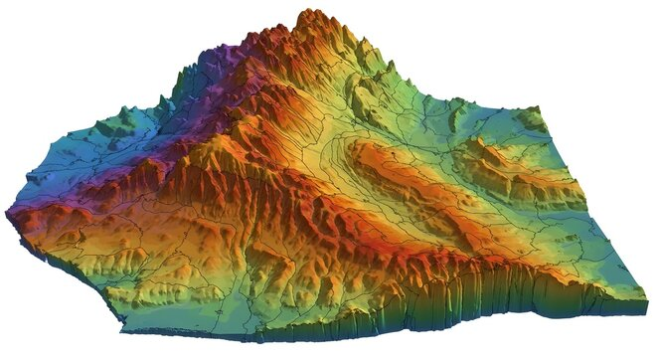
River Cross-Section Data
NextGen Hydrofabric3D
USGS 05454220
Digital Elevation Model

