Slide 1
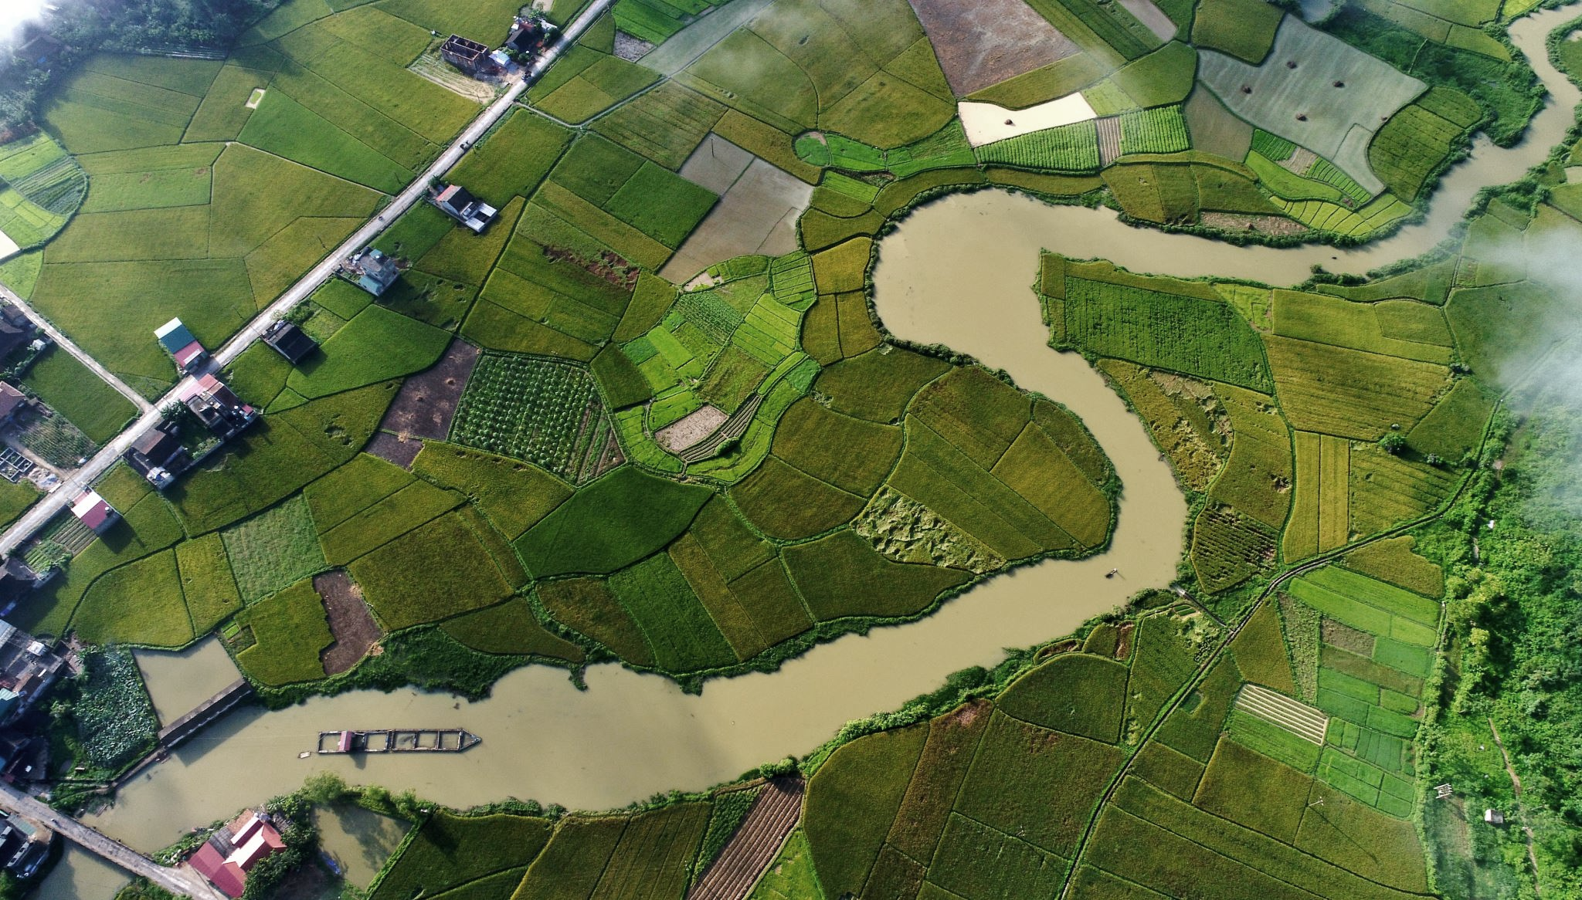



T-Route Workshop
Session 3: Calibration of the NextGen Rainfall-Runoff Model
Md Saiduzzaman
July 15, 2026

Slide 2


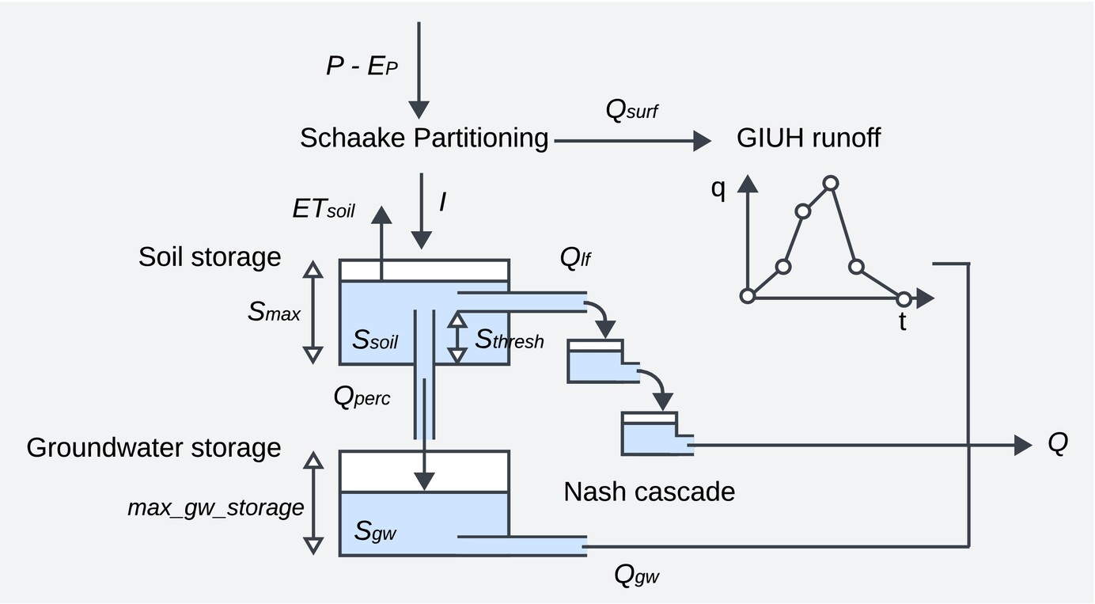
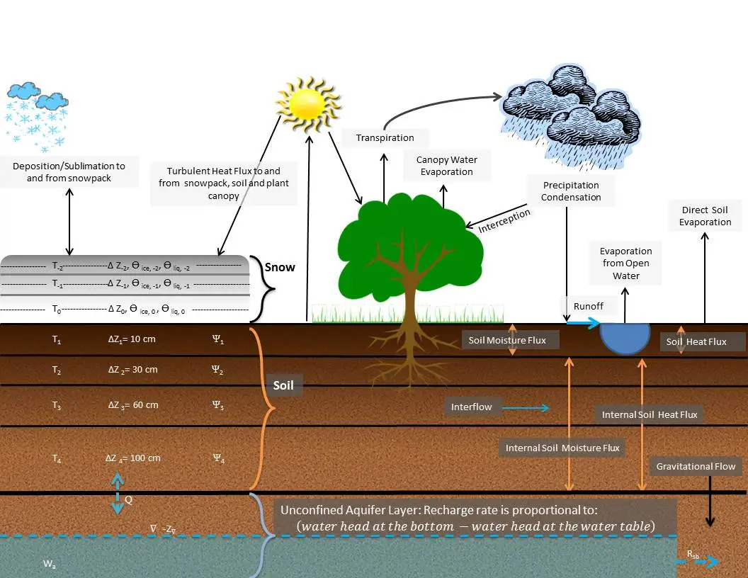
Rainfall-Runoff Model
AORC Meteorological Forcings
Conceptual Functional Equivalent (CFE)
BMI-Compliant Noah MP
Liquid water to soil surface
Total ET flux
https://doi.org/10.1111/1752-1688.70002
https://alice-lab.com/noah-mp-land-surface-model/

Slide 3


Model Parameters
CFE Parameters
Noah MP Parameters
Param
Description
Units
Range
Init
Param
Description
Units
Range
Init
b
Pore-size distribution exponent
–
2.0 – 15.0
4.05
RSURF_EXP
Soil-evap. resistance exponent
–
1.0 – 6.0
5.0
satpsi
Saturated capillary head
m
0.03 – 0.955
0.355
CWP
Canopy wind absorption coefficient
1/m
0.09 – 0.36
0.18
satdk
Saturated hydraulic conductivity
m/s
1.0e-7 – 7.26e-4
3.38e-6
MP
Ball–Berry conductance slope
–
3.6 – 12.6
9.0
maxsmc
Saturated soil moisture (porosity)
vol.
0.16 – 0.59
0.439
VCMX25
Max carboxylation rate at 25 °C
μmol/m²/s
24.0 – 112.0
52.2
refkdt
Schaake surface runoff partitioning
–
0.1 – 4.0
1.0
MFSNO
Snow-cover depletion melt factor
–
0.5 – 4.0
2.0
slope
Bottom-of-soil drainage coefficient
–
0.0 – 1.0
0.1
RSURF_SNOW
Surface resistance for snow
s/m
0.136 – 100.0
50.0
Klf
Lateral subsurface flow constant
–
0.0 – 1.0
0.01
SCAMAX
Max snow-cover fraction
–
0.7 – 1.0
0.9
Kn
Nash-cascade routing coefficient
–
0.0 – 1.0
0.03
max_gw_storage
Max GW reservoir storage
m
0.01 – 0.25
0.05
expon
Nonlinear GW reservoir exponent
–
1.0 – 8.0
3.0
Cgw
GW-to-channel discharge coefficient
m/hr
1.8e-6 – 1.8e-3
1.8e-5
CFE Parameters
Noah MP Parameters

Slide 4





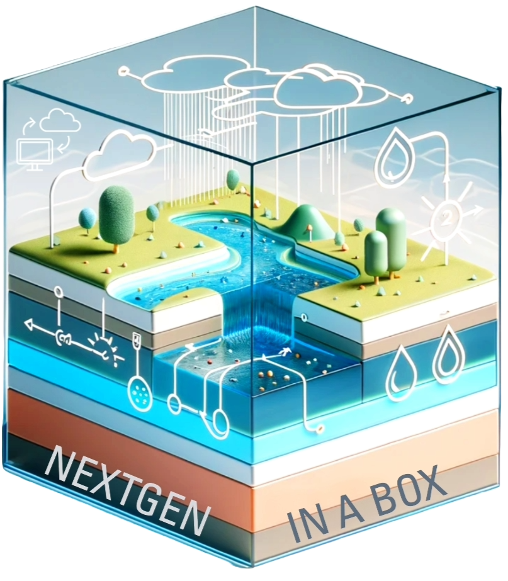
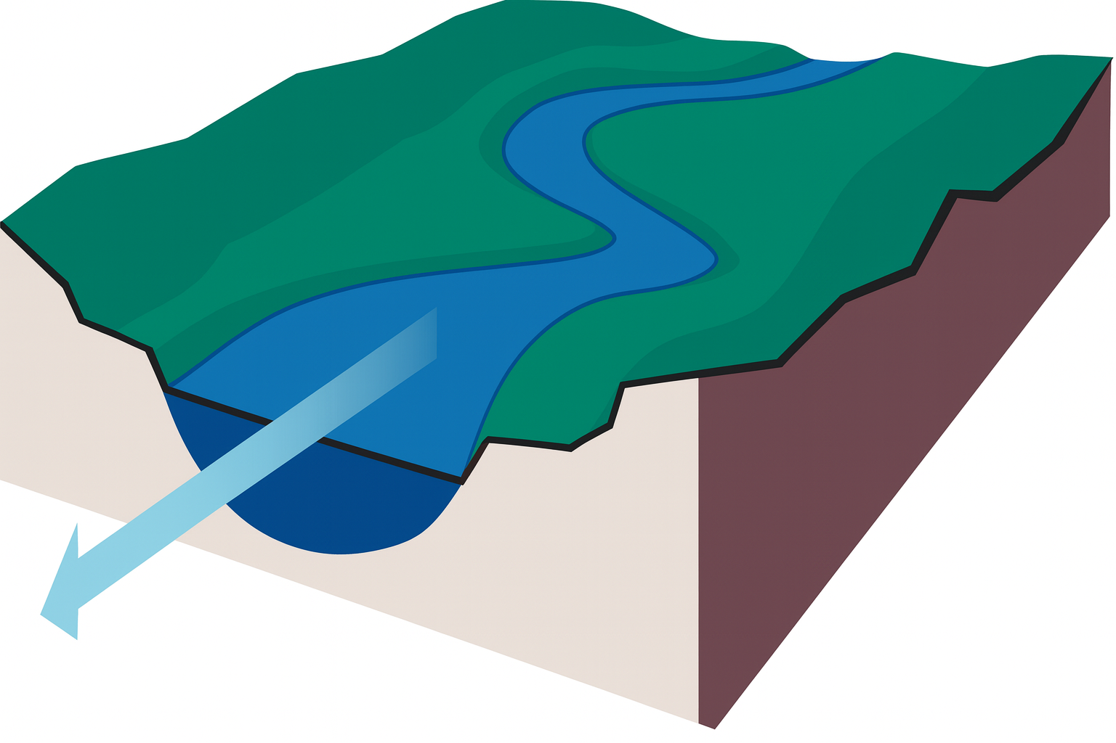



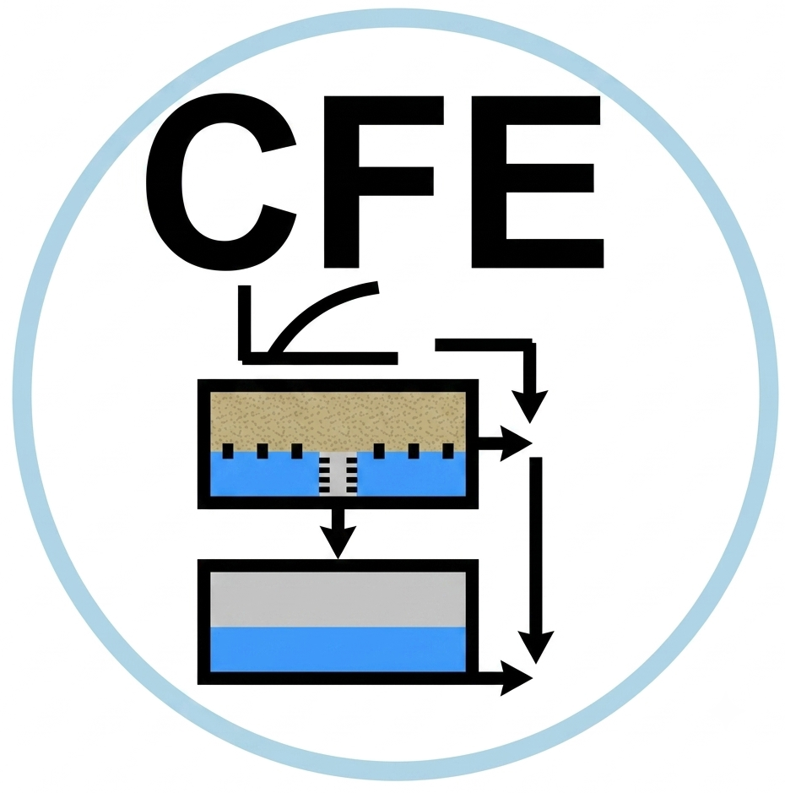
Calibration Process
Dynamically Dimensioned Search (DDS)
Objective Function
Single Gage calibration
Channel Routing (T-Route)

