Slide 1
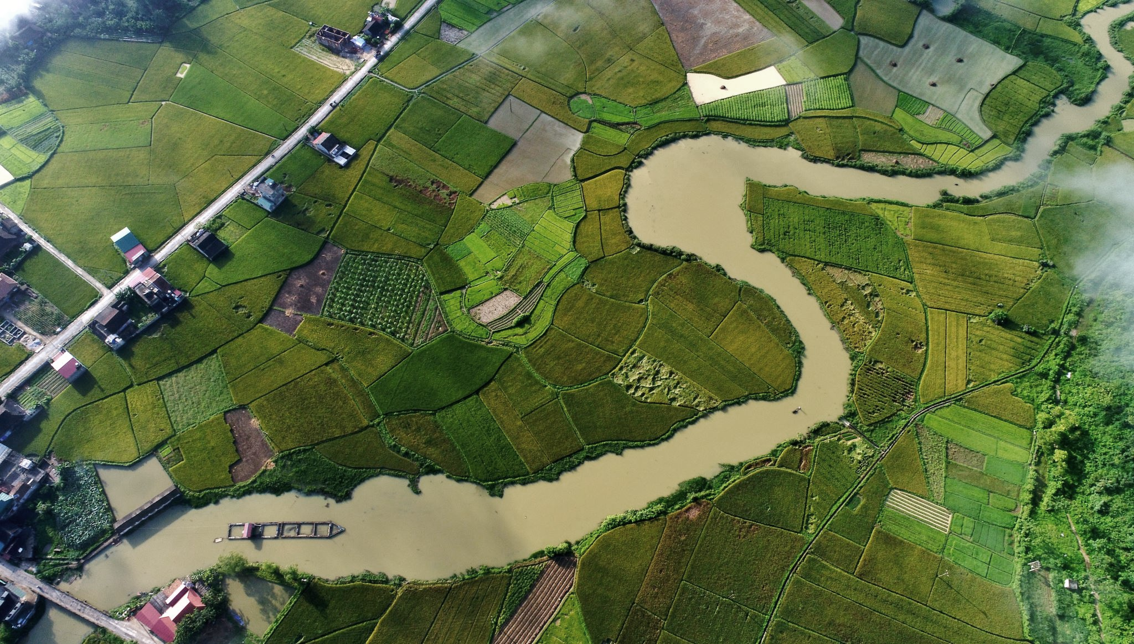



T-Route Workshop
Session 4: T-Route Configuration and open-loop Simulation
Md Saiduzzaman
July 15, 2026

Slide 2
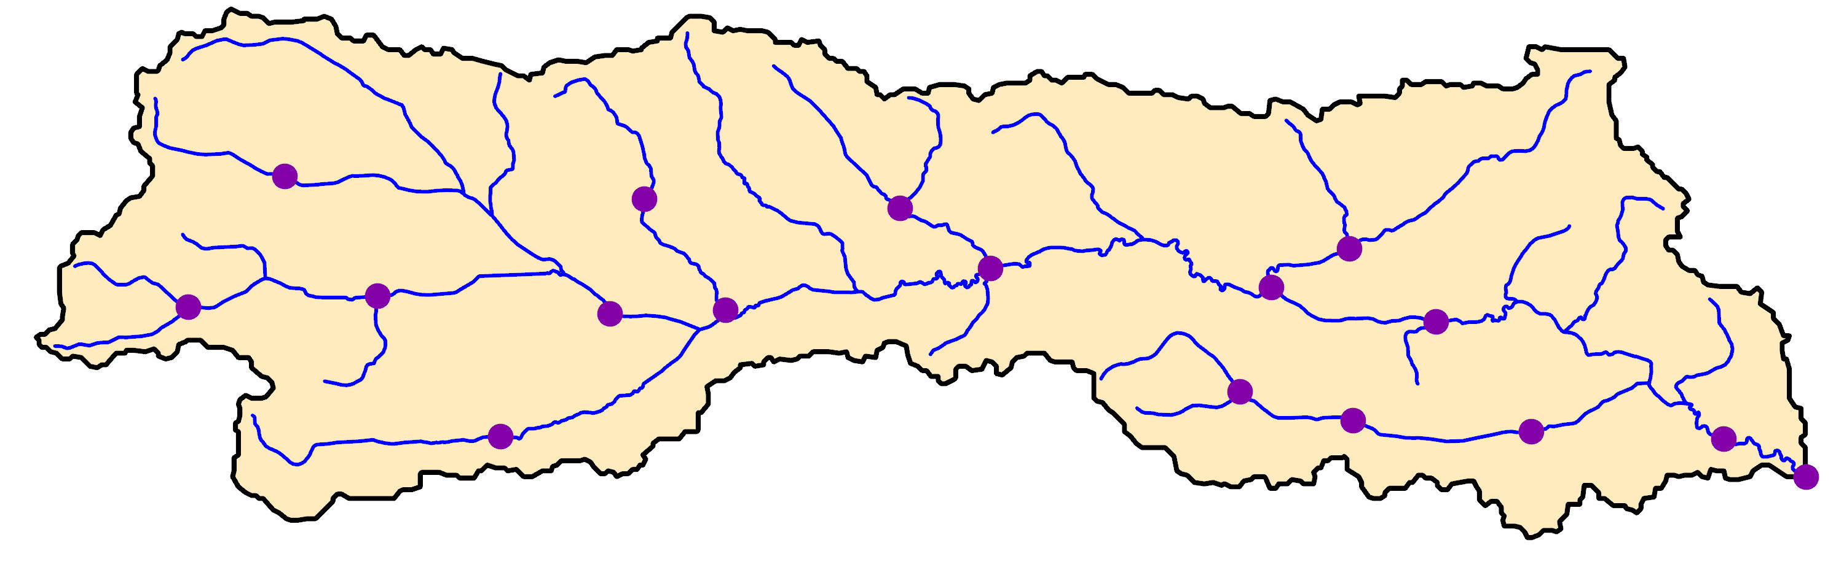

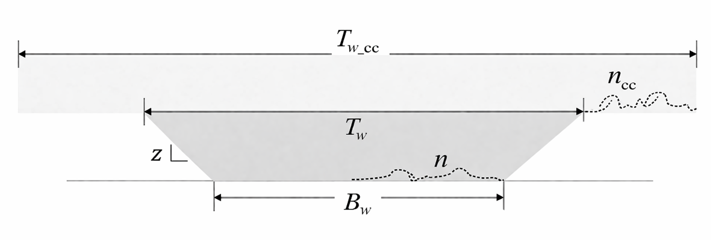
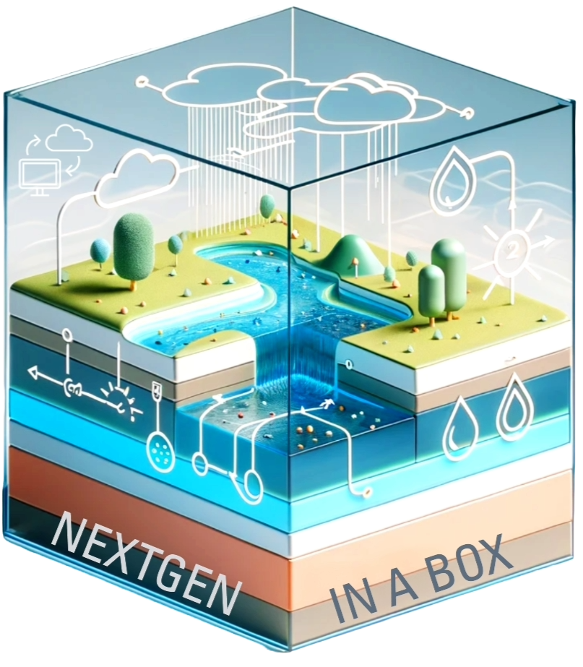
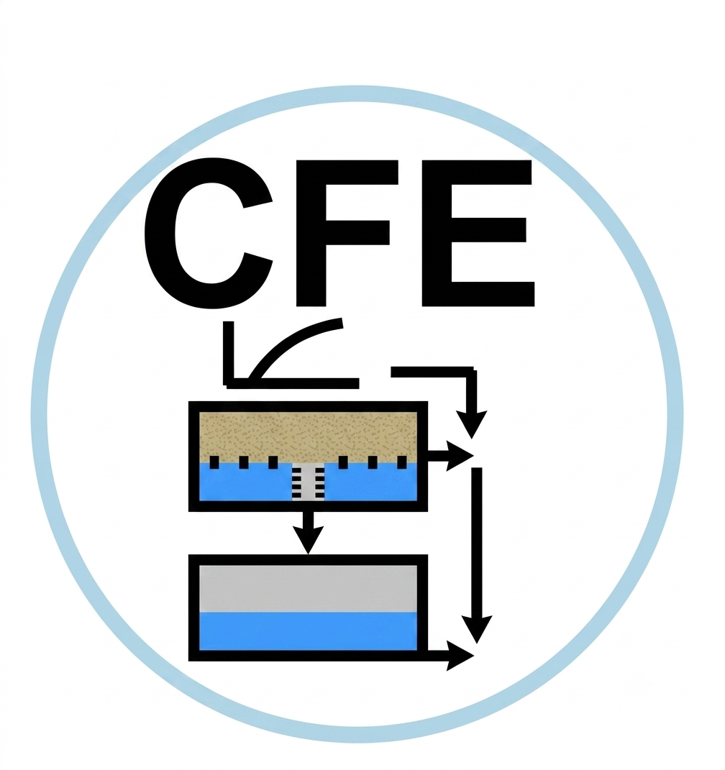
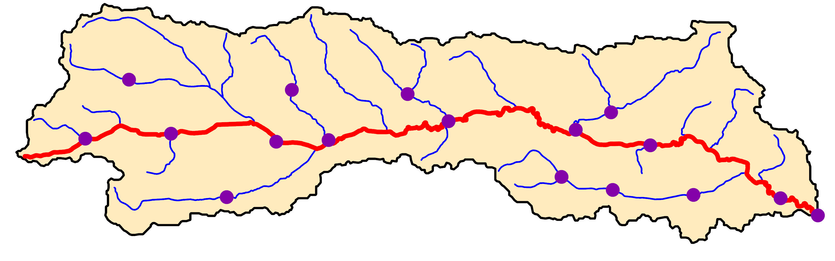
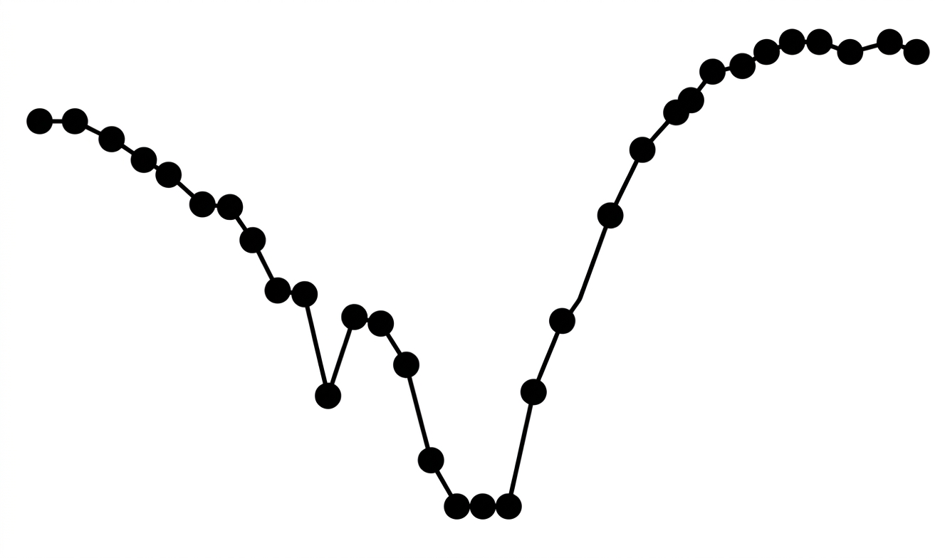
Open-loop Simulation
MC
Flowpaths Attributes
DW
Hydrofabric 3D

Slide 3
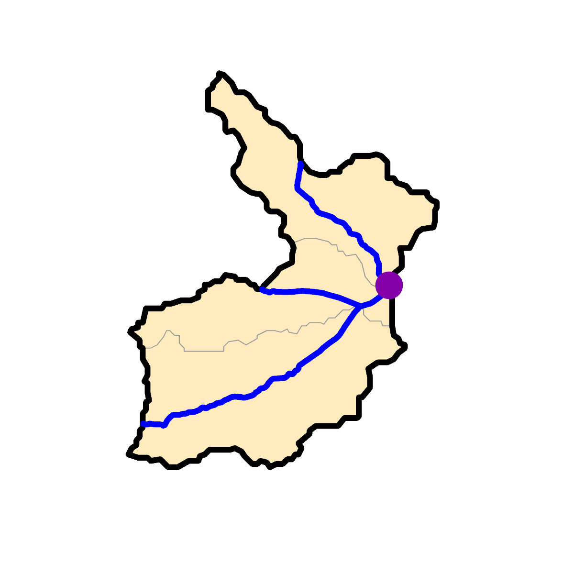
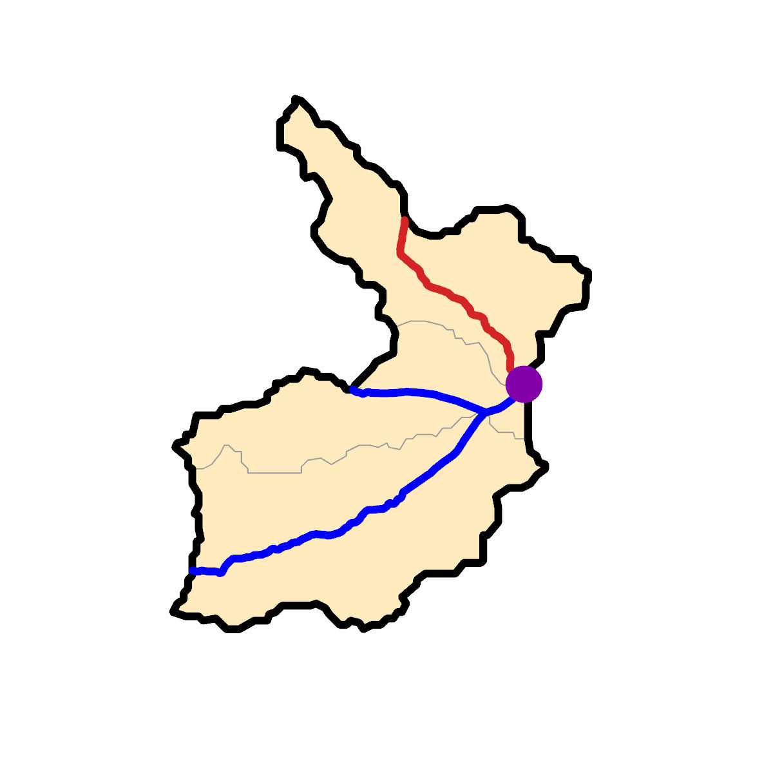
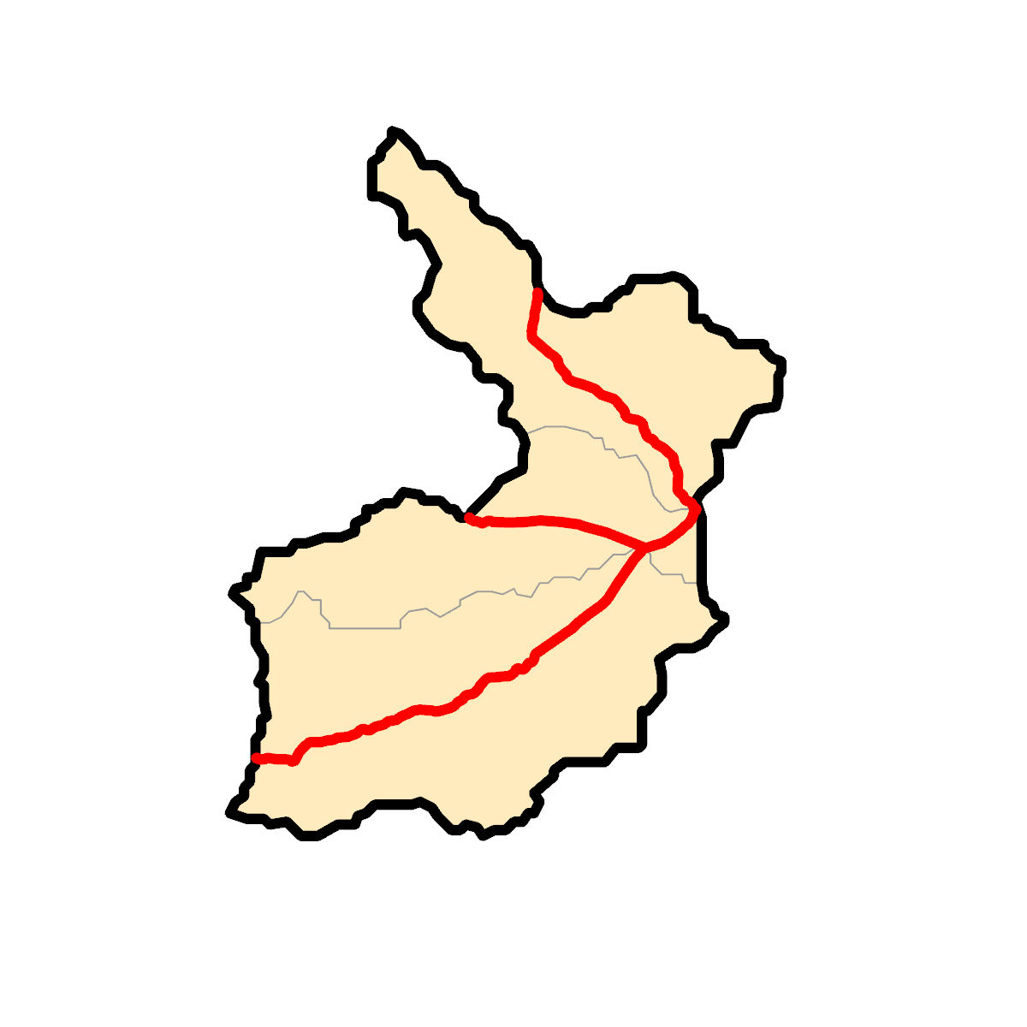







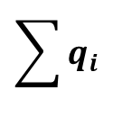
Routing Structure
Correction
Rainfall-Runoff
$$q_{1}$$
$$q_{2}$$
$$q_{3}$$
Channel routing
Channel routing
No routing
Nexus
Divide
$$\sum{q_{i}}$$
$$q_{1}$$
Routing
$$q_{2}$$
$$q_{3}$$

