Slide 1
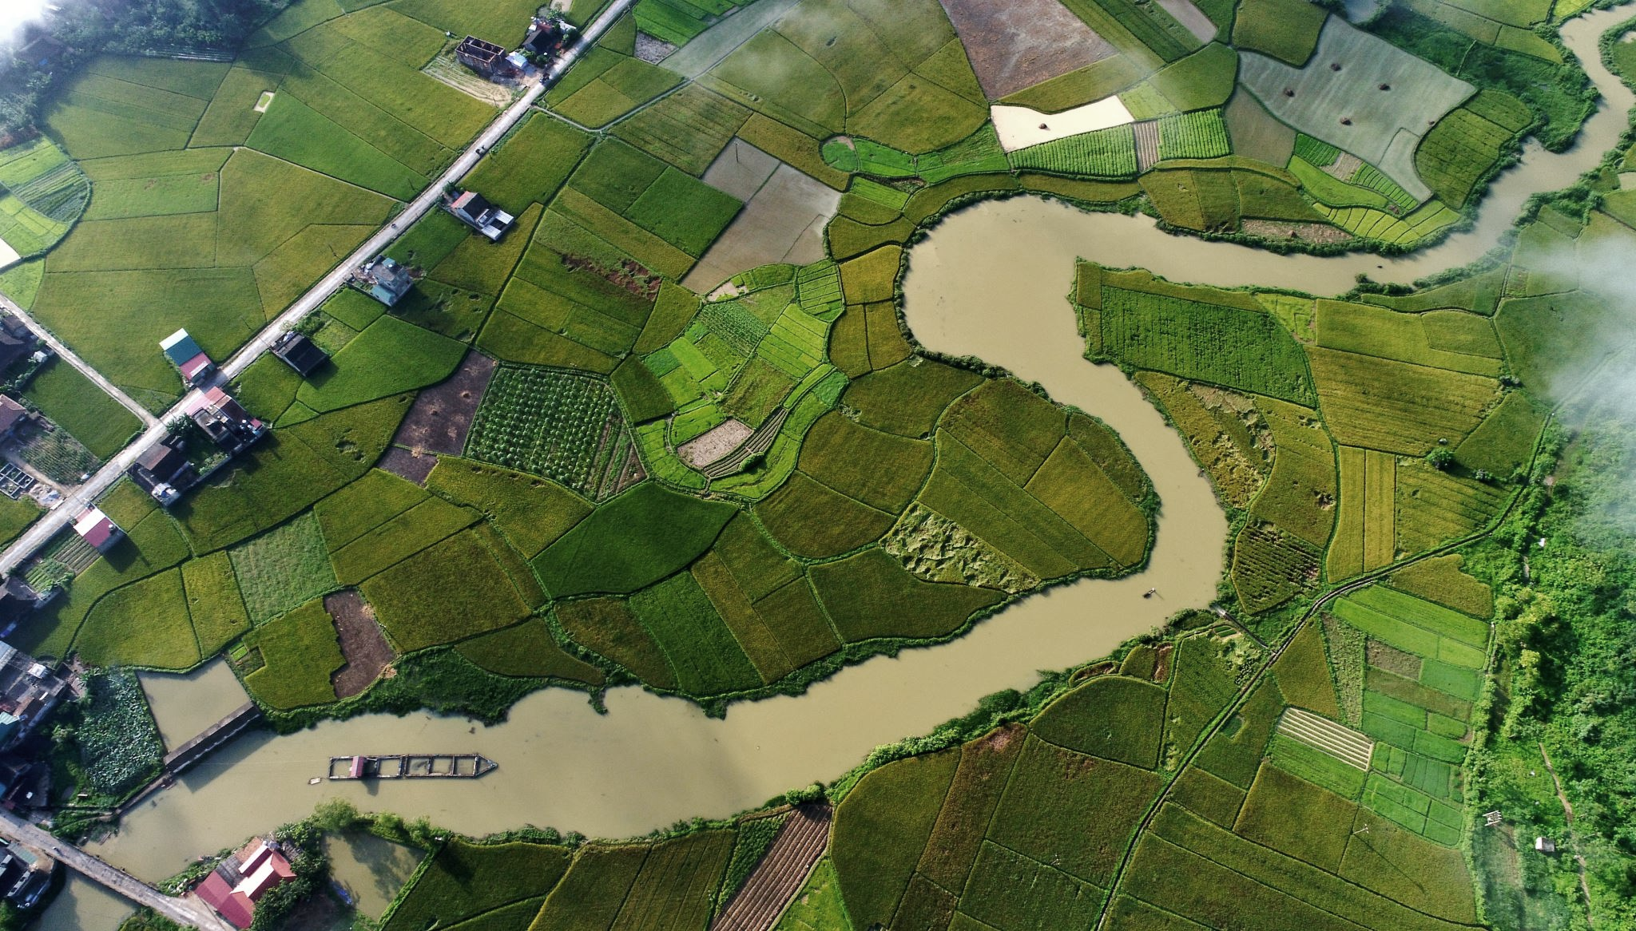



T-Route Workshop
Session 5: Streamflow Data Assimilation in T-Route
Md Saiduzzaman
July 15, 2026

Slide 2
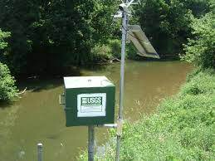

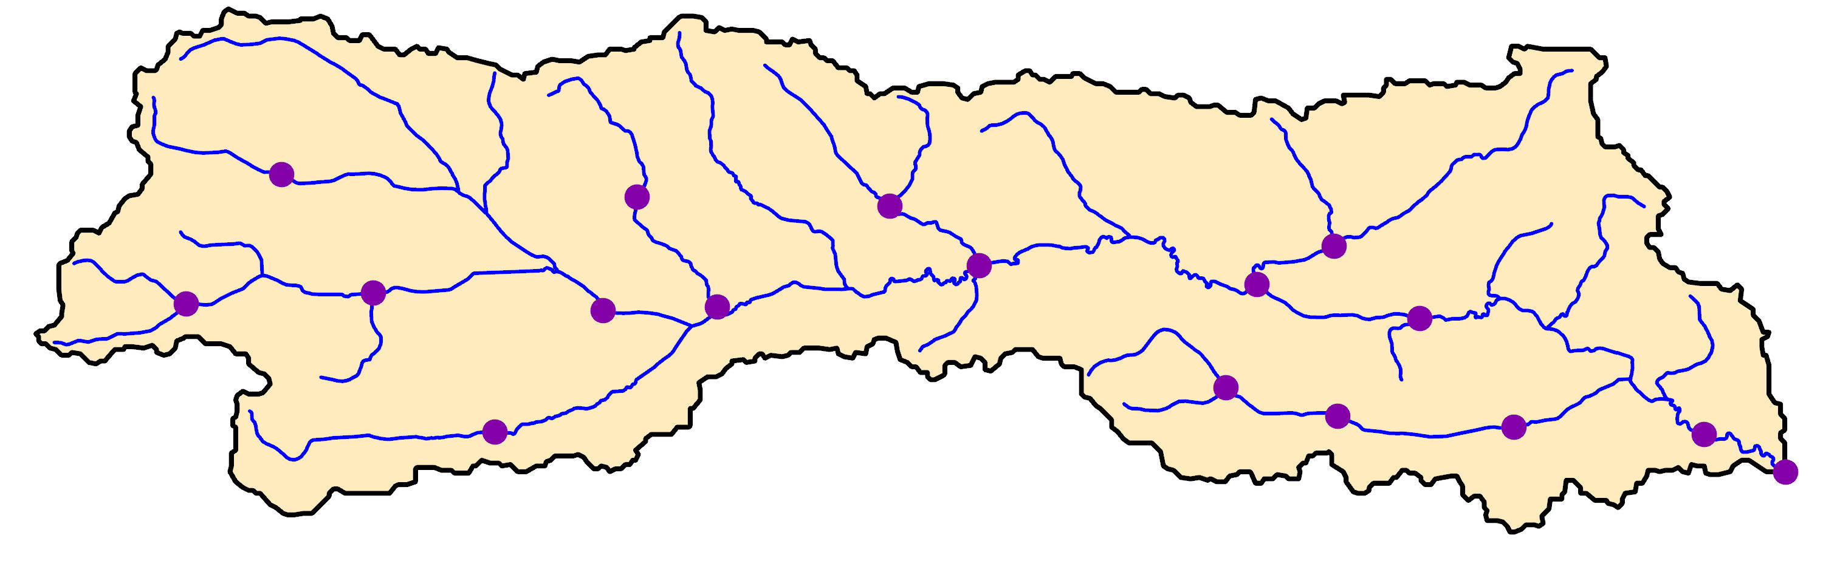

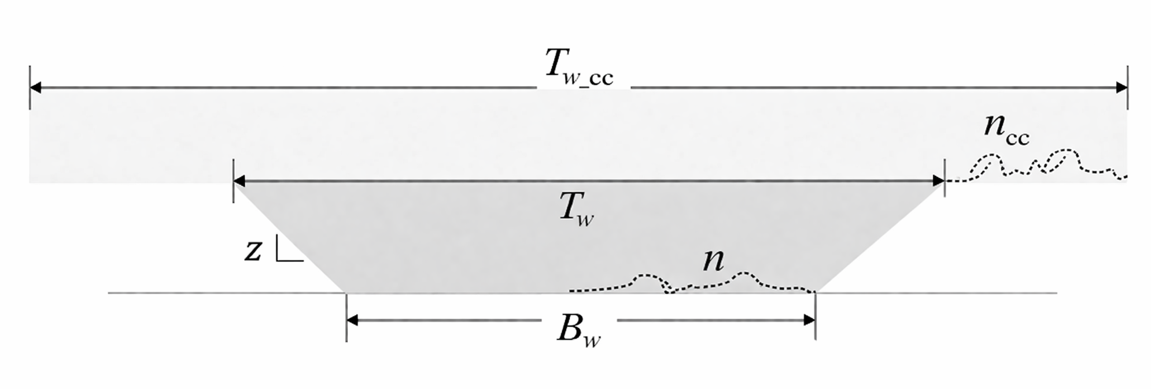
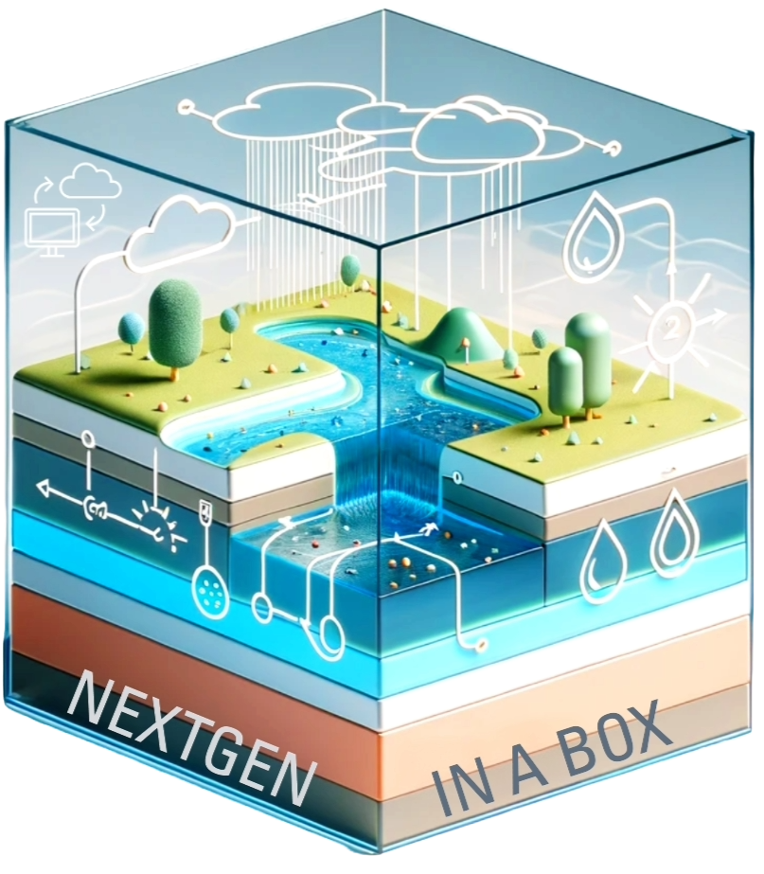
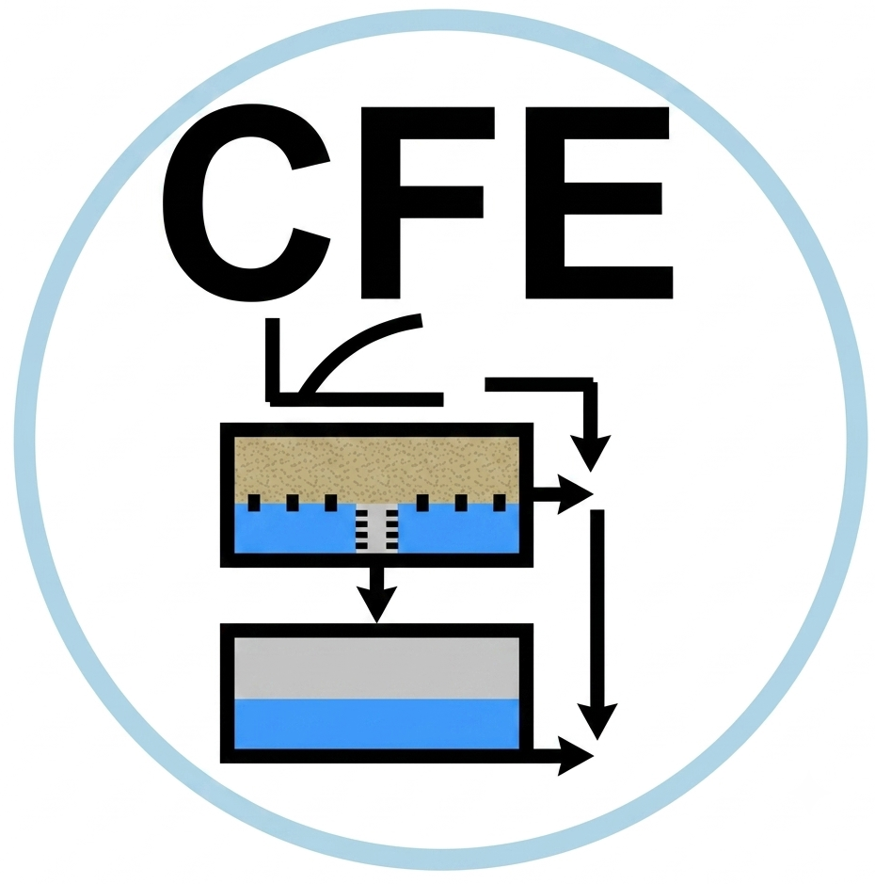
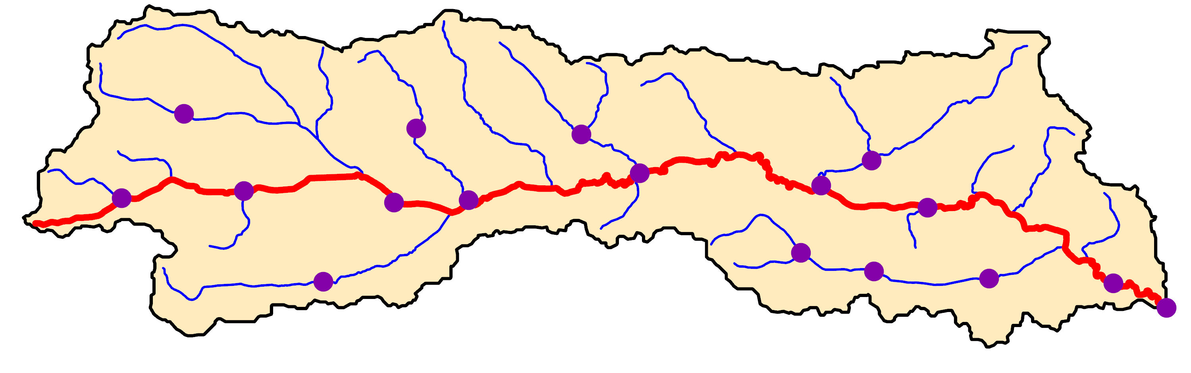
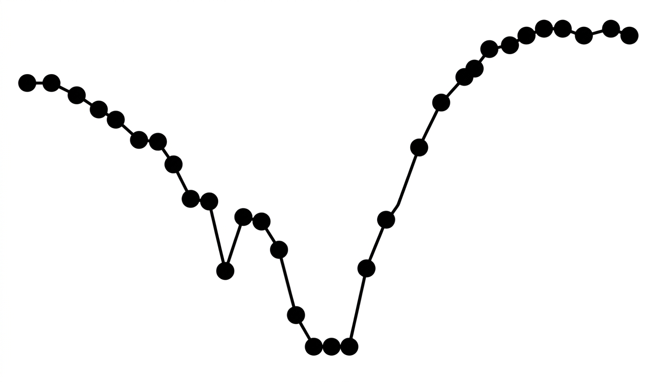
DA Simulation
Data Assimilation (DA)
MC
Flowpaths Attributes
DW
Hydrofabric 3D

Slide 3
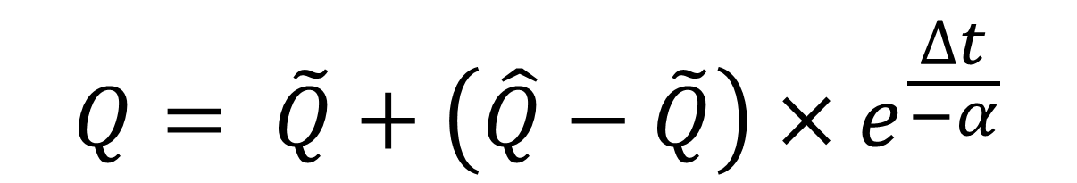


Nudging Scheme
$$Q= \tilde{Q}+\left(\hat{Q}−\tilde{Q}\right)×e^{\frac{∆t}{−α}}$$
$$\hat{Q}=the observed value$$
$$\tilde{Q}=the modeled value$$
$$∆t=the difference between modeled time and the observation time$$
$$α=the decay coefficient (defaults to 120 minutes)$$

Slide 4
Assimilation (MC vs. DW)
DW only
MC & DW
Notes:
We implemented simple nudging for DW

