Slide 1
ACM Contest Scoring
Contributors: Seth Kitchen

Slide 2
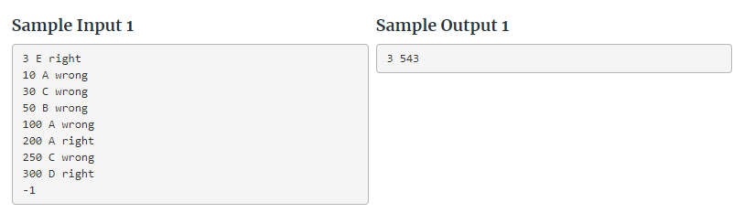
Gist
Grade one team’s ACM Contest
Inputs are:
Time of each submission
Letter (or name) of each problem for each submission
Whether the submission was right or wrong
You need to Output:
The team’s final score

Slide 3
Important Takeaways from Description:
-
-According to contest rules, after a team solves a particular problem, any further submissions of the same problem are ignored (and thus omitted from the log). Because times are discretized to whole minutes, there may be more than one submission showing the same number of minutes. In particular there could be more than one submission of the same problem in the same minute, but they are chronological, so only the last entry could possibly be correct. As a second example, consider the following submission log:
a team’s time score is equal to the sum of those submission times that resulted in right answers, plus a 20-minute penalty for each wrong submission of a problem that is ultimately solved. If no problems are solved, the time measure is 0

Slide 4
Solution Strategy:
Simply store each problem in a dictionary until it is solved keeping a count of the attempts
When it is solved, multiply the attempts by 20 and add it to the points with the current time.
Keep a separate counter for the total problems solved.

Slide 5
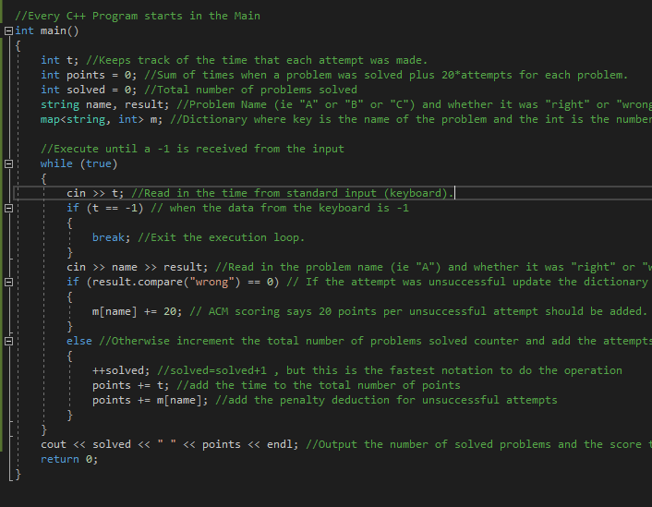
C++ Code Walkthrough
T=3
T!=-1 continue
Name=E
Result=right
Solved=1
Points=3
Points=3
T=10
T!=-1 continue
Name=A
Result=wrong
M[“A”]=20
…

