Slide 1
Line Them Up
Contributors: Seth Kitchen

Slide 2
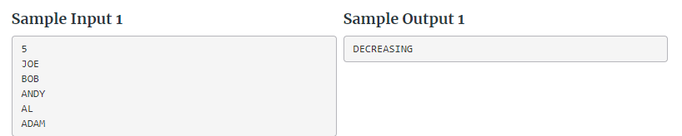
Gist:
Tell if a series of strings is increasing, decreasing, or neither from their ASCII values
Inputs are:
Number of inputs (int)
Input (string)
You need to Output:
“INCREASING”, “DECREASING”, or “NEITHER” depending on what the inputs are doing

Slide 3
Important Takeaways from Description:
Given a list of names, you are to determine if the list is in increasing alphabetical order, decreasing alphabetical order or neither
A name will be at least two characters and at most 12 characters in length and will consist only of capital letters, and with no white spaces (sorry BILLY BOB and MARY JOE). Duplicates names will not be allowed on a team.

Slide 4
Solution Strategy
Simple two boolean problem. Keep Track if they names are increasing or if they are decreasing.
If both booleans are false at the end, then print neither.

Slide 5
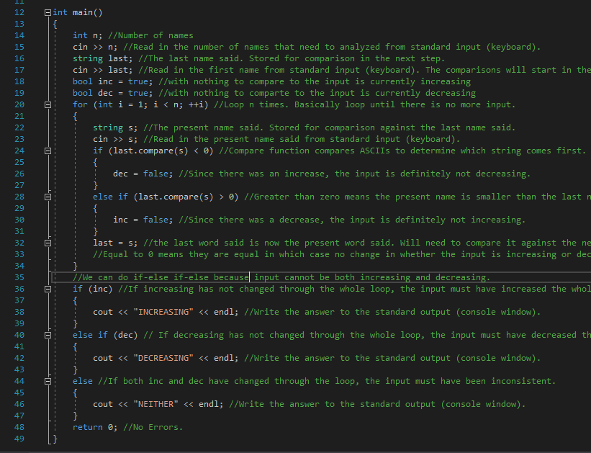
C++ Code Walkthrough
N=5 Last=JOE inc,dec=true i=1<n loop s=BOB
JOE.Compare(BOB)>0 inc=false last=BOB i=2<n loop
s=ANDY
Bob.Compare(ANDY)>0
inc=false last=ANDY …
Dec=true cout “DECREASING”

