Slide 1
Natrij
Contributors: SETH KITCHEN

Slide 2
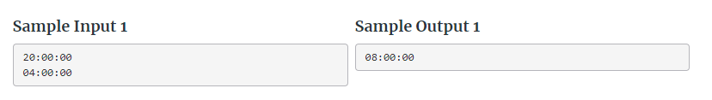
Gist:
Subtract two time periods and display the elapsed time
Inputs are:
Time one (string hh:mm:ss)
Time two (string hh:mm:ss)
You need to Output:
Time two-Time one and display as hh:mm:ss

Slide 3
Important Takeaways from Problem Description
The first line of input contains the current time in hh:mm:ss format (hours, minutes, seconds). The hours will be between 0 and 23 (inclusive) and the minutes and seconds between 0 and 59. The second line contains the time of the explosion in the same format.
Write a program that calculates the time to the explosion (this is the time Borko will enter into the microprocessor). The time Borko wants is at least one second and at most 24 hours.

Slide 4
Solution Strategy
Take the difference between the given times and normalize them

Slide 5
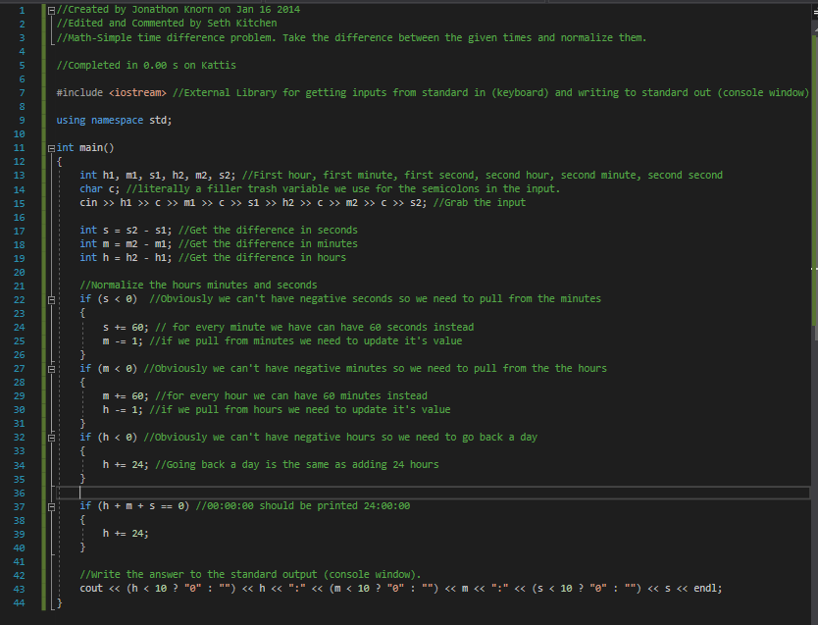
C++ Code Walkthrough
H1=20 m1=0 s1=0 h2=4 m2=0 s2=0 s=0 m=0 h=-16 s!<0 continue m!<0 continue h<0-> h=-16+24=8 print(08:00:00)

