Slide 1
Intelligent Statistics
Presentation of the restaurant sales dashboard project.

Slide 2
Memory Summary
- Academic project delivered as a working demo.
- Goal: descriptive sales analysis from an API.
- Serverless design with AWS and static frontend.
- Focus on visualization, integration, and usability.

Slide 3
Objective
- Display sales statistics with an interactive dashboard.
- Receive JSON data from a real API.
- Load data with a central button.
- Visualize metrics without manual preprocessing.

Slide 4
Architecture
- Static frontend in HTML/CSS/JS.
- Data logic in main.js with fetch to /sales.
- Backend designed for AWS serverless: API Gateway + Lambda.
- Recommended database: DynamoDB or RDS MySQL.

Slide 5
Code and structure
- index.html / en.html: UI in Spanish and English.
- main.js: data loading, errors, and charts.
- translations.js: localization.
- utils.js: formatting and theme.
- style.css: responsive and light/dark mode.

Slide 6
Data model
- products: product catalog.
- sales: recorded sales.
- Basic design for the demo.
- Scalable to restaurants, employees, tables, tickets, and payment methods.

Slide 7
Frontend
- Central Load data button.
- Error handling and loading state.
- Charts with Chart.js.
- Light/dark mode and multilingual support.

Slide 8
Backend
- REST API for /sales.
- JSON response with sales records.
- Deployed in AWS with public access for demo.
- Production environments require stronger security.

Slide 9
Key features
- Revenue by category.
- Orders by hour.
- Top selling items.
- Daily revenue trends.

Slide 10
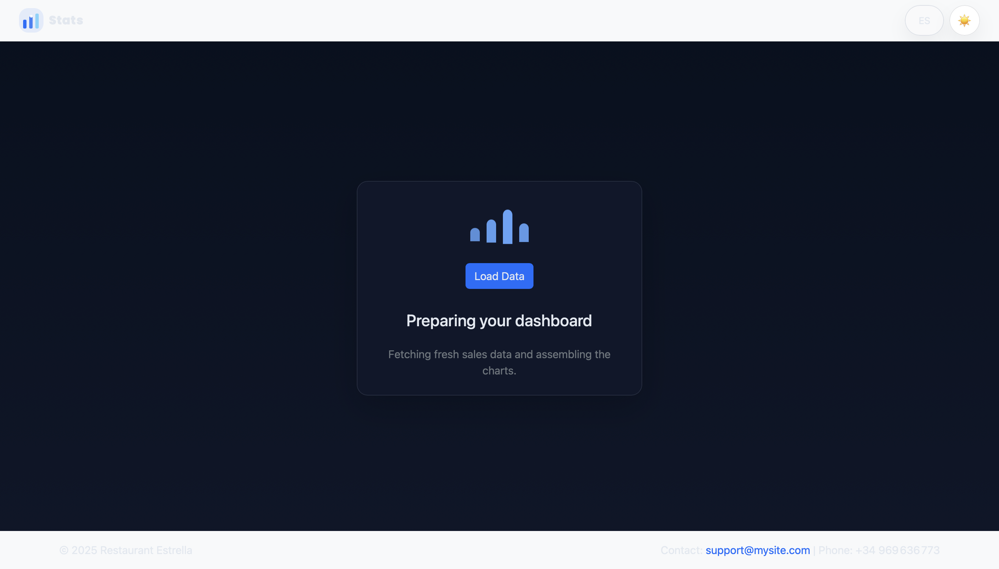
Loading screen
The app shows a loading state and handles network errors.

Slide 11
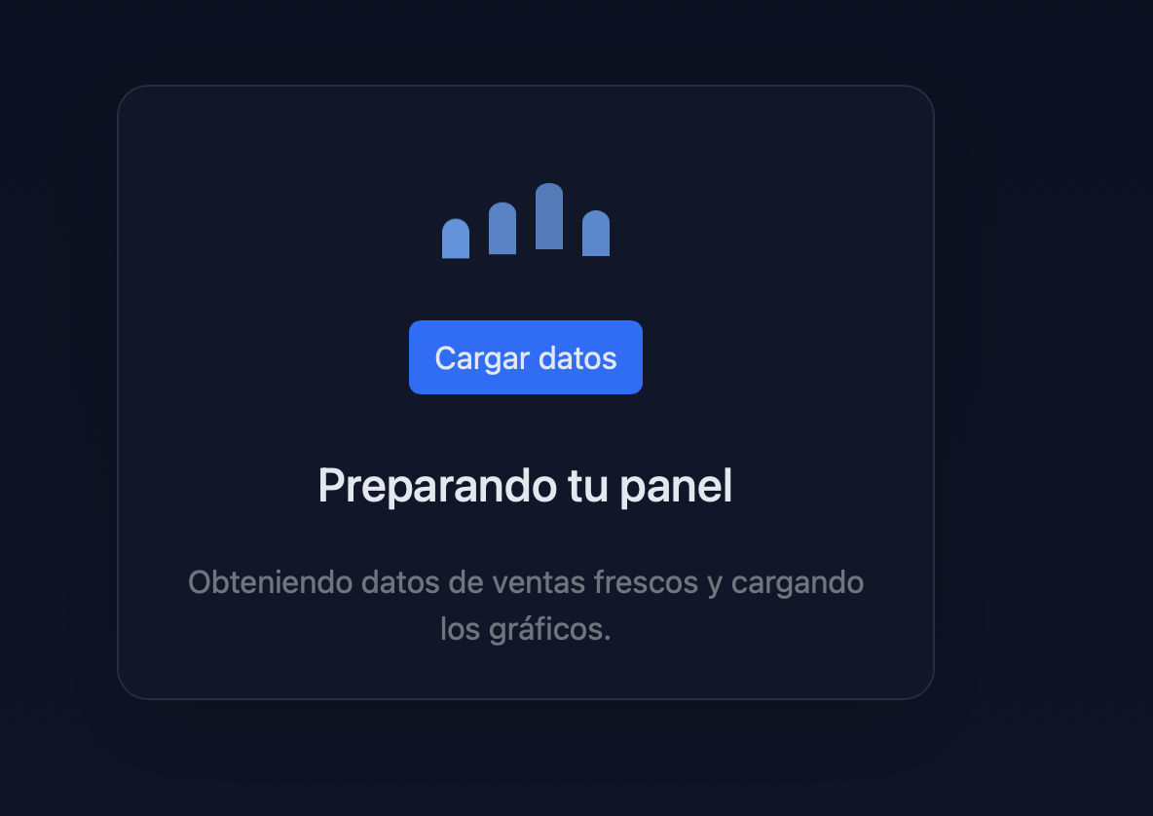
Main dashboard
Shows revenue by category, orders by hour, top items, and daily revenue.

Slide 12
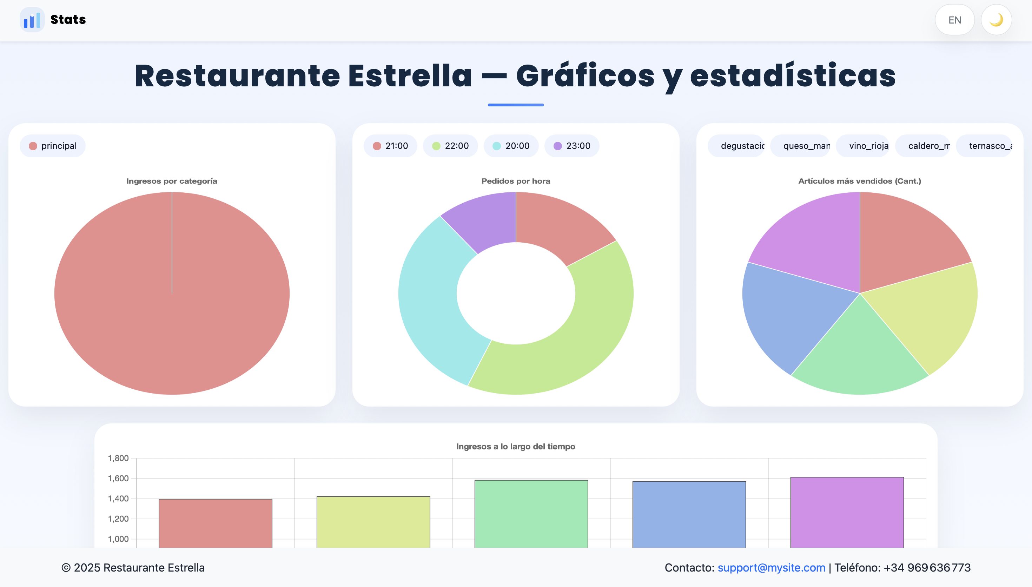
Light mode
The same dashboard works in light mode and maintains visual consistency.

Slide 13
Feature video
Add a short video showing data loading, chart updates, language switch, and theme toggle.
Video placeholder: presentation_video.mp4

Slide 14
SWOT analysis
- Strengths: real AWS deployment, serverless architecture, clear visualization.
- Weaknesses: descriptive focus, no full operational panel.
- Opportunities: POS, CSV import, multi-restaurant, advanced analytics.
- Threats: SaaS competition and data security requirements.

Slide 15
Conclusion
- Working demo completed.
- Solid foundation for a more complete restaurant solution.
- Ready to evolve toward prediction, administration, and multi-restaurant support.

