Slide 1
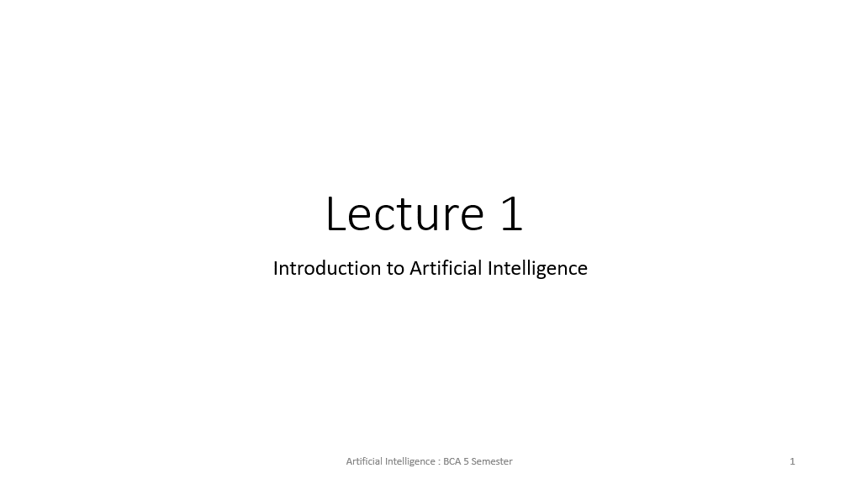

Slide 2
Topics to be covered​
A brief review of AI history ​
What is artificial intellience? ​
Related research fields ​
Scope of this course​

Slide 3
Early Work (Around 1900)
Representatives
George Boole
Alfred North Whitehead
Bertrand A. W. Russel
Main Contributions
Boolean Algebra
Principia Mathematical
PM was an attempt to describe a set of axioms and interference rules in symbolic logic which all mathematical truths could in principle be proven.
However in 1931. Godel’s incompleteness theorem proved definitively that PM could never achieve this lofty goal

Slide 4

Early work (1930～）
I am ZHAO.
You can ask
any questions,
and see if I
am the real
person.
Representatives
– Alan Turing
– Claude Shannon
– John von Neumann
• Main contributions
– Theory of computation, Turing Machine
– Turing test (to distinguish machine from human)
– Information theory, application of Boolean algebra
– von Neumann model of computing machines

Slide 5
The first wave (1950～)
The term AI was
proposed by these
persons in the wellknown Dartmouth
Artificial Intelligence
conference (1956)
Representatives
– John McCarthy
– Marvin Lee Minsky
– Herbert Alexander Simon
– Allen Newell
– Edward Albert Feigenbaum
• Main contributions
– LISP
– Semantic network and frame
– General problem solver and Expert systems

Slide 6
The second wave (1980～)
Representatives
– David Rumelhart
– Lotfi Zdeh
– John Holland
– Lawrence Forgel
– Ingo Rechenberg
– John Koza
• Main contributions
– Learning of MLP
– Fuzzy logic
– Genetic algorithms
– Evolutionary programming
– Evolution strategy
– Genetic programming
Soft computing Human like computing and natural computing

Slide 7
The third wave (2000～)
Representative technologies
– Internet
• Tim Berners-Lee, WWW inventor, 1989
– Internet of things
• Kevin Ashton, MIT Auto-ID Center, 1999
– Cloud computing
• Main frame (1950s), virtual machine (1970s), cloud (1990s)
– Big data
• John R. Masey, SGI, 1998
– Deep learning
• Geoffrey Hinton, UoT, 2006

Slide 8
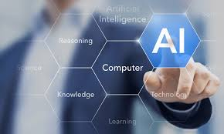
A brief summary
Early work
– Theoretic foundations
• First wave:
– Reasoning with given knowledge
• Second wave
– Learning-based knowledge acquisition
• Third wave
– Learn in the cyber-space
The same as learning inside the brain. Each brain has a “natural intelligence” that can learn using the sensor data captured by different parts of the body.

Slide 9
Current status of AI
61% of business executives with an innovation strategy say AI helps them identify otherwise missed opportunities in data.
75% of commercial enterprise applications will use AI by 2021, according to IDC predictions.
80% of tech and business leaders believe AI creates jobs and improves worker efficiency.
54% of business executives who have implemented AI solutions say productivity has already increased.
$57.6 billion will be spent globally on cognitive and AI systems in 2021.
70% of business decision-makers say workers can focus on more meaningful work with the help of AI.
72% of leaders surveyed in the technology, media and telecommunications industry think their product offerings will be impacted significantly by AI in the next five years.
47% of executives say it’s challenging to integrate AI initiatives with existing processes and systems.

Slide 10
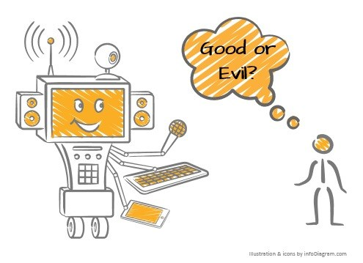
Do you think AI is good or evil?
Super-intelligence should be a tool for unifying the human beings, support them, and lives together with them!

Slide 11
After all, what is intelligence?
Intelligence is an umbrella term used to describe a property of the mind that encompasses many related abilities, such as the capacities – to reason,
– to plan,
– to solve problems,
– to think abstractly,
– to comprehend ideas,
– to use language, and
– to learn.

Slide 12
Intelligence can be defined as the ability for solving problems
Problem solving is to find the “best” solution in the problem space.
Reasoning is to interpret or justify solutions or subsolutions.
Planning is to find ways for solving the problem.
Thinking abstractly is to simulate the problem solving process inside the system (brain).
Idea/language comprehension is a way (or means) for data/problem/knowledge representation;
Learning is the process to find better ways for solving a problem (or a class of problems).

Slide 13
What is AI ?
Textbooks often define artificial intelligence as “the study and design of computing systems that perceives its environment and takes actions like human beings”.
• The term was introduced by John McCarthy in 1956 in the well-known Dartmouth Conference.
• In my study, an AI is defined as a system that possesses at least one (not necessarily all) of the abilities mentioned in the previous page.
As a research area, AI studies theories and technologies for obtaining systems that are partially or fully intelligent.

Slide 14
A rough classification of AI
Systems that think like humans
Systems that think rationally
Systems that act like humans
Systems that act rationally

Slide 15
Related research fields
Search and optimization
Natural Language Processing
• Knowledge representation
• Reasoning and automatic proving
• Learning and understanding
• Pattern classification / recognition
• Planning
• Problem solving

Slide 16
Search
Brute-force search
– Depth-first search
– Breadth-first search
• Heuristic Search
– Hill climbing search
– Best-first search
– A* Algorithm
• Intelligent search
– Genetic algorithms
– Meta-heuristics (if time permits)

Slide 17
Three MAPs for knowledge acquisition
What is the input? – Map from real world to the mind model
• What is the output? – Map from the mind model to the real world
• What is the relation between the input and the output? – Abstraction of the real world
Sensors
Actuators
Real World
Problem Representation
Learning
Knowledge Representation
Real World

Slide 18
Representation methods
Representation of the problem
– State space representation
– Vector representation
• Representation of knowledge
– Production (decision) rules
– Semantic network and ontology
– Predicate logic
– Fuzzy logic
– Neural network (for tacit knowledge)

Slide 19
Learning models and algorithms
Neural network learning
– Including MLP, deep learning, etc.
• Evolutionary learning
– GA or meta-heuristics in general
• Natural Language Processing
Reinforcement learning
• Artificial immune system
• Fuzzy logic
• Decision tree

Slide 20
Scope of this course
Search
– Problem formulation and basic search algorithms
• Expert system-based reasoning
– Production system, semantic network, and frame
• Logic based-reasoning
– Propositional logic and predicate logic
• Soft computing based reasoning
– Fuzzy logic and multilayer neural network

Slide 21
Scope of this course
Natural Language Processing
Neural networks
Decision trees
Genetic algorithm
Fuzzy Logic and system
Image recognition
Predictive analysis (if time permits)

Slide 22
Purpose of this course
Learn how to use the basic search methods;
• Understand the basic methods for problem formulation and knowledge representation;
• Understand the basic idea of automatic reasoning;
• Know some basic concepts related to pattern recognition and machine learning.

Slide 23
Quizzes for today
What is AI as a research area?
What are the three MAPs for knowledge acquisition?
What is Search?
Explain any one learning model.

